Slide 1
Smart Columbus Open Data Enthusiasts
Food access use case and Data Discussion
7/12/2018

Slide 2
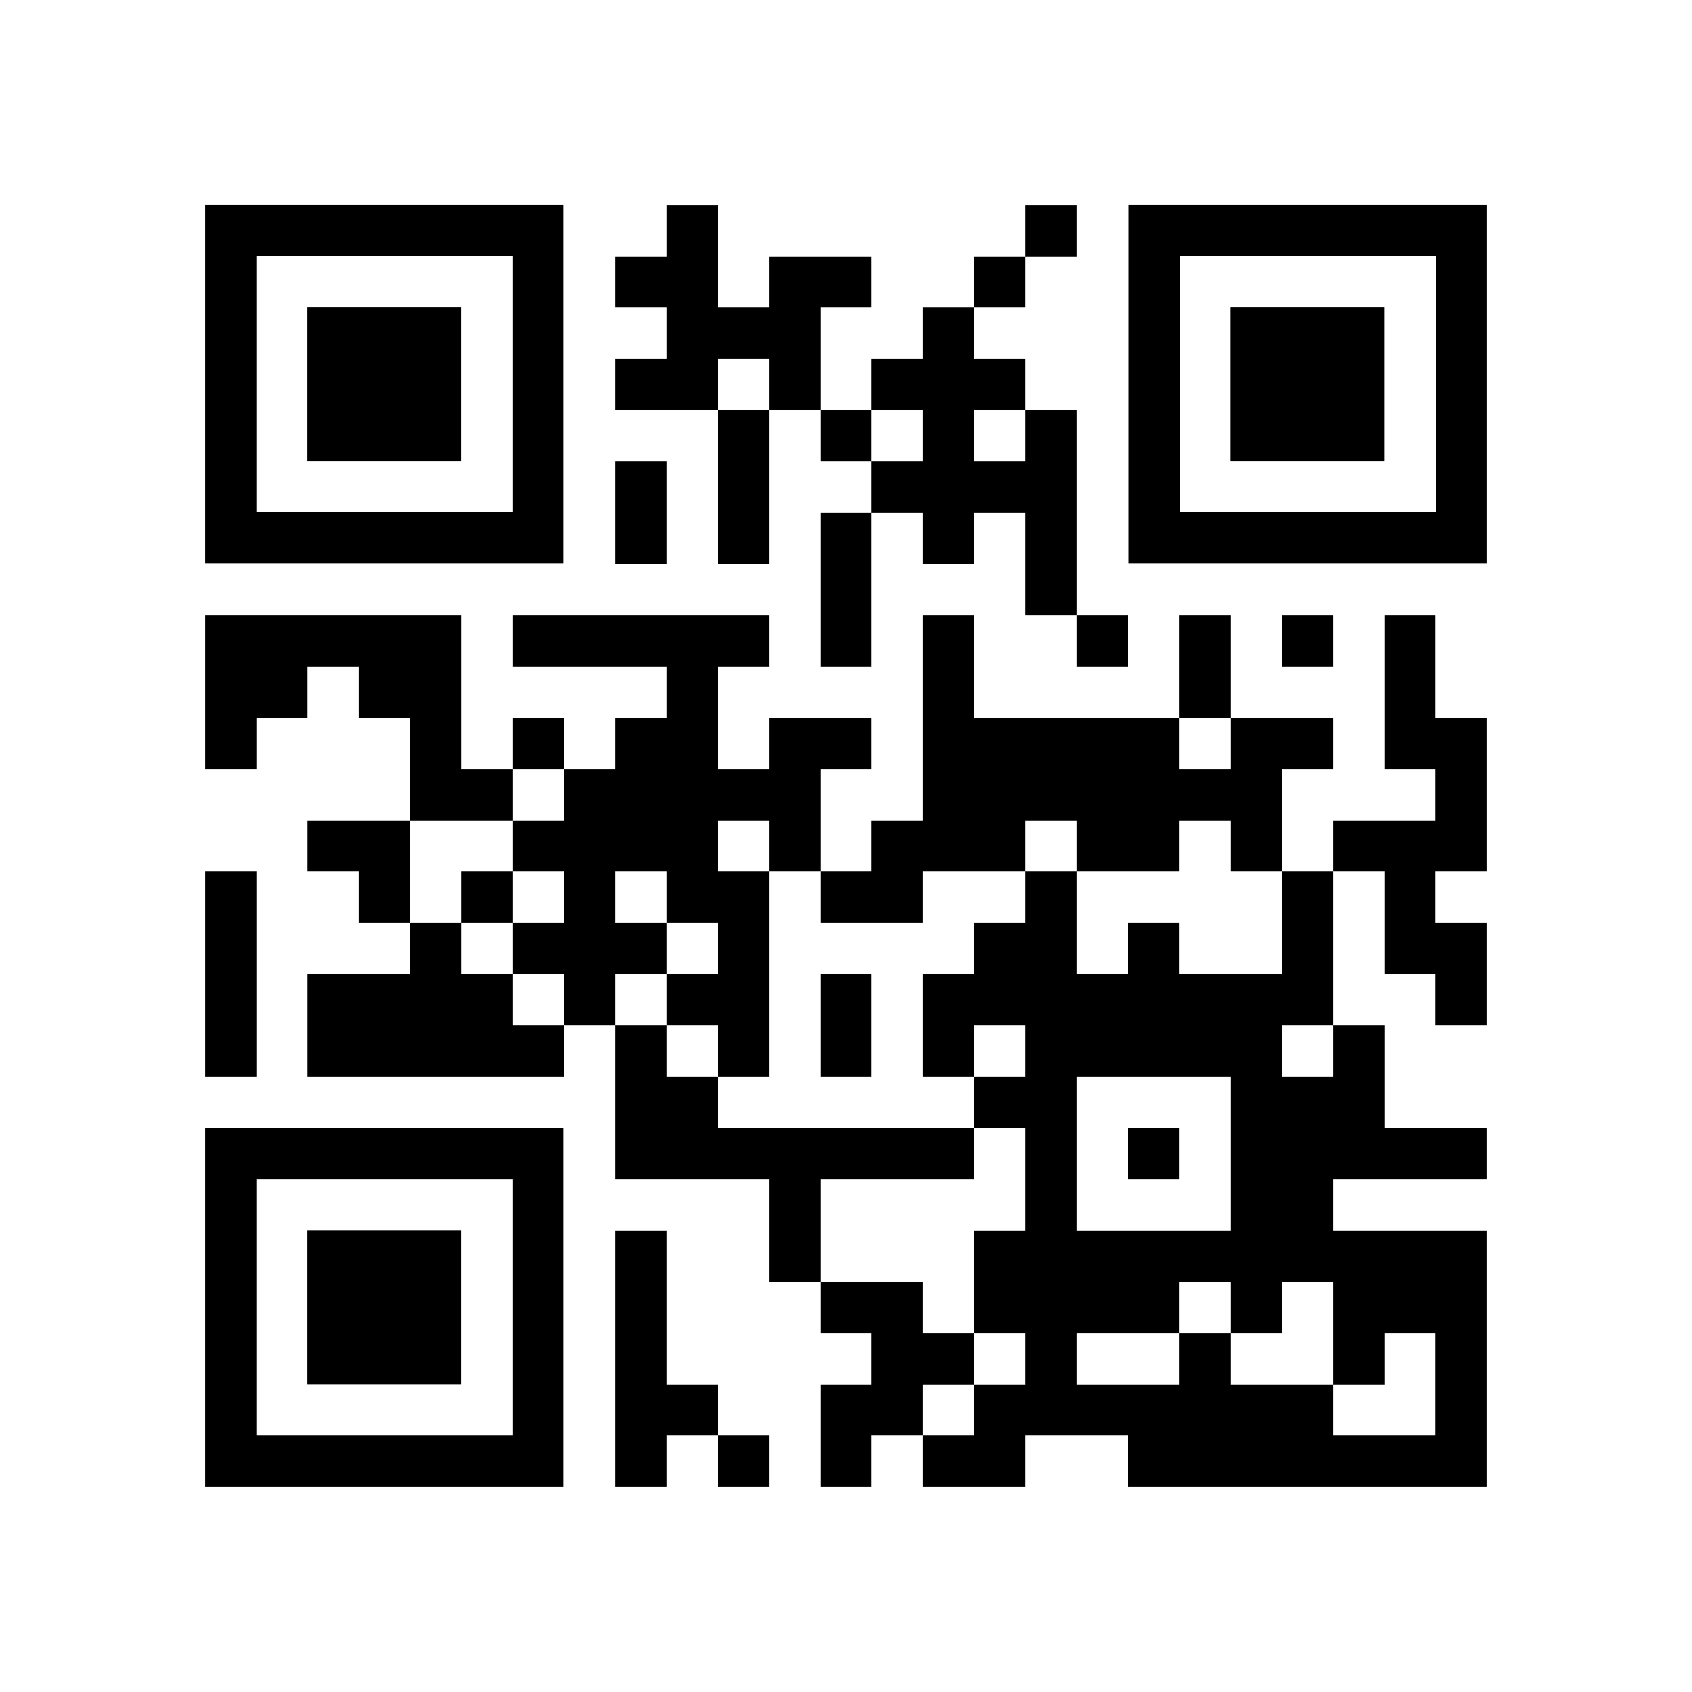
Important links – please go here now!
http://bit.ly/2NIcqL2

Slide 3
Agenda
Introduction
Description of the food access data story
Introducing Personas and Use cases related to use food access
Introduction of available data sets related to the use case
Form teams

