Slide 1
N-Graph Abstraction for Partitioning Relation Based Data Structures
Gerrett Diamond

Slide 2
Overview
Problem and Related Works
What is the N-Graph
Partitioning Goals
Target Application

Slide 3
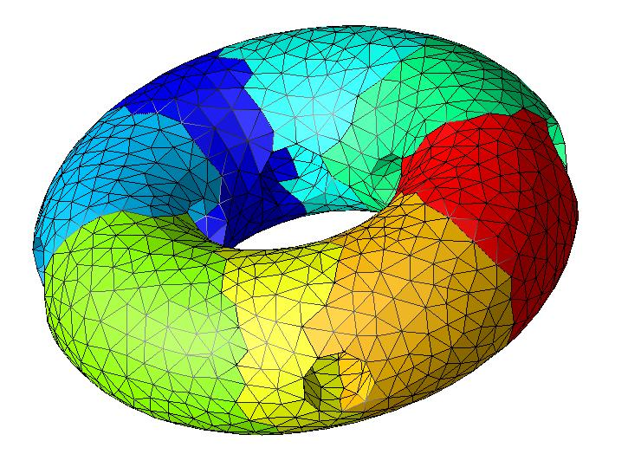
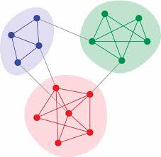
Partitioning
Many application with unique partitioning needs.
Multi-criteria load balancing.
Different data structures and designs that need to be accounted for.

Slide 4
Previous Work
Graph Partitioners: ParMETIS [3], PT-Scotch [4].
Diffusive Load Balancing: ParMA [5].
Abstract Partitioning Interface: Zoltan/Zoltan2 [1,2].

Slide 5
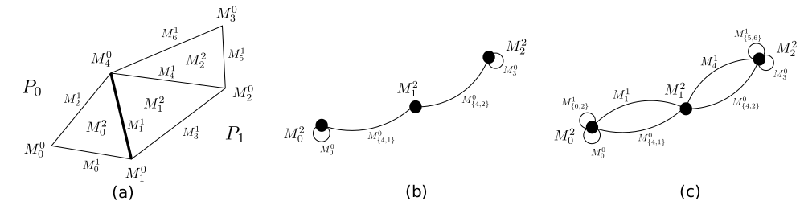
N-Graph
The N-Graph is defined as G^{n}(V,E₀,E₁,...,E_{n-1}) where:
  V is the set of vertices, u_{i} of the domain.
  E_{i} is the set of relations of type i, e_{i}(u,v), between vertices u, v ∈ V.
Weights can be assigned to both vertices and edges as needed for the application specific goals.

Slide 6
Partitioning Goals
Leverage existing algorithms for (hyper)graph and geometric partitioning
Implement ParMA like diffusive load balancing techniques
Implement our algorithms and data structures to support next generation hardware such as SIMD vectorization and GP-GPU cores

Slide 7
Target Application Support
Constantly evolving scale-free/web graphs.
Multi-criteria partitioning on adaptive unstructured mesh simulations.
Multi-level/multi-model simulations.

Slide 8
References
[1] E. Boman et al. Zoltan2: Next-generation combinatorial toolkit. Trilinos Group Meeting, 2012.
[2] K. Devine et al. Zoltan data management services for parallel dynamic applications. Computing in Science & Engineering, 4(2):90-96, 2002.
[3] G. Karyphis et al. Parallel Graph Partitioning and Sparse Matrix Ordering Libraray, Version 4.0 2015.
[4] F. Pellegrini. Distilling Knowledge about scotch. Dagstuhl Seminar Proceedings, 2009.
[5] C. Smith et al. Application specific partition improvement. SIAM Journal on Scientific Computing, submitted 2015.

