Slide 1
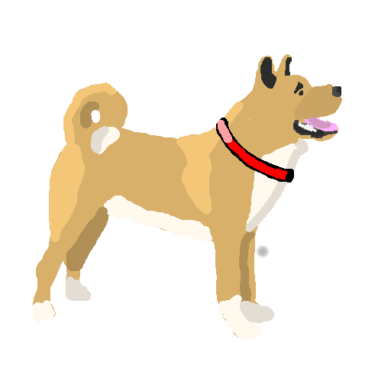
BARK!
Preliminary Design

Slide 2
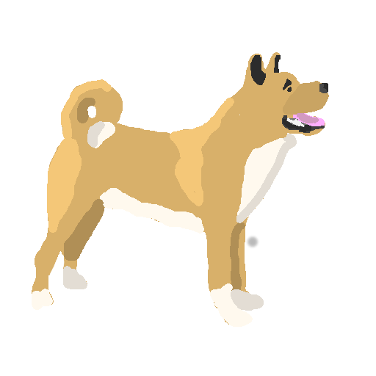
Overview
A student oriented, fun, friendly CompSci-themed discussion forum.
An easy to use, personalised, customisable experience
Users can browse or follow tags, customising their homepage
Reserved tags for universities, special groups. TODO?: Users have to be verified/accepted to post in these groups.
Positive voting encourages a positive atmosphere
Not restricted to questions, general discussion welcome

Slide 3
Requirements
Users can view posts, view tag categories (or combined tag categories), and search the site.
Registered, logged in users can:
- post content, questions, interesting links, videos
- rate posts positively, “like”
- comment on existing posts
- subscribe to tags which puts them on their homepage.
Content is sorted as a function of views, likes, number of comments, and post time.
Easily navigated.
Site needs to respond quickly (as given).
Tutorial / on hand help at any time if users get stuck

Slide 4
User Personas
<Copy / Paste >

Slide 5
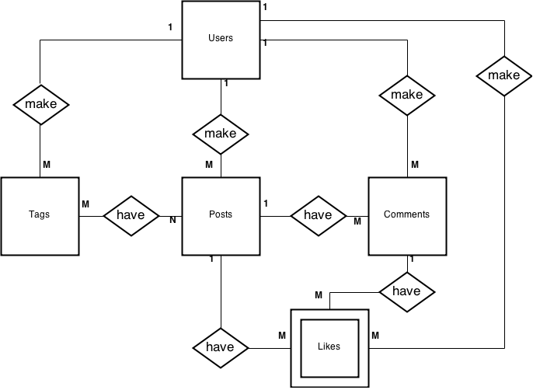
ER Diagram

Slide 6

n-Tier Diagram

Slide 7
Wireframes
Paste this shit in, bitch

