Slide 1
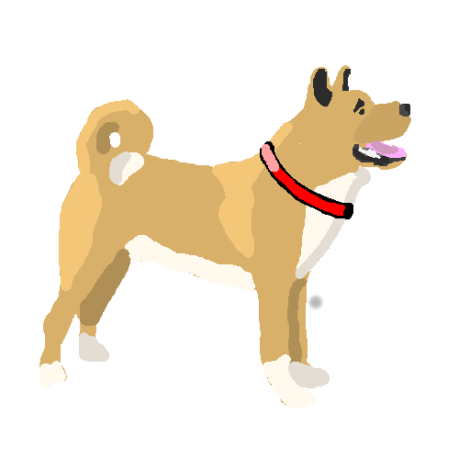
BARK! Created by N-Tier The Matrix
Paul Cowie, Lewis Dicks, Michael McKay, Ewan McCartney

Slide 2
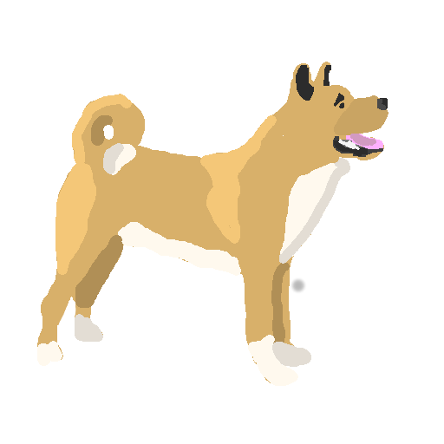
Overview
A student oriented, fun, friendly CompSci-themed discussion forum.
An easy to use, personalised, customisable experience
Users can browse or follow tags, customising their homepage
Reserved tags for universities, special groups. TODO?: Users have to be verified/accepted to post in these groups.
Positive voting encourages a positive atmosphere
Not restricted to questions, general discussion welcome

Slide 3
Requirements
Users can view posts, view tag categories (or combined tag categories), and search the site.
Registered, logged in users can:
- post content, questions, interesting links, videos
- rate posts positively, “like”
- comment on existing posts
- subscribe to tags which puts them on their homepage.
Content is sorted as a function of views, likes, number of comments, and post time.
Easily navigated.
Site needs to respond quickly (as given).
Tutorial / on hand help at any time if users get stuck

Slide 4
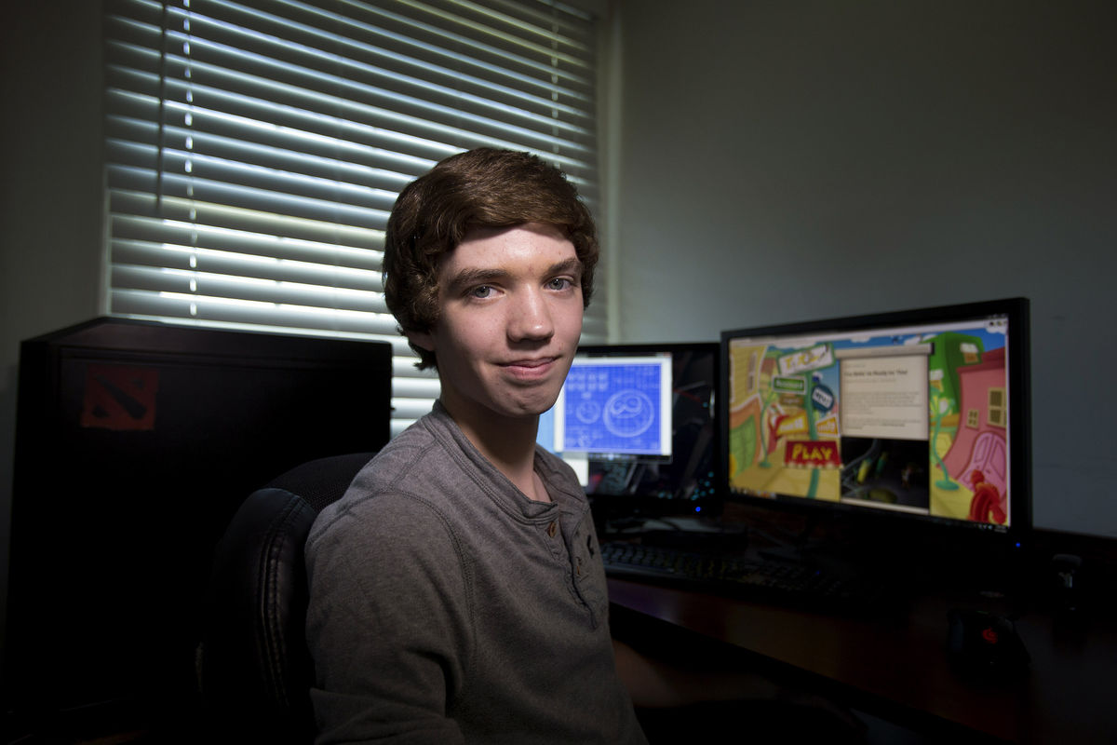
User Personas
Jim goes here

Slide 5

User Personas
Dave goes here

Slide 6

User Personas
Trollo goes here

Slide 7
User Needs Table TODO!
User | Need | Met? | Met by
Jim (beginner) | Search for posts about certain topics, posts with about A “and” B, or ask a new question |  | Other users?
 | Browse the site generally, view interesting content
Dave (pro user) | To view unanswered posts about topics he knows about |  | Unanswered/new questions view
 | Discuss / communicate with other pro-users at his level |  | Other users?
Trollo | To leave, be bored and unsatisfied with BARK! | Of course! | Moderators/admins monitoring website

Slide 8
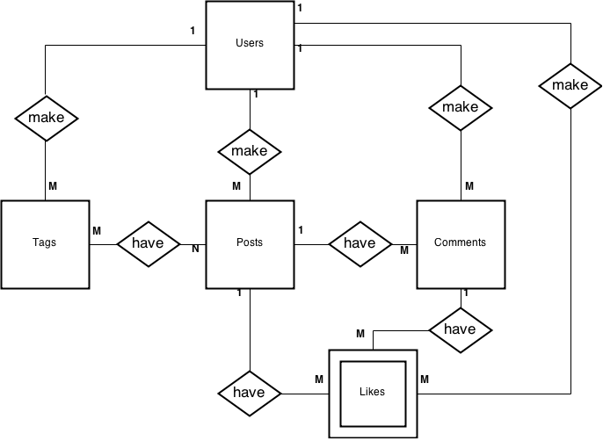
ER Diagram

Slide 9

n-Tier Diagram

Slide 10
Wireframes
Paste this shit in, bitch

