Slide 2
Overview
More friendly StackOverflow for students.
Features
More personalised experience
Users can follow tags, customizing their homepage
Dedicated tags for Universities/Topics so questions are seen by people who can answer them properly
Positive voting encourages a positive atmosphere
Not restricted to questions, general discussion welcome

Slide 3
Requirements
Users need to sign up
- Validation of email address
Users need to be able to log in
- Users can post questions or content
- Users can rate others content, with a positive scale
- Users can comment on existing posts or content
- Users can search content by one or more tags
- Users can subscribe to tags to view them easily
Site needs to respond quickly (as given)
Content that the user is interested in should be shown more often
Easily navigated
Tutorial/Explaination + onhand help at any time if users get stuck or can't remember

Slide 4
User Personas
<Copy / Paste >

Slide 5
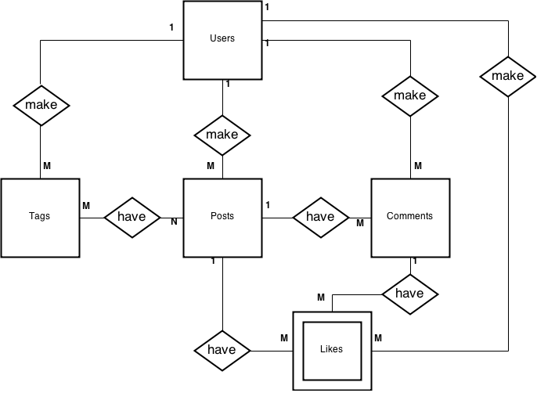
ER Diagram

Slide 6

N-Teir Diagram

Slide 7
Wireframes
INCOMPLETE

