Slide 1
Overcoming microenvironmental stresses through DNA methylation in cancer

Slide 2
Outline
An overview of gene expression and DNA methylation data
Gene expression prediction with GLMs
Gene methylation
Transcription factor methylation
Gene Set Enrichment Analysis

Slide 3
Methylation Data
Cancer type | Tumor : Normal | Count
BLCA | hypomethylated | 115940
BLCA | hypermethylated | 48140
BLCA | insignificant | 126249
BRCA | hypomethylated | 102357
BRCA | hypermethylated | 103329
BRCA | insignificant | 76287
COAD | hypomethylated | 81489
COAD | hypermethylated | 102978
COAD | insignificant | 108945
ESCA | hypomethylated | 42566
ESCA | hypermethylated | 68300
ESCA | insignificant | 179322
… | … | …

Slide 4
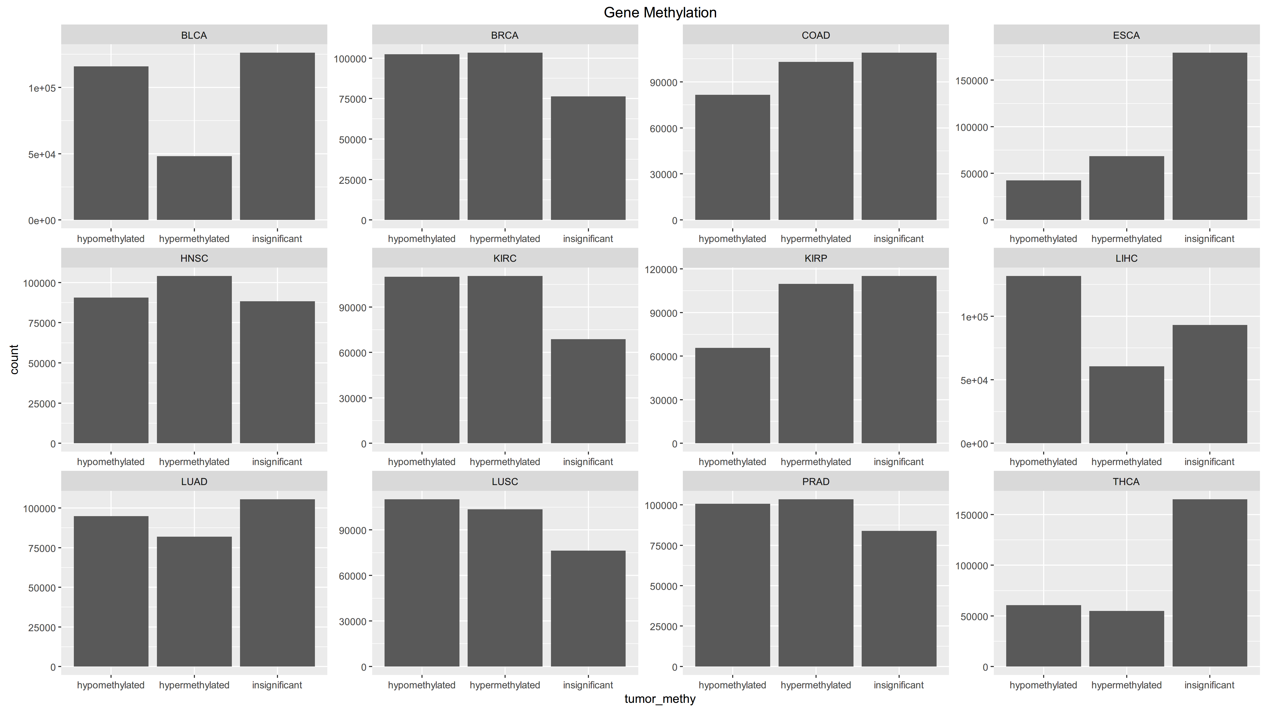
Methylation Data
No global pattern, but generally DNA is hypomethylated in cancer cells.

Slide 5
Expression Data
Cancer type | Tumor : Normal | Count
BLCA | down-regulated | 4001
BLCA | up-regulated | 3850
BLCA | insignificant | 4937
BRCA | down-regulated | 5853
BRCA | up-regulated | 5285
BRCA | insignificant | 1930
COAD | down-regulated | 5052
COAD | up-regulated | 4630
COAD | insignificant | 3034
ESCA | down-regulated | 166
ESCA | up-regulated | 1910
ESCA | insignificant | 2393
… | … | …

Slide 6
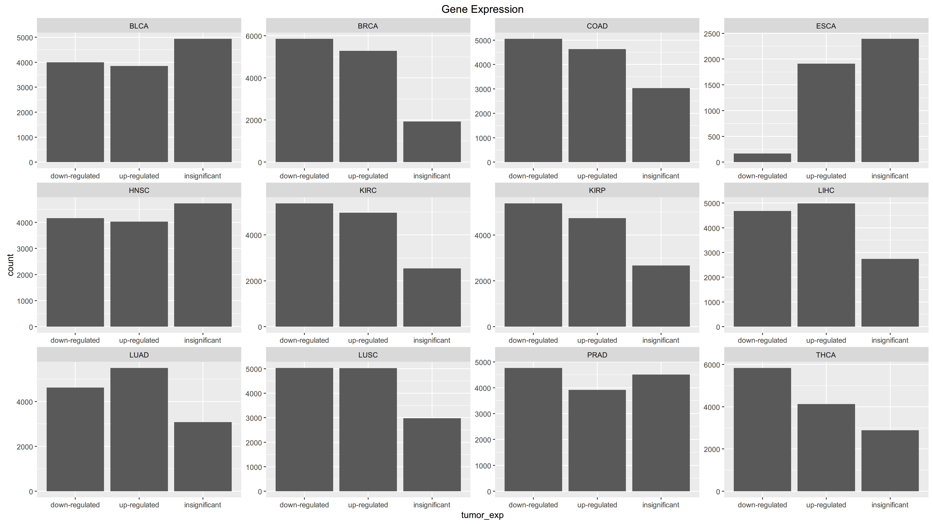
Expression Data
Again, we don’t see a global pattern.
ESCA probably seems abnormal due to its small sample size.

Slide 7
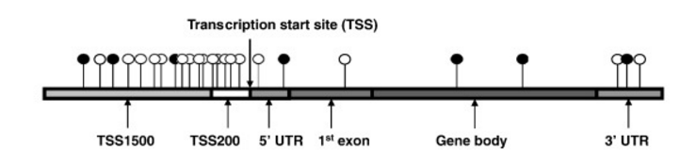
Generalized Linear Model
Split DNA methylation data into following groups:
And build GLMs to predict gene expression level with methylation data

Slide 8
More Input --- Transcription Factors
In addition to previous groups, we added the methylation level of each gene’s transcription factor(s) (if any) as a new group named “Tfmethy”, and use them together to build a GLM
Databases used: TRED, Neph2012, ENCODE, Marbach2016, TRRUST
As the generated models have different numbers of predictors, we picked best-performing models with 2 to 5 predictors in each GLM to standardize the results

Slide 9
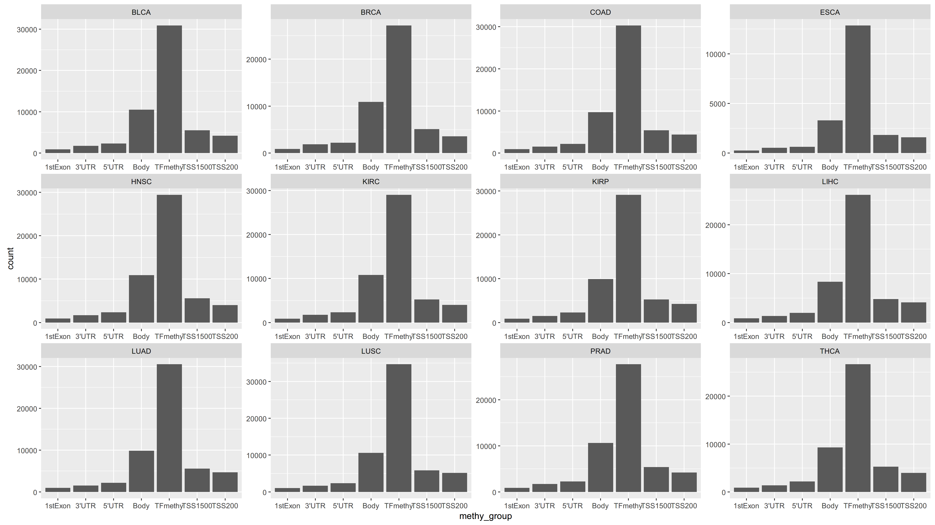
More Input --- Transcription Factors
We can see clearly from the figure that groups “body” and “Tfmethy” are much better predictors in this case (normal samples with 5 predictors for each GLM).

Slide 10
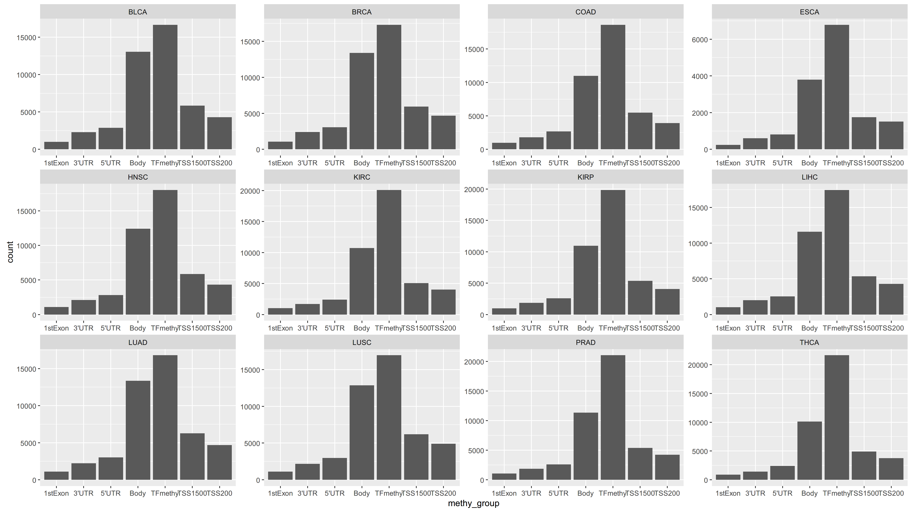
More Input --- Transcription Factors
The same holds true for tumor samples. Gene body and gene’s transcription factor proves to be better predictors.

Slide 11
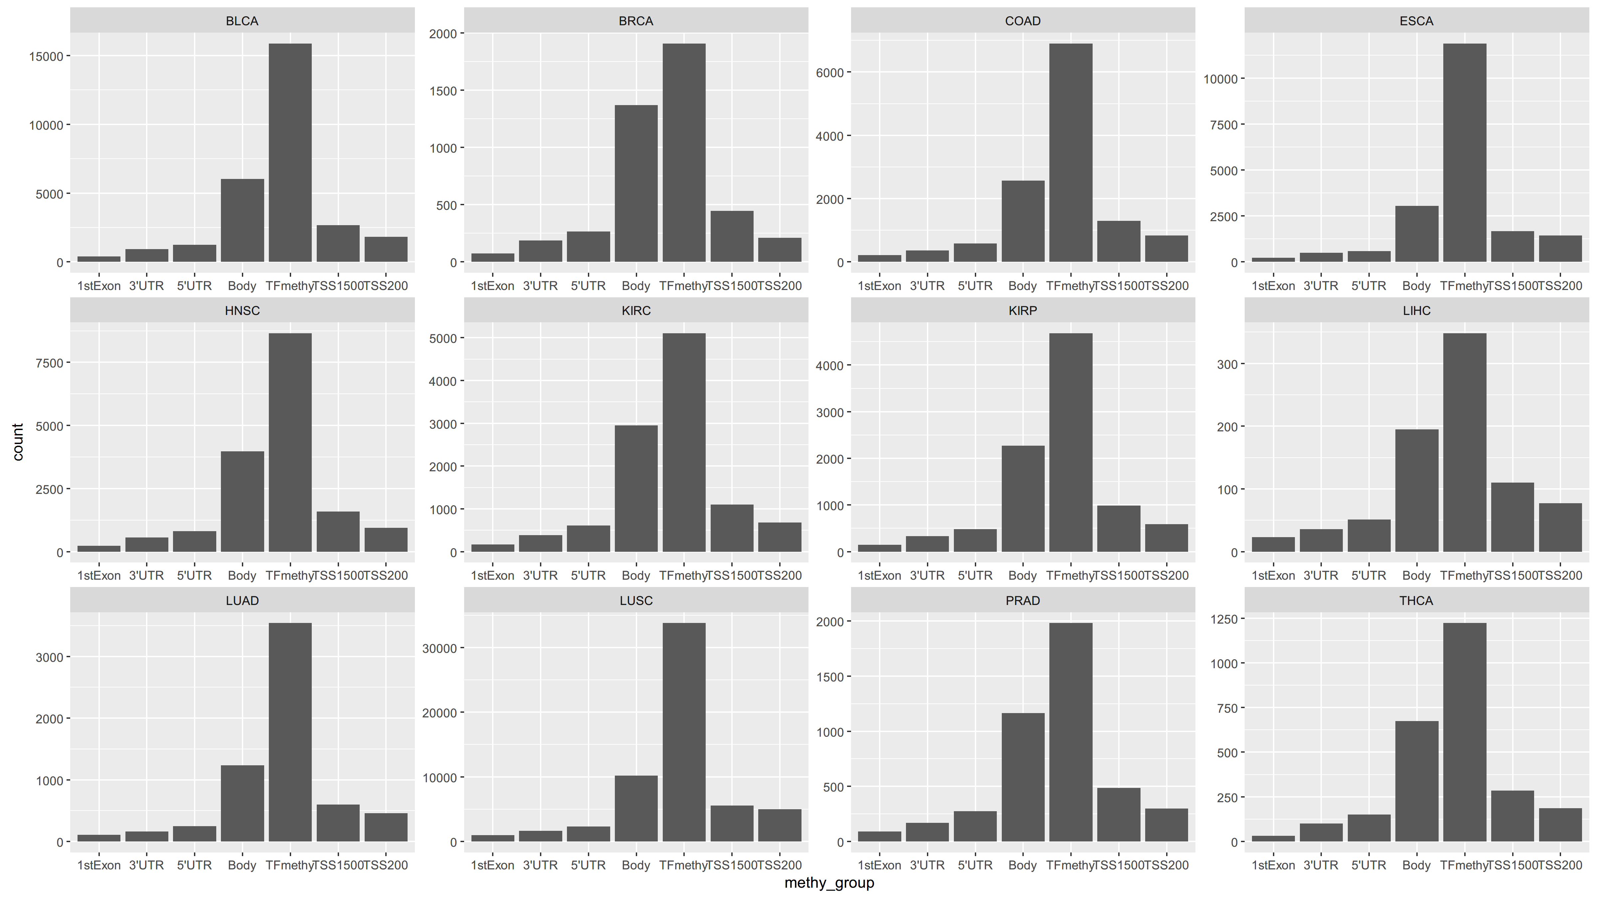
More Input --- Transcription Factors
Things are basically the same when we look at better-performing models (models that have 60% or higher percentage of deviance explained) in normal samples.

Slide 12
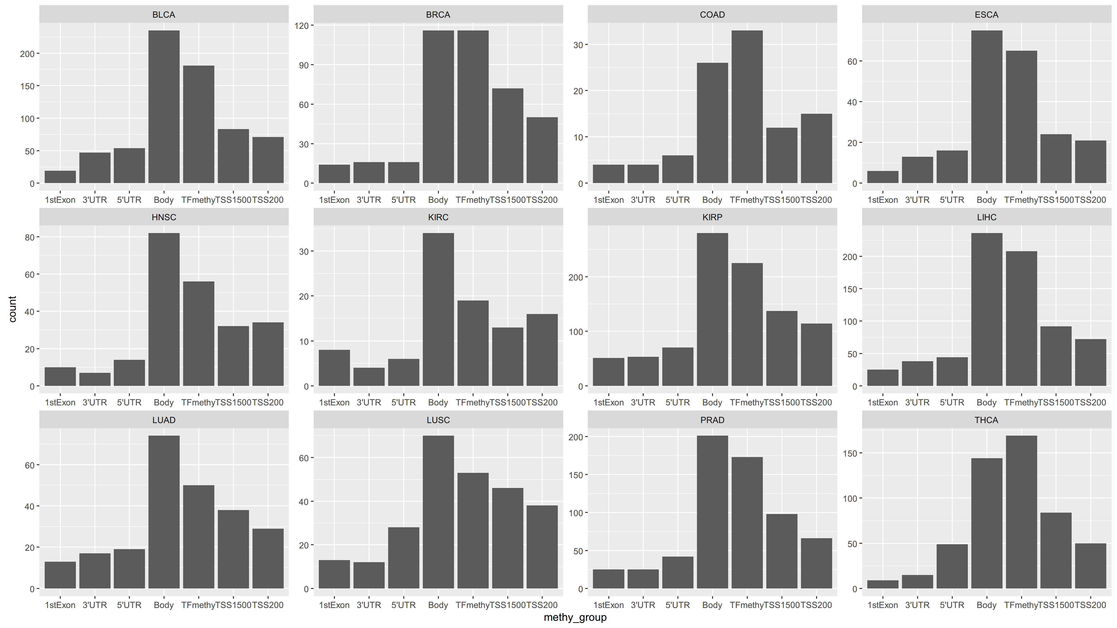
More Input --- Transcription Factors
In tumor samples, however, the “Tfmethy” group doesn’t stand out as much anymore. This could be a result of misregulations of transcription factors in tumor cells.

Slide 13
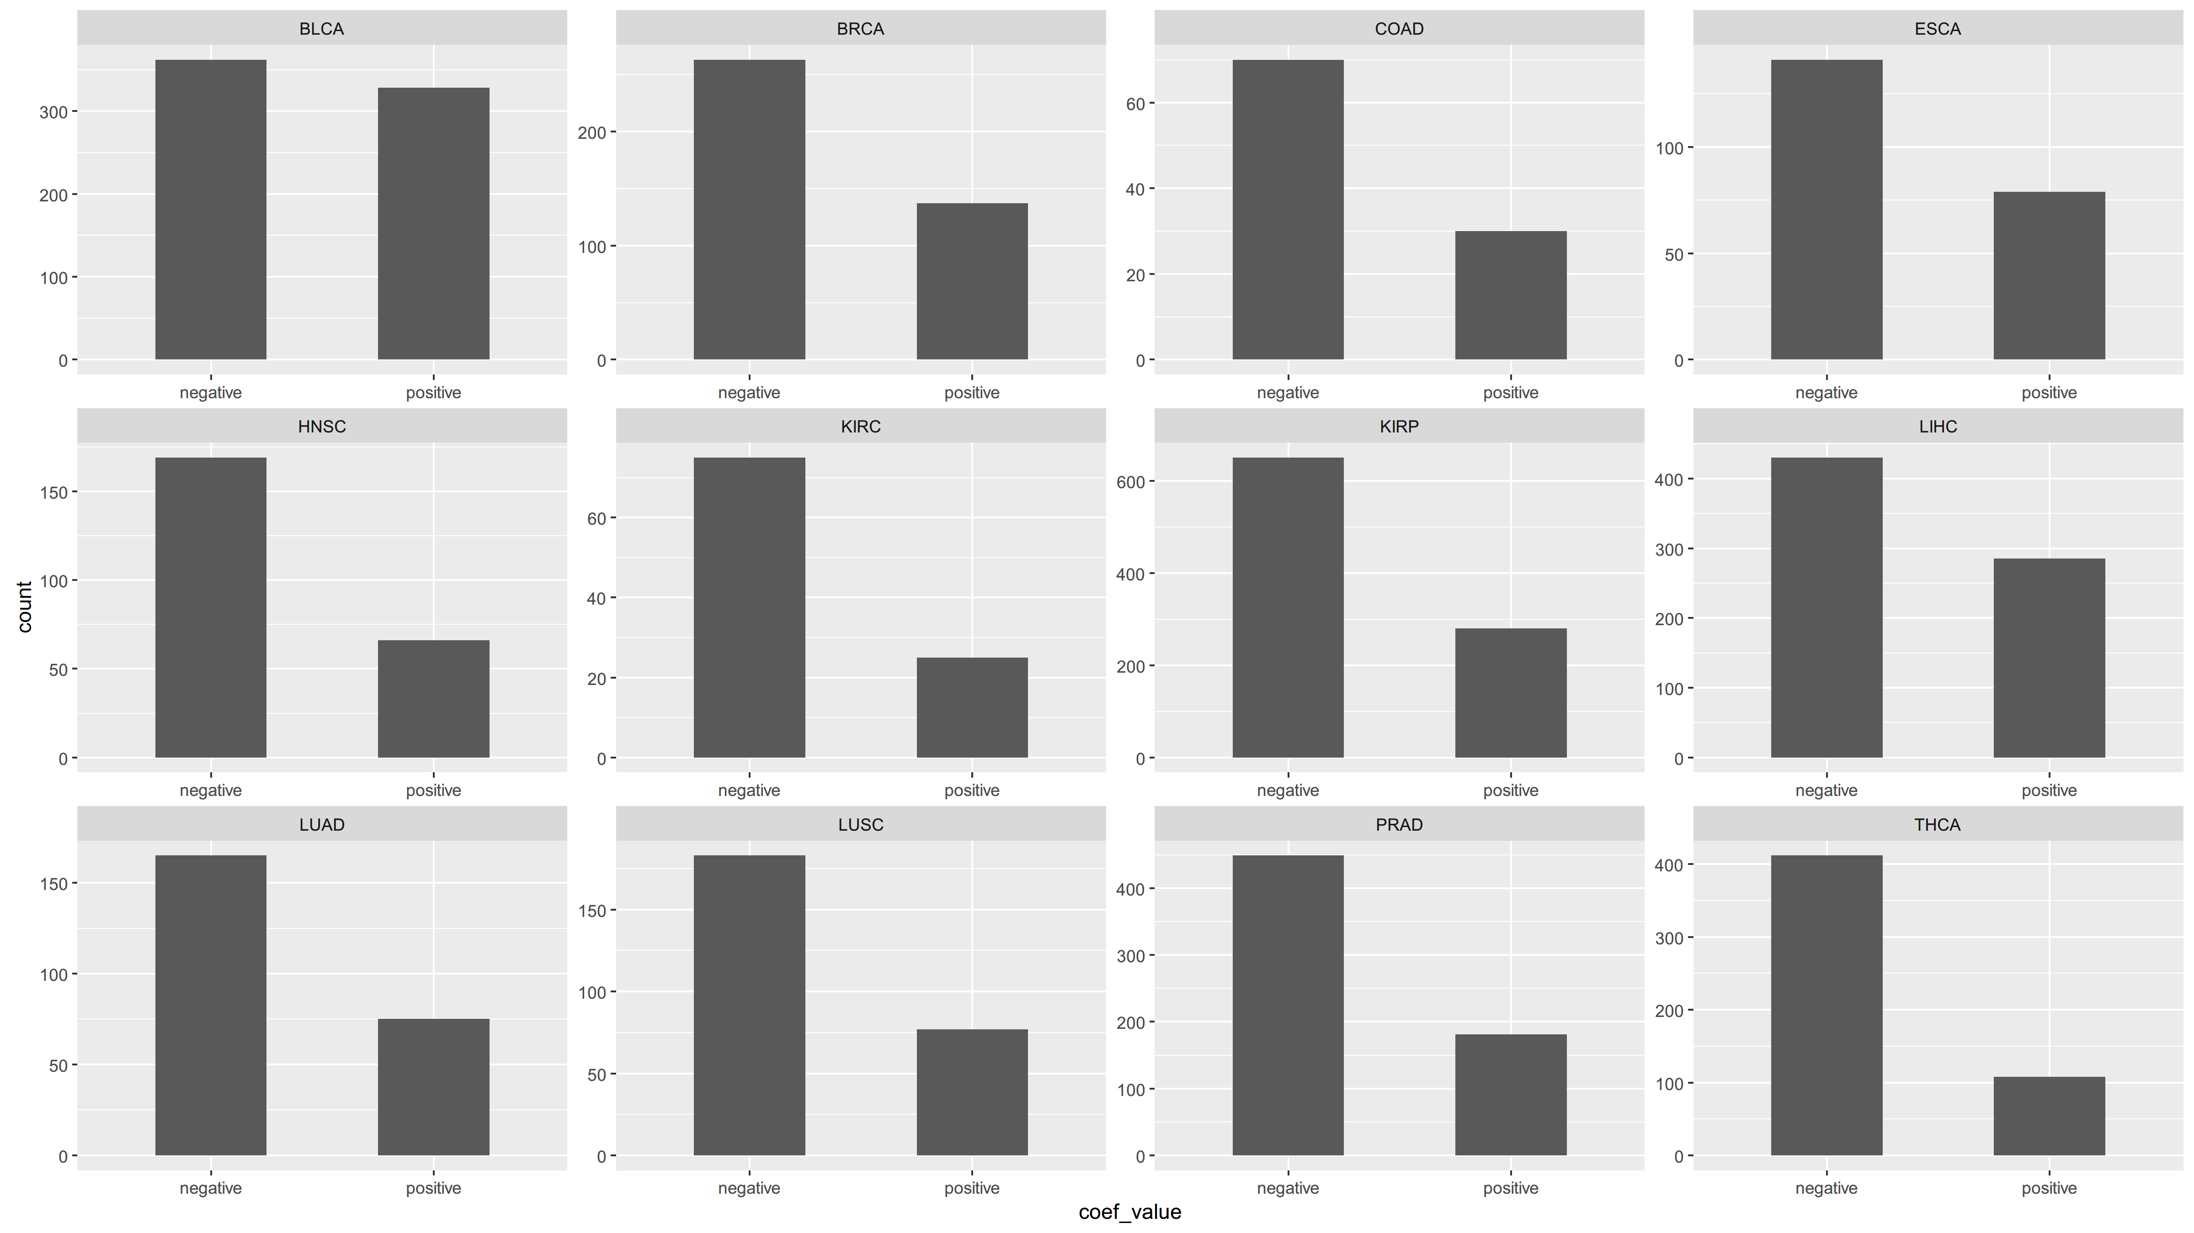
Distribution of Coefficients
When we look at the value of the coefficients in the models, there’s no significant difference in other cases. However, for 60% coverage tumor sample models, we do observe more negative coefficients than positive ones.

Slide 14
Gene Set Enrichment Analysis
Using random walks, we calculated enrichment scores for pathways / gene sets
Genes that are predicted by transcription factors are calculated separately
The results need further confirmation as R² values weren’t calculated

Slide 15
Gene Set Enrichment Analysis
All Genes
Pathways / Gene Sets | Enrichment Score
KUROKAWA_LIVER_CANCER_EARLY_RECURRENCE_DN | 0.97579
WUNDER_INFLAMMATORY_RESPONSE_AND_CHOLESTEROL_DN | 0.96421
RHSA1236977:Endosomal_Vacuolar_pathway | 0.95369
REACTOME_ENDOSOMAL_VACUOLAR_PATHWAY | 0.95105
BIOCARTA_TH1TH2_PATHWAY | 0.94939
BIOCARTA_TCYTOTOXIC_PATHWAY | 0.94827
REACTOME_TRANSLOCATION_OF_ZAP_70_TO_IMMUNOLOGICAL_SYNAPSE | 0.9447
BIOCARTA_IL5_PATHWAY | 0.94369
GOMacro:T_cell_receptor_complex | 0.94333
BIOCARTA_CTL_PATHWAY | 0.94307

Slide 16
Gene Set Enrichment Analysis
Transcription Factor Predictable Genes
Pathways / Gene Sets | Enrichment Score
BIOCARTA_ASBCELL_PATHWAY | 0.99488
BIOCARTA_CSK_PATHWAY | 0.98982
BIOCARTA_IL5_PATHWAY | 0.98982
BIOCARTA_TCRA_PATHWAY | 0.98982
GUTIERREZ_WALDENSTROEMS_MACROGLOBULINEMIA_2 | 0.98901
RHSA202430:Translocation_of_ZAP70_to_Immunological_synapse | 0.98718
RHSA389948:PD1_signaling | 0.98718
RHSA202427:Phosphorylation_of_CD3_and_TCR_zeta_chains | 0.98718
PID_TCR_PATHWAY | 0.98608
REACTOME_PHOSPHORYLATION_OF_CD3_AND_TCR_ZETA_CHAINS | 0.98537
4/14/2017
15

Slide 17
Thank You!

