Slide 1
Instructions for the Leaf Classification Problem
TKO 3120 Machine Learning and Pattern Recognition 2026
Welgamage Supun
Doctoral Researcher Department of Computing
svwelg@utu.fi

Slide 2
Exercise task in general
• The task is to classify leaf images using supervised machine learning
• 3 different leaf classes of images, one label per image
• Gather a training set by extracting several features from the images
• Train classifiers to identify the classes of the images
Ridge Classifier
Random Forest
Multi-Layer Perceptron
• Find the best hyperparameters for the classifiers
• Estimate the performance of each classifier
• Coding with Python
• Individual exercise to be submitted by 15 March
• Please note: Project work must be submitted before taking the e‑exam.
• A Jupyter Notebook template, image folders for leafs, and instructions will be found on the Moodle course page

Slide 3
Anaconda
• Install Miniconda or Anaconda Distribution to your computer (Python 3)
• https://conda.io/projects/conda/en/latest/user-guide/install/index.html
• Includes NumPy, Pandas, Jupyter, scikit-learn, scikit-image, Matplotlib
• You may also use other modules if needed
• Tutorials
• Jupyter Notebook
• https://www.dataquest.io/blog/jupyter-notebook-tutorial/
• Python 3
• https://www.tutorialspoint.com/python3/
• Scikit-learn
• https://scikit-learn.org/stable/user_guide.html
• Scikit-image
• https://scikit-image.org/docs/dev/index.html

Slide 4
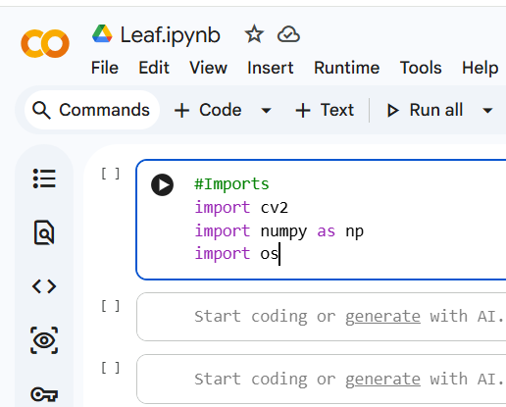
Google Colaboratory
• Write and execute Python in your browser
• No configuration required
• Free access to GPUs
• Easy sharing
• https://colab.research.google.com/

Slide 5



Dataset
Three leaf classes: Basil, Lemon, Chinar
RGB images
Each image processed independently
Data source is Kaggle

Slide 6
Data preparation
• Read the images from the leaf
• RGB images
• Stored as 3 dimensional arrays
• [height, width, color channel]
• Pixel values as 8-bit unsigned integers: [0,255]
• Change the images into grayscale (2-dimensional array) and reduce the quantization level, e.g. to 8 levels, i.e. pixel values [0,7]
• Calculate Gray Level Co-occurrence Matrix (GLCM)

Slide 7
Feature extraction
• First order texture measures: statistics
• Calculate the mean for each RGB color channel
• Calculate the variance for each RGB color channel
• Second-order texture measures: spatial relationships between neighboring pixels
• Calculate the correlation from the Gray-Level- CoOccurrence matrix in horizontal and vertical directions with two different reference pixel distances

Slide 8
Second-Order Texture Features (GLCM)
GLCM describes texture by counting how often two neighboring pixels have certain gray-level values.
The correlation feature captures how strongly pixel values are related in space.
Horizontal and vertical directions with distances of 1 and 2 pixels are used to capture both fine and coarse textures.

Slide 9
Why These GLCM Distances?
d = 1: captures fine local texture
d = 2: captures slightly coarser texture
Both distances are standard and interpretable

Slide 10
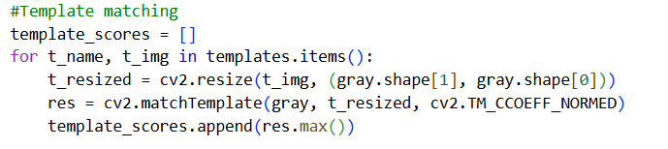
Template Matching
One representative leaf image is selected as a template for each class.
Normalized cross-correlation is used to measure how closely each image matches that template.
The maximum response value is used as a feature, representing how similar the leaf shape is to the class prototype.

Slide 11
Feature Vector
6 color features
4 GLCM correlation features
3 template matching scores
Total: 13 features per image

Slide 12
Preprocessing
Feature matrix X and label vector y
Standardization using z-score normalization
Ensures fair comparison between features

Slide 13
Classification Models
• Train different classifiers to identify the classes of the images
• Ridge Classifier
• Random Forest RF
• Multi-Layer Perceptron MLP
• Find the best hyper-parameters for each classifier with k-fold cross validation
• Estimate the performance of the classifiers with nested cross-validation

Slide 14
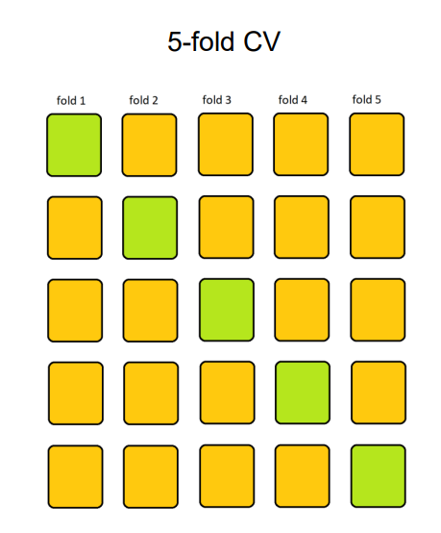
K-fold cross validation
• A single split to test/training sets may lead to unstable results
• A procedure to estimate a model performance with unseen data (data which has not taken part in the training of the model)
• Data is split into subsets called folds
• Each fold has approximately the same size
• Each fold is used once as test data while the remaining folds are used for model training
• At each round, a performance estimation is calculated
• The total performance is calculated as the mean performance of all rounds

Slide 15
Model Selection
Hyperparameter tuning is performed using GridSearch with cross-validation.
Stratified folds are used to preserve class balance.
Accuracy used as evaluation metric

Slide 16
Nested Cross-Validation
Used to obtain an unbiased estimate of model performance
Consists of two cross-validation loops
Inner loop (model selection):
Uses k-fold cross-validation
Performs GridSearchCV
Selects the best hyperparameters
Outer loop (performance estimation):
Uses a separate k-fold split
Evaluates the model selected in the inner loop
Estimates performance on unseen data
Final performance is reported as the mean accuracy of the outer folds

Slide 17
Evaluation
Check classification accuracy for each model.
Inspect confusion matrices.
Review classification reports.
Analyze feature importance for Random Forest.
Visualize the feature space using PCA.

Slide 18
About the report
• You can use the template provided in Moodle
• Write a clear report, understandable for an unspecialized reader
• Write easily readable code with comments
• If you exploit some code from web, provide a reference
• Avoid redundant code! Exploit the relevant parts and modify the code for your purposes to produce only what you need
• Everyone should submit their own implementation. It is ok to discuss the assignment with a friend. But it is not ok to copy someone's work.
• Return your output as a working Jupyter notebook
• Name your file as MLPR26_exercise_surname_firstname.jpynb

Slide 19
Grading
• The exercise covers a part of the grading in this course
• The course grade consists of the exercise and the exam, with a total score of 36 points
• Exam has 5 questions, 6 points for each
• Exercise gives 6 exam points
• From the exercise template, you can see how many exercise points can be acquired from each task.
• Exam points are given according to the table below:
• 9–10 exercise points: 1 exam point
• 11–12 exercise points: 2 exam points
• 13–14 exercise points: 3 exam points
• 15–16 exercise points: 4 exam points
• 17–18 exercise points: 5 exam points
• 19–20 exercise points: 6 exam points
• At least 9 exercise points are needed to pass the exercise
• The points should be distributed somewhat evenly into tasks

Slide 20
Deadline 15th of March at 16:00
• No extension granted, unless you have an extremely justified reason. In such case, ask for extension well in advance!
• Please note: Project work must be submitted before taking the e‑exam.
• Start early, do not leave it to the last minute. This exercise will need some labor!
• If you encounter problems, Google first, and if you can’t find an answer, ask for help
• In the discussion area at Moodle
• Email: svwelg@utu.fi

