Slide 1

Arc Guard: A Servo-Based
Directional Intrusion Detection and
Radar Visualization System
Pratham Pawar | VU4F2324148
Preeti Goud | VU4F2324145
Mariyam Ashrafi | VU4S2425018
Ashmeet Bhat Vernekar | VU4S2425019
Under the guidance of Dr. Kavita Wagh
AY:2026-27

Slide 2
INTRODUCTION
Security monitoring systems are essential in modern environments such as laboratories, offices, and restricted-access rooms.
However, most low-cost systems:
Use fixed sensors with limited coverage
Generate false positives
Lack spatial awareness
Do not provide intuitive visualization
Arc Guard addresses these limitations with fixed-zone and 180° directional scanning, a learned room baseline, and live radar-style visualization on the web and on a phone.

Slide 3
PROBLEM STATEMENT
Conventional low-cost security systems:
Use PIR or a single fixed ultrasonic sensor
Have limited detection coverage
Produce high false alarms
Lack directional awareness
Camera-based systems:
Increase cost
Raise privacy concerns
Require high processing power
There is a need for a low-cost, privacy-preserving, directional intrusion detection system.

Slide 4
PROPOSED SOLUTION
Arc Guard uses:
ESP32-WROOM-32U Wi-Fi microcontroller as the main controller
Two fixed HC-SR04 ultrasonic sensors watching Zone A and Zone B
One US-100-type ultrasonic sensor on an MG90S servo for 0–180° scanning
All sensors powered at 3.3 V, so no resistors or level shifters are needed
A learned baseline for every sensor and every scan angle
Confirmed detection, with movement and anomaly events reported separately
MH-FMD buzzer alarm that works even if Wi-Fi is down
FastAPI backend + SQLite, live web dashboard and Android app
Arc Guard continuously monitors two fixed zones and scans a 180° arc to detect abnormal spatial changes in real time.

Slide 5
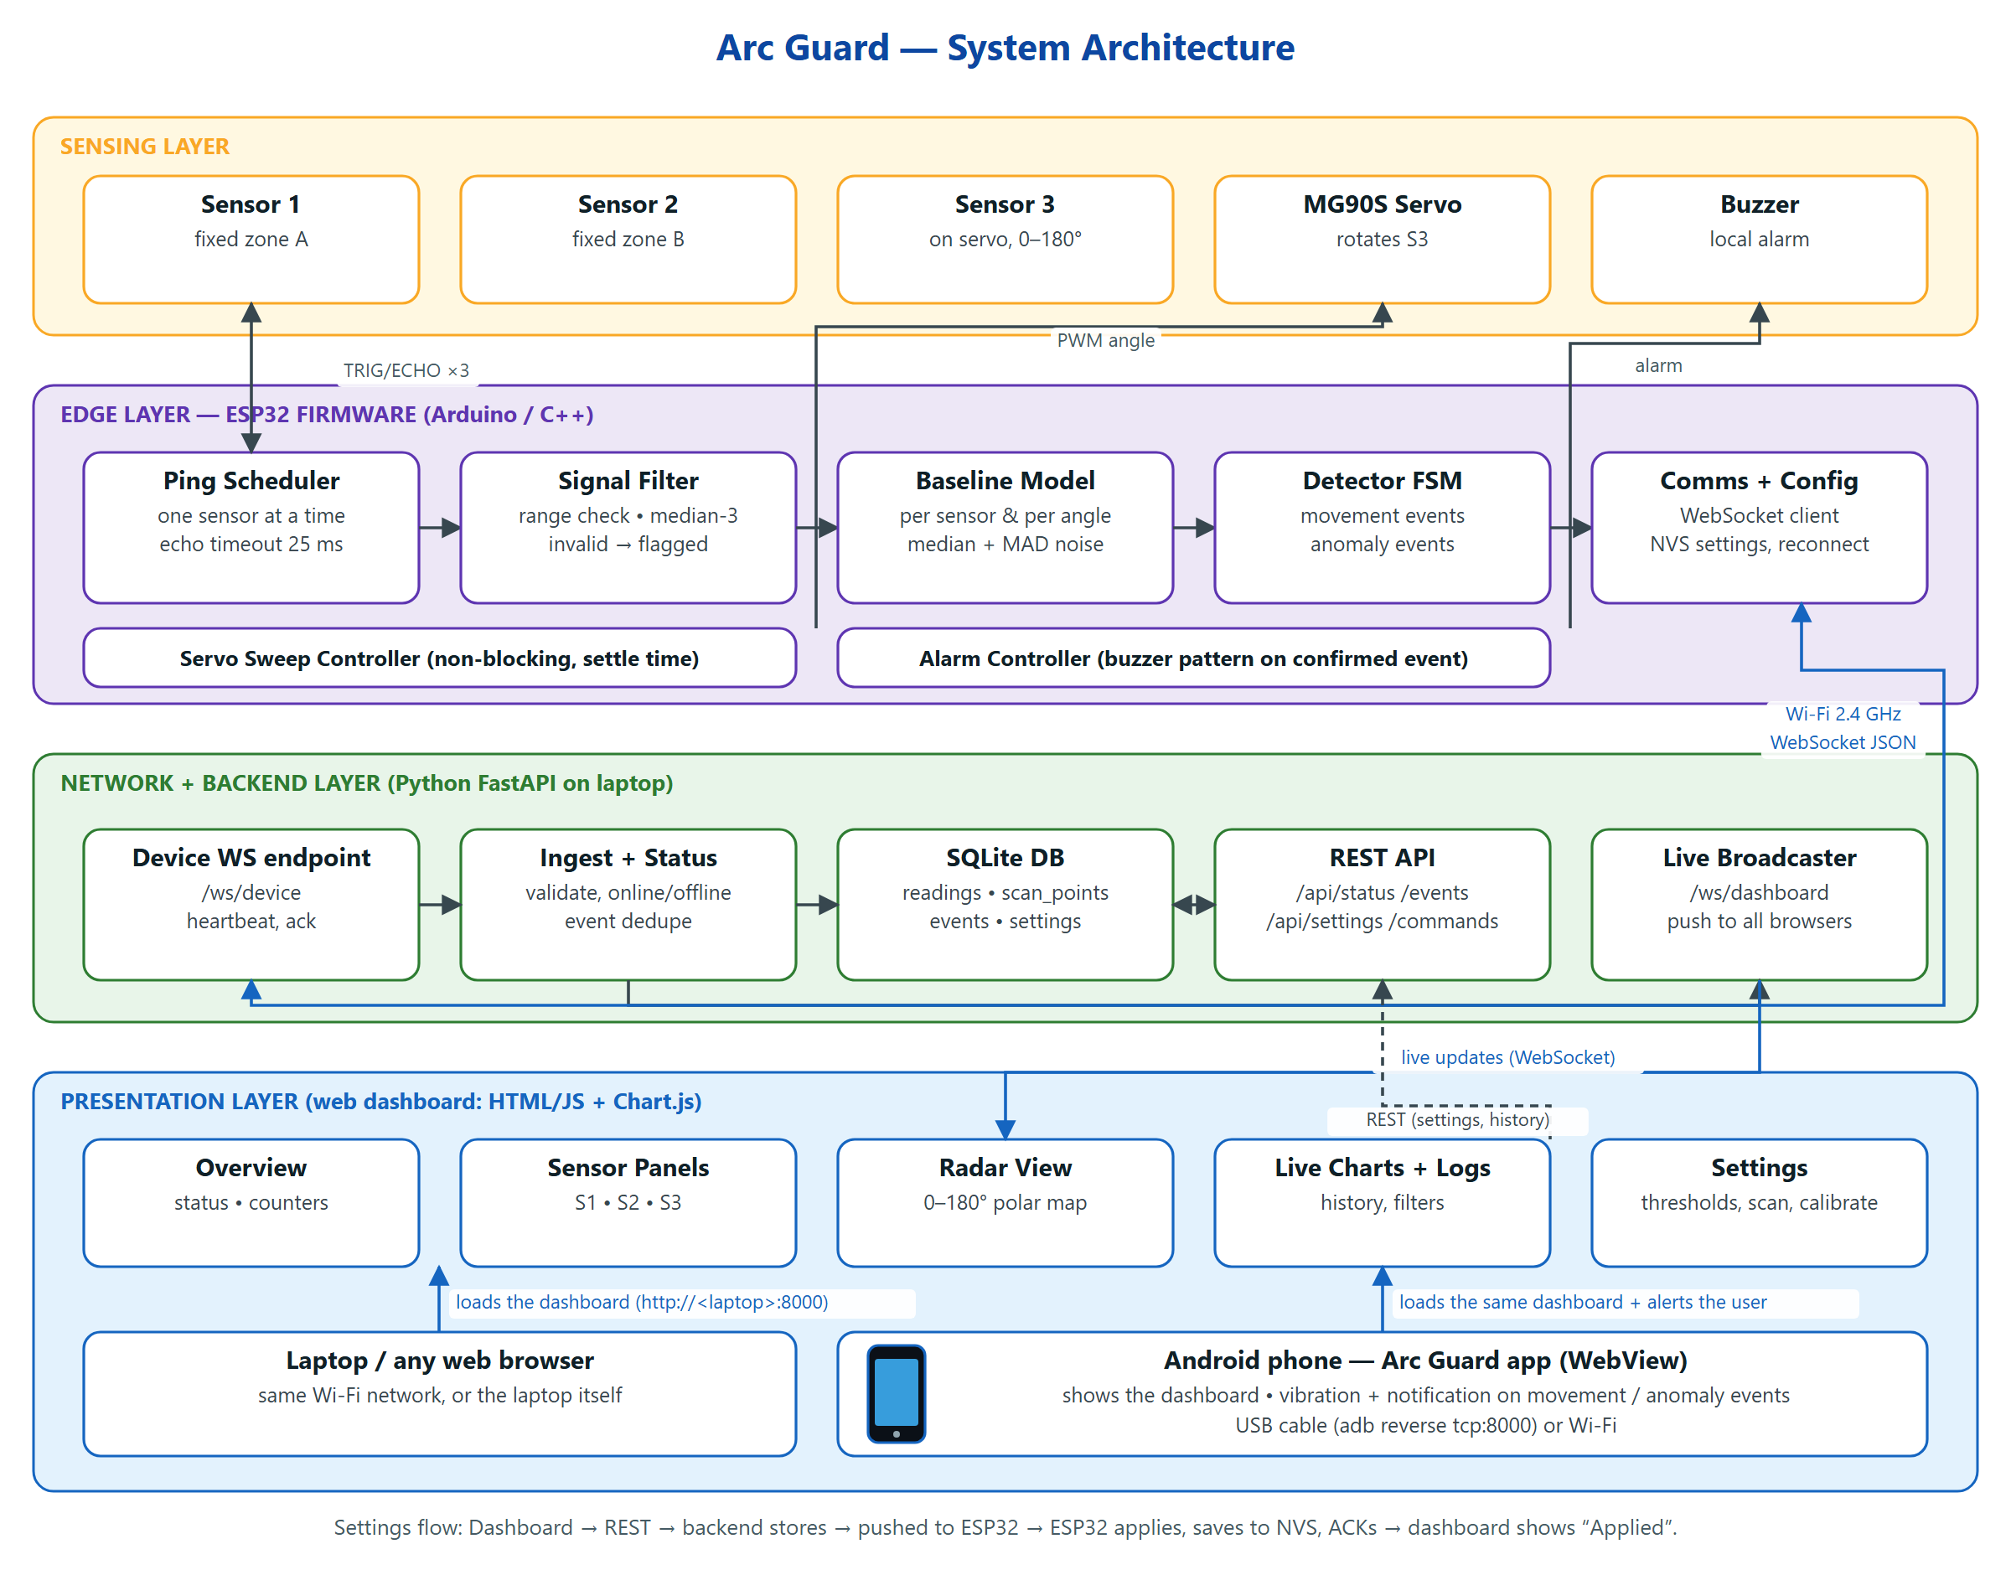
SYSTEM ARCHITECTURE
Notes:
Four layers: sensing (3 ultrasonic sensors, servo, buzzer), edge (ESP32 firmware: scheduling, filtering, baselines, detector, comms), backend (FastAPI + SQLite on the laptop), presentation (web dashboard in any browser, or the Android app). Detection runs on the ESP32, so the buzzer still works without Wi-Fi.

Slide 6
OBJECTIVES
Design a low-cost, camera-free room monitor using an ESP32.
Watch two fixed zones and a 180° arc using three ultrasonic sensors.
Learn a baseline for every sensor and scan angle, and detect changes from it.
Reduce false positives by confirming a change before reporting it.
Classify movement and anomaly events, and alert locally through a buzzer.
Enable Wi-Fi-based monitoring through a web dashboard and an Android app.

Slide 7
KEY FEATURES
Three-sensor monitoring (2 fixed + 1 scanning)
180° directional scanning in 5° steps
Per-angle baseline with a robust noise model
Confirmed detection: movement vs anomaly events
Real-time buzzer alert on the device
ESP32 Wi-Fi with live WebSocket streaming
Web-based & Mobile-based monitoring (Android app alerts)
Radar-style room map, live charts and event log
Privacy-preserving — no camera required

Slide 8
WHAT MAKES ARC GUARD DIFFERENT ?
Fixed + directional sensing instead of relying on a single sensor
A learned baseline per angle instead of one fixed threshold
Movement and anomaly events reported separately
Dashboard settings are applied and confirmed by the device
Web dashboard and Android app with phone alerts
Only 5 parts, no extra components; no camera → privacy-friendly

Slide 9
HARDWARE COMPONENTS
Sr. No. | Component | Pins / Power | Function
1 | ESP32-WROOM-32U DevKit (38-pin) | USB 5 V from the laptop | Main controller, Wi-Fi, detection
2 | HC-SR04 — Sensor 1 | TRIG 23 / ECHO 22 · 3.3 V | Fixed zone A
3 | HC-SR04 — Sensor 2 | TRIG 19 / ECHO 18 · 3.3 V | Fixed zone B
4 | US-100-type — Sensor 3 | TRIG 17 / ECHO 16 · 3.3 V | Directional scanning on the servo
5 | Tower Pro MG90S servo | Signal 21 · 5 V (VIN) | Rotates Sensor 3 through 0–180°
6 | MH-FMD buzzer | I/O 4 · 3.3 V | Local audible alarm
7 | Breadboard & jumper wires | No resistors or capacitors | Circuit connections
8 | USB cable / power bank | 5 V USB | Power to the system
Notes:
Hardware is fixed: exactly these parts, no resistors, capacitors or level shifters. The three sensors and the buzzer run from the ESP32's 3.3 V pin, so their ECHO outputs are safe for the ESP32 inputs.

Slide 10
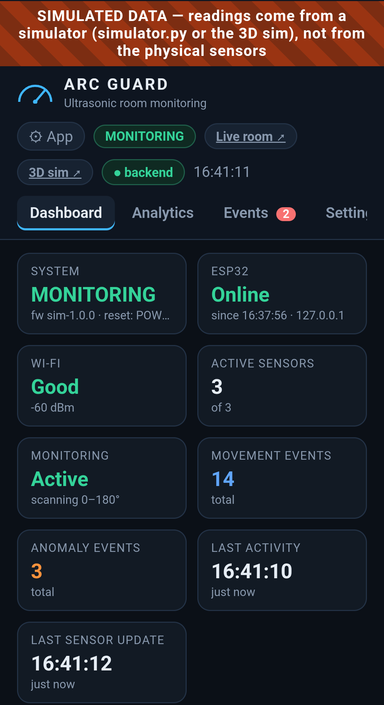
SOFTWARE COMPONENTS
ESP32 Firmware (Arduino C++)
Sensor scheduling & filtering
Servo sweep control
Baseline + detection logic
Buzzer alarm
Wi-Fi + WebSocket, saved settings
Web Dashboard
Real-time sensor data & status
Radar-style map + 3D live room
Charts, event log, CSV export
Settings applied on the ESP32
Backend (Python FastAPI)
WebSocket + REST API
SQLite history
Device online / offline
Mobile Application (Android)
Real-time monitoring
Event notifications + vibration
Same live dashboard
USB or Wi-Fi connection
Android app (simulated data)

Slide 11
Minimum System Requirements for
Arc Guard
Processor: Dual-core CPU, 1.8 GHz or higher (Intel i3 / AMD Ryzen 3 or equivalent)
RAM: 4 GB minimum (8 GB recommended)
Storage: 2 GB free disk space (IDE, ESP32 core, Python packages, database)
Operating System: Windows 10/11 (also runs on Linux or macOS)
Network: 2.4 GHz Wi-Fi shared by the laptop and the ESP32
USB Port: at least one USB 2.0 or higher port (ESP32 programming and power)
Software: Arduino IDE 2.x or PlatformIO, Python 3.10+, CP210x / CH340 USB driver, a browser
Phone (optional): Android 7.0 or later for the Arc Guard app

Slide 12
INTRUSION DETECTION LOGIC
An event is detected when:
|Current Distance − Baseline| > max(15 cm, 4 × noise σ)
AND
The change persists for 3 readings and ≥ 300 ms
(2 sweeps for the scanning sensor)
It is then classified as:
Movement — fast change, brief movement, movement across the scan
Anomaly — object appeared / disappeared, sudden jump, pattern, sensor fault
This reduces false alarms, temporary disturbances and noise-based triggers.
New reading
range check + median filter
Compare with baseline
|d − baseline| > max(15 cm, 4σ) ?
Candidate
3 readings in a row and ≥ 300 ms
Confirmed → classify
rate of change and how long it lasts
MOVEMENT
fast or brief change
ANOMALY
persists 10 s, jump, fault
then a 3 s cooldown before the next event

Slide 13
ADVANTAGES , LIMITATIONS & APPLICATIONS
Advantages
Limitations
Applications
Low cost (5 parts)
Privacy-friendly (no camera)
Easy deployment on one breadboard
Real-time detection + live dashboard
Movement vs anomaly classification
Web + Android monitoring
Limited range (~4 m, ultrasonic)
Cannot identify specific individuals
Line-of-sight only; ~15° beam gives coarse direction
Soft or angled surfaces may not echo
Short Wi-Fi range (no external antenna)
Laboratories
Classrooms
Offices
Small warehouses
Restricted-access rooms
Indoor security monitoring

Slide 14
FUTURE ENHANCEMENT
In future, Arc Guard can be enhanced with push notifications that reach the phone even when the app is closed, occupancy-grid mapping of the room from accumulated sweeps, adaptive baselines that safely follow slow changes, focused re-scanning of a sector after a change, and additional Arc Guard nodes reporting to one backend for wider-area coverage. Once enough labelled event data has been recorded, a small on-device (TinyML) model can be compared against the rule-based detector to improve automated security monitoring.

Slide 15
SUSTAINABLE DEVELOPMENT GOALS (SDGs)
SDG 9 – Industry, Innovation and Infrastructure: a low-cost, open embedded approach to safer infrastructure through directional sensing and real-time monitoring.
SDG 11 – Sustainable Cities and Communities: improves the safety of indoor spaces such as campuses and workplaces while respecting the privacy of occupants.
SDG 12 – Responsible Consumption and Production: achieves the goal with a minimal component count and a low-power microcontroller.
SDG 16 – Peace, Justice and Strong Institutions: supports protection of controlled-access institutional rooms without surveillance cameras.
The project emphasizes accessible and scalable technology, enabling wider adoption.

Slide 16
CONCLUSION
Arc Guard provides a low-cost, privacy-preserving room monitor built from one ESP32, three ultrasonic sensors, one servo and one buzzer, with no extra components. Fixed-zone sensing and 180° servo scanning, learned baselines and confirmed detection report movement and anomalies separately, while a FastAPI backend streams everything live to a web dashboard and an Android app. The system provides a scalable foundation for modern IoT-based security applications.

