Slide 1
Esri
&
Utility Network

Slide 2

Concluímos na última sexta-feira a Esri User Conference 2024 em San Diego, Califórnia, e foi uma experiência incrível! O evento reuniu cerca de 20 mil pessoas de todo o mundo e tivemos a honra de contar com a presença de clientes como Copel, Eletrobrás, Itaipu, TIM, Vivo, Sanepar, Sabesp e Caesb. As apresentações da Valeria Carazzai Gerente Executiva da Eletrobrás e do Thiago Becker Gerente de TI da Itaipu foram sensacionais, enriquecedoras em conhecimento e representaram com excelência o Brasil. Foi uma semana repleta de aprendizado, networking, novas ideias e orientações. Agradecemos a todos que participaram e contribuíram para tornar este evento tão especial. Volto para o Brasil energizado e ansioso para evoluir com nossos clientes nas últimas inovações em GeoAI, IA generativa, integração do GIS com BIM/CAD, entre outros temas que lá foram discutidos. GIS - Uniting our world.
https://www.linkedin.com/posts/joaopauloiolle_conclu%C3%ADmos-na-%C3%BAltima-sexta-feira-a-esri-user-ugcPost-7220936618688278528-oawD?utm_source=share&utm_medium=member_desktop&rcm=ACoAAAMQtAUB5UouXqdBJgo_gWpNVZ7Imay_2Tg

Slide 3
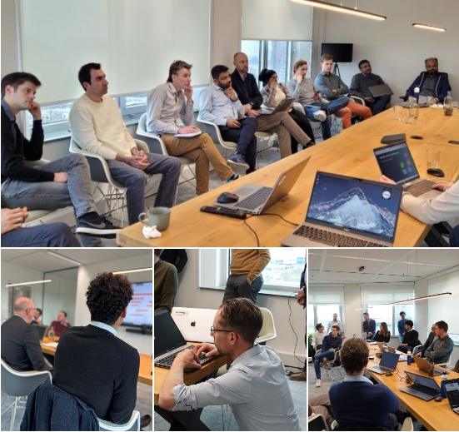
Our international team of Esri Utility Network Specialists joins forces with great frequency. We do so because in this way our approach around advice, implementation and maintenance of the Esri Utility Network remains the absolute best. This way we’re able to maintain our position as knowledge leader around the Utility Network worldwide. All with one goal: serving our Utility customers optimally.
https://www.linkedin.com/posts/avineon-tensing_esriutilitynetwork-elevatingspatialintelligence-activity-7166823083297751040-khaT?utm_source=share&utm_medium=member_desktop&rcm=ACoAAAMQtAUB5UouXqdBJgo_gWpNVZ7Imay_2Tg

Slide 4
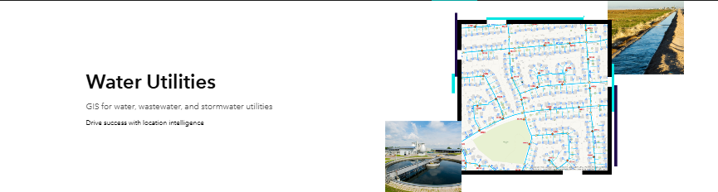
Esri's Water Utilities web pages provide a good introduction to how GIS helps the water industry increase efficiency and make data driven decisions. They also provide links to eBooks, reports, customer stories, and more. https://lnkd.in/gzAnieVD hashtag#EsriWater hashtag#ArcGIS
https://www.linkedin.com/posts/crstacampbell_gis-for-water-utilities-smart-water-solutions-activity-7183841569031041024-uNT2?utm_source=share&utm_medium=member_desktop&rcm=ACoAAAMQtAUB5UouXqdBJgo_gWpNVZ7Imay_2Tg

Slide 5
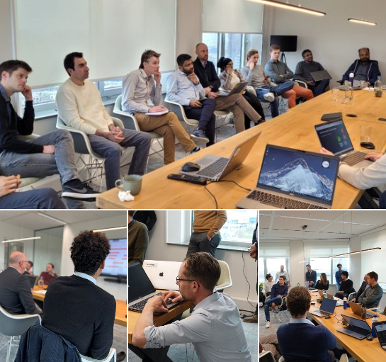
Our international team of Esri Utility Network Specialists joins forces with great frequency. We do so because in this way our approach around advice, implementation and maintenance of the Esri Utility Network remains the absolute best. This way we’re able to maintain our position as knowledge leader around the Utility Network worldwide. All with one goal: serving our Utility customers optimally. But what is special is that last three days a large part of those specialists came together in Utrecht (NL). Experts from the United Kingdom, Belgium, France, India and the United States came over to join our team in the Netherlands to talk about their latest experiences and newest developments, to inspire each other and to exchange knowledge. For example, Pulikallu Giri Venkata Ramana Reddy shared his vision and ideas about valuable partnerships and talked about the Utility Network services we provide in the Middle East. Here he talked about the fantastic data migration project at Dubai Electricity & Water Authority (DEWA). Anil Jayavarapu, PMP, SA shared best practices from the Eversource project - where we deployed the Esri Utility Network in a sandbox environment as part of our GIS consolidation project for an electric company in Northeast America. M'barek inspired with great work we are doing for an electric transmission company in Africa to help them explore the benefits of the Utility Network for their operations. Further immersion was found around specific topics such as data modeling and data migration for Utility Network projects using our knowledge on Safe Software FME. We look back on three great, inspiring days. That holds great promise for the future!
https://www.linkedin.com/posts/avineon-tensing_esriutilitynetwork-elevatingspatialintelligence-activity-7166823083297751040-khaT?utm_source=share&utm_medium=member_desktop&rcm=ACoAAAMQtAUB5UouXqdBJgo_gWpNVZ7Imay_2Tg

Slide 6
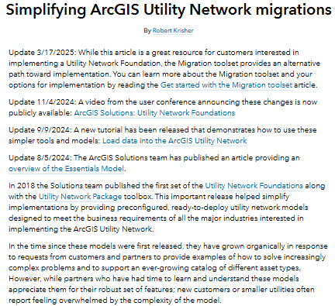
In my latest article (https://lnkd.in/ghNPhMzM) I discuss how key releases this year have made migrating to the utility network easier than ever. Just in time for the Esri User Conference no less! This article contains more detail than what I've been musing about on LinkedIn for the past few days, but there's even more technical information and guidance that I'm working on getting out there.
https://www.linkedin.com/posts/robert-krisher-5a989438_simplifying-arcgis-utility-network-migrations-activity-7215715411999219712-E1Qn?utm_source=share&utm_medium=member_desktop&rcm=ACoAAAMQtAUB5UouXqdBJgo_gWpNVZ7Imay_2Tg

Slide 7

Duplication of data entry within the Utility Construction process has been around for so long some consider this redundant work to simply be how it has to be. With the continued collaboration between Esri and AutoDesk, this legacy method of redundancy can be eliminated. hashtag#gas hashtag#pipeline hashtag#utilitymapping
https://www.linkedin.com/posts/tom-dewitte-esriengineer_gas-pipeline-utilitymapping-activity-7170507372568797185-gpTZ?utm_source=share&utm_medium=member_desktop&rcm=ACoAAAMQtAUB5UouXqdBJgo_gWpNVZ7Imay_2Tg

Slide 8
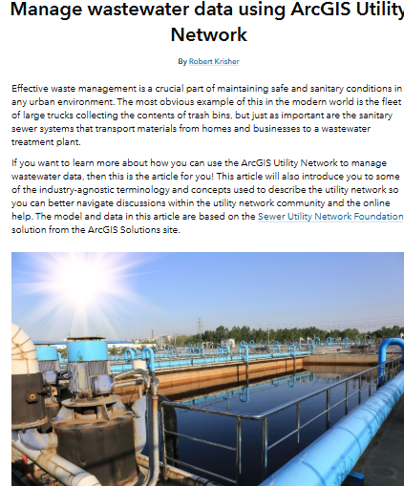
Quer entender como funciona a gestão de ativos do Sistema de esgotamento sanitário com a Utility Network? Esse artigo traz uma uma ótima visão desse tema. https://lnkd.in/dzzkYHyW
https://www.linkedin.com/posts/wallamys-venancio_manage-wastewater-data-using-the-arcgis-utility-activity-7205986056490377217-q9Oa?utm_source=share&utm_medium=member_desktop&rcm=ACoAAAMQtAUB5UouXqdBJgo_gWpNVZ7Imay_2Tg

Slide 9
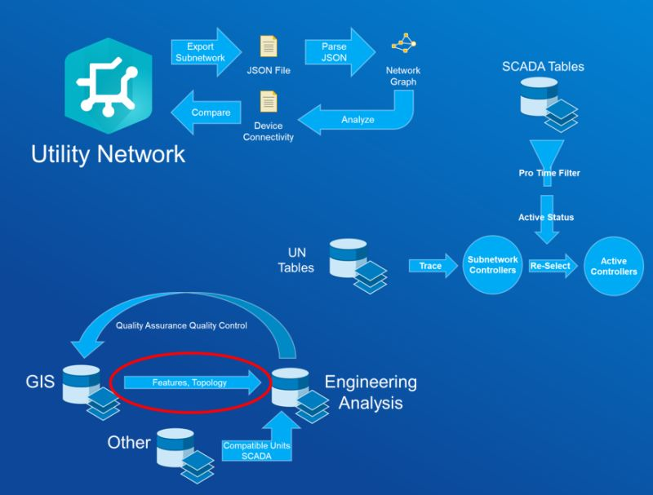
Videos from Dev Summit 2024 just went live! You can find utility network specific session on the ArcGIS Utility Network channel (https://lnkd.in/esinW-aY), or for the all the sessions you can go directly to the Developer's Summit 2024 page (https://lnkd.in/eaiViWYv). Not every recorded session is made public, and even though the recordings are released the slides aren't made available to the general public. If you want to get access to slides from a conference or want to have access to videos even sooner (and you didn't attend the conference) I recommend you sign up for digital access. Esri offers digital access to most of their conferences for less than the cost of a flight to get there! That'll get you access to live streams during the conference along with access to the conference proceedings site where you can access recordings and slides for recorded sessions.
https://www.linkedin.com/posts/robert-krisher-5a989438_videos-from-dev-summit-2024-just-went-live-activity-7199042312398589954-40As?utm_source=share&utm_medium=member_desktop&rcm=ACoAAAMQtAUB5UouXqdBJgo_gWpNVZ7Imay_2Tg

Slide 10
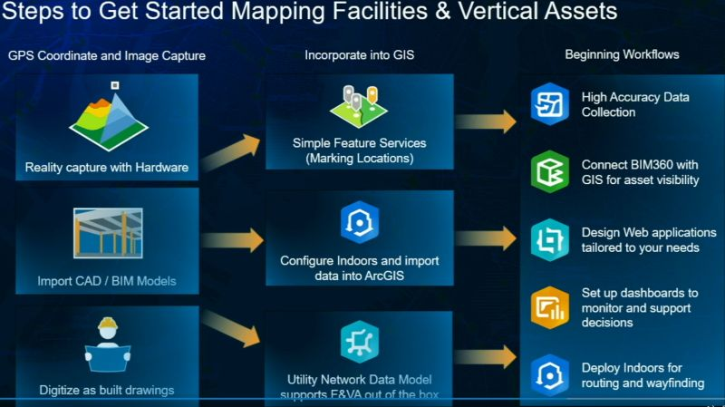
I've had many questions this past year about the best practice for modeling vertical assets in the ArcGIS Utility Network, and how this information can be integrated with an asset management system and BIM models. This presentation (https://lnkd.in/g59-F48Q) at IMGIS last year shows an example of how you can achieve this and what it looks like. I've got a few other examples I'll be sharing over the next few days, so make sure you're following me if you want to get notified when I post them.
https://www.linkedin.com/posts/robert-krisher-5a989438_ive-had-many-questions-this-past-year-about-activity-7194340346942697472-kmTy?utm_source=share&utm_medium=member_desktop&rcm=ACoAAAMQtAUB5UouXqdBJgo_gWpNVZ7Imay_2Tg

Slide 11
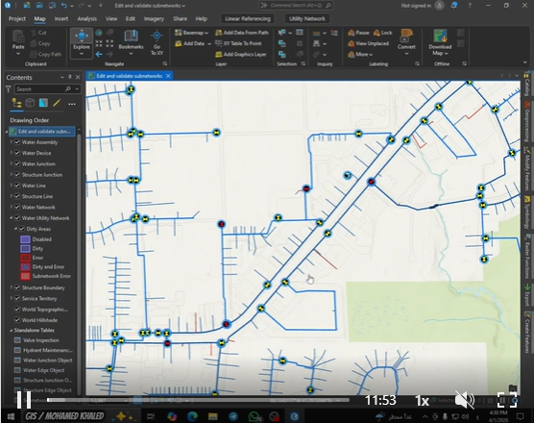
- 𝐄𝐝𝐢𝐭 𝐚𝐧𝐝 𝐕𝐚𝐥𝐢𝐝𝐚𝐭𝐞 𝐒𝐮𝐛𝐧𝐞𝐭𝐰𝐨𝐫𝐤𝐬 𝐢𝐧 𝐔𝐭𝐢𝐥𝐢𝐭𝐲 𝐍𝐞𝐭𝐰𝐨𝐫𝐤𝐬 𝐔𝐬𝐢𝐧𝐠 𝐀𝐫𝐜𝐆𝐈𝐒 𝐏𝐫𝐨 🌐⚡
https://www.linkedin.com/posts/mohamed-khalied_gisabrmohamedabrkhaled-gis-arcgispro-activity-7445153915064688640-unQA?utm_source=share&utm_medium=member_desktop&rcm=ACoAAAMQtAUB5UouXqdBJgo_gWpNVZ7Imay_2Tg

Slide 12

Slides and videos for the 2024 Esri User Conference are starting to be made available for those who attended in person or signed up for digital access. To kick things off I'll shout out to my co-workers Chris Cremons, Remi Myers, and David Crawford for their introduction to the utility network presentation: https://lnkd.in/eqtaMiVd I'll be calling out interesting presentations that you can watch on-demand over the next few weeks, so make sure you watch this space! hashtag#EsriUC2024
https://www.linkedin.com/posts/robert-krisher-5a989438_esriuc2024-activity-7227676447035830272-O14d?utm_source=share&utm_medium=member_desktop&rcm=ACoAAAMQtAUB5UouXqdBJgo_gWpNVZ7Imay_2Tg

Slide 13
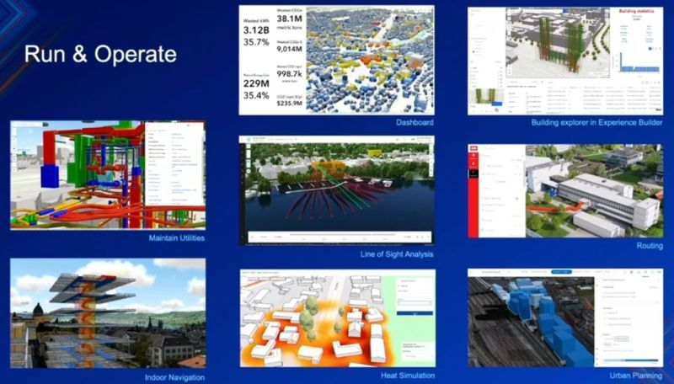
The term "Digital Twin" has been a buzzword for a long time that means a lot of different things to different people. If you want to cut through the buzz and see some practical examples of using GIS as a digital twin, check out this recorded session from the user conference: https://lnkd.in/gYEHMwag To access the video and slides you need to have attended the 2024 Esri User Conference or purchased digital access to the conference. There is so much content at the conference that I find it impossible to attend all the sessions that I want to, so being able to watch so many sessions on demand is something I am extremely grateful for. While I always enjoy the presentations I see in person, there's usually one or two sessions at each conference that are game-changing to me that I only saw because of digital access! hashtag#EsriUC2024
https://www.linkedin.com/posts/robert-krisher-5a989438_esriuc2024-activity-7228058842821967873-o15R?utm_source=share&utm_medium=member_desktop&rcm=ACoAAAMQtAUB5UouXqdBJgo_gWpNVZ7Imay_2Tg

Slide 14
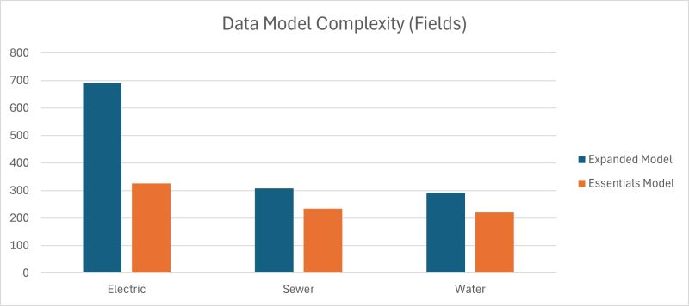
Some of the most significant additions to the utility network migration process were released last week, and they seem to have flown under most people's radar. So, I figured I'd take some time to break down these changes and talk about their importance in the weeks leading up to this year's Esri User Conference. The first thing I'll be talking about is the changes made to the Utility Network Foundations with the introductions of the essentials model. Since the first release of the ArcGIS Utility Network, the solutions team has provided industry-specific data models, known as Utility Network Foundations. These solutions contain everything you need to get started building your own utility network. This includes a fully configured data model, maps, editing templates, and even a sample dataset you can practice with. This was great, but over the years these models have grown as customers have wanted to see additional things added to the model to support new workflows. Customers took notice of this and started complaining that the models were becoming too complex and difficult to implement. In recognition of this the solutions team now provides two separate data models inside each foundation. There is an 'expanded model', which is the same model they've been releasing that contains all the fields and configuration for all the workflows and demonstrations they've built since its release. But in addition to this they also now have what's known as an 'essentials model', which contains a paired down set of fields and configurations that represent what they believe to be the simplest data model that a utility could use to build a utility network without compromising any core business requirements. The idea is that customers who want to start simple and build their model out can use the essentials model to get started, then add on their own fields and configurations to make the model match their existing business processes. What about all the capabilities of the expanded model? More mature organizations may choose to implement the expanded model, but smaller organizations that want to implement certain pieces of that model can use tools provided by the Solutions team to pick and choose features from the expanded model and add them to the essentials model. There's a lot to digest here, so if you want to know more about the changes to the Utility Network Foundations, I recommend you attend the ArcGIS Solutions: Utility Network Foundations session at 8:00 AM on Tuesday, July 16 at this year's Esri User Conference (agenda: https://lnkd.in/g6fwrXqJ). You can get learn about, and get access to, the Utility Network Foundations using this link: https://lnkd.in/gCcwUDhG . I will continue the discussion tomorrow with some new data migration tools that were released that complement the new essentials models.
https://www.linkedin.com/posts/robert-krisher-5a989438_some-of-the-most-significant-additions-to-activity-7214621242694205441-VDmp?utm_source=share&utm_medium=member_desktop&rcm=ACoAAAMQtAUB5UouXqdBJgo_gWpNVZ7Imay_2Tg

Slide 15
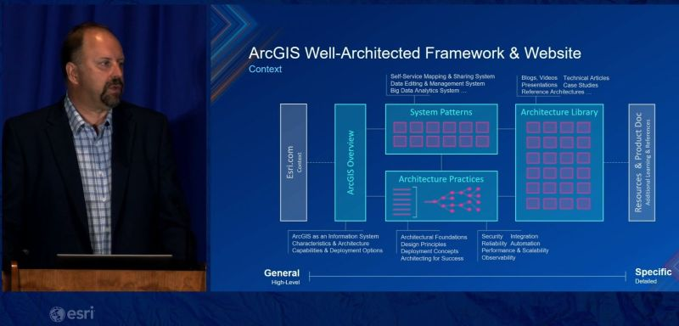
If you're not already familiar with the ArcGIS Architecture Center, check out this presentation from this year's Esri User Conference: https://lnkd.in/gwx-yaxA . Shout out to Dave Wrazien and Michael Mirobelli, MEA for delivering such a wonderful presentation! GIS has always been an important analytical tool, but over the past decades it has evolved into an enterprise platform found in the heart of many organizations. With this evolution came many questions from customers about reference architectures, best practices, and even test studies for different workflows. In response to this Esri created the ArcGIS Architecture Center (https://lnkd.in/gDYavjkz), which contains information about all these topics and more! This site went live late last year and is a resource I refer to often throughout the week in my conversations with customers. In particular, I find many utility customers moving from ArcMap to ArcGIS Pro have a lot of questions about how to best configure their ArcGIS Enterprise. For these customers, I often refer them to the "Network Management System" reference architecture (https://lnkd.in/g9jjUKa5) where they can find sample architectures, workflows, and easy-to-understand descriptions of how the different components of the system interact. hashtag#EsriUC2024
https://www.linkedin.com/posts/robert-krisher-5a989438_esriuc2024-activity-7228380981747924992-44r7?utm_source=share&utm_medium=member_desktop&rcm=ACoAAAMQtAUB5UouXqdBJgo_gWpNVZ7Imay_2Tg

Slide 16
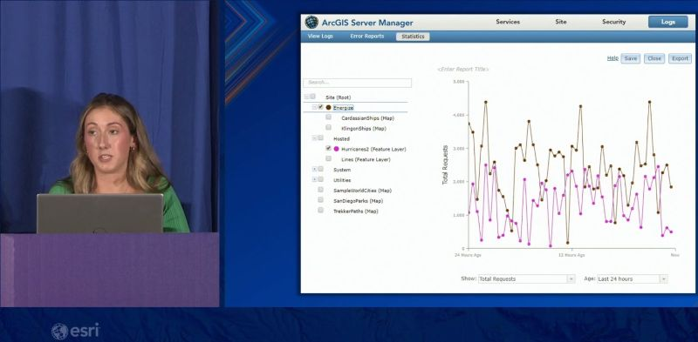
If you're a Geodatabase Administrator you should check out this presentation (https://lnkd.in/gWsGwNqr) by Kaitlyn Purcell Jon Emch from this year's Esri User Conference. It contains a wealth of interesting tips and tricks as well as practical things you can do daily to keep on top of your environment and spot issues before your users do. The coolest thing I saw in this presentation, which wasn't previously on my radar, was the Statistics tab in ArcGIS Server Manager. It doesn't have all the bells and whistles the ArcGIS Monitor has, but there are still many quick and easy metrics you can get out of your services to help you identify system health. As always, make sure you stick around for the Q&A session at the end for some great user questions.
https://www.linkedin.com/posts/robert-krisher-5a989438_esriuc2024-activity-7229111775936274432-tHtT?utm_source=share&utm_medium=member_desktop&rcm=ACoAAAMQtAUB5UouXqdBJgo_gWpNVZ7Imay_2Tg

Slide 17
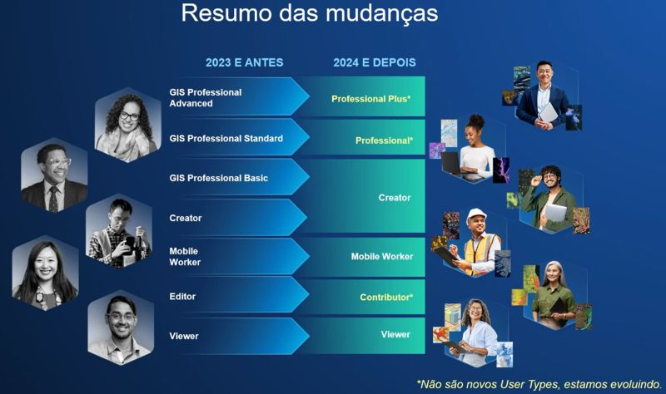
News Geo 📢 💡 Desde junho de 2024, a Esri atualizou seu modelo de licenças para se alinhar com as inovações na plataforma ArcGIS. Essa mudança simplifica a implantação do sistema, oferecendo seis tipos de usuários baseados em funções, que proporcionam acesso ampliado aos recursos, aplicativos e serviços do ArcGIS, permitindo que suas equipes colaborem de qualquer lugar, em qualquer dispositivo. Quer saber mais quais são essas mudanças? Veja o vídeo com a explicação do meu colega Lucas Alves: https://lnkd.in/dy8fbmjG e acesse a matriz de comparação: https://lnkd.in/dhzYZVE7
https://www.linkedin.com/posts/alinecoimbra_news-geo-desde-junho-de-2024-a-esri-activity-7230262383930208256-RAhd?utm_source=share&utm_medium=member_desktop&rcm=ACoAAAMQtAUB5UouXqdBJgo_gWpNVZ7Imay_2Tg

Slide 18
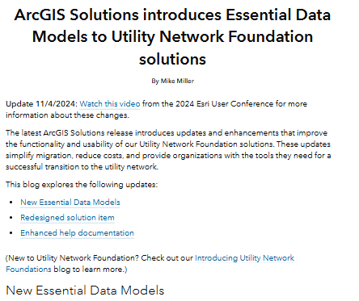
Are you a water, sewer, or electric utility looking to migrate to the ArcGIS Utility Network? If so, you will be very interested in the major enhancements we recently made to the UN Foundations. Learn more in this blog post. https://lnkd.in/exx4VzWT
https://www.linkedin.com/posts/scott-oppmann_arcgis-solutions-introduces-essential-data-activity-7228866893242085377-vj5N?utm_source=share&utm_medium=member_desktop&rcm=ACoAAAMQtAUB5UouXqdBJgo_gWpNVZ7Imay_2Tg

Slide 19
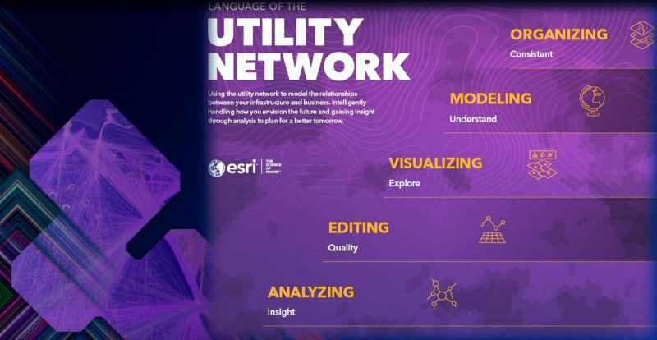
Another round of videos from this year's Esri User Conference has been published for digital access (https://lnkd.in/gVWsSsRS). The first one I'd like to call out is the Essential Network Diagram Workflows presentation given by Anne-Yvonne Blin and Koya Brown. The power of network diagrams to convey information is often overlooked when implementing the utility network, especially with all the other activities surrounding a large implementation. I recommend existing utility network customers watch this presentation to get an idea of how they could be better using the system. I know many customers who manually maintain CAD files or Visio diagrams of their system, and these files are out of date as soon as the GIS is updated. By using network diagrams, you get all the benefits of a schematic representation of your data, but because the data is dynamically linked to your GIS features you never have to worry about it being stale!
https://www.linkedin.com/posts/robert-krisher-5a989438_esriuc2024-activity-7233846143619624960-t5dr?utm_source=share&utm_medium=member_desktop&rcm=ACoAAAMQtAUB5UouXqdBJgo_gWpNVZ7Imay_2Tg

Slide 20

With all the recent changes made to provide industry-specific learning content for the utility network, we decided to make a single playlist that contains all the industries, along with a link to migration resources: https://lnkd.in/g78PZz8G We decided to make this change because many customers were struggling to find the new playlists. This new structure makes it easier for customers to find content relevant to their work and to quickly access content from different industries. Photo by Clay Banks at Unsplash.
https://www.linkedin.com/posts/robert-krisher-5a989438_with-all-the-recent-changes-made-to-provide-activity-7235291482952224768-UCzM?utm_source=share&utm_medium=member_desktop&rcm=ACoAAAMQtAUB5UouXqdBJgo_gWpNVZ7Imay_2Tg

Slide 21
𝐀𝐫𝐜𝐆𝐈𝐒 𝐔𝐭𝐢𝐥𝐢𝐭𝐲 𝐍𝐞𝐭𝐰𝐨𝐫𝐤 𝐓𝐮𝐭𝐨𝐫𝐢𝐚𝐥𝐬 𝐬𝐞𝐫𝐢𝐞𝐬 (𝐖𝐚𝐭𝐞𝐫, 𝐄𝐥𝐞𝐜𝐭𝐫𝐢𝐜𝐢𝐭𝐲, 𝐆𝐚𝐬, 𝐒𝐞𝐰𝐞𝐫 𝐍𝐞𝐭𝐰𝐨𝐫𝐤𝐬) Learn ArcGIS Utility Network for Sewer and Stormwater tutorial series: https://lnkd.in/dVPVNRwc شبكات الصرف Learn ArcGIS Utility Network for Water Utilities tutorial series: https://lnkd.in/dvVhZQKE شبكات المياه Learn ArcGIS Utility Network for Electric Utilities tutorial series: https://lnkd.in/dxafGdnr شبكات الكهرباء Learn ArcGIS Utility Network for Gas and Pipeline tutorial series: https://lnkd.in/dxPQFV8B شبكات الغاز https://lnkd.in/dXCxEcvV
Link: https://www.linkedin.com/posts/omnia-mohamed-116584157_%F0%9D%90%80%F0%9D%90%AB%F0%9D%90%9C%F0%9D%90%86%F0%9D%90%88%F0%9D%90%92-%F0%9D%90%94%F0%9D%90%AD%F0%9D%90%A2%F0%9D%90%A5%F0%9D%90%A2%F0%9D%90%AD%F0%9D%90%B2-%F0%9D%90%8D%F0%9D%90%9E%F0%9D%90%AD%F0%9D%90%B0%F0%9D%90%A8%F0%9D%90%AB%F0%9D%90%A4-activity-7247311843948417026-0zHT?utm_source=share&utm_medium=member_desktop&rcm=ACoAAAMQtAUB5UouXqdBJgo_gWpNVZ7Imay_2Tg

Slide 22
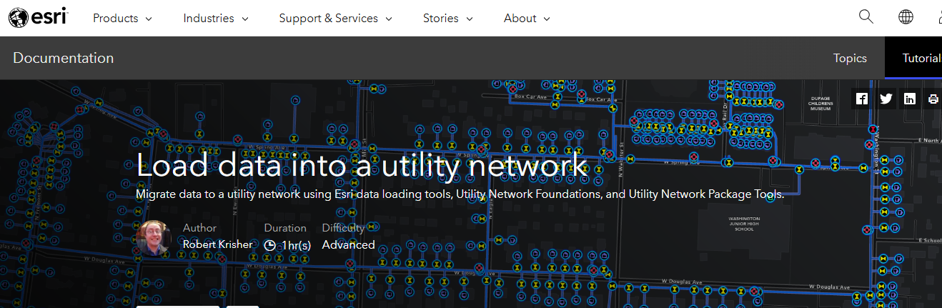
After several months of work with our solutions and learn team, we completely rewrote the Load data into the ArcGIS Utility Network (https://lnkd.in/eJBDXR9K) to take advantage of the new simpler data model and simpler data migration tools (https://lnkd.in/ghNPhMzM). The result? A tutorial that walks through the entire process for data mapping, migration, deployment, and creating a QaQc report for a full water dataset in less than an hour! The previous tutorial only covered two layers, took twice as long, and didn't include any steps for deployment or QaQc. Less time and more content, I view this as a huge win for the community of DIY migration customers out there!
https://www.linkedin.com/posts/robert-krisher-5a989438_load-data-into-the-arcgis-utility-network-activity-7237856155887128576-pNL9?utm_source=share&utm_medium=member_desktop&rcm=ACoAAAMQtAUB5UouXqdBJgo_gWpNVZ7Imay_2Tg

Slide 23
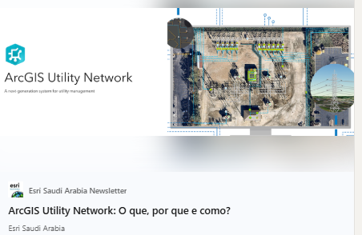
🌐 Exciting News for Utility Companies! 🌐 Discover how the ArcGIS Utility Network can transform your infrastructure management! This powerful tool offers advanced capabilities for modeling, analyzing, and managing utility networks - enhancing operational efficiency and decision-making in the utilities sector. Dive deeper into the "What, Why, and How" of the ArcGIS Utility Network in our latest article. Explore how it supports everything from outage management to real-time data integration for utilities like electric, gas, water, and more.
https://www.linkedin.com/posts/esri-saudi-arabia_esri-esrisaudiarabia-arcgis-activity-7186711649947439104-NTH9?utm_source=share&utm_medium=member_desktop&rcm=ACoAAAMQtAUB5UouXqdBJgo_gWpNVZ7Imay_2Tg

Slide 24
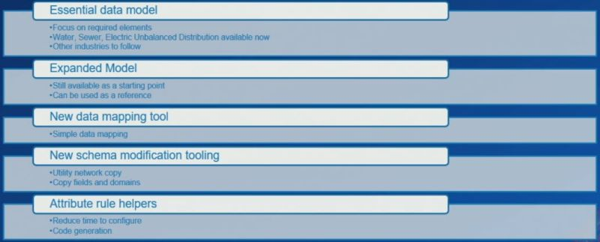
PSA: Many of the videos from the 2024 Esri User Conference are now publicly available! I've added all the utility network related videos to our UC playlist on the ArcGIS Utility Network video channel. The first video I'd like to call out is ArcGIS Solutions: Utility Network Foundations (https://lnkd.in/giUPvtAM). In this presentation, Mike Miller and Patrick Cowan discuss the changes they made to separate out some of their models into "essentials" and "extended' models, along with their new data mapping and migration tools. Given the announcements just made at IMGIS about basic/standard/advanced models, it's worth going back and rewatching this video to see how these tools/models fit into that larger strategy.
https://www.linkedin.com/posts/robert-krisher-5a989438_psa-many-of-the-videos-from-the-2024-esri-activity-7257099385304489985-YPrL?utm_source=share&utm_medium=member_desktop&rcm=ACoAAAMQtAUB5UouXqdBJgo_gWpNVZ7Imay_2Tg

Slide 25
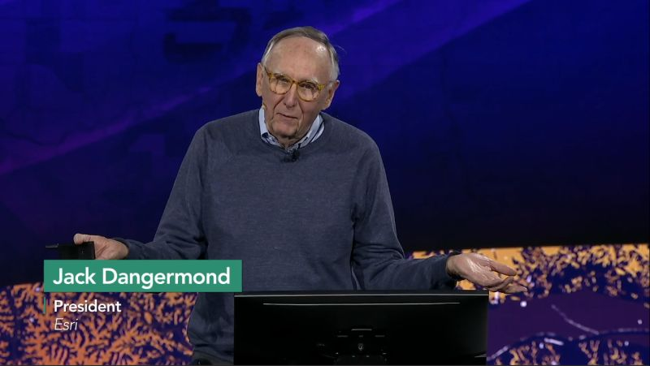
Were you unable to attend Esri's IMGIS conference this year, but still want to access some of the content? Or maybe you aren't familiar with IMGIS or whether it would interest you next year? The entire plenary from the conference is freely and publicly available on Esri's video site: https://lnkd.in/gQszEKcf For those of you that attended in-person or digitally you can use the detailed agenda page (https://lnkd.in/gzXgGmRR) to search for sessions that have recordings available now, or available later.
https://www.linkedin.com/posts/robert-krisher-5a989438_were-you-unable-to-attend-esris-imgis-conference-activity-7257390769508921345-ZNYY?utm_source=share&utm_medium=member_desktop&rcm=ACoAAAMQtAUB5UouXqdBJgo_gWpNVZ7Imay_2Tg

Slide 26
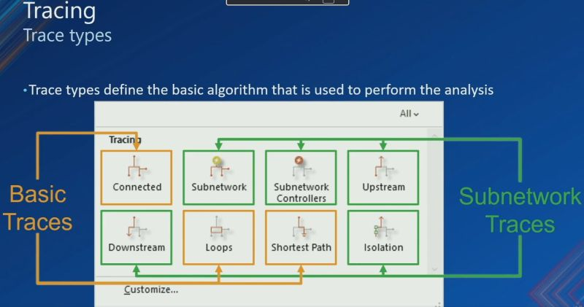
Every year at the Esri User Conference there are a pair of technical sessions to introduce new users to the core concepts of the utility network. If you've never attended these sessions, or you're looking for a refresher, you can now access them publicly on the ArcGIS Utility Network video channel! Introduction: https://lnkd.in/gzThaQgJ Advanced Network Management: https://lnkd.in/gvwkDukD Remember that these sessions are targeted at the user conference audience. If you want something even more technical, check out some of the videos in the Developer's Summit playlist, or better yet register to attend next year! Developer's Summit playlist: https://lnkd.in/esinW-aY
https://www.linkedin.com/posts/robert-krisher-5a989438_every-year-at-the-esri-user-conference-there-activity-7258865712750878720-MygI?utm_source=share&utm_medium=member_desktop&rcm=ACoAAAMQtAUB5UouXqdBJgo_gWpNVZ7Imay_2Tg

Slide 27

Are you interested in trying out the new Utility Network migration tools? We're looking for some more customers or partners to join our early adopter community (https://lnkd.in/gaqdfNys) and give us feedback on these tools.
Link: https://www.linkedin.com/posts/robert-krisher-5a989438_utility-network-builder-activity-7287914312424136704-rlee?utm_source=share&utm_medium=member_desktop&rcm=ACoAAAMQtAUB5UouXqdBJgo_gWpNVZ7Imay_2Tg

Slide 28

Have you been able to try out the new Migration toolset yet? Do you want to know how the tool turns a geometric network into a utility network? Check out the Building Your Utility Network article we just released on the ArcGIS Blog site. https://lnkd.in/gAWa6GJF
https://www.linkedin.com/posts/robert-krisher-5a989438_building-your-utility-network-activity-7302342204067323904-XQiY?utm_source=share&utm_medium=member_desktop&rcm=ACoAAAMQtAUB5UouXqdBJgo_gWpNVZ7Imay_2Tg

Slide 29
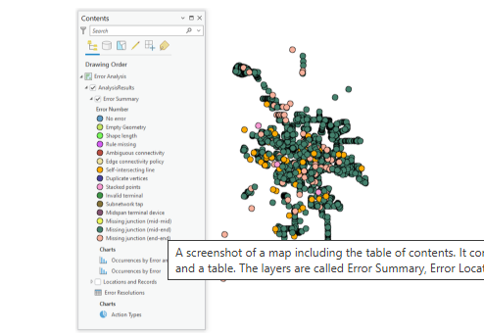
The Migration toolset is about more than migrating data to a utility network, it also includes a robust set of tools to identify and provide automated resolutions to the most common types of data quality issues! You can learn about this process in the new Analyzing Topology Errors article I posted on the ArcGIS Blog. https://lnkd.in/gscvc7RT
Link: https://www.linkedin.com/posts/robert-krisher-5a989438_analyzing-topology-errors-activity-7302689030012379136-Fxem?utm_source=share&utm_medium=member_desktop&rcm=ACoAAAMQtAUB5UouXqdBJgo_gWpNVZ7Imay_2Tg

Slide 30
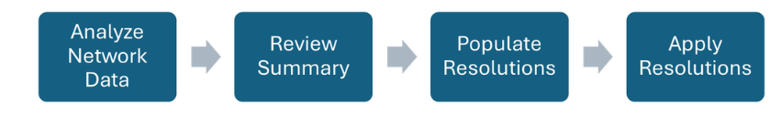
Do you want to learn how to AUTOMATE correcting the top 6 topology errors that account for 95% of topology errors in a utility network? If you said no, I don't believe you. Read the new Resolving Topology Errors article that was just posted on the Esri Community site for a deep-dive on how to use the Migration toolset to fix your data! https://lnkd.in/gThHVgXz This article is a great companion piece to the article I published yesterday that showed you how to incorporate the Analyze Network Data and Apply Error Resolutions table into a quality assurance and quality control process for a data migration. https://lnkd.in/gThHVgXz
Link: https://www.linkedin.com/posts/robert-krisher-5a989438_resolving-topology-errors-activity-7303072140881272832-5N4k?utm_source=share&utm_medium=member_desktop&rcm=ACoAAAMQtAUB5UouXqdBJgo_gWpNVZ7Imay_2Tg

Slide 31
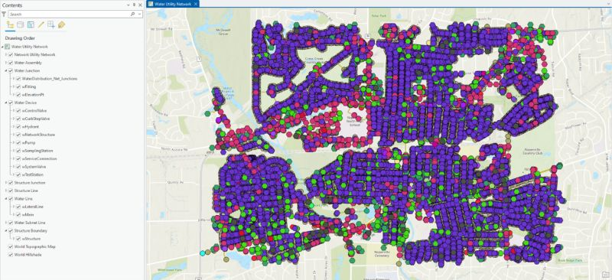
If you're looking for an easy way to find all the articles related to the new Migration toolset, check out this community article I just created. It contains links to all the articles I've published and also includes instructions on how you can access the latest version of the tools. If you subscribe to that page, you will also get notified whenever we add a new article or make an update to the tools. https://ow.ly/Poaz30sKzQm
Link: https://www.linkedin.com/posts/robert-krisher-5a989438_if-youre-looking-for-an-easy-way-to-find-activity-7303778995647455233-UHOA?utm_source=share&utm_medium=member_desktop&rcm=ACoAAAMQtAUB5UouXqdBJgo_gWpNVZ7Imay_2Tg

Slide 32
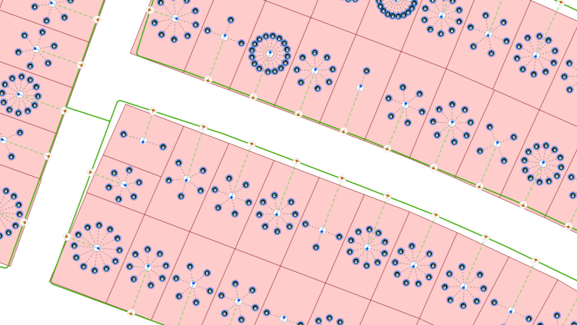
In this article, I share some experiences with using Calculation Attribute Rules in #ArcGIS and the #UtilityNetwork to create customer connections.
Link: https://www.linkedin.com/posts/xanderbakker_arcgis-utilitynetwork-ugcPost-7328536476671971328-BcjR?utm_source=share&utm_medium=member_desktop&rcm=ACoAAAMQtAUB5UouXqdBJgo_gWpNVZ7Imay_2Tg

Slide 33
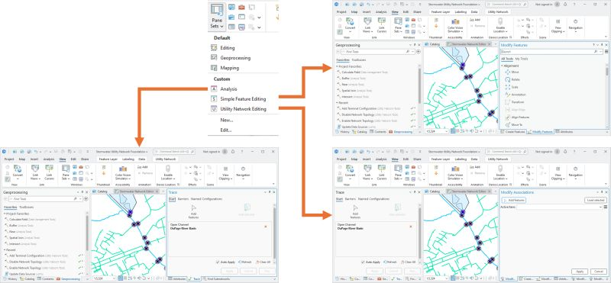
Do you spend a lot of time opening/closing tools in ArcGIS Pro to perform different tasks? If so, you should check out custom pane sets in ArcGIS Pro 3.5! This new feature lets you save which panes you have open at a given time to different named 'pane sets' that you can quickly toggle between. Like many of you, I wear "different hats" at my job. One minute I may be knee-deep in spatial analysis, and the next I may be editing, doing quality assurance, or creating map books. Custom pane sets allow ArcGIS Pro to remember which tools/panes you use for each of these workflows so you can quickly switch back and forth between them. This feature has a dedicated section in the release notes: https://lnkd.in/g-nVkN5P You can read the full release notes for ArcGIS Pro 3.5 here: https://lnkd.in/gAvj3QK7
Link: https://www.linkedin.com/posts/robert-krisher-5a989438_do-you-spend-a-lot-of-time-openingclosing-share-7328763602952224770-yldg?utm_source=share&utm_medium=member_desktop&rcm=ACoAAAMQtAUB5UouXqdBJgo_gWpNVZ7Imay_2Tg

Slide 34
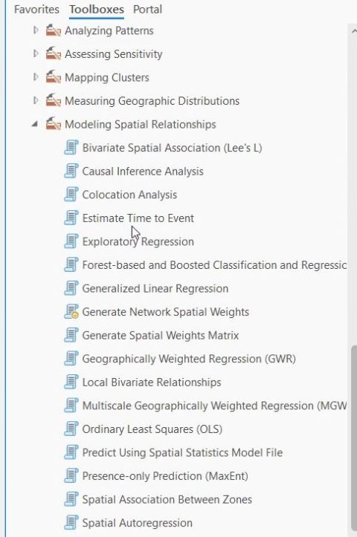
ESRI have outdone themselves. ArcPro 3.5 has an estimate time to event tool. Perfect for inputting asset management data such as age, material, condition rating and performance. A risk metric such as likelihood may be used. The output that is added to the map is time units until the event reaches probability percentage. Local government have the ability to make high level decisions without a full engineering analysis, or are be able to integrate the data into other spatial analysis. #GIS
Linl: https://www.linkedin.com/posts/marc-galle-747a361a2_gis-share-7328955563982118913-YdrS?utm_source=share&utm_medium=member_desktop&rcm=ACoAAAMQtAUB5UouXqdBJgo_gWpNVZ7Imay_2Tg

Slide 35
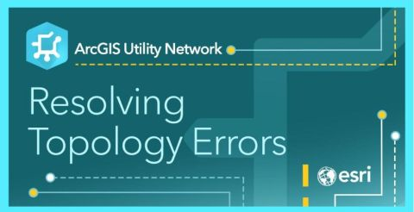
One of the challenges that many customers have been very open about with the utility network is that to get the most out of it, you need to do a lot of data cleanup. To help with this ArcGIS Pro now includes automated data cleanup tools to assist customers who are migrating data to the utility network. Learn more about how to use these tools by reading the following articles: Analyzing network data: https://ow.ly/cgme50W5SAa Resolving topology errors: https://ow.ly/b9Qf50W5SAb I have had hundreds, if not thousands, of conversations with customers about the importance of data quality at an organization, and how the utility network helps fix problems they’ve likely been struggling with for decades but haven’t known about. Poor data quality is a cost multiplier on every decision your organization makes, and it directly impacts your ability to create planning models, do staking/construction design, perform analysis, and even secure permits. These costs may be hidden because you hire third parties to do the work for you. But that just means you’re paying them to clean up your data every time you work with them. By implementing the utility network and cleaning up your data (any maybe even standardizing your model) you’ll have improved decision-making capabilities directly related to your improved data quality. Maybe this means you can go back to your vendors and renegotiate how much they are charging to create your planning models? Maybe your data is good enough you can start creating the models in-house?
Link: https://www.linkedin.com/posts/robert-krisher-5a989438_one-of-the-challenges-that-many-customers-share-7337101267812478976-QYBy?utm_source=share&utm_medium=member_desktop&rcm=ACoAAAMQtAUB5UouXqdBJgo_gWpNVZ7Imay_2Tg

Slide 36

Do you want to learn more about the new, simpler way of implementing the utility network? This article shows you the magic of how the Migrate To Utility Network tool migrates any geodatabase to a utility network! https://ow.ly/Xlrz50W3kha
Link: https://www.linkedin.com/posts/chasefishergis_do-you-want-to-learn-more-about-the-new-share-7338202073848520704-l3WA?utm_source=share&utm_medium=member_desktop&rcm=ACoAAAMQtAUB5UouXqdBJgo_gWpNVZ7Imay_2Tg

Slide 37
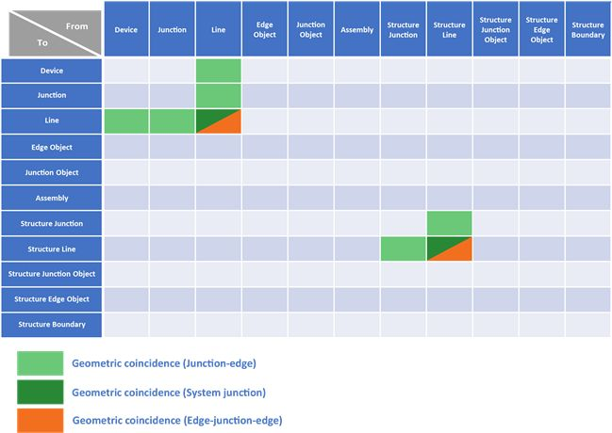
Coincidence Features ESRI UN
Link: https://www.linkedin.com/posts/gowri-srinivas-guthikonda_un-esri-share-7334150950128885760-fBEP?utm_source=share&utm_medium=member_desktop&rcm=ACoAAAMQtAUB5UouXqdBJgo_gWpNVZ7Imay_2Tg

Slide 38
Voice Controlled Data Collection... Utilizing ESRI’s QuickCapture app and, voice controls in Apple IOS 13. Here's a link to a blog with more info - https://lnkd.in/d7dkH4w Here is a link to it being used with Google. https://lnkd.in/d7rWxtt #datacollection #apple #voice #google #ios13 #arcgis #esri #geospatial #QuickCapture #scienceofwhere #gis Rob Hathcock Matthew Hoehn Marcus Kitchens Video By Earl McDowell,
https://www.linkedin.com/posts/chasefishergis_datacollection-apple-voice-ugcPost-6608419571496038400-jzZz?utm_source=share&utm_medium=member_desktop&rcm=ACoAAAMQtAUB5UouXqdBJgo_gWpNVZ7Imay_2Tg

Slide 39
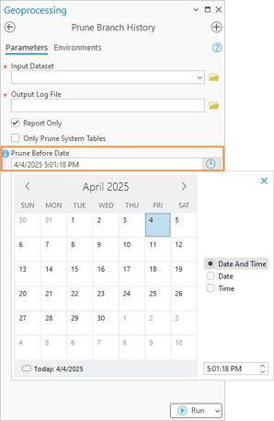
I’ve been waiting a long time for the Prune Branch History tool to be released, and it’s finally here in ArcGIS Pro 3.5! This isn’t a tool that most customers will ever need to run, and those who do likely won’t need to run it often. But for those asking for a tool like this, just in case, it is here. Before running the tool, you need to read the help topic that talks about branch history and why you may or may not want to prune history here, and what you stand to gain and lose: https://lnkd.in/gmY8eRaK You will also need to learn about the concept of referenced moments here: https://lnkd.in/g9hgmKGx You can find the documentation for the tool here: https://lnkd.in/gES_VQ9y This tool is highlighted in the ArcGIS Pro release notes: https://lnkd.in/ghZ6WAtx You can read the full release notes for ArcGIS Pro 3.5 here: https://lnkd.in/gAvj3QK7
https://www.linkedin.com/posts/robert-krisher-5a989438_ive-been-waiting-a-long-time-for-the-prune-share-7332386424878514177-OZ_q?utm_source=share&utm_medium=member_desktop&rcm=ACoAAAMQtAUB5UouXqdBJgo_gWpNVZ7Imay_2Tg

Slide 40
I had several discussions with customers last week who were seeking ways to push the limits of analysis in their utility networks. Thinking along those lines, we published a developer's sample that includes 16 different examples of ways you can extend your utility network through batch tracing. You can find the Batch Tracing CoreHost developer's sample here: https://lnkd.in/gyH3ue5r Most of the use cases included with the tool are based on discussions with customers and partners who sought to solve a problem with their utility network. This includes examples of risk management, exporting customer connectivity, and even doing quality assurance on pressure zones. The tool includes 16 sample configurations for 16 different use cases that were each built and tested against utility network foundations.
Link: https://www.linkedin.com/posts/robert-krisher-5a989438_i-had-several-discussions-with-customers-activity-7376246666317914112-vJpP?utm_source=share&utm_medium=member_desktop&rcm=ACoAAAMQtAUB5UouXqdBJgo_gWpNVZ7Imay_2Tg

Slide 41

Durante a Esri User Conference 2025, tivemos o prazer de reencontrar nossos parceiros da HERE Technologies e Near Location, uma parceria sólida que se fortalece a cada projeto e conversa. Ao longo do evento, estivemos juntos em diversas trocas estratégicas, compartilhando ideias, desafios e visões sobre o futuro da inteligência geoespacial. Essa proximidade é essencial para que possamos continuar entregando soluções para clientes no mundo inteiro. Um dos destaques foi o lançamento do novo produto da HERE: o GIS Data Suite, pensado especialmente para usuários do ArcGIS Pro. A novidade oferece acesso a dados com conteúdo premium, em formato file geodatabase, com quatro atualizações por ano, uma solução prática, atualizada e com alto valor agregado para análises espaciais. A Zukk tem orgulho de contar com parceiros que, como nós, acreditam no poder dos dados de localização para transformar operações, territórios e decisões
Link:https://www.linkedin.com/posts/zukk-esri-here-ugcPost-7352040960144330752-uCIp?utm_source=share&utm_medium=member_desktop&rcm=ACoAAAMQtAUB5UouXqdBJgo_gWpNVZ7Imay_2Tg

Slide 42
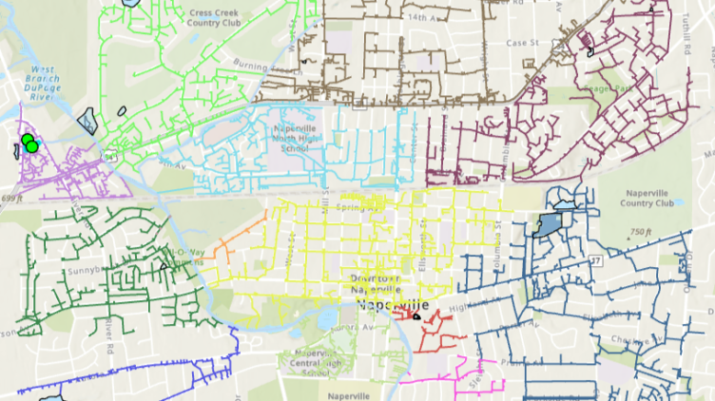
The article highlights the advanced capabilities of the ArcGIS Utility Network, particularly its ability to model real-world infrastructure and perform sophisticated tracing to support utility operations like FOG management and overflow prevention. With recent updates in ArcGIS Pro 3.3 and Utility Network version 7, users can now trace using digitized flow direction—enhancing accuracy and simplifying complex configurations.
https://www.linkedin.com/posts/avtar-singh-36a7571b_the-article-highlights-the-advanced-capabilities-ugcPost-7355135574476775424-EvUx?utm_source=share&utm_medium=member_desktop&rcm=ACoAAAMQtAUB5UouXqdBJgo_gWpNVZ7Imay_2Tg

Slide 43
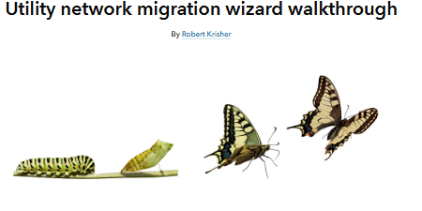
The topic of utility network data migration has been a big part of many conversations I've had this year with customers looking to move off ArcMap. While we've released numerous articles and videos on the topic, I'm excited to announce that we've finally released the first set of tutorials on the Migration toolset, covering everything you need to know to get started! Learn how to use the Utility Network Migration Wizard (https://lnkd.in/g33QD6Fs) Learn how to analyze and resolve topology errors (https://lnkd.in/gh2jb9-J) If you follow the instructions in both tutorials with your data, you'll end up creating a prototype utility network and identifying all the critical data quality issues that need to be addressed.
Link: https://www.linkedin.com/posts/robert-krisher-5a989438_utility-network-migration-wizard-walkthrough-activity-7358154194144415744-3PWJ?utm_source=share&utm_medium=member_desktop&rcm=ACoAAAMQtAUB5UouXqdBJgo_gWpNVZ7Imay_2Tg

Slide 44
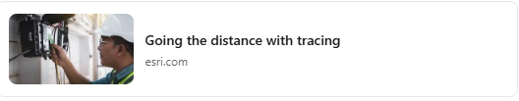
Check out the new article we just posted that shows how you can use functions when tracing a utility network to both calculate values and control your results: https://lnkd.in/gRpmhKZP . The use case at the heart of the article is using an OTDR (Optical Time-Domain Reflectometer) to locate a fault in a fiber network, but the concepts apply to all industries (electrical pipes, clogged pipes, leaks).
Link: https://www.linkedin.com/posts/robert-krisher-5a989438_going-the-distance-with-tracing-activity-7370815427201073152-HLOv?utm_source=share&utm_medium=member_desktop&rcm=ACoAAAMQtAUB5UouXqdBJgo_gWpNVZ7Imay_2Tg

Slide 45
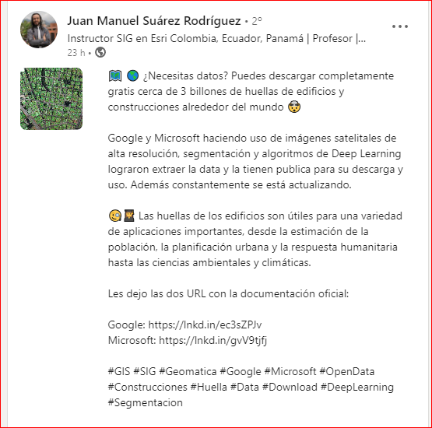
https://sites.research.google/open-buildings/
https://sites.research.google/open-buildings/#dataformat
Material bem ruim, so serve em padrão americano (telhado vermelho, jardim entorno)
Precisa estudar como usar o download
https://github.com/microsoft/GlobalMLBuildingFootprints

Slide 46
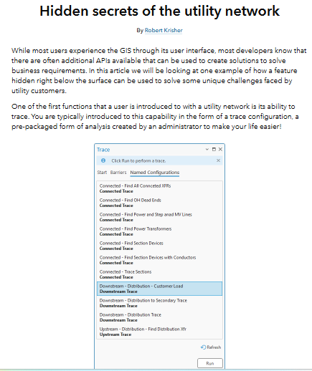
After having quite a few discussions around the techniques that our customers are using to model proposed construction across the entire design, construction, and commissioning process, I decided to publish an article that deep dives exactly how you can configure this: https://lnkd.in/gRQ2gr5e. I had previously outlined this approach in an article from 2022 (one of the first articles I ever published at Esri), but that article was focused on the data modeling requirements.
Link: https://www.linkedin.com/posts/robert-krisher-5a989438_hidden-secrets-of-the-utility-network-activity-7425536091555934208-lEQh?utm_source=share&utm_medium=member_desktop&rcm=ACoAAAMQtAUB5UouXqdBJgo_gWpNVZ7Imay_2Tg

Slide 47
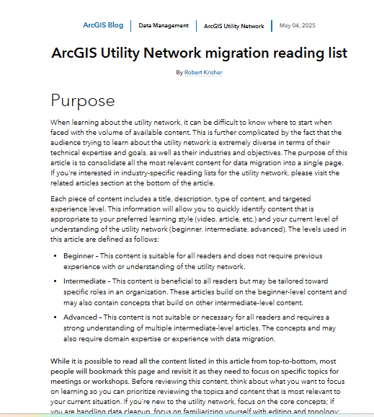
We put all our ArcGIS Utility Network data migration learning materials into one list. Start from the beginning, or jump into a learning resource for where you currently are in your migration journey. Apply these lessons to your industry-specific workflows. Check out the reading list on ArcGIS Blog ⬇️: https://ow.ly/hy4k50Xgc3Q hashtag#ArcGIS hashtag#Utilities hashtag#Telecom hashtag#ArcGISUtilityNetwork hashtag#UtilityNetwork hashtag#DataMigration
Link:https://www.linkedin.com/posts/kerrirasmussen_arcgis-utility-network-migration-reading-activity-7389649826289831936-jDHQ?utm_source=share&utm_medium=member_desktop&rcm=ACoAAAMQtAUB5UouXqdBJgo_gWpNVZ7Imay_2Tg

Slide 48

The discussion of engineering analysis and network information management systems is closely intertwined. This article, which Tom DeWitte and Tom Coolidge just published, lays out some of the best practices for integrating the two systems. This article highlights a product from one of our business partners in the Gas and Pipeline industry, but you can find examples of this best practice from many of the systems that leverage utility network data for analysis.
Link: https://www.linkedin.com/posts/robert-krisher-5a989438_the-discussion-of-engineering-analysis-and-activity-7426649373217857536-UjD1?utm_source=share&utm_medium=member_desktop&rcm=ACoAAAMQtAUB5UouXqdBJgo_gWpNVZ7Imay_2Tg

Slide 49
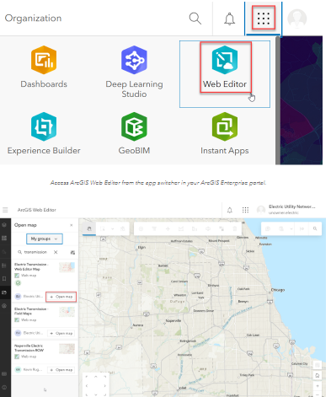
Neste artigo, a ESRI apresenta como o ArcGIS Web Editor permite editar a Utility Network diretamente no navegador, mantendo regras, integridade e governança do modelo de rede. Isso significa mais agilidade na atualização de ativos, menos dependência de ferramentas desktop e maior integração entre campo e escritório.
Link: https://www.linkedin.com/posts/matheus-sparapani-336927138_edit-a-utility-network-with-arcgis-web-editor-activity-7432107069102735361-GB_3?utm_source=share&utm_medium=member_desktop&rcm=ACoAAAMQtAUB5UouXqdBJgo_gWpNVZ7Imay_2Tg

Slide 50
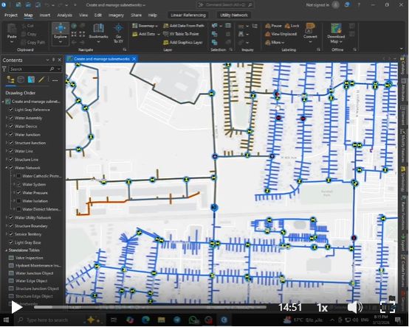
- 𝐂𝐫𝐞𝐚𝐭𝐞 𝐚𝐧𝐝 𝐌𝐚𝐧𝐚𝐠𝐞 𝐒𝐮𝐛𝐧𝐞𝐭𝐰𝐨𝐫𝐤𝐬 𝐢𝐧 𝐔𝐭𝐢𝐥𝐢𝐭𝐲 𝐍𝐞𝐭𝐰𝐨𝐫𝐤𝐬 𝐔𝐬𝐢𝐧𝐠 𝐀𝐫𝐜𝐆𝐈𝐒 𝐏𝐫𝐨 🌐⚡ * As part of my continuous Journey to develop advanced skills in Utility GIS and Infrastructure Network Management, - I recently Completed a new hands-on Project titled: "Create and Manage Subnetworks in Utility Networks" - Project Overview: • The main Goal of this Project was to understand how Utility Networks are organized into Subnetworks to manage complex infrastructure systems efficiently. • By defining Subnetwork Controllers, creating Subnetworks, and updating network topology, the workflow helps maintain proper connectivity and operational structure within Utility Networks. - Key Benefits: • Organizing large Utility Networks into manageable Subnetworks. • Improving Network Visibility and Structure for better Infrastructure Management. • Supporting Engineers and Utility teams with clearer network segmentation. • Maintaining network integrity and ensuring accurate connectivity across the system. - Why This Matters: * Subnetworks play a critical role in managing Utility infrastructure and ensuring efficient network operations. - Subnetworks are essential for: • Distribution Network Management. • Utility Infrastructure Monitoring. • Network Connectivity and Flow Management. • Operational Analysis and Maintenance. • Supporting Smart Grid and Modern Utility Systems. - This Project highlights how GIS-based Utility Network modeling can significantly improve infrastructure management and operational efficiency. * Special Thanks to Engineer/Robert Krisher for Providing the Original Tutorial 👏🏼– you can explore it here: ⬇️ https://lnkd.in/dpdHzY8x * Special Thanks to Engineer/Sherif Osama ElSherif for Highlighting my Integration of Utility Network with GIS and for the great guidance 👏🏼 https://lnkd.in/gBdXbB8J • I look forward to continuing this learning series with the next tutorials on Editing, Validating, and Performing Quality Assurance on Subnetworks 🔜 * Finally, I'd be happy to connect with professionals working in Utility Networks and GIS-based Infrastructure Management 🥰
Link: https://www.linkedin.com/posts/mohamed-khalied_gisabrmohamedabrkhaled-gis-arcgispro-activity-7438291932352507904-tNNB?utm_source=share&utm_medium=member_desktop&rcm=ACoAAAMQtAUB5UouXqdBJgo_gWpNVZ7Imay_2Tg

Slide 51
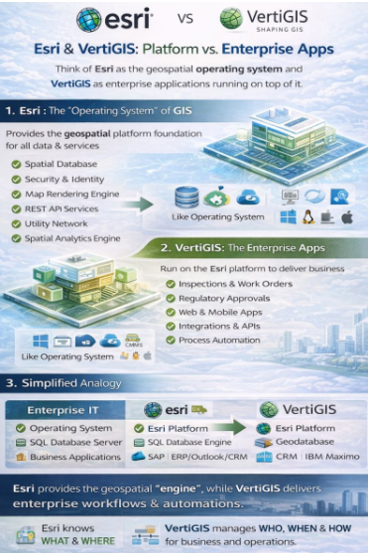
Link: https://www.linkedin.com/posts/gowri-srinivas-guthikonda_activity-7429481323905548288-V8NB?utm_source=share&utm_medium=member_desktop&rcm=ACoAAAMQtAUB5UouXqdBJgo_gWpNVZ7Imay_2Tg

Slide 52
Link: https://www.linkedin.com/posts/field-csi_we-often-get-asked-what-the-difference-is-activity-7437870992259100672-j_Ft?utm_source=share&utm_medium=member_desktop&rcm=ACoAAAMQtAUB5UouXqdBJgo_gWpNVZ7Imay_2Tg
We often get asked what the difference is between GE Vernova Smallworld and ESRI. My typical response has been: ESRI makes great maps; Smallworld builds great networks. I sometimes compare it to operating systems: ESRI is like Windows—great presentation and widely used. Smallworld is more like UNIX—built from the ground up for reliability, scalability, and handling complex systems. Recently, I realized there’s an even more fundamental difference in how the two platforms are designed. ESRI’s model is essentially: * Geometry → Attribution → Topology Smallworld’s model is: * Topology → Geometry → Attribution That ordering matters more than it might seem. When topology comes first, the network itself is the primary object. Connectivity, tracing, and system behavior are native to the model. Geometry is simply how that network is visualized. When geometry comes first, the map is the primary object, and the network has to be derived from it. For industries like electric, telecom, gas, and water—where the network is the business—that design choice has long-term consequences for scalability, performance, and model stability. It also helps explain why Smallworld’s network capabilities have scaled for decades without needing fundamental re-architecture.

Slide 53

Modernization during Utility Network migrations is coming up a lot lately, and it makes sense! When teams move to the UN, they’re already deep in the system: data models, integrations, infrastructure, governance. It’s a natural moment to ask whether the foundation underneath everything still makes sense, and a practical time to modernize. Worth thinking about if your organization is heading down the UN path. https://lnkd.in/g_sCZHRB
Link: https://www.linkedin.com/posts/elizabethgaines_the-case-for-pairing-un-migrations-with-cloud-based-activity-7435013715407552513-RNGU?utm_source=share&utm_medium=member_desktop&rcm=ACoAAAMQtAUB5UouXqdBJgo_gWpNVZ7Imay_2Tg

Slide 54
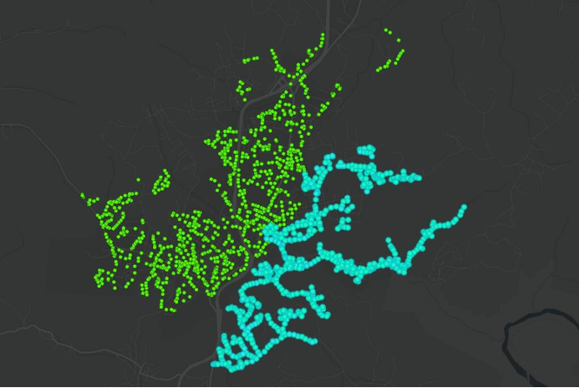
The City of Oak Hill in West Virginia successfully rehabilitated and accurately mapped over 630 rural manholes using ArcGIS and high-accuracy GNSS technology. They replaces unreliable legacy data and improved system management, operational efficiency, and infrastructure integrity while reducing inflow and infiltration issues. Learn more about their achievement in this Industry Blog
Link: https://www.linkedin.com/posts/crstacampbell_from-hard-to-find-to-hard-to-miss-mapping-activity-7437482933180903424-7jz7?utm_source=share&utm_medium=member_desktop&rcm=ACoAAAMQtAUB5UouXqdBJgo_gWpNVZ7Imay_2Tg

Slide 55
PARTE 1
A transição para a Utility Network é um marco para empresas de saneamento, energia e gás. Para facilitar essa jornada, o Utility Network Migration Wizard (parte das ArcGIS Solutions) automatiza a configuração do esquema e a carga de dados. Veja como utilizar esta ferramenta estrategicamente: 1. Preparação do Ambiente Antes de abrir o assistente, você deve ter o ArcGIS Pro com a extensão de Utility Network ativa e o pacote de soluções específico do seu setor (ex: Water Distribution Utility Network) instalado. 2. Configurando o Stage Utility Network O primeiro passo do Wizard é criar a estrutura "vazia". O que ele faz: Cria o File Geodatabase ou Enterprise Geodatabase, habilita a estrutura da UN e define as regras de topologia básicas. Dica: Certifique-se de que o sistema de coordenadas está correto logo no início, pois a UN é extremamente sensível a precisão espacial.
3. Mapeamento de Atributos (Field Mapping) Esta é a etapa mais crítica. O Wizard permite correlacionar os campos da sua base antiga (Legacy Data) com as novas classes da UN. Asset Group e Asset Type: Diferente do modelo antigo, a UN organiza tudo por categorias e tipos. Você usará o Wizard para definir quais valores de "tipo de cano" ou "voltagem" se tornam subtipos oficiais. Justificativa: Isso garante que a integridade dos dados históricos seja mantida na nova arquitetura. 4. Aplicação do Data Loading Workspace O Wizard utiliza o Data Loading Tools (Python-based) por baixo do capô. Você define a origem dos dados e o destino. O assistente gera um arquivo de mapeamento (geralmente em Excel ou JSON) onde você pode revisar as regras antes de executar a carga definitiva. 5. Validação e Limpeza Após a carga, o Wizard ajuda a identificar as Dirty Areas (áreas sujas). Validação de Topologia: A UN não aceita conectividade inválida. O assistente listará erros onde as regras de associação (como uma bomba conectada diretamente a um hidrante sem válvula intermediária) foram violadas.

Slide 56
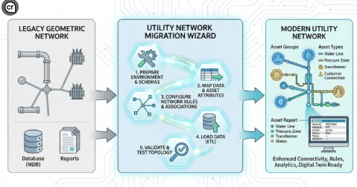
PARTE 2
Para empresas com redes complexas, o uso do assistente reduz o erro humano em até 60% comparado à migração manual via scripts Python puros. Ele garante que as regras de rede (Network Rules) sejam aplicadas uniformemente desde o primeiro dia. Dica Pro: Sempre execute um projeto piloto em uma pequena área geográfica antes de rodar o Wizard em todo o banco de dados da empresa! Explicando a figura: O "Utility Network Migration Wizard" é como o núcleo do processo, com os cinco passos críticos que mencionei anteriormente (Preparação, Mapeamento, Regras, Carga e Validação).
Link:https://www.linkedin.com/posts/cyntia-virolli_gis-utilitynetwork-arcgispro-activity-7435319032330919937-mcVa?utm_source=share&utm_medium=member_desktop&rcm=ACoAAAMQtAUB5UouXqdBJgo_gWpNVZ7Imay_2Tg

Slide 57
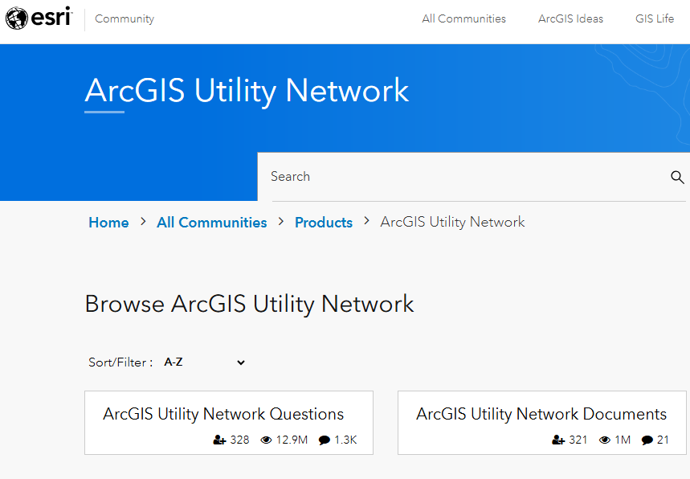
We are 1 week away from the Esri Developer and Technology Summit in Palm Springs. If you are interested in Utility Network related content, check out this custom agenda that the team put together: https://lnkd.in/grCgQmXu I will be doing a presentation with Xu Teng about extracting network data from a utility network for analysis. I will also be doing a demo theatre where I show off some of the newly released (and upcoming!) community samples we have for the utility network. I will be spending the rest of my time at the ArcGIS Utility Network booth in the "Technology Zone" answering YOUR questions! If you're going to be there, I hope we can catch up! If not, there's always the Esri Community site: https://lnkd.in/g-3TFtYH
Link: https://www.linkedin.com/posts/robert-krisher-5a989438_arcgis-utility-network-activity-7434618638533529602-Z9Ko?utm_source=share&utm_medium=member_desktop&rcm=ACoAAAMQtAUB5UouXqdBJgo_gWpNVZ7Imay_2Tg

Slide 58
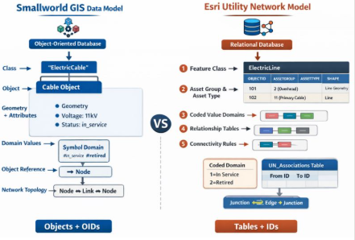
Link: https://www.linkedin.com/posts/gowri-srinivas-guthikonda_activity-7433022996841390080-wswV?utm_source=share&utm_medium=member_desktop&rcm=ACoAAAMQtAUB5UouXqdBJgo_gWpNVZ7Imay_2Tg

Slide 59
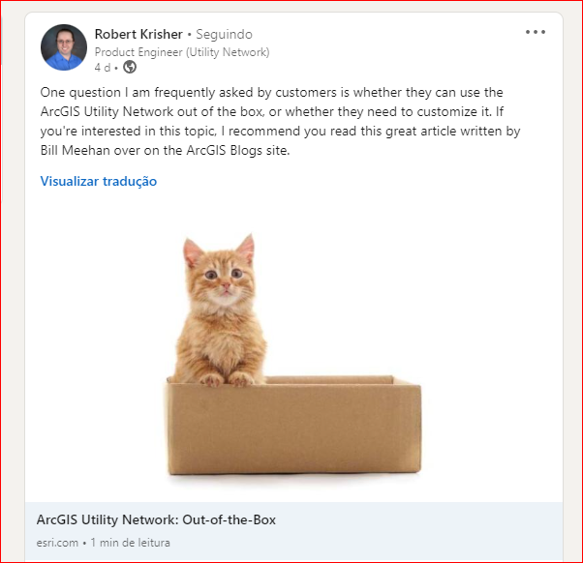
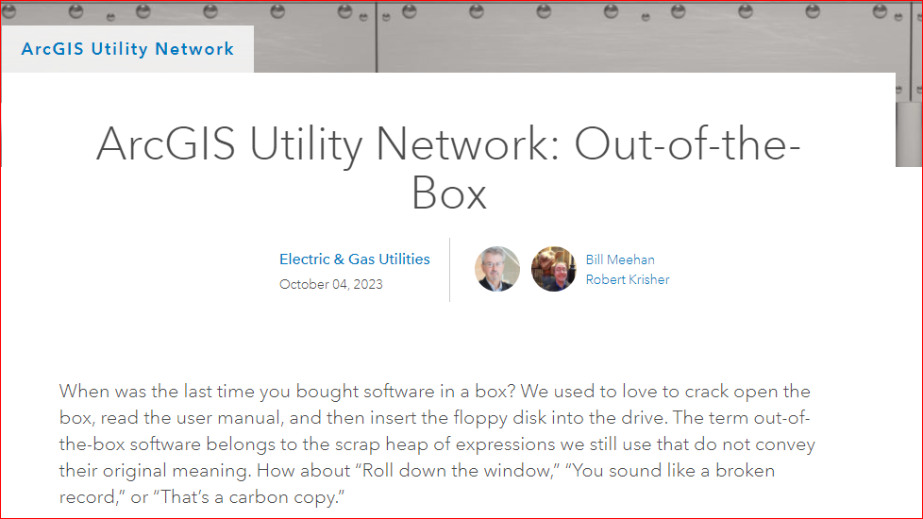
Por que o esri UN ? Posso fazer eu mesmo ?
https://www.esri.com/arcgis-blog/products/utility-network/electric-gas/arcgis-utility-network-out-of-the-box/

Slide 60
GIS

Slide 61

Você sabia que pode criar seu WebGIS e compartilhar seus projetos GIS Desktop pela Internet tornando-os acessíveis a outros usuários sem digitar uma única linha de código? Se sua resposta for não, neste post, vamos compartilhar 5 ferramentas de código aberto que permitirão que você transforme seus projetos QGIS (localmente), mesmo se você não for um profissional de programação, veja: 👉 Qgis2Web: extensão do QGIS que permite criar um mapa web a partir de um projeto QGIS. O resultado da exportação desse projeto está na forma de um conjunto de arquivos html, css e javascript que você pode publicar na internet (página do GitHub, por exemplo). Você levará apenas alguns minutos para publicar; 👉 Lizmap: Solução completa para publicação de um WebGIS a partir de um projeto QGIS. Desenvolvido pela empresa 3liz, sua instalação, configuração e utilização requerem um certo número de pré-requisitos, incluindo administração de servidor por ser baseado em QGIS Server e Apache; 👉 QGIS Cloud: Uma plataforma baseada na nuvem projetada para hospedar e compartilhar projetos GIS criados com QGIS. Esses projetos podem ser visualizados diretamente online através de um navegador web e podem ser sincronizados com sua versão desktop em caso de modificações. A hospedagem é gratuita para pequenos projetos, mas pode ser paga para projetos de grande escala. Para se beneficiar dele, você precisa criar uma conta, instalar o plugin QGIS Cloud; 👉 MapStore: plataforma open source desenvolvida pela Geosolutions destinada à criação, publicação e gestão de aplicações cartográficas web, dashboards, geostories. Pode ser usado em conjunto com o Geoserver; 👉 GeoNode: É um sistema de gerenciamento de conteúdo (CMS) geoespacial desenvolvido pela mesma empresa Geosolutions, uma plataforma de gerenciamento e publicação de dados geoespaciais que permite a usuários não especializados compartilhar dados e criar mapas interativos. Também pode ser usado em um projeto Django para quem deseja integrar componentes de mapas prontos para uso.
https://www.linkedin.com/feed/update/urn:li:activity:7178115154906144770?utm_source=share&utm_medium=member_desktop&rcm=ACoAAAMQtAUB5UouXqdBJgo_gWpNVZ7Imay_2Tg

Slide 62
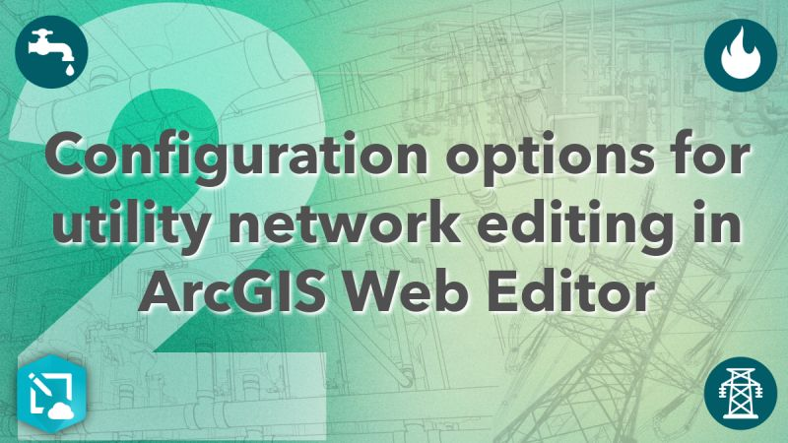
Ready to enable web-based utility network editing? This blog walks you through how to configure hashtag#ArcGISWebEditor to edit your utility network. Read the blog ➡️ https://lnkd.in/gq3YPSmu
https://www.linkedin.com/posts/arcgis-enterprise_arcgiswebeditor-activity-7452023278539411456-RrOc?utm_source=share&utm_medium=member_desktop&rcm=ACoAAAMQtAUB5UouXqdBJgo_gWpNVZ7Imay_2Tg

Slide 63
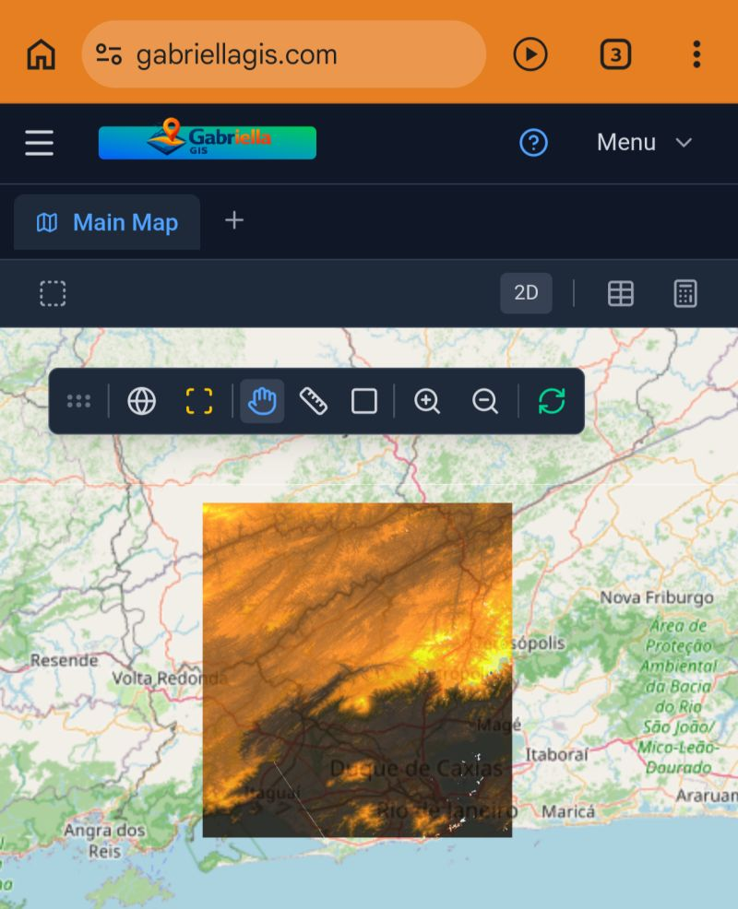
Alguns profissionais têm entrado em contato comigo porque não acreditam que o Gabriella GIS: seja completamente gratuito; não exija instalação; possa ser utilizado diretamente em um smartphone; permita editar camadas georreferenciadas (SHP, KML, GeoJSON, CSV); possibilite a edição de tabelas de atributos; trabalhe com arquivos raster; realize análises de dados DEM em 3D; execute análises geoespaciais (buffer, dissolve, difference, entre outras); exporte mapas em PDF; preserve o sigilo dos dados (por ser totalmente client-side). E eu entendo perfeitamente esse ceticismo — eu mesmo não acreditava que isso seria possível. Durante o desenvolvimento, pensei várias vezes que uma aplicação rodando no navegador não daria conta: que iria travar, não renderizar corretamente ou não suportar operações mais pesadas. Mas aqui estamos — e hoje já utilizo o Gabriella GIS em projetos reais, com resultados consistentes. O projeto evolui um pouco todos os dias. Ainda há muito a desenvolver, muitas funcionalidades a construir e melhorias a implementar para apoiar a comunidade GIS. Meu objetivo é simples: que ele seja útil. Se o Gabriella GIS conseguir ajudar ao menos um colega — ou um estudante que não tenha acesso a um computador potente, mas que agora pode produzir seus mapas diretamente do smartphone — então já terá valido a pena. Se quiser experimentar a solução e até migrar seus projetos para o Gabriella GIS (gabriellagis.com), será um prazer enorme ouvir sua experiência.
https://www.linkedin.com/posts/activity-7451068559482425344-Pqps?utm_source=share&utm_medium=member_desktop&rcm=ACoAAAMQtAUB5UouXqdBJgo_gWpNVZ7Imay_2Tg

Slide 64

🌎 Top FREE GIS (Geographic Information System) books - Part 2 5️⃣ Google Earth Engine Applications - A special issues journal published as a free PDF covers applications of the platform - https://lnkd.in/d_XsY5QB 6️⃣ GIS for Public Safety - Rutgers offers a guide covering ArcGIS tools and procedures for public safety GIS - https://lnkd.in/dQ-mYWmJ 7️⃣ Essays on Geography And GIS Volume 2 - This two-volume of essays by industry leaders and academics has been published by Esri - https://lnkd.in/dgsRRQab https://lnkd.in/duAUAMjG 8️⃣ Beyond Mapping Articles - This resource isn’t technically a free GIS book resource but, the resource is a collection of eight articles written by Joseph K. Berry on the subject of GIS. These articles cover topics such as spatial analysis, the direction of GIS, geospatial technology, and applications of GIS techniques - https://lnkd.in/d6evYf2U 🔻 Follow me at Ankur S. for similar resources ↗️ ♻️ Share to help others learn and gain access to these courses ⬇️ Comment below if you have any questions or more resources 📌 Part 1 - https://lnkd.in/d23VEYRY
https://www.linkedin.com/posts/ankur-s-803497126_climatecareers-geospatial-climatetech-activity-7163545587416526850-8b-z?utm_source=share&utm_medium=member_desktop&rcm=ACoAAAMQtAUB5UouXqdBJgo_gWpNVZ7Imay_2Tg

Slide 65

Top GIS courses covering basics around data analysis, visualisation and mapping - Part 1 🔻 1️⃣ GIS, Mapping, and Spatial Analysis Capstone (University of Toronto) - Apply the skills learned throughout the specialization by designing and completing your own GIS project - https://lnkd.in/dus4UnhD 2️⃣ GIS Data Formats, Design and Quality (UC Davis) - This course covers data models and formats, including vector data concepts - https://lnkd.in/dCtyrdcn 3️⃣ GIS Data Acquisition and Map Design (University of Toronto) - Learn how to find, prepare, and evaluate GIS data, as well as cartographic principles for effective map design - https://lnkd.in/dhcKr78g 4️⃣ GIS Applications Across Industries (UC Davis) - Explore real-world GIS applications and workflows in environmental, public health, emergency response, and business domains - https://lnkd.in/dvk6mgdQ 5️⃣ Getting Started with BigQuery GIS for Data Analysts (Google Cloud) - Learn to analyze and visualize location data in BigQuery and Geo Viz through hands-on exercises in a cloud environment - https://lnkd.in/dakSU4b6 6️⃣ Geospatial Big Data Visualization with KeplerGL (Coursera) - Experiment with KeplerGL, an open-source tool for rendering massive location datasets - https://lnkd.in/dmRmmmgU 🚨 Follow me at Ankur S. for more such GIS stories, updates and resources ↗️ ♻️ Share to help others learn and gain access to these courses
https://www.linkedin.com/posts/ankur-s-803497126_climatecareers-geospatial-climatetech-activity-7188539655204589568-ANAO?utm_source=share&utm_medium=member_desktop&rcm=ACoAAAMQtAUB5UouXqdBJgo_gWpNVZ7Imay_2Tg

Slide 66
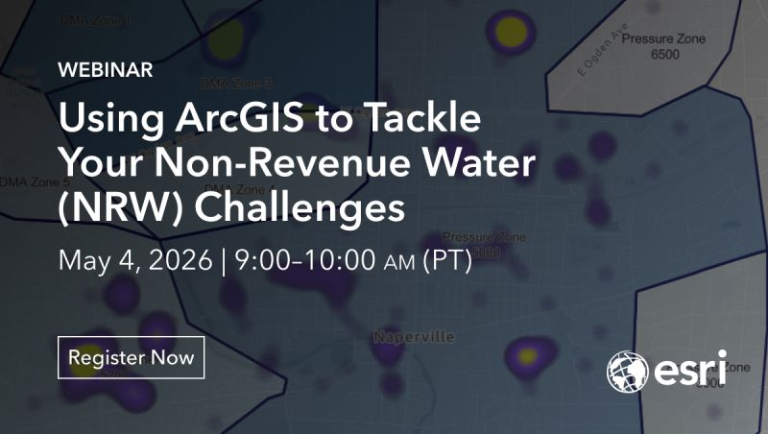
Our next hashtag#EsriWater webinar will focus on non-revenue water challenges. Register now to learn how hashtag#ArcGIS can be used to help you better understand and reduce water loss. https://ow.ly/Smzu50YJ7Z1
https://www.linkedin.com/posts/crstacampbell_esriwater-arcgis-activity-7450151455627558912-ECQq?utm_source=share&utm_medium=member_desktop&rcm=ACoAAAMQtAUB5UouXqdBJgo_gWpNVZ7Imay_2Tg

Slide 67
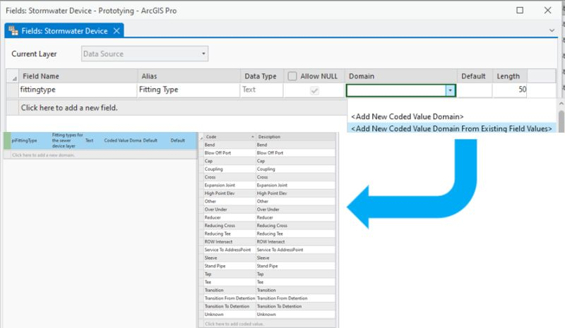
Are you trying to get your GIS cleaned up? Do you have a bunch of freeform text fields that you need to get under control? Well, I've got good news for you! ArcGIS Pro 3.3 now lets you create a new domain for a field using existing values in the table. Read more about this feature here: https://lnkd.in/g5eeRivG Domains are an important first step on the journey to getting your data cleaned up. A range domain or coded value domain will prevent users from putting unsupported values into a field. When you have a domain on the field you can also run a data reviewer check to validate that all the values in the field match the domain. Domains also make it easier to configure symbology for layers and charts because the GIS knows what values to expect in the field! You can learn more about the important of the domains, and try them out via a tutorial, by checking out the Attribute Domains page on the Geodatabase resource hub (https://lnkd.in/ggNr-5VF). Remember that if your data has subtypes you can also have different domains for each subtype. As an example, distribution, transmission, and service features all have different ranges of acceptable pressure/voltage. You can learn more about subtypes on the Subtypes page on the Geodatabase resource hub (https://lnkd.in/gpeGNmQ6).
https://www.linkedin.com/posts/robert-krisher-5a989438_are-you-trying-to-get-your-gis-cleaned-up-activity-7198670991957319680-XlBU?utm_source=share&utm_medium=member_desktop&rcm=ACoAAAMQtAUB5UouXqdBJgo_gWpNVZ7Imay_2Tg

Slide 68
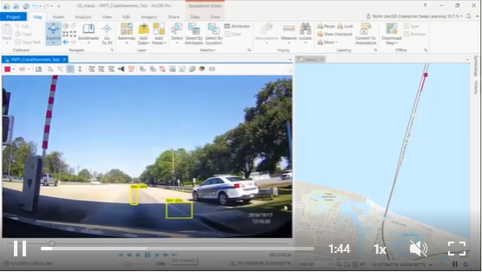
DETECTANDO RACHADURAS NO PAVIMENTO usando hashtag#ArcGIS e hashtag#deeplearning. Este agora é um caderno de exemplo! Veja https://lnkd.in/fpuadFG para ver a metodologia completa, desde o treinamento do modelo de deep learning até aplicá-lo em um vídeo e mapear as falhas! E mais? Como hashtag#ArcGISPro suporta Full Motion Video, você pode visualizar as rachaduras detectadas em um mapa! Junte-se a nós se quiser trabalhar em coisas tão legais, enquanto faz a diferença na sociedade e resolve problemas importantes! Confira o centro de P&D hashtag#esri hashtag#newdelhi em https://lnkd.in/fp_gDan e junte-se à equipe incrível que produziu esse trabalho :)
https://www.linkedin.com/posts/rohitgeo_arcgis-deeplearning-arcgispro-activity-6613841233456521217-J3L9?utm_source=share&utm_medium=member_desktop&rcm=ACoAAAMQtAUB5UouXqdBJgo_gWpNVZ7Imay_2Tg

Slide 69
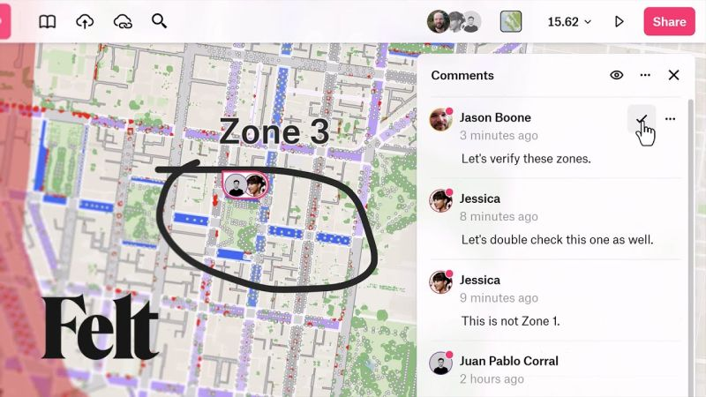
Commenting and collaborating via a map is not typically taught in most hashtag#GIS courses. You can learn how with this quick tutorial from Felt!
https://www.linkedin.com/posts/lindacstevens_gis-data-maps-activity-7181762427380715520-W-4B?utm_source=share&utm_medium=member_desktop&rcm=ACoAAAMQtAUB5UouXqdBJgo_gWpNVZ7Imay_2Tg

Slide 70

One of the new features in ArcGIS Pro 3.3 that I benefit from every day is the ability to configure shortcuts for commands on the ribbon. Previously it was a bit of a hassle to navigate all the menus required to set up a keyboard shortcut, but now it's as simple as right-clicking a command and choosing "Configure Shortcut"! I have now set up keyboard shortcuts for all my favorite editing tools so I can do almost all my editing without needing to change between tabs on the ribbon! You can read more about this new feature on the help page (https://lnkd.in/gJRmj-dP). If you come by the utility network booth at this year's Esri User Conference I can show you the keyboard shortcuts I've been using to turbo-charge my editing workflows! What keyboard shortcuts do you use most often?
https://www.linkedin.com/posts/robert-krisher-5a989438_one-of-the-new-features-in-arcgis-pro-33-activity-7197600342535020544-pqO7?utm_source=share&utm_medium=member_desktop&rcm=ACoAAAMQtAUB5UouXqdBJgo_gWpNVZ7Imay_2Tg

Slide 71

One of the new features added in ArcGIS Pro 3.3 is the ability to share a non-hosted service that contains only a table. At first glance, it seems like a pretty weird workflow to share a map that contains only non-spatial data, but it's becoming increasingly common. Because GIS has become a conduit for integrating data between different systems, many of which are non-spatial, it makes sense that there is an increased need to share non-spatial data via services to facilitate one-way or two-way communication with these non-spatial systems. You can read more about this feature in the online help: https://lnkd.in/gTCW5ABk How did you work around this limitation in the past? My favorite was to keep an empty point-feature layer in the GIS called "Pointless" that I would add to the map whenever I needed to add a spatial layer to a collection of tables.
https://www.linkedin.com/posts/robert-krisher-5a989438_one-of-the-new-features-added-in-arcgis-pro-activity-7199398993586499586-2joC?utm_source=share&utm_medium=member_desktop&rcm=ACoAAAMQtAUB5UouXqdBJgo_gWpNVZ7Imay_2Tg

Slide 72

With changes in GIS... it obviously brings about changes in the core concepts and topics within the discipline/technology. In terms of mapping & cartography - here are some thoughts on 'what has shifted/changed' - did I miss anything? Here is a blog that the hashtag#esri education team put together - highlights some resources and other content to help educators: https://lnkd.in/eVgxUejg
https://www.linkedin.com/posts/baldwinbrian_esri-moderngis-teachgis-activity-7196875787109564419-hObG?utm_source=share&utm_medium=member_desktop&rcm=ACoAAAMQtAUB5UouXqdBJgo_gWpNVZ7Imay_2Tg

Slide 73

One of the most impressive new features added in ArcGIS Pro 3.3 is the ability to do flood simulations (https://lnkd.in/gfvSjmjs). As someone who works primarily with utilities, I was initially skeptical about how useful I would find this feature. But then I remembered over the past few years how I've talked with utilities wanting to simulate flooding impacts on their critical infrastructure. It's also a common request from sewer/stormwater customers to want to visualize/analyze what happens when a manhole overflows.
https://www.linkedin.com/posts/robert-krisher-5a989438_flood-simulation-activity-7197218133420433409-bJm7?utm_source=share&utm_medium=member_desktop&rcm=ACoAAAMQtAUB5UouXqdBJgo_gWpNVZ7Imay_2Tg

Slide 74

I had another discussion with a customer yesterday about vertical assets and the utility network and this presentation (https://lnkd.in/expVYkAZ) from IMGIS last year is still one of the best customer presentations I have seen on the topic. Jose L. Huerta, GISP from Santa Clarita Valley Water District, and Ali Diba & Haritha V. from DCSE. The presentation is very detailed, covering a lot of the challenges and possible solutions that you encounter during this project. If you watch this presentation and wished you could have asked them a question, I've got good news for you! Jose is going to be presenting on a similar topic at this year's user conference (https://lnkd.in/efNGEzrV) so if you attend the conference make sure to check it out! Even if you're not going to be attending the conference I recommend you sign up for digital access to the conference (https://lnkd.in/gY3_sHyF). Digital access allows you to live stream certain sessions as well as get access to exclusive recordings during for a period of time after the conference is over.
https://www.linkedin.com/posts/robert-krisher-5a989438_i-had-another-discussion-with-a-customer-activity-7196509430614577152-WiyS?utm_source=share&utm_medium=member_desktop&rcm=ACoAAAMQtAUB5UouXqdBJgo_gWpNVZ7Imay_2Tg

Slide 75

Top 5 GIS and Geospatial YouTube channels. You are welcome to extend the list. 1. John Nelson Maps: Best videos showing how to make beautiful and useful maps. https://lnkd.in/dz5KBKa2 2. GIS Simplified: Tutorials, explanations, and educational content https://lnkd.in/dRgMbGXy 3. Geospatial World Industry news, interviews, and insights on geospatial technologies and trends. https://lnkd.in/drzPYiph 4. SpatialZone: Comprehensive GIS tutorials, software reviews, and industry news. https://lnkd.in/dm2f26mc 5. Reality Capture Network Series of podcasts and interviews focused on technology innovation and education. https://lnkd.in/d7WuRk28
https://www.linkedin.com/posts/arkadiuszszadkowski_realitycapture-geospatial-maps-share-7202213674382422016-uU6e?utm_source=share&utm_medium=member_desktop&rcm=ACoAAAMQtAUB5UouXqdBJgo_gWpNVZ7Imay_2Tg

Slide 76

GIS professionals won’t like to hear this, but while I am shocked and saddened to see the many recent GIS program closures in Canada, I must confess that upon reflection I cannot say I am surprised. And I believe it is our own fault.
https://www.linkedin.com/posts/gisgeek_gis-professionals-wont-like-to-hear-this-activity-7191188447338897408-vNFl?utm_source=share&utm_medium=member_desktop&rcm=ACoAAAMQtAUB5UouXqdBJgo_gWpNVZ7Imay_2Tg

Slide 77

𝐒𝐨𝐥𝐯𝐢𝐧𝐠 𝐭𝐡𝐞 𝐆𝐈𝐒 𝐈𝐝𝐞𝐧𝐭𝐢𝐭𝐲 𝐂𝐫𝐢𝐬𝐢𝐬 Chris North raises again the age old conversation around GIS. His article is excellent. In this short Spatial Talk (the first one for some time) I provide my thoughts on this niche to mainstream discussion. And there is a simple success formula.
https://www.linkedin.com/posts/matt-sheehan-a8455b44_gis-geospatial-remotesensing-activity-7191512610075217920-j1hb?utm_source=share&utm_medium=member_desktop&rcm=ACoAAAMQtAUB5UouXqdBJgo_gWpNVZ7Imay_2Tg

Slide 78

3ª postagem sobre água - e se houver um VAZAMENTO!! Executar uma trilha de isolamento em SIG é essencial para resolver rapidamente vazamentos de água. Ao identificar as áreas afetadas e minimizar interrupções no serviço, o GIS ajuda as concessionárias a economizar água, priorizar reparos e aumentar a segurança pública. Uma resposta eficiente, impulsionada por GIS, garante ação rápida, reduzindo a perda de água e protegendo as comunidades. hashtag#GIS hashtag#WaterManagement hashtag#Utilities hashtag#EmergencyResponse hashtag#Arcgis hashtag#Smartcampus Dê uma olhada neste storymap para mais detalhes: https://arcg.is/08Cur01 Mais detalhes sobre a solução aqui: https://lnkd.in/gX-nexmB
https://www.linkedin.com/posts/alicejin_gis-watermanagement-utilities-activity-7191791076083392513-J2FN?utm_source=share&utm_medium=member_desktop&rcm=ACoAAAMQtAUB5UouXqdBJgo_gWpNVZ7Imay_2Tg

Slide 79

The editing snap chip in ArcGIS Pro is now aware of terminals! This means that when you connect a utility network line to a device with terminals, you can use the snap chip to pick the terminal it is connected to without switching to the Terminal Connections tool. You can learn more about this feature here: https://lnkd.in/gVNJNBjA
https://www.linkedin.com/posts/robert-krisher-5a989438_the-editing-snap-chip-in-arcgis-pro-is-now-activity-7202314564913274884-h8pk?utm_source=share&utm_medium=member_desktop&rcm=ACoAAAMQtAUB5UouXqdBJgo_gWpNVZ7Imay_2Tg

Slide 80

Did you know you can create presentations in ArcGIS Pro? Presentations are a new project item that allow you to organize maps, scenes, text, images, and videos and display them in full-screen mode. You can use presentations to tell the story of a project from within ArcGIS Pro. # presentation hashtag#ARCGISPro hashtag#GIS
https://www.linkedin.com/posts/mohamed-rabie-122a9a1b5_arcgispro-gis-activity-7224742597771112448-P5Tb?utm_source=share&utm_medium=member_desktop&rcm=ACoAAAMQtAUB5UouXqdBJgo_gWpNVZ7Imay_2Tg

Slide 81

Licensing is usually a dull topic, to be avoided, but the ArcGIS Advanced Editing user-type extension changes at 11.2 are something worth being excited about! I'll summarize the changes as succinctly as I can here. The first benefit of this new user-type extension is that starting with the ArcGIS Enterprise 11.2 release, tracing no longer requires an additional user-type extension license. So, suppose you want to publish an application that allows field and office workers to trace the network (outage analysis, isolation traces, etc). In that case, the user needs a license to view or edit the data and you no longer need a separate user-type extension to trace! The second benefit of this new user-type extension is that it bundles the capabilities of the utility network, trace network, and parcel fabric user-type extensions into a single license. This is a big win for smaller organizations with users wearing many hats since the same user who performs multiple functions can use the same license to move back and forth between these different datasets. If you want a full breakdown of all the capabilities this license unlocks, read the article announcing the Advanced Editing user-type extension: https://lnkd.in/gab5ZQWb You can also catch a glimpse of this and other important changes in the 'What's New for the ArcGIS Utility Network' article that was released earlier this year: https://lnkd.in/gZinka7P
https://www.linkedin.com/posts/robert-krisher-5a989438_licensing-is-usually-a-dull-topic-to-be-activity-7202667071900442624-rw3z?utm_source=share&utm_medium=member_desktop&rcm=ACoAAAMQtAUB5UouXqdBJgo_gWpNVZ7Imay_2Tg

Slide 82

🛑 Basemap NÃO é dado de satélite para processamento! Muitos profissionais de Geoprocessamento ainda confundem Basemaps (como os do plugin QuickMapServices no QGIS) com Imagens de Satélite Científicas. Entender essa diferença é crucial para a integridade do seu trabalho: ▫️🖼️ Basemaps (Pano de Fundo): São apenas "retratos" estáticos (RGB) prontos para visualização. Eles passam por compressões e tratamentos estéticos (são mosaicos de retalhos de imagens de diversas fontes) que removem as informações originais do sensor. ▫️📡 Dados de Satélite (Imagens Científicas): Contêm informações espectrais (infravermelho, borda do vermelho, etc.), radiométricas (valores reais de reflectância) e temporais. Por que você não pode usar Basemaps para processamento? 1. Sem Bandas Espectrais: Não é possível calcular índices como NDVI ou EVI, pois não há a banda do infravermelho próxima. 2. Dados Corrompidos: O que você vê no Basemap é um valor de cor (0-255) otimizado para os olhos humanos, e não a energia refletida pelo alvo. 3. Finalidade: Basemaps servem para orientação espacial e composição de mapas, nunca para análises biofísicas ou classificações automáticas. Se você precisa analisar o vigor da vegetação ou uso do solo com precisão, busque dados originais em catálogos como Copernicus (Sentinel), NASA (Landsat) ou INPE (CBERS). O uso da ferramenta certa separa um "desenhador de mapas" de um especialista em Geotecnologias. 💡🚀
https://www.linkedin.com/posts/geosaber_qgis-geoprocessamento-sensoriamentoremoto-activity-7442929011900596224-0brB?utm_source=share&utm_medium=member_desktop&rcm=ACoAAAMQtAUB5UouXqdBJgo_gWpNVZ7Imay_2Tg

Slide 83

We're just a few weeks away from hashtag#IMGIS, and this is the most excited I've been about presenting in a long time! It's a 3-hour hands-on session about performance and best practices for the utility network and how to apply this knowledge during or after a project. Come learn the tips and tricks that I use every day for troubleshooting and diagnosing performance issues.
https://www.linkedin.com/posts/robert-krisher-5a989438_imgis-activity-7444726899873914880-a1Hg?utm_source=share&utm_medium=member_desktop&rcm=ACoAAAMQtAUB5UouXqdBJgo_gWpNVZ7Imay_2Tg

Slide 84
GIS infrastructure rules: 🤔 💻 🗺️ 1. Place critical business services on different servers (as best possible) 2. Reduce concurrent requests (use tile cache where possible) 3. Keep max ArcSOC instances low (mostly shared pooling) 4. Spatial indexes where appropriate 5. Limit expensive queries (work with 3rd parties to optimize integration) What do you think? I left scaled symbology and dealing with backups/logs out for simplicity. Do I need a top 10? What am I missing? Should 🙏 to the ESRI Gods be #10!? 🔭 🛰️ hashtag#ESRI hashtag#GIS hashtag#ArcGIS
https://www.linkedin.com/posts/tim-callahan-356180144_esri-gis-arcgis-activity-7441564350026244096-mDNp?utm_source=share&utm_medium=member_desktop&rcm=ACoAAAMQtAUB5UouXqdBJgo_gWpNVZ7Imay_2Tg

Slide 85

With the release of #ArcGISEnterprise 11.3, users can now trace using digitized direction when performing an Upstream or Downstream trace in ArcGIS Utility Network. #UtilityNetwork Learn more ➡️ https://ow.ly/w7tR50S7qCP
https://www.linkedin.com/posts/raed-m-aldbagh_arcgisenterprise-utilitynetwork-share-7203461530019848192-g_qz?utm_source=share&utm_medium=member_desktop&rcm=ACoAAAMQtAUB5UouXqdBJgo_gWpNVZ7Imay_2Tg

Slide 86

Dilemas sobre a carreira em GIS.
https://www.linkedin.com/posts/deborahcancadopeixotopires_gis-inteligenciaartificial-python-ugcPost-7203447618113306625-2N9J?utm_source=share&utm_medium=member_desktop&rcm=ACoAAAMQtAUB5UouXqdBJgo_gWpNVZ7Imay_2Tg

Slide 87

Grande parte das informações geradas nos projetos de infraestrutura se perde antes de chegar à operação. No saneamento, isso se reflete em ativos que passam décadas em funcionamento sem que todo o conhecimento produzido no projeto esteja disponível para quem precisa tomar decisões no dia a dia. A integração entre BIM e GIS tem um papel importante nesse processo ao conectar projeto, obra e operação, trazendo contexto espacial e dados mais confiáveis para as decisões de engenharia. No artigo publicado no blog da FF Solutions a Symetri Company, compartilho algumas reflexões e exemplos práticos sobre como essa integração pode apoiar a transformação digital do setor de saneamento. https://lnkd.in/dFF3Z8Pt
https://www.linkedin.com/posts/diogo-reis-47725329_bim-e-gis-no-saneamento-conectando-projeto-share-7437120102237544449-kA23?utm_source=share&utm_medium=member_desktop&rcm=ACoAAAMQtAUB5UouXqdBJgo_gWpNVZ7Imay_2Tg

Slide 88

Link: https://www.linkedin.com/posts/gowri-srinivas-guthikonda_activity-7432238921398435840-_kB5?utm_source=share&utm_medium=member_desktop&rcm=ACoAAAMQtAUB5UouXqdBJgo_gWpNVZ7Imay_2Tg

Slide 89

O Poder do GIS na Modernização do Saneamento! Você sabia que os Sistemas de Informações Geográficas (GIS) são ferramentas essenciais para enfrentar os desafios do setor de saneamento? Desde o cadastro técnico de redes até a gestão de perdas de água, o GIS oferece soluções que otimizam a operação das companhias de saneamento, melhoram a eficiência e reduzem custos. Com o avanço da tecnologia, o modelo SaaS (Software as a Service) tornou o GIS ainda mais acessível, permitindo que empresas de todos os portes usufruam de ferramentas sofisticadas sem a necessidade de grandes investimentos em infraestrutura. O GeoMonitora, solução desenvolvida pela Monitora, é um exemplo disso: uma aplicação GIS totalmente via web, que democratiza o acesso a informações críticas, garantindo flexibilidade, segurança e inovação. Quer saber mais sobre como o GIS está transformando o saneamento? E como o GeoMonitora pode se adaptar as suas necessidades? Leia o artigo completo e descubra como sua empresa pode se beneficiar dessa tecnologia! Somos Especialistas em Gestão da Água | Maior bem do Mundo https://lnkd.in/d9c8VAVe
https://www.linkedin.com/posts/aguavalemaisquediamante-paranaejsaguavalemaisquediamante-ugcPost-7232105047197708291-J2eK?utm_source=share&utm_medium=member_desktop&rcm=ACoAAAMQtAUB5UouXqdBJgo_gWpNVZ7Imay_2Tg

Slide 90
🛑 Basemap NÃO é dado de satélite para processamento! Muitos profissionais de Geoprocessamento ainda confundem Basemaps (como os do plugin QuickMapServices no QGIS) com Imagens de Satélite Científicas. Entender essa diferença é crucial para a integridade do seu trabalho: ▫️🖼️ Basemaps (Pano de Fundo): São apenas "retratos" estáticos (RGB) prontos para visualização. Eles passam por compressões e tratamentos estéticos (são mosaicos de retalhos de imagens de diversas fontes) que removem as informações originais do sensor. ▫️📡 Dados de Satélite (Imagens Científicas): Contêm informações espectrais (infravermelho, borda do vermelho, etc.), radiométricas (valores reais de reflectância) e temporais. Por que você não pode usar Basemaps para processamento? 1. Sem Bandas Espectrais: Não é possível calcular índices como NDVI ou EVI, pois não há a banda do infravermelho próxima. 2. Dados Corrompidos: O que você vê no Basemap é um valor de cor (0-255) otimizado para os olhos humanos, e não a energia refletida pelo alvo. 3. Finalidade: Basemaps servem para orientação espacial e composição de mapas, nunca para análises biofísicas ou classificações automáticas. Se você precisa analisar o vigor da vegetação ou uso do solo com precisão, busque dados originais em catálogos como Copernicus (Sentinel), NASA (Landsat) ou INPE (CBERS). O uso da ferramenta certa separa um "desenhador de mapas" de um especialista em Geotecnologias. 💡🚀
https://www.linkedin.com/posts/qgis-geoprocessamento-sensoriamentoremoto-share-7442929010789105664-rsEG?utm_source=share&utm_medium=member_desktop&rcm=ACoAAAMQtAUB5UouXqdBJgo_gWpNVZ7Imay_2Tg

Slide 91

Learn how GIS and the ArcGIS Utility Network can be used to create an accurate model of the natural and manmade infrastructure used to capture and manage stormwater. https://ow.ly/QjKg30sCI1O
https://www.linkedin.com/posts/andylovell_learn-how-gis-and-the-arcgis-utility-network-activity-7207397678060589057-6uKD?utm_source=share&utm_medium=member_desktop&rcm=ACoAAAMQtAUB5UouXqdBJgo_gWpNVZ7Imay_2Tg

Slide 92

O Poder do GIS na Modernização do Saneamento! Você sabia que os Sistemas de Informações Geográficas (GIS) são ferramentas essenciais para enfrentar os desafios do setor de saneamento? Desde o cadastro técnico de redes até a gestão de perdas de água, o GIS oferece soluções que otimizam a operação das companhias de saneamento, melhoram a eficiência e reduzem custos. Com o avanço da tecnologia, o modelo SaaS (Software as a Service) tornou o GIS ainda mais acessível, permitindo que empresas de todos os portes usufruam de ferramentas sofisticadas sem a necessidade de grandes investimentos em infraestrutura. O GeoMonitora, solução desenvolvida pela Monitora, é um exemplo disso: uma aplicação GIS totalmente via web, que democratiza o acesso a informações críticas, garantindo flexibilidade, segurança e inovação. Quer saber mais sobre como o GIS está transformando o saneamento? E como o GeoMonitora pode se adaptar as suas necessidades? Leia o artigo completo e descubra como sua empresa pode se beneficiar dessa tecnologia! Somos Especialistas em Gestão da Água | Maior bem do Mundo https://lnkd.in/d9c8VAVe
https://www.linkedin.com/posts/monitora-tecnologia-e-informacao_aguavalemaisquediamante-paranaejsaguavalemaisquediamante-activity-7232105047952621568-EL5Z?utm_source=share&utm_medium=member_desktop&rcm=ACoAAAMQtAUB5UouXqdBJgo_gWpNVZ7Imay_2Tg

Slide 93

GeoNode e ArcGIS Online são plataformas de software GIS que permitem a criação e o compartilhamento de mapas e aplicativos web. No entanto, existem diferenças importantes entre as duas plataformas que podem influenciar na escolha da solução mais adequada para suas necessidades, como: 📍 Funcionalidades 📍 Curva de aprendizado 📍 Documentação 📍 Taxas de licenciamento e custos de assinatura 📍 Personalização e Desenvolvimento 📍 Escalabilidade e flexibilidade Você pode ler a análise completa em https://lnkd.in/dwqWqbMG 👉 Quer saber mais? A Geocursos está com inscrições abertas para o Curso de GeoNode que é oferecido na modalidade EAD Ao Vivo, com uma carga horária de 18 horas divididos em 6 encontros. Porém, essas aulas são gravadas e ficam disponíveis ao aluno por 12 meses em nosso portal do aluno. Então, se por acaso você não puder comparecer em alguma das aulas ao vivo, não se preocupe, você poderá rever a aula gravada a qualquer momento.
https://www.linkedin.com/feed/update/urn:li:activity:7228779397976080384?utm_source=share&utm_medium=member_desktop&rcm=ACoAAAMQtAUB5UouXqdBJgo_gWpNVZ7Imay_2Tg

Slide 94

Olá de novo, rede! Vim trazer mais uma dica rápida que dessa vez aprendi nos meus estudos de geoprocessamento com python. Na imagem que compartilho, destaco o arruamento detalhado e os polígonos dos edifícios locais, obtidos diretamente com dados do OSM. - O que é OSMnx? OSMnx é uma biblioteca Python que permite baixar, modelar, analisar e visualizar redes de ruas e outros recursos geoespaciais do OpenStreetMap (OSM). Com apenas uma linha de código, consigo baixar e modelar redes de transporte, e analisá-las e visualizá-las. Além disso, o OSMnx também permite trabalhar com amenidades urbanas, como pontos de interesse, contornos de edifícios, paradas de transporte público, dados de elevação, orientações de ruas, velocidade/tempo de viagem e roteamento (quero explorar mais isso!). Explorar o geoprocessamento com Python tem sido uma diversão para mim. A flexibilidade e poder das ferramentas disponíveis, como OSMnx, GDAL, GeoPandas, e PyQGIS, tornam possível automatizar tarefas complexas (quem já teve que fazer isso na unha sabe o trabalho rsrs) e gerar insights valiosos a partir de dados geoespaciais. Acredito que, atualmente, aprender Python se mostra indispensável para quem trabalha com informações geográficas.
https://www.linkedin.com/posts/carolina-cattaneo_geoprocessamento-python-osmnx-activity-7209555672982605825-vqRh?utm_source=share&utm_medium=member_desktop&rcm=ACoAAAMQtAUB5UouXqdBJgo_gWpNVZ7Imay_2Tg

Slide 95

Did you know you can create presentations in ArcGIS Pro? Presentations are a new project item that allow you to organize maps, scenes, text, images, and videos and display them in full-screen mode. You can use presentations to tell the story of a project from within ArcGIS Pro. # presentation hashtag#ARCGISPro hashtag#GIS
https://www.linkedin.com/posts/mohamed-rabie-122a9a1b5_arcgispro-gis-activity-7224742597771112448-P5Tb?utm_source=share&utm_medium=member_desktop&rcm=ACoAAAMQtAUB5UouXqdBJgo_gWpNVZ7Imay_2Tg

Slide 96

If you are new to ArcGIS Pro an interested in editing best practices check out this presentation (https://lnkd.in/gdWSNWFk) from the Esri UC by Robert LeClair and Leah Bailey. It covers best practices around geodatabase and map design to make sure you're making your editing process as easy as possible while maintaining a high data quality standard. This is a good presentation for new and aspiring geodatabase administrators to take to get started on understanding how their role as an administrator can benefit their users. There are a few more sessions I'll be posting later this week that show some of the more advanced techniques that administrators can use to improve the end-user experience through configuration. hashtag#EsriUC2024
https://www.linkedin.com/posts/robert-krisher-5a989438_esriuc2024-activity-7229852509798813696-IHVx?utm_source=share&utm_medium=member_desktop&rcm=ACoAAAMQtAUB5UouXqdBJgo_gWpNVZ7Imay_2Tg

Slide 97

One of the unsung heroes of editing in ArcGIS is feature templates. Jennifer Cadkin and Phil Sanchez gave a fantastic presentation (https://lnkd.in/gAeQArBj) at this year's Esri User Conference giving you a rundown of everything you need to know to about editing templates. It's a very demo-heavy presentation, which is important given the subject matter, that starts off simple but gets pretty advanced/fancy by the end. As the more advanced capabilities of editing templates make their past the desktop and into the web and mobile environments it is becoming increasingly important that administrators understand the power they have available to them through these templates. I've also had quite a few conversations with customers and partners who were planning on developing custom attribute rules or python add-ins only to discover that what they wanted to do was already available out of the box with feature templates! Why create a several hundred line attribute rule to automatically create a tap and excess flow valve with some dummy attributes, when you can just configure an editing template that does it all in a single sketch with prompts for key attributes (diameter, material, etc)!
https://www.linkedin.com/posts/robert-krisher-5a989438_esriuc2024-activity-7230210187997945856-DOCm?utm_source=share&utm_medium=member_desktop&rcm=ACoAAAMQtAUB5UouXqdBJgo_gWpNVZ7Imay_2Tg

Slide 98

O Poder do GIS na Modernização do Saneamento! Você sabia que os Sistemas de Informações Geográficas (GIS) são ferramentas essenciais para enfrentar os desafios do setor de saneamento? Desde o cadastro técnico de redes até a gestão de perdas de água, o GIS oferece soluções que otimizam a operação das companhias de saneamento, melhoram a eficiência e reduzem custos. Com o avanço da tecnologia, o modelo SaaS (Software as a Service) tornou o GIS ainda mais acessível, permitindo que empresas de todos os portes usufruam de ferramentas sofisticadas sem a necessidade de grandes investimentos em infraestrutura. O GeoMonitora, solução desenvolvida pela Monitora, é um exemplo disso: uma aplicação GIS totalmente via web, que democratiza o acesso a informações críticas, garantindo flexibilidade, segurança e inovação. Quer saber mais sobre como o GIS está transformando o saneamento? E como o GeoMonitora pode se adaptar as suas necessidades? Leia o artigo completo e descubra como sua empresa pode se beneficiar dessa tecnologia! Somos Especialistas em Gestão da Água | Maior bem do Mundo https://lnkd.in/d9c8VAVe
https://www.linkedin.com/posts/monitora-tecnologia-e-informacao_aguavalemaisquediamante-paranaejsaguavalemaisquediamante-activity-7232105047952621568-EL5Z?utm_source=share&utm_medium=member_desktop&rcm=ACoAAAMQtAUB5UouXqdBJgo_gWpNVZ7Imay_2Tg

Slide 99

Gerenciamento do Ambiente Arcgis Enteprise - Análise de Logs Como está o desempenho do seu ambiente de mapas web? Há tempos tentando entender como identificar os gargalos do ambiente Arcgis Enteprise cheguei em algumas documentações que possibilitaram avaliar os logs em detalhes para identificar e corrigir os problemas. " Ao examinar logs detalhados, você frequentemente verá as mensagens Beginning of layer draw e End of layer draw . O tempo entre o início e o fim do layer draw é o tempo que a solicitação gasta na camada do servidor GIS. Se você determinar que o desempenho é aceitável na camada do servidor GIS, mas seu aplicativo ainda estiver lento, é possível que seu servidor web seja a causa ou que seu aplicativo esteja aguardando instâncias de serviço disponíveis para que ele possa desenhar a camada." https://lnkd.in/eaXvVBKS https://lnkd.in/eaPhMZag
https://www.linkedin.com/posts/ariane-zancan_gis-esri-arcgis-activity-7233566308380934144-Uw6z?utm_source=share&utm_medium=member_desktop&rcm=ACoAAAMQtAUB5UouXqdBJgo_gWpNVZ7Imay_2Tg

Slide 100

Graças ♥️ a Deus O projeto dos sistemas de água (esquema) para a água foi concluído. O painel foi criado para visualizar os dados caso seja tomada qualquer decisão sobre o tipo de medidor, seja residencial ou comercial, o status dos extintores é ativo e inativo. Diâmetro da parede, seja Distribuição ou Transmissão. Por fim, crie um Aplicativo Instantâneo por causa de seus recursos, incluindo o fato de extrair tudo o que você precisa na visualização do mapa em formato PDF. Os dados estão disponíveis para todos em termos de apresentação. A rede de utilidades é usada dentro do ArcGIS Pro. A ideia de criar uma rede de utilidades é que nós nos enquadramos nela. Rede Domanie Distribuído para Conjunto de Água, Dispositivo W, Entroncamento W, Linha W, Linha de Sub-rede W Exemplo de Water Devicr. Ele contém várias camadas dele (Medidor de Serviço, Válvula de Serviço, Válvula do Sistema, etc). E aplicou junção de água. Ele contém uma camada de Fitting. Além da rede de Estruturas. Ele se enquadra nela. Limite Estrutural Linha estrutural Junção estrutural Eles não passam de suplementos para a Domanie Network Boa sorte a todos Painel 📊 de Link https://lnkd.in/dN4vAkT6 Link Aplicativo👨 💻 Instantâneo https://lnkd.in/dFCjEkym
https://www.linkedin.com/posts/ibrahim-nabil-elsayed_gis-maps-utility-activity-7235662105775882240-50Il?utm_source=share&utm_medium=member_desktop&rcm=ACoAAAMQtAUB5UouXqdBJgo_gWpNVZ7Imay_2Tg

Slide 101

https://www.linkedin.com/posts/mashford-mahute-012487178_gis-gis-qgis-activity-7235259361772617728-85Ns?utm_source=share&utm_medium=member_desktop&rcm=ACoAAAMQtAUB5UouXqdBJgo_gWpNVZ7Imay_2Tg

Slide 102

Welcome back to GIS Diaries. In the last post we stepped into Utility GIS, how it emerged and how it is different from regular GIS. In this post we will see about what the significance of data model in Utility GIS is. If you think of GIS implementation or GIS project, think of RedPlanet Solutions
https://www.linkedin.com/posts/ehanthalingam-gopaul_gis-utilitygis-redplanet-activity-7238516500674846720-9jyz?utm_source=share&utm_medium=member_desktop&rcm=ACoAAAMQtAUB5UouXqdBJgo_gWpNVZ7Imay_2Tg

Slide 103

Estou muito contente em apresentar o ILOVEGIS, uma ferramenta inovadora para gerar relatórios de informações geográficas. Acesse o site: ilovegis.com.br Desenvolvi essa solução para facilitar e otimizar o trabalho de consultores ambientais que precisam de análises espaciais, mas não utilizam softwares de SIG ou desejam visualizar restrições ambientais rapidamente. Com o ILOVEGIS, você pode simplesmente fazer o upload do desenho da sua poligonal ou de um arquivo KMZ, e o site gera um Relatório de Informações Geográficas utilizando IA e dados espaciais atualizados. O relatório inclui introdução ao tema, tabela de quantitativos, figuras temáticas e interpretações preliminares feitas por IA para apoiar seu estudo ambiental. O relatório costuma ser entregue por e-mail em cerca de 10 minutos, dependendo da fila. Atenção: Verifique também a pasta de lixo eletrônico/spam, caso não encontre o e-mail na sua caixa de entrada. Nas próximas semanas serão adicionados mais de 30 camadas socioambientais que estarão disponíveis para análise. Nos comentários vou deixar anexado um relatório gerado pelo ILOVEGIS.
https://www.linkedin.com/posts/anderson-stolfi-50263b1b0_estou-muito-contente-em-apresentar-o-ilovegis-activity-7239301650891325440-sfhs?utm_source=share&utm_medium=member_desktop&rcm=ACoAAAMQtAUB5UouXqdBJgo_gWpNVZ7Imay_2Tg

Slide 104

#ArcGIS Utility Network has saved Brabant Water N.V. a lot of time. One example is the workflow tracking rehabilitated pipeline. It used to consume 208 hours a year and now takes a push of a button. Check out this article to learn more. hashtag#EsriWater https://lnkd.in/gNr6Khpg Esri Nederland
https://www.linkedin.com/posts/crstacampbell_arcgis-esriwater-activity-7241506385371267072-aCv4?utm_source=share&utm_medium=member_desktop&rcm=ACoAAAMQtAUB5UouXqdBJgo_gWpNVZ7Imay_2Tg

Slide 105
𝟕 𝐢𝐧𝐬𝐢𝐠𝐡𝐭𝐬 𝐩𝐚𝐫𝐚 𝐮𝐦𝐚 𝐠𝐞𝐬𝐭ã𝐨 𝐞𝐟𝐢𝐜𝐢𝐞𝐧𝐭𝐞 𝐝𝐞 𝐥𝐢𝐜𝐞𝐧ç𝐚𝐬 𝐀𝐫𝐜𝐆𝐈𝐒 Quanto maior o negócio ou organização, maiores são os desafios enfrentados para manter eficiência no uso dos recursos. Abaixo, deixo alguns pontos a considerar nessa gestão: 1. Mapeamento do uso das equipes 🗺: Entender os tipos de demandas executadas com o sistema ArcGIS, permitirá identificar a subutilização de recursos já contratados e disponíveis, e a necessidade de upgrades em recursos online, extensões e níveis de licença do ArcGIS Pro. 2. Limpeza de usuários 🗑: Verificar e investigar acessos realizados há muito tempo, pode liberar licenças, permitindo realocação e criação de novos usuários. 3. Centralização da gestão 📑: Possuir uma equipe gestora/gestor único na organização, permite uma visão global da distribuição dos recursos, gargalos e oportunidades, facilitando o uso otimizado dos produtos e soluções. A descentralização pode, inclusive, gerar custos desnecessários. 4. Domínio técnico do software 💻: Quanto mais souber dos recursos e ferramentas disponíveis em cada extensão e para que elas servem, mais otimização poderá implementar. Às vezes, uma extensão pode ser suficiente para realizar operações que, inicialmente, se pensaria com duas.
4. Domínio técnico do software 💻: Quanto mais souber dos recursos e ferramentas disponíveis em cada extensão e para que elas servem, mais otimização poderá implementar. Às vezes, uma extensão pode ser suficiente para realizar operações que, inicialmente, se pensaria com duas. 5. Saber as minúcias do sistema de licenciamento 🔍: Tipos de usuário, permissões, tipos de contas, níveis de licenças. Entender esse sistema, ajudará a fornecer os acessos que o usuário precisa. Nada se perde. 6. Compartilhamento de extensões 🤝: Nem sempre será necessário possuir uma licença para cada usuário nomeado (tópico 5). O bom entendimento dos tópico 1 e 4, pode ajudar na sistematização de compartilhamentos, aumentando a capacidade de uso, sem aumentar custos. 7. Comunicação eficiente 🎯: Um dos, senão o mais importante dos temas. De nada adianta conhecer e buscar implementar esses tópicos se não existir comunicação assertiva e efetiva com os envolvidos. Entender as necessidades das equipes, vender a ideia de centralização, caso não exista, e organizar o compartilhamento.
Link: https://www.linkedin.com/posts/vitorgeo_arcgis-esri-arcgispro-activity-7240112183760588800-pzIN?utm_source=share&utm_medium=member_desktop&rcm=ACoAAAMQtAUB5UouXqdBJgo_gWpNVZ7Imay_2Tg

Slide 106

..Mobile Dashboard!! We are in the final stage of our new project that enables live tracking of energy outages through the integration of ArcGIS Utility Network and SAP-PM. With this system, we can monitor current outages in real time and perform estimated analyses of undelivered energy amounts.(kWh) Additionally, the entire process can be seamlessly monitored through the ArcGIS Mobile Dashboard. Some of the systems we are using in this project include ArcGIS Utility Network, SAP-PM, FME Form-Flow, and ArcGIS Dashboard... -------------------------------------------------------------- ArcGIS Utility Network ve SAP-PM arasında gerçekleştirdiğimiz entegrasyon ile enerji kesintilerinin canlı takibini sağlayan yeni projemizde son aşamadayız. Bu sistem sayesinde mevcut kesintileri anlık olarak izleyip örneğin dağıtılamayan enerji miktarını tahmini olarak analiz edebiliyoruz.(kWh) Ayrıca bu sürecin tamamını ArcGIS Mobil Dashboard üzerinden de takip edilebiliyoruz. Bu projede kullandığımız sistemlerden bazıları; ArcGIS Utility Network & SAP-PM & FME Form-FLow & ArcGIS Dashboard....
https://www.linkedin.com/posts/emin-saka-06816b76_utilitynetwork-fme-dashboard-activity-7242506762556194816-rag7?utm_source=share&utm_medium=member_desktop&rcm=ACoAAAMQtAUB5UouXqdBJgo_gWpNVZ7Imay_2Tg

Slide 107

👏 Mashford Mahute is creating some amazing content for the geospatial community recently. I definitely recommend giving him a follow and here is one of my personal favorite posts from him. Keep it up!
https://www.linkedin.com/posts/mbforr_gis-moderngis-geospatial-activity-7242527033493262336-pjL_?utm_source=share&utm_medium=member_desktop&rcm=ACoAAAMQtAUB5UouXqdBJgo_gWpNVZ7Imay_2Tg

Slide 108

The new ArcGIS Web Editor was released earlier this week! Read the announcement for a list of all the capabilities it has at launch: https://lnkd.in/gxutgrHq . I'm pretty impressed with how much functionality is included with this first release of the product! I've spent the past few days building a demo for the upcoming IMGIS conference (https://lnkd.in/ecZSMU4i) and I've been having a lot of fun with it. If you want to see my demo and are going to IMGIS you can either come to the presentation (https://lnkd.in/gZWSa5Nb) I'm doing with Patrick Demer, or you can come by the ArcGIS Utility Network booth. ArcGIS Web Editor - Utility Network: https://lnkd.in/gKMaNxsd
https://www.linkedin.com/posts/robert-krisher-5a989438_arcgis-web-editor-utility-network-tools-activity-7242892825753747456-qGq3?utm_source=share&utm_medium=member_desktop&rcm=ACoAAAMQtAUB5UouXqdBJgo_gWpNVZ7Imay_2Tg

Slide 109

What do we need as GIS professionals to thrive nowadays? In my latest article I make the case for a balance of skillset, toolset and mindset.
https://www.linkedin.com/posts/gisgeek_what-do-we-need-as-gis-professionals-to-thrive-activity-7245383092733952000-Lzzy?utm_source=share&utm_medium=member_desktop&rcm=ACoAAAMQtAUB5UouXqdBJgo_gWpNVZ7Imay_2Tg

Slide 110


https://www.linkedin.com/posts/ahmed-yasser-ezzat_%D9%81%D9%8A-%D9%85%D8%AC%D8%A7%D9%84-%D9%86%D8%B8%D9%85-%D8%A7%D9%84%D9%85%D8%B9%D9%84%D9%88%D9%85%D8%A7%D8%AA-%D8%A7%D9%84%D8%AC%D8%BA%D8%B1%D8%A7%D9%81%D9%8A%D8%A9-gis-%D8%AA%D8%B3%D8%AA%D8%AE%D8%AF%D9%85-activity-7246106720458985473-4-__?utm_source=share&utm_medium=member_desktop&rcm=ACoAAAMQtAUB5UouXqdBJgo_gWpNVZ7Imay_2Tg

Slide 111

⚖️ I have talked a lot about modern GIS and decided to update my comparison chart. Here are the key new developments in GIS over the last three years: ☁️ The rapid adoption of cloud platforms has allowed GIS professionals to store, process, and analyze large-scale spatial data efficiently. Modern GIS now seamlessly integrates with cloud services like AWS, Google Cloud, and Azure for on-demand scalability. 🔓 The emergence of open data formats like GeoParquet and COG (Cloud-Optimized GeoTIFF) has improved data sharing and interoperability, moving away from the limitations of traditional proprietary formats. 🕒 Integration with real-time data sources, including IoT devices, APIs, and Kafka streams, has transformed GIS from retrospective analysis to dynamic, real-time decision-making, especially in logistics, smart cities, and environmental monitoring. 🤝 The rise of open-source GIS tools (e.g., GeoPandas, PostGIS) and cloud-based collaboration has democratized access to spatial data processing, allowing for multi-user, version-controlled workflows. 💻 New GIS platforms now offer low-code/no-code solutions, simplifying spatial data analysis and visualization for non-developers, expanding GIS use cases across various industries. 💡 Enhanced support for SQL-based querying and Python libraries (e.g., GeoPandas, Apache Sedona) in modern GIS tools has streamlined data integration, making it easier to connect diverse datasets for analysis and visualization. 📈 The implementation of distributed processing with cloud-based architectures, including serverless functions and containerization, enables handling of large geospatial datasets more efficiently than ever.
https://www.linkedin.com/posts/mbforr_gis-moderngis-geospatial-activity-7247270856039493632-4ybB?utm_source=share&utm_medium=member_desktop&rcm=ACoAAAMQtAUB5UouXqdBJgo_gWpNVZ7Imay_2Tg

Slide 112

Da série: "Trabalhos com imagens de alta resolução e Deep Learning" Post: COMO UTILIZAR DEEP LEARNING PARA EXTRAÇÃO DE DADOS EM IMAGENS DO GOOGLE EARTH NO QGIS PARTE 2 No Post de hoje, continuando nosso tutorial, mostro como criar uma conta free no Plugin Map Flow, explorar os tipos, funcionamentos e aplicações dos modelos e processar a imagem extraída do Google earth para ver como se comportam os modelos para detecção de construções, ruas e árvores. Se você não viu a primeira parte, procure nos post o video anterior e assiste este em seguida Comente e compartilhe -------------------------------- HOW TO USE DEEP LEARNING TO EXTRACT DATA FROM GOOGLE EARTH IMAGES IN QGIS PART 2 In today's post, continuing our tutorial, I show how to create a free account on the Map Flow Plugin, explore the types, functions and applications of the models and process the image extracted from Google Earth to see how the models behave for detecting buildings, streets and trees. If you haven't seen the first part, look for the previous video in the post and watch this one next. Comment and share https://lnkd.in/deMtAuRf
https://www.linkedin.com/posts/leandrogregoriogeo_googleearth-google-deeplearning-activity-7249011833003462658--bNO?utm_source=share&utm_medium=member_desktop&rcm=ACoAAAMQtAUB5UouXqdBJgo_gWpNVZ7Imay_2Tg

Slide 113

Adicione o Google Maps no ArcGIS Online Você sabia que é possível integrar o Google Maps diretamente no ArcGIS Online 🎯 Se você trabalha com SIG, esta integração oferece uma excelente oportunidade para explorar novas fontes de dados e melhorar suas análises espaciais. 🔗Copie a URL e adicione como mosaico para utilizar essa funcionalidade. Google Maps : https://lnkd.in/dFvgfaE2 {col}&y={linha}&z={nível} Google Satellite : https://lnkd.in/dq26DHak {col}&y={linha}&z={nível} Google Satellite Hybrid : https://lnkd.in/dWpTj55V {col}&y={linha}&z={nível}
https://www.linkedin.com/posts/lucas-cabral-analista-geoprocessamento_gis-arcgis-googlemaps-activity-7249830441476644865-7wHJ?utm_source=share&utm_medium=member_desktop&rcm=ACoAAAMQtAUB5UouXqdBJgo_gWpNVZ7Imay_2Tg

Slide 114

In Geographic Information Systems (GIS), data is primarily represented in two formats: Vector and Raster. Understanding the differences between these two formats is crucial for choosing the right data structure for various applications. The infographic highlights the key distinctions between vector and raster data to help guide your GIS projects, differentiating the two data types along the issues of: ➡️ File Size ➡️ Rendering ➡️ Scalability ➡️ Data Attributes ➡️ Best Use Cases ➡️ Storage Formats ➡️ Software Processing ➡️ Data Representation ➡️ Coordinate Precision ➡️ Analysis Applications Both vector and raster data play important roles in GIS. Vector data excels in representing discrete features with high precision, while raster data is ideal for modeling continuous phenomena. Knowing when to use each type can significantly improve your GIS analysis and decision-making. If you find this post insightful, kindly consider reposting.
https://www.linkedin.com/posts/mashford-mahute-012487178_gis-qgis-arcgispro-activity-7250429389731991552-chQW?utm_source=share&utm_medium=member_desktop&rcm=ACoAAAMQtAUB5UouXqdBJgo_gWpNVZ7Imay_2Tg

Slide 115

𝐃𝐞𝐞𝐩 𝐋𝐞𝐚𝐫𝐧𝐢𝐧𝐠 𝐢𝐧 𝐐𝐆𝐈𝐒 𝐃𝐞𝐞𝐩𝐧𝐞𝐬𝐬: 𝐃𝐞𝐞𝐩 𝐍𝐞𝐮𝐫𝐚𝐥 𝐑𝐞𝐦𝐨𝐭𝐞 𝐒𝐞𝐧𝐬𝐢𝐧𝐠 : Inference of deep neural network models (ONNX) for segmentation, detection and regression Deepness plugin allows to easily perform segmentation, detection and regression on raster ortophotos with custom ONNX Neural Network models, bringing the power of deep learning to casual users. Features highlights: - processing any raster layer (custom ortophoto from file or layers from online providers, e.g Google Satellite) - limiting processing range to predefined area (visible part or area defined by vector layer polygons) - common types of models are supported: segmentation, regression, detection - integration with layers (both for input data and model output layers). Once an output layer is created, it can be saved as a file manually - model ZOO under development (planes detection on Bing Aerial, Corn field damage, Oil Storage tanks detection, cars detection, ...) - training data Export Tool - exporting raster and mask as small tiles - parametrization of the processing for advanced users (spatial resolution, overlap, postprocessing) Plugin requires external python packages to be installed. After the first plugin startup, a Dialog will show, to assist in this process. 𝐋𝐢𝐧𝐤 𝐏𝐥𝐮𝐠𝐢𝐧𝐬 : https://lnkd.in/dvN3Nyqk 𝐋𝐢𝐧𝐤 𝐌𝐨𝐝𝐞𝐥𝐬 : https://lnkd.in/dya9Z8Je 𝐀𝐛𝐨𝐮𝐭 𝐟𝐨𝐫 𝐏𝐥𝐮𝐠𝐢𝐧𝐬 : https://lnkd.in/dVhR7dCe Deep Learning is a field of Artificial Intelligence that focuses on teaching computer models to represent data in a way that supports prediction and classification. One important application of Deep Learning is extracting information from satellite images, where learning models can analyze these images accurately and extract objects and important information from them. When Deep Learning techniques are applied to extracting objects from satellite images, models can gradually and autonomously learn how to recognize patterns and distinctive features in these images and extract useful information accurately and effectively.
https://www.linkedin.com/posts/mohamed-el-mahdi_deeplearning-qgis-openabrsource-activity-7250807440064008192-IFyS?utm_source=share&utm_medium=member_desktop&rcm=ACoAAAMQtAUB5UouXqdBJgo_gWpNVZ7Imay_2Tg

Slide 116

Geographic Information Systems (GIS) have emerged as a powerful tool in spatial analysis, environmental monitoring, and decision-making across a variety of fields. From urban planning to climate change studies, GIS enables researchers and professionals to collect, visualize, and analyze geographic data in ways that were previously unimaginable. The integration of GIS with Machine Learning, and Artificial Intelligence opens new avenues for research and application. This list of 40 GIS research topics provides a comprehensive overview of the vast potential GIS offers for solving real-world problems. As the world continues to face challenges like climate change, urbanization, and resource management, the role of GIS becomes increasingly vital. By addressing these 40 diverse research topics, GIS practitioners can contribute valuable insights to both global and local issues. Whether in environmental conservation, disaster management, or public health, GIS-driven research has the capacity to improve decision-making, foster innovation, and drive sustainable development in multiple sectors. If you find this post insightful, kindly consider reposting.
https://www.linkedin.com/posts/mashford-mahute-012487178_gisresearch-geospatialanalysis-remotesensing-activity-7252974861294194688-OiIC?utm_source=share&utm_medium=member_desktop&rcm=ACoAAAMQtAUB5UouXqdBJgo_gWpNVZ7Imay_2Tg

Slide 117

We all live on our phones, and hashtag#GIS has evolved with them! 📱 . "Mobile GIS" is a key part of modern GIS. Here are resources to better integrate hashtag#mobileGIS into your courses 📖 https://ow.ly/IU0450TPShZ
Link: https://www.linkedin.com/posts/jctarazona_gis-mobilegis-activity-7254160838800871424-QqCD?utm_source=share&utm_medium=member_desktop&rcm=ACoAAAMQtAUB5UouXqdBJgo_gWpNVZ7Imay_2Tg

Slide 118
Recentemente, me perguntaram como e para quê eu uso Python no geoprocessamento, tanto no QGIS quanto no ArcGIS. A resposta me fez pensar sobre o quanto essa linguagem tem mudado minha forma de produzir e trabalhar. Comecei como muitos, automatizando tarefas repetitivas: criação de layouts, processamento de ortofotos em larga escala, aquelas rotinas que tomam muito tempo e são altamente repetitivas. Mas tudo mudou quando conheci o Tree Detect (do ArcGis) , uma aplicação de machine learning voltada para geoprocessamento. Com ele, treinamos o modelo para identificar indivíduos arbóreos em ortofotos com um GSD relativamente pequeno. O impacto? Imagine ter uma área florestal digitalizada, onde cada árvore é identificada de forma precisa e rápida, pronta para análises ambientais detalhadas! Esse exemplo do Tree Detect me mostrou o poder de Python: de algo que parecia apenas para agilizar o básico, passei a realizar análises complexas, antes quase impensáveis. E é assim que eu vejo a programação aplicada ao geoprocessamento: como um mundo em que criatividade e código se encontram. "Engatinhar" na programação é, sem dúvida, o passo mais importante. Com Python e várias bibliotecas GIS, o limite é sua imaginação – e a necessidade de resolver problemas de maneira inovadora. Hoje é algo do meu dia a dia, o qual não abro mal.
Link: https://www.linkedin.com/posts/luis-felipe-bispo-dos-santos-8a0ba1218_recentemente-me-perguntaram-como-e-para-activity-7255542089826877441-C_99?utm_source=share&utm_medium=member_desktop&rcm=ACoAAAMQtAUB5UouXqdBJgo_gWpNVZ7Imay_2Tg

Slide 119

Choosing the right geospatial data format can significantly impact your workflow. While Shapefile has long been the industry standard for GIS professionals, GeoJSON has emerged as a more modern and web-friendly option. This infographic breaks down the key differences between these two formats, helping you decide which is best for your needs. Both Shapefile and GeoJSON offer unique advantages depending on your project requirements. Whether you prioritize compatibility and complexity or web integration and simplicity, understanding these differences will help you make informed decisions for efficient data management. If you find this post insightful, kindly consider reposting.
https://www.linkedin.com/posts/mashford-mahute-012487178_gis-geojson-shapefile-activity-7255195053726334976-8MXk?utm_source=share&utm_medium=member_desktop&rcm=ACoAAAMQtAUB5UouXqdBJgo_gWpNVZ7Imay_2Tg

Slide 120

In GIS, technical skills are just one piece of the puzzle. To truly excel, GIS professionals need a blend of soft skills that empower them to communicate insights, solve problems, and work collaboratively across teams. Here are 8 essential soft skills that every GIS expert should hone. Strengthening these soft skills can make a significant impact on your career in GIS, allowing you to bridge the gap between data and decision-making. Invest in these abilities to become a more versatile, impactful, and valued GIS professional. If you find this post insightful, kindly consider reposting.
https://www.linkedin.com/posts/mashford-mahute-012487178_gis-geospatial-softskills-activity-7257748804144119809-4pVy?utm_source=share&utm_medium=member_desktop&rcm=ACoAAAMQtAUB5UouXqdBJgo_gWpNVZ7Imay_2Tg

Slide 121

This is how to use AI in ArcGIS Pro, It is like a magic wand that helps you find whatever you'r looking for. special thank to Ahmed Noureldeen, PhD Rohit S. Vinay Viswambharan. "Ahmed Al Humaidi it is a good idea to use it" hashtag#esri hashtag#arcgis hashtag#pro
https://www.linkedin.com/posts/ali-al-duwaiki-793a6b20a_esri-arcgis-pro-activity-7258696535842963456-uHz-?utm_source=share&utm_medium=member_desktop&rcm=ACoAAAMQtAUB5UouXqdBJgo_gWpNVZ7Imay_2Tg

Slide 122

Kaukauna implemented fresh overhead design capabilities that integrate with ArcGIS Utility Network. The new designs honor the Utility Network validation rules, resulting in very few manual spatial and attribute data manipulations. https://ow.ly/mCoM50TYvAC hashtag#Arcgis Utility Network hashtag#Electric hashtag#Utilities Bill Meehan Tom Coolidge Matt Piper hashtag#UtilityNetwork hashtag#Kaukauna
https://www.linkedin.com/posts/pat-hohl-pe-64a40821_kaukauna-utilities-case-study-activity-7259233304569159680-3yLW?utm_source=share&utm_medium=member_desktop&rcm=ACoAAAMQtAUB5UouXqdBJgo_gWpNVZ7Imay_2Tg

Slide 123

Como Filtrar e Exportar Dados do Open Buildings no Formato SHP a partir de um CSV e GeoJSON Você já se deparou com grandes volumes de dados geoespaciais e a necessidade de filtrar informações específicas para a sua área de interesse? Compartilho como criei um script para filtrar e exportar dados do Open Buildings, utilizando um arquivo GeoJSON como referência e gerando um arquivo SHP, pronto para ser usado no ArcGIS Pro.
Link: https://www.linkedin.com/posts/lucas-cabral-analista-geoprocessamento_gis-geoespacial-arcgispro-activity-7261821526616772608-nPS7?utm_source=share&utm_medium=member_desktop&rcm=ACoAAAMQtAUB5UouXqdBJgo_gWpNVZ7Imay_2Tg

Slide 124

GIS is an indispensable tool for solving complex spatial problems and making informed decisions. However, even seasoned professionals can encounter setbacks due to preventable mistakes. Whether you're just starting out or have years of experience, it’s crucial to recognize and avoid common errors that can compromise data quality, mislead analysis, or hinder project progress. From overlooking metadata to relying on outdated data or poorly organizing your layers, small oversights can have big consequences. By understanding these 16 mistakes and learning how to prevent them, you can streamline your workflows, improve accuracy, and ensure your GIS projects deliver maximum value. Remember, successful GIS work isn’t just about using the right tools—it’s about applying them thoughtfully and consistently. If you find this post insightful, kindly consider reposting.
https://www.linkedin.com/posts/mashford-mahute-012487178_gis-geospatial-mapping-activity-7267222996749099009-qryo?utm_source=share&utm_medium=member_desktop&rcm=ACoAAAMQtAUB5UouXqdBJgo_gWpNVZ7Imay_2Tg

Slide 125

Digital Elevation Models (DEMs) are essential tools in Geographic Information Systems (GIS) and Remote Sensing, providing detailed representations of the Earth's surface. They are widely used across various fields, including hydrology, geology, urban planning, and environmental monitoring. However, not all DEMs are created equal. Three of the most popular global DEMs—SRTM DEM, ASTER DEM, and Copernicus DEM—offer different levels of resolution, accuracy, and coverage. Each is tailored for specific applications, from flood risk analysis and topographic mapping to geological studies and urban infrastructure planning. Therefore, understanding the differences between these DEMs can significantly impact the accuracy and reliability of your spatial analysis. This infographic breaks down the key characteristics of SRTM DEM, ASTER DEM, and Copernicus DEM, helping you make an informed decision based on your project’s needs and goals. Selecting the right DEM is a critical step in producing high-quality spatial insights. Explore the comparison and discover which DEM aligns best with your requirements. If you find this post valuable, kindly consider reposting.
https://www.linkedin.com/posts/mashford-mahute-012487178_gis-remotesensing-dem-activity-7268954596562096128-LDS-?utm_source=share&utm_medium=member_desktop&rcm=ACoAAAMQtAUB5UouXqdBJgo_gWpNVZ7Imay_2Tg

Slide 126

If you want to learn more about the new Triggering Fields functionality released in ArcGIS Pro 3.4, read this article written by Hussein Nasser. It includes several examples of how and why this new functionality is so important to so many customers. https://lnkd.in/gzee2ccd
https://www.linkedin.com/posts/robert-krisher-5a989438_attribute-rules-triggering-fields-in-arcgis-activity-7272009948878807042-1E88?utm_source=share&utm_medium=member_desktop&rcm=ACoAAAMQtAUB5UouXqdBJgo_gWpNVZ7Imay_2Tg

Slide 127

As we head into 2025, the world of Geographic Information Systems (GIS) is undergoing a significant transformation. The integration of cutting-edge technologies like artificial intelligence (AI), cloud computing, and big data is driving new possibilities for spatial analysis, data management, and decision-making. With a growing emphasis on sustainability, climate resilience, and biodiversity conservation, GIS is playing a critical role in tackling some of the most pressing global challenges. From enabling smarter cities to supporting carbon trading and monitoring environmental impacts, the trends shaping the GIS industry in 2025 promise to redefine the way we interact with the world around us. This year, GIS professionals, organizations, and researchers will need to stay ahead of the curve and adapt to these evolving trends to unlock new opportunities and create impactful, data-driven solutions. If you find this post insightful, kindly consider reposting.
https://www.linkedin.com/posts/mashford-mahute-012487178_gis-geospatialtrends-ai-activity-7273306451861733376-4Tbw?utm_source=share&utm_medium=member_desktop&rcm=ACoAAAMQtAUB5UouXqdBJgo_gWpNVZ7Imay_2Tg

Slide 128

𝐀𝐫𝐜𝐆𝐈𝐒 𝐄𝐧𝐭𝐞𝐫𝐩𝐫𝐢𝐬𝐞 11.4 𝐟𝐮𝐧𝐜𝐭𝐢𝐨𝐧𝐚𝐥𝐢𝐭𝐲 𝐦𝐚𝐭𝐫𝐢𝐱 ArcGIS Enterprise is the foundational software for geographic information system (hashtag#GIS) technology, hashtag#mapping, hashtag#visualization, hashtag#analytics, and Esri’s suite of geospatial applications. It is self-hosted software in hashtag#public, hashtag#private, and hashtag#onpremises infrastructure. ArcGIS Enterprise can be deployed on hashtag#Windows, hashtag#Linux, and hashtag#Kubernetes. ArcGIS Enterprise comes with enterprise-ready features including full hashtag#datamanagement control that empowers users to visualize your hashtag#data spatially, perform analysis in the web browser to discover hashtag#patterns and hashtag#trends, and hashtag#share and hashtag#collaborate inside and outside your hashtag#organization. ArcGIS Enterprise includes options for comprehensive mapping, image exploitation, hashtag#realtime data processing, hashtag#bigdata analysis, and using data science tools. It also powers the full suite of applications for hashtag#field data hashtag#collection, analysis, hashtag#operational intelligence, and workforce hashtag#tracking. The functionality matrix below features the vast and diverse hashtag#capabilities of ArcGIS Enterprise. It helps users identify which hashtag#products, hashtag#licenses, hashtag#usertypes, hashtag#capabilities, and hashtag#extensions best suit user needs and manage, hashtag#map, analyze, and share GIS data to power your decisions.
https://www.linkedin.com/posts/sherif-osama-elsherif-94082233_arcgis-enterprise-functionality-matrix-activity-7269990885583376384-5g7S?utm_source=share&utm_medium=member_desktop&rcm=ACoAAAMQtAUB5UouXqdBJgo_gWpNVZ7Imay_2Tg

Slide 129

Do you use GIS to manage wastewater data? Are you interested in learning how the utility network supports some of your most important daily workflows? Check out the new tutorial we just released that does just that! https://lnkd.in/gGUsgGrV If you're interested in more utility network content for sewer/storm workflows, be sure to check out the sewer/storm learning series: https://lnkd.in/gSReh-2E
https://www.linkedin.com/posts/robert-krisher-5a989438_get-started-with-arcgis-utility-network-for-activity-7274428952717238274-QUgJ?utm_source=share&utm_medium=member_desktop&rcm=ACoAAAMQtAUB5UouXqdBJgo_gWpNVZ7Imay_2Tg

Slide 130

A TPF Engenharia revolucionou a gestão de projetos complexos com o uso do ArcGIS GeoBIM. 🔝 • Economia de tempo: Conexão direta entre nuvens, eliminando downloads pesados e acelerando análises críticas. ⏰ • Ampliação do faturamento: Soluções inovadoras, como o PLUG, abriram novas oportunidades no mercado. 💰 • Otimização de dados BIM: Integração eficiente, eliminando gargalos e simplificando fluxos de trabalho. 🌐 Em parceria com a Imagem Geosistemas, a TPF Engenharia entrega eficiência e inovação no mercado de engenharia consultiva. 😉 Assista o vídeo e confira agora como a TPF Engenharia escalou resultados integrando GIS e BIM! 👏
Link: https://www.linkedin.com/posts/imagemesri_imgesri-gis-arcgis-activity-7274848035329781762-7w-A?utm_source=share&utm_medium=member_desktop&rcm=ACoAAAMQtAUB5UouXqdBJgo_gWpNVZ7Imay_2Tg

Slide 131

Free breakdown of Data Types and Guide to Digitising Accurately 🌍 GIS data types are the building blocks of modern geospatial analysis. Each format has unique characteristics that make it suitable for specific tasks—from visualising geographic data to performing advanced spatial analyses. However, navigating these options can feel like a maze, especially with the rapid evolution of technology and the increasing availability of cloud-based and open-source solutions. Here is a breakdown of each one and where you would most likely use them! To make it easier for everyone, I’ve compiled everything into a single, handy PDF guide! 📄 - See Comment Whether you're a student, a professional, or just GIS-curious, this guide will help you better understand key data types, including: ✅ Geopackage ✅ GeoJSON ✅ GeoTIFF ✅ COGs (Cloud Optimized GeoTIFFs) ✅ Shapefile ✅ GeoParquet ✅ Esri GeoDatabase ✅ KML (Keyhole Markup Language) ✅ Bonus Guide : 🟢- Digitising Accurately Each data type is broken down into: 🟢- Introduction 🟢- How it works 🟢- Why you would use it 🟢- Who’s using it today Feel free to download this guide and keep it as a reference for your GIS journey! 💡
https://www.linkedin.com/posts/semir-kahrimanovic-44020a175_gis-geospatial-data-activity-7275790852998803456-GOOK?utm_source=share&utm_medium=member_desktop&rcm=ACoAAAMQtAUB5UouXqdBJgo_gWpNVZ7Imay_2Tg

Slide 132

Choosing the best GIS software can make a big difference in how smoothly and effectively you work. QGIS, ArcMap, and ArcGIS Pro are some of the most widely used tools for mapping, spatial analysis, and data processing. Each has its own strengths, costs, and features. This guide breaks down the key differences in a clear and simple way to help you pick the software that fits your needs, budget, and goals. If you find this post valuable, kindly consider reposting.
Link: https://www.linkedin.com/posts/mashford-mahute-012487178_gis-geospatial-arcmap-activity-7280582420007968769-uTCd?utm_source=share&utm_medium=member_desktop&rcm=ACoAAAMQtAUB5UouXqdBJgo_gWpNVZ7Imay_2Tg

