Slide 1
Chapter 1: Introduction

Slide 2
Chapter 1: Introduction
What Operating Systems Do
Computer-System Organization(组织)
Computer-System Architecture(架构)
Operating-System Structure
Operating-System Operations
Process Management (进程管理)
Memory Management (内存管理)
Storage Management (存储管理)
Protection and Security (保护与安全)
Distributed Systems (分布式系统)
Special-Purpose Systems
Computing Environments
Open-Source Operating Systems

Slide 3
Objectives
To provide a grand tour of the major operating systems components
To provide coverage of basic computer system organization

Slide 4
What is an Operating System?
A program that acts as an intermediary between a user of a computer and the computer hardware(人机接口)
Operating system goals:
Execute user programs and make solving user problems easier
Make the computer system convenient to use
Use the computer hardware in an efficient manner

Slide 5
Computer System Structure
Computer system can be divided into four components:
Hardware(硬件) – provides basic computing resources
CPU, memory, I/O devices
Operating system(操作系统)
Controls and coordinates use of hardware among various applications and users
Application programs(应用程序) – define the ways in which the system resources are used to solve the computing problems of the users
Word processors, compilers, web browsers, database systems, video games
Users(用户)
People, machines, other computers

Slide 6
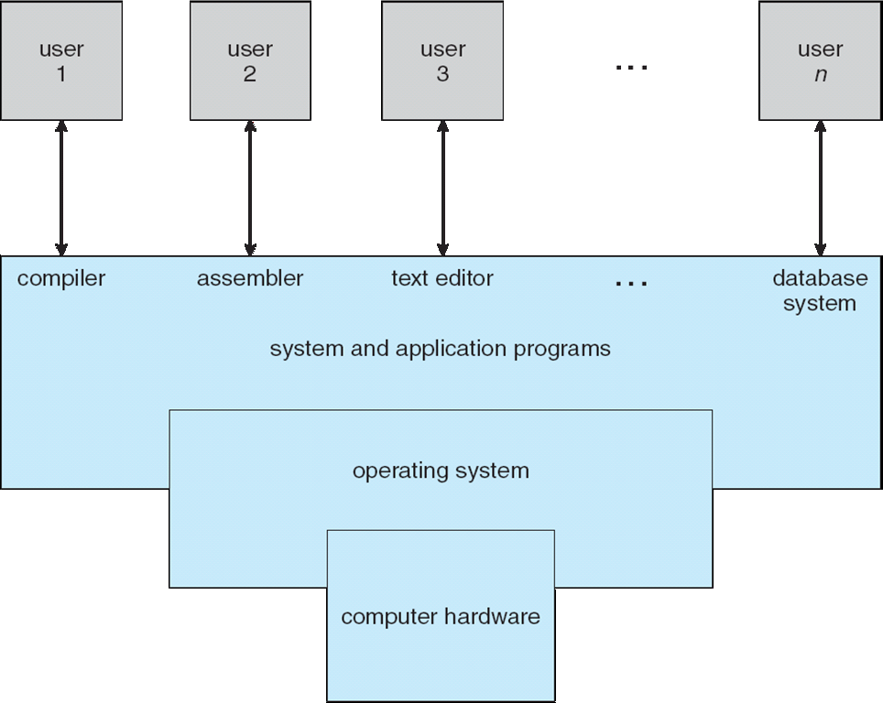
Four Components of a Computer System

Slide 7
What Operating Systems Do
Depends on the point of view
Users want convenience, ease of use
Don’t care about resource utilization(资源利用率)
But shared computer such as mainframe(大型机) or minicomputer(小型机) must keep all users happy
Users of dedicate systems such as workstations(工作站) have dedicated resources but frequently use shared resources from servers(服务器)
Handheld computers are resource poor, optimized for usability and battery life
Some computers have little or no user interface, such as embedded computers in devices and automobiles

Slide 8
Operating System Definition
OS is a resource allocator(资源分配者)
Manages all resources
Decides between conflicting requests for efficient and fair resource use
OS is a control program(控制程序)
Controls execution of programs to prevent errors and improper use of the computer

Slide 9
Operating System Definition (Cont.)
No universally accepted definition
“Everything a vendor ships when you order an operating system” is good approximation
But varies wildly
“The one program running at all times on the computer” is the kernel(内核). Everything else is either a system program (ships with the operating system) or an application program.

Slide 10
Computer Startup
bootstrap program(引导程序) is loaded at power-up or reboot
Typically stored in ROM or EPROM, generally known as firmware(固件)
Initializes all aspects of system
Loads operating system kernel and starts execution

Slide 11
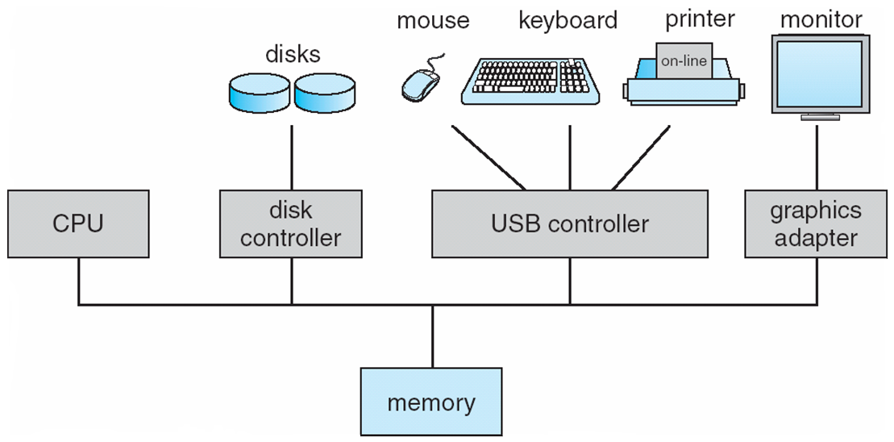
Computer System Organization
Computer-system operation
One or more CPUs, device controllers connect through common bus providing access to shared memory
Concurrent execution of CPUs and devices competing for memory cycles

Slide 12
Computer-System Operation
I/O devices and the CPU can execute concurrently(并发执行)
Each device controller(控制器) is in charge of a particular device type
Each device controller has a local buffer
CPU moves data from/to main memory to/from local buffers
I/O is from the device to local buffer of controller
Device controller informs CPU that it has finished its operation by causing an interrupt (中断)

Slide 13
Common Functions of Interrupts
Interrupt transfers control to the interrupt service routine generally, through the interrupt vector(中断向量), which contains the addresses of all the service routines
Interrupt architecture must save the address of the interrupted instruction
Incoming interrupts are disabled while another interrupt is being processed to prevent a lost interrupt
A trap(陷阱) is a software-generated interrupt caused either by an error or a user request
An operating system is interrupt driven(中断驱动的)

Slide 14
Interrupt Handling
The operating system preserves the state of the CPU by storing registers(寄存器) and the program counter(程序计数器)
Determines which type of interrupt has occurred:
polling
vectored interrupt system
Separate segments of code determine what action should be taken for each type of interrupt

Slide 15
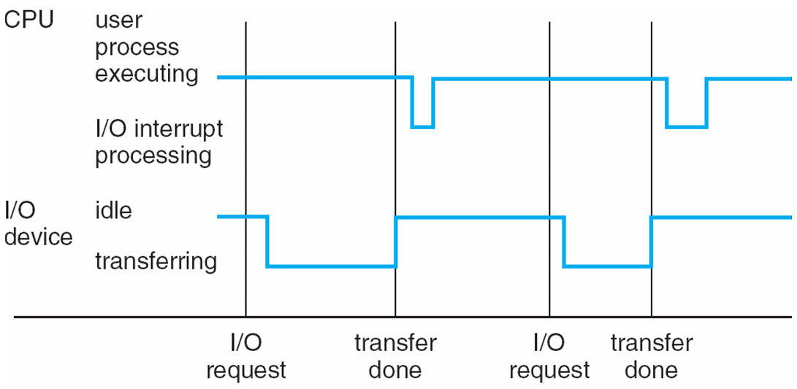
Interrupt Timeline

Slide 16
I/O Structure
After I/O starts, control returns to user program only upon I/O completion
Wait instruction idles the CPU until the next interrupt
Wait loop (contention for memory access)
At most one I/O request is outstanding at a time, no simultaneous I/O processing
After I/O starts, control returns to user program without waiting for I/O completion
System call – request to the operating system to allow user to wait for I/O completion
Device-status table contains entry for each I/O device indicating its type, address, and state
Operating system indexes into I/O device table to determine device status and to modify table entry to include interrupt

Slide 17
Direct Memory Access Structure
Used for high-speed I/O devices able to transmit information at close to memory speeds
Device controller transfers blocks of data from buffer storage directly to main memory without CPU intervention
Only one interrupt is generated per block, rather than the one interrupt per byte

Slide 18
Storage Structure
Main memory – only large storage media that the CPU can access directly
Random access(随机访问)
Typically volatile(易失的)
Secondary storage – extension of main memory that provides large nonvolatile(非易失的) storage capacity
Magnetic disks(磁盘) – rigid metal or glass platters covered with magnetic recording material
Disk surface is logically divided into tracks, which are subdivided into sectors
The disk controller determines the logical interaction between the device and the computer

Slide 19
Storage Hierarchy
Storage systems organized in hierarchy
Speed
Cost
Volatility
Caching(缓存) – copying information into faster storage system; main memory can be viewed as a cache for secondary storage

Slide 20
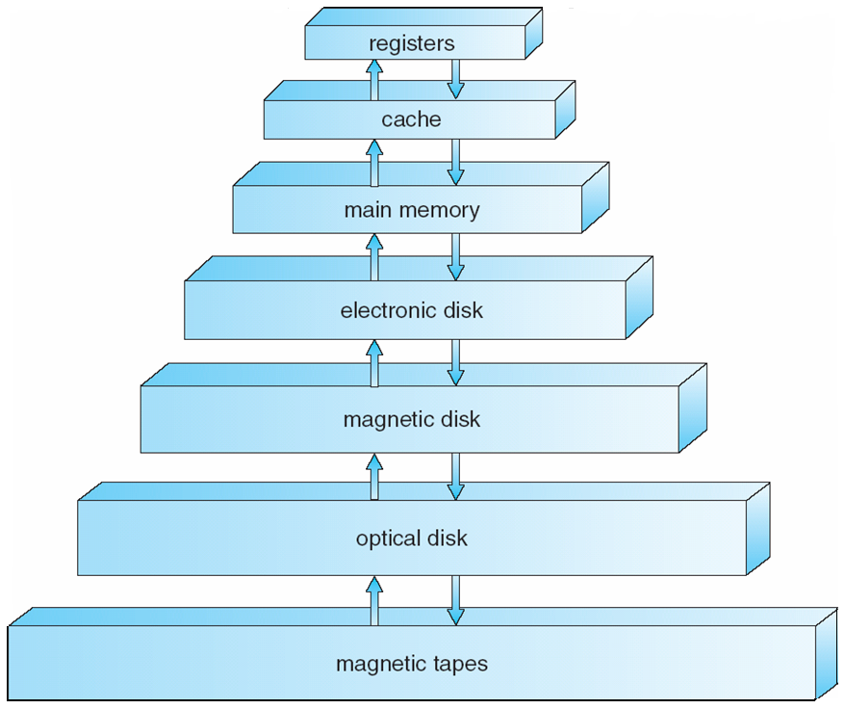
Storage-Device Hierarchy

Slide 21
Caching
Important principle, performed at many levels in a computer (in hardware, operating system, software)
Information in use copied from slower to faster storage temporarily
Faster storage (cache) checked first to determine if information is there
If it is, information used directly from the cache (fast)
If not, data copied to cache and used there
Cache smaller than storage being cached
Cache management important design problem
Cache size and replacement policy

Slide 22
Computer-System Architecture
Most systems use a single general-purpose processor (PDAs through mainframes)
Most systems have special-purpose processors as well
Multiprocessors systems growing in use and importance
Also known as parallel systems, tightly-coupled systems
Advantages include:
Increased throughput(吞吐)
Economy of scale
Increased reliability – graceful degradation or fault tolerance
Two types:
Asymmetric Multiprocessing
Symmetric Multiprocessing(SMP，对称多处理器)

Slide 23
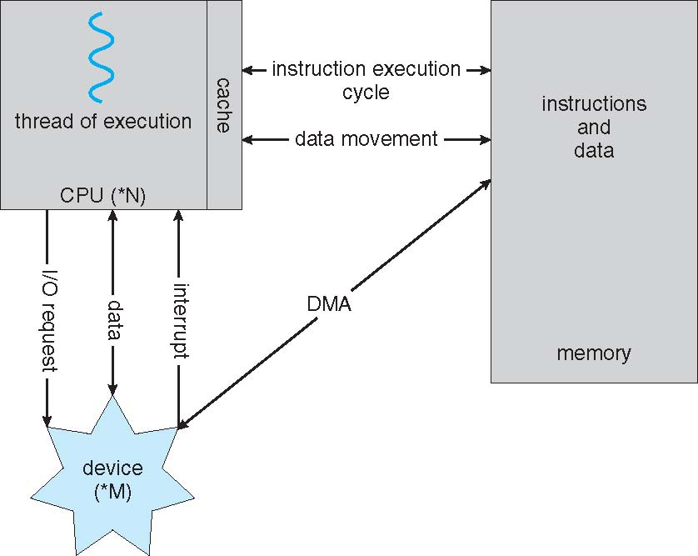
How a Modern Computer Works
A von Neumann architecture

Slide 24
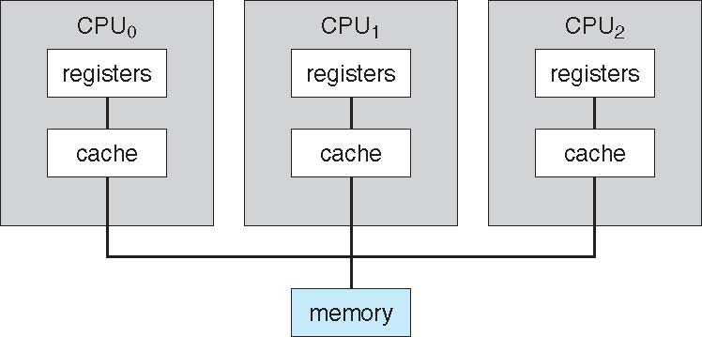
Symmetric Multiprocessing Architecture

Slide 25
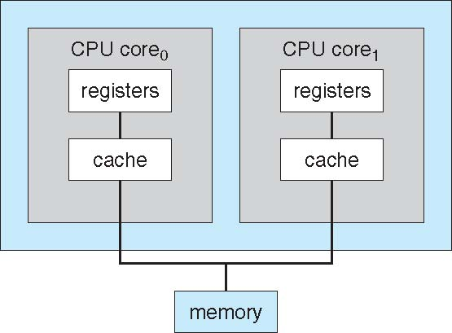
A Dual-Core Design

Slide 26
Clustered Systems
Like multiprocessor systems, but multiple systems working together
Usually sharing storage via a storage-area network (SAN)
Provides a high-availability service which survives failures
Asymmetric clustering has one machine in hot-standby mode
Symmetric clustering has multiple nodes running applications, monitoring each other
Some clusters are for high-performance computing (HPC)
Applications must be written to use parallelization

Slide 27
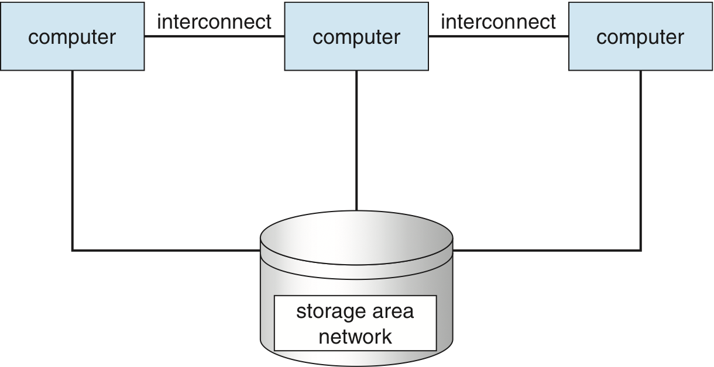
Clustered Systems

Slide 28
Operating System Structure
Multiprogramming(多道程序设计) needed for efficiency
Single user cannot keep CPU and I/O devices busy at all times
Multiprogramming organizes jobs (code and data) so CPU always has one to execute
A subset of total jobs in system is kept in memory
One job selected and run via job scheduling(作业调度)
When it has to wait (for I/O for example), OS switches to another job
Timesharing (multitasking)(分时) is logical extension in which CPU switches jobs so frequently that users can interact with each job while it is running, creating interactive computing(交互计算)
Response time(响应时间) should be < 1 second
Each user has at least one program executing in memory  process(进程)
If several jobs ready to run at the same time  CPU scheduling(调度)
If processes don’t fit in memory, swapping(交换) moves them in and out to run
Virtual memory(虚拟内存) allows execution of processes not completely in memory

Slide 29
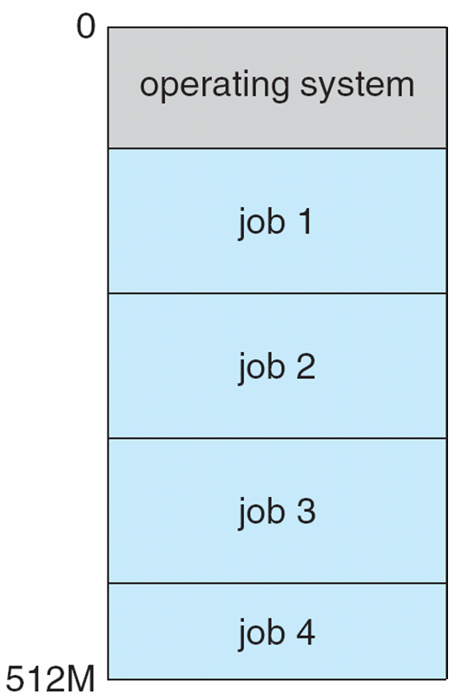
Memory Layout for Multiprogrammed System

Slide 30
Operating-System Operations
Interrupt driven by hardware
Software error or request creates exception or trap
Division by zero, request for operating system service
Other process problems include infinite loop, processes modifying each other or the operating system
Dual-mode operation allows OS to protect itself and other system components
User mode and kernel mode (用户态和内核态)
Mode bit provided by hardware(模式位)
Provides ability to distinguish when system is running user code or kernel code
Some instructions designated as privileged, only executable in kernel mode(特权指令只能在内核态执行)
System call changes mode to kernel, return from call resets it to user(系统调用可以更改CPU模式)

Slide 31
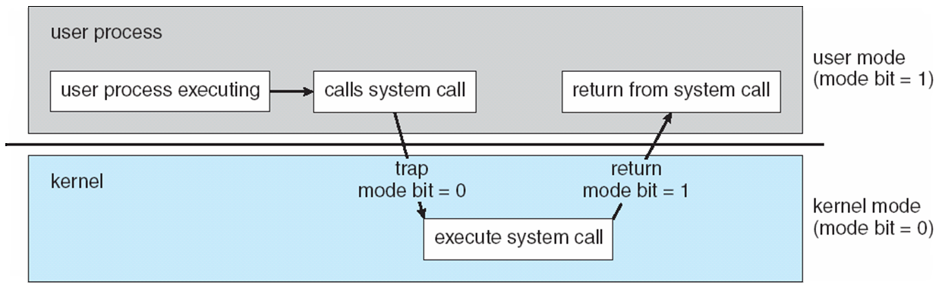
Transition from User to Kernel Mode
Timer to prevent infinite loop / process hogging resources
Set interrupt after specific period
Operating system decrements counter
When counter zero generate an interrupt
Set up before scheduling process to regain control or terminate program that exceeds allotted time

Slide 32
Process Management
A process(进程) is a program in execution. It is a unit of work within the system. Program is a passive entity, process is an active entity.
Process needs resources to accomplish its task
CPU, memory, I/O, files
Initialization data
Process termination requires reclaim of any reusable resources
Single-threaded process has one program counter specifying location of next instruction to execute
Process executes instructions sequentially, one at a time, until completion
Multi-threaded process has one program counter per thread
Typically system has many processes, some user, some operating system running concurrently on one or more CPUs
Concurrency by multiplexing the CPUs among the processes / threads

Slide 33
Process Management Activities
The operating system is responsible for the following activities in connection with process management:
Creating and deleting both user and system processes
Suspending and resuming processes (挂起和继续)
Providing mechanisms for process synchronization (进程同步)
Providing mechanisms for process communication (进程间通讯)
Providing mechanisms for deadlock handling (死锁处理)

Slide 34
Memory Management
All data in memory before and after processing
All instructions in memory in order to execute
Memory management determines what is in memory when
Optimizing CPU utilization and computer response to users
Memory management activities
Keeping track of which parts of memory are currently being used and by whom
Deciding which processes (or parts thereof) and data to move into and out of memory
Allocating and deallocating memory space as needed

Slide 35
Storage Management
OS provides uniform, logical view of information storage
Abstracts physical properties to logical storage unit - file(文件)
Each medium is controlled by device (i.e., disk drive, tape drive)
Varying properties include access speed, capacity, data-transfer rate, access method (sequential or random(顺序或随机))
File-System management
Files usually organized into directories(目录)
Access control on most systems to determine who can access what
OS activities include
Creating and deleting files and directories
Primitives to manipulate files and directories
Mapping files onto secondary storage
Backup files onto stable (non-volatile) storage media

Slide 36
Mass-Storage Management
Usually disks used to store data that does not fit in main memory or data that must be kept for a “long” period of time
Proper management is of central importance
Entire speed of computer operation hinges on disk subsystem and its algorithms
OS activities
Free-space management
Storage allocation (存储分配)
Disk scheduling (磁盘调度)
Some storage need not be fast
Tertiary storage includes optical storage, magnetic tape
Still must be managed – by OS or applications
Varies between WORM (write-once, read-many-times) and RW (read-write)

Slide 37
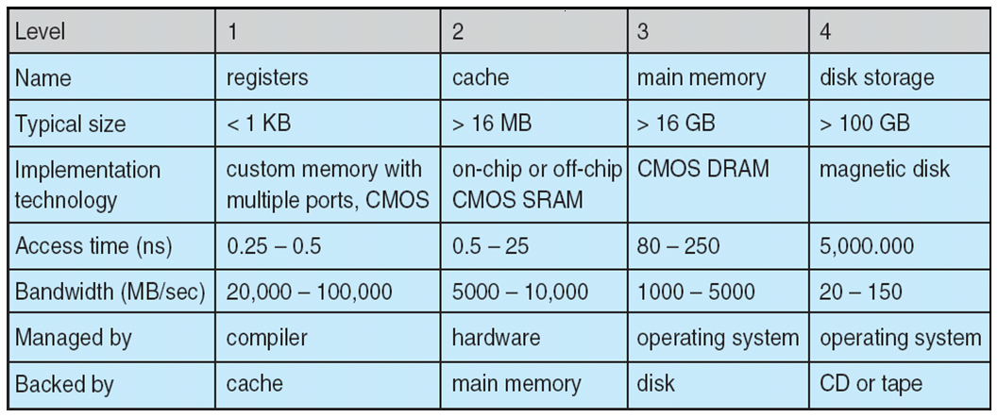
Performance of Various Levels of Storage
Movement between levels of storage hierarchy can be explicit or implicit

Slide 38
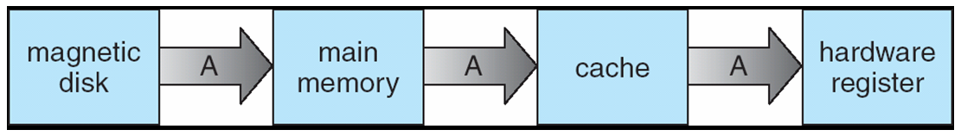
Migration of Integer A from Disk to Register
Multitasking environments must be careful to use most recent value, no matter where it is stored in the storage hierarchy
Multiprocessor environment must provide cache coherency in hardware such that all CPUs have the most recent value in their cache
Distributed environment situation even more complex
Several copies of a datum can exist
Various solutions covered in Chapter 17

Slide 39
I/O Subsystem
One purpose of OS is to hide peculiarities of hardware devices from the user (隐藏硬件设备的特殊性)
I/O subsystem responsible for
Memory management of I/O including buffering (storing data temporarily while it is being transferred), caching (storing parts of data in faster storage for performance), spooling (the overlapping of output of one job with input of other jobs)
General device-driver interface
Drivers for specific hardware devices

Slide 40
Protection and Security
Protection – any mechanism for controlling access of processes or users to resources defined by the OS
Security – defense of the system against internal and external attacks
Huge range, including denial-of-service, worms, viruses, identity theft, theft of service
Systems generally first distinguish among users, to determine who can do what
User identities (user IDs, security IDs) include name and associated number, one per user
User ID then associated with all files, processes of that user to determine access control
Group identifier (group ID) allows set of users to be defined and controls managed, then also associated with each process, file
Privilege escalation allows user to change to effective ID with more rights

Slide 41
Distributed Computing (分布系统)
Collection of separate, possibly heterogeneous, systems networked together
Network is a communications path
Local Area Network (LAN)
Wide Area Network (WAN)
Metropolitan Area Network (MAN)
Network Operating System provides features between systems across network
Communication scheme allows systems to exchange messages
Illusion of a single system

Slide 42
Special-Purpose Systems
Real-time embedded systems most prevalent form of computers
Vary considerable, special purpose, limited purpose OS, real-time OS (实时系统)
Multimedia systems (多媒体系统)
Streams of data must be delivered according to time restrictions
Handheld systems (手持系统，嵌入式系统)
PDAs, smart phones, limited CPU, memory, power
Reduced feature set OS, limited I/O

Slide 43
Computing Environments
Traditional computer
Blurring over time
Office environment
PCs connected to a network, terminals attached to mainframe or minicomputers providing batch(批处理) and timesharing(分时)
Now portals allowing networked and remote systems access to same resources
Home networks
Used to be single system, then modems
Now firewalled, networked

Slide 44
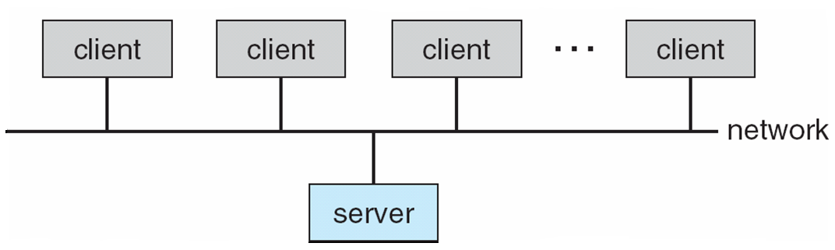
Computing Environments (Cont.)
Client-Server Computing (客户-服务器)
Dumb terminals supplanted by smart PCs
Many systems now servers, responding to requests generated by clients
Compute-server provides an interface to client to request services (i.e., database)
File-server provides interface for clients to store and retrieve files

Slide 45
Peer-to-Peer Computing
Another model of distributed system
P2P does not distinguish clients and servers
Instead all nodes are considered peers
May each act as client, server or both
Node must join P2P network
Registers its service with central lookup service on network, or
Broadcast request for service and respond to requests for service via discovery protocol
Examples include Napster and Gnutella

Slide 46
Web-Based Computing
Web has become ubiquitous
PCs most prevalent devices
More devices becoming networked to allow web access
New category of devices to manage web traffic among similar servers: load balancers (负载均衡)
Use of operating systems like Windows 95, client-side, have evolved into Linux and Windows XP, which can be clients and servers

Slide 47
Open-Source Operating Systems
Operating systems made available in source-code format rather than just binary closed-source
Counter to the copy protection and Digital Rights Management (DRM) movement
Started by Free Software Foundation (FSF), which has “copyleft” GNU Public License (GPL)
Examples include GNU/Linux and BSD UNIX (including core of Mac OS X), and many more

Slide 48
End of Chapter 1

