Slide 1
Chapter 17: Distributed-File Systems

Slide 2
Chapter 17 Distributed-File Systems
Background
Naming and Transparency
Remote File Access
Stateful versus Stateless Service
File Replication
An Example: AFS

Slide 3
Chapter Objectives
To explain the naming mechanism that provides location transparency and independence
To describe the various methods for accessing distributed files
To contrast stateful and stateless distributed file servers
To show how replication of files on different machines in a distributed file system is a useful redundancy for improving availability
To introduce the Andrew file system (AFS) as an example of a distributed file system

Slide 4
Background
Distributed file system (DFS) – a distributed implementation of the classical time-sharing model of a file system, where multiple users share files and storage resources
A DFS manages set of dispersed storage devices
Overall storage space managed by a DFS is composed of different, remotely located, smaller storage spaces
There is usually a correspondence between constituent storage spaces and sets of files

Slide 5
DFS Structure
Service – software entity running on one or more machines and providing a particular type of function to a priori unknown clients
Server – service software running on a single machine
Client – process that can invoke a service using a set of operations that forms its client interface
A client interface for a file service is formed by a set of primitive file operations (create, delete, read, write)
Client interface of a DFS should be transparent, i.e., not distinguish between local and remote files

Slide 6
Naming and Transparency
Naming – mapping between logical and physical objects
Multilevel mapping – abstraction of a file that hides the details of how and where on the disk the file is actually stored
A transparent DFS hides the location where in the network the file is stored
For a file being replicated in several sites, the mapping returns a set of the locations of this file’s replicas; both the existence of multiple copies and their location are hidden

Slide 7
Naming Structures
Location transparency – file name does not reveal the file’s physical storage location
Location independence – file name does not need to be changed when the file’s physical storage location changes

Slide 8
Naming Schemes — Three Main Approaches
Files named by combination of their host name and local name; guarantees a unique system-wide name
Attach remote directories to local directories, giving the appearance of a coherent directory tree; only previously mounted remote directories can be accessed transparently
Total integration of the component file systems
A single global name structure spans all the files in the system
If a server is unavailable, some arbitrary set of directories on different machines also becomes unavailable

Slide 9
Remote File Access
Remote-service mechanism is one transfer approach
Reduce network traffic by retaining recently accessed disk blocks in a cache, so that repeated accesses to the same information can be handled locally
If needed data not already cached, a copy of data is brought from the server to the user
Accesses are performed on the cached copy
Files identified with one master copy residing at the server machine, but copies of (parts of) the file are scattered in different caches
Cache-consistency problem – keeping the cached copies consistent with the master file
Could be called network virtual memory

Slide 10
Cache Location – Disk vs. Main Memory
Advantages of disk caches
More reliable
Cached data kept on disk are still there during recovery and don’t need to be fetched again
Advantages of main-memory caches:
Permit workstations to be diskless
Data can be accessed more quickly
Performance speedup in bigger memories
Server caches (used to speed up disk I/O) are in main memory regardless of where user caches are located; using main-memory caches on the user machine permits a single caching mechanism for servers and users

Slide 11
Cache Update Policy
Write-through – write data through to disk as soon as they are placed on any cache
Reliable, but poor performance
Delayed-write – modifications written to the cache and then written through to the server later
Write accesses complete quickly; some data may be overwritten before they are written back, and so need never be written at all
Poor reliability; unwritten data will be lost whenever a user machine crashes
Variation – scan cache at regular intervals and flush blocks that have been modified since the last scan
Variation – write-on-close, writes data back to the server when the file is closed
Best for files that are open for long periods and frequently modified

Slide 12
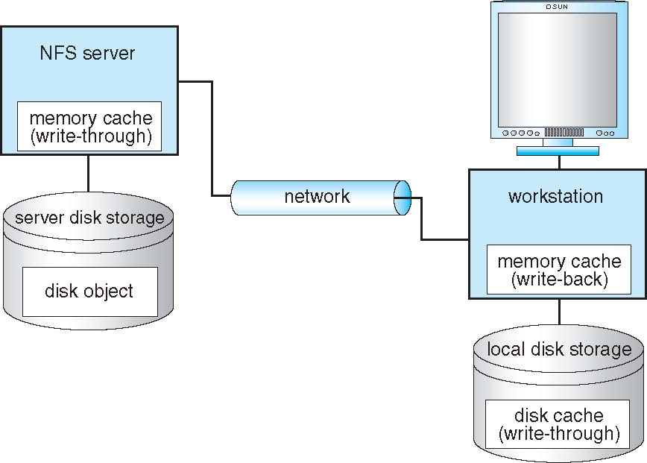
CacheFS and its Use of Caching

Slide 13
Consistency
Is locally cached copy of the data consistent with the master copy?
Client-initiated approach
Client initiates a validity check
Server checks whether the local data are consistent with the master copy
Server-initiated approach
Server records, for each client, the (parts of) files it caches
When server detects a potential inconsistency, it must react

Slide 14
Comparing Caching and Remote Service
In caching, many remote accesses handled efficiently by the local cache; most remote accesses will be served as fast as local ones
Servers are contracted only occasionally in caching (rather than for each access)
Reduces server load and network traffic
Enhances potential for scalability
Remote server method handles every remote access across the network; penalty in network traffic, server load, and performance
Total network overhead in transmitting big chunks of data (caching) is lower than a series of responses to specific requests (remote-service)

Slide 15
Caching and Remote Service (Cont.)
Caching is superior in access patterns with infrequent writes
With frequent writes, substantial overhead incurred to overcome cache-consistency problem
Benefit from caching when execution carried out on machines with either local disks or large main memories
Remote access on diskless, small-memory-capacity machines should be done through remote-service method
In caching, the lower intermachine interface is different form the upper user interface
In remote-service, the intermachine interface mirrors the local user-file-system interface

Slide 16
Stateful File Service
Mechanism
Client opens a file
Server fetches information about the file from its disk, stores it in its memory, and gives the client a connection identifier unique to the client and the open file
Identifier is used for subsequent accesses until the session ends
Server must reclaim the main-memory space used by clients who are no longer active
Increased performance
Fewer disk accesses
Stateful server knows if a file was opened for sequential access and can thus read ahead the next blocks

Slide 17
Stateless File Server
Avoids state information by making each request self-contained
Each request identifies the file and position in the file
No need to establish and terminate a connection by open and close operations

Slide 18
Distinctions Between Stateful and Stateless Service
Failure Recovery
A stateful server loses all its volatile state in a crash
Restore state by recovery protocol based on a dialog with clients, or abort operations that were underway when the crash occurred
Server needs to be aware of client failures in order to reclaim space allocated to record the state of crashed client processes (orphan detection and elimination)
With stateless server, the effects of server failure sand recovery are almost unnoticeable
A newly reincarnated server can respond to a self-contained request without any difficulty

Slide 19
Distinctions (Cont.)
Penalties for using the robust stateless service:
longer request messages
slower request processing
additional constraints imposed on DFS design
Some environments require stateful service
A server employing server-initiated cache validation cannot provide stateless service, since it maintains a record of which files are cached by which clients
UNIX use of file descriptors and implicit offsets is inherently stateful; servers must maintain tables to map the file descriptors to inodes, and store the current offset within a file

Slide 20
File Replication
Replicas of the same file reside on failure-independent machines
Improves availability and can shorten service time
Naming scheme maps a replicated file name to a particular replica
Existence of replicas should be invisible to higher levels
Replicas must be distinguished from one another by different lower-level names
Updates – replicas of a file denote the same logical entity, and thus an update to any replica must be reflected on all other replicas
Demand replication – reading a nonlocal replica causes it to be cached locally, thereby generating a new nonprimary replica

Slide 21
An Example: AFS
A distributed computing environment (Andrew) under development since 1983 at Carnegie-Mellon University, purchased by IBM and released as Transarc DFS, now open sourced as OpenAFS
AFS tries to solve complex issues such as uniform name space, location-independent file sharing, client-side caching (with cache consistency), secure authentication (via Kerberos)
Also includes server-side caching (via replicas), high availability
Can span 5,000 workstations

Slide 22
ANDREW (Cont.)
Clients are presented with a partitioned space of file names: a local name space and a shared name space
Dedicated servers, called Vice, present the shared name space to the clients as an homogeneous, identical, and location transparent file hierarchy
The local name space is the root file system of a workstation, from which the shared name space descends
Workstations run the Virtue protocol to communicate with Vice, and are required to have local disks where they store their local name space
Servers collectively are responsible for the storage and management of the shared name space

Slide 23
ANDREW (Cont.)
Clients and servers are structured in clusters interconnected by a backbone LAN
A cluster consists of a collection of workstations and a cluster server and is connected to the backbone by a router
A key mechanism selected for remote file operations is whole file caching
Opening a file causes it to be cached, in its entirety, on the local disk

Slide 24
ANDREW Shared Name Space
Andrew’s volumes are small component units associated with the files of a single client
A fid identifies a Vice file or directory - A fid is 96 bits long and has three equal-length components:
volume number
vnode number – index into an array containing the inodes of files in a single volume
uniquifier – allows reuse of vnode numbers, thereby keeping certain data structures, compact
Fids are location transparent; therefore, file movements from server to server do not invalidate cached directory contents
Location information is kept on a volume basis, and the information is replicated on each server

Slide 25
ANDREW File Operations
Andrew caches entire files form servers
A client workstation interacts with Vice servers only during opening and closing of files
Venus – caches files from Vice when they are opened, and stores modified copies of files back when they are closed
Reading and writing bytes of a file are done by the kernel without Venus intervention on the cached copy
Venus caches contents of directories and symbolic links, for path-name translation
Exceptions to the caching policy are modifications to directories that are made directly on the server responsibility for that directory

Slide 26
ANDREW Implementation
Client processes are interfaced to a UNIX kernel with the usual set of system calls
Venus carries out path-name translation component by component
The UNIX file system is used as a low-level storage system for both servers and clients
The client cache is a local directory on the workstation’s disk
Both Venus and server processes access UNIX files directly by their inodes to avoid the expensive path name-to-inode translation routine

Slide 27
ANDREW Implementation (Cont.)
Venus manages two separate caches:
one for status
one for data
LRU algorithm used to keep each of them bounded in size
The status cache is kept in virtual memory to allow rapid servicing of stat() (file status returning) system calls
The data cache is resident on the local disk, but the UNIX I/O buffering mechanism does some caching of the disk blocks in memory that are transparent to Venus

Slide 28
End of Chapter 17

Slide 29
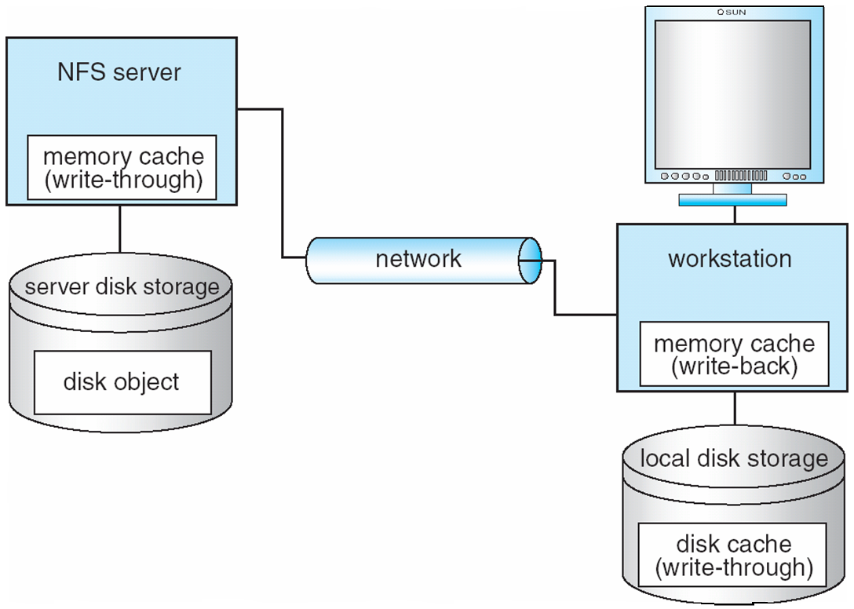
Fig. 17.01

