Slide 1
Chapter 19: Real-Time Systems

Slide 2
Chapter 19: Real-Time Systems
System Characteristics
Features of Real-Time Systems
Implementing Real-Time Operating Systems
Real-Time CPU Scheduling
An Example: VxWorks 5.x

Slide 3
Objectives
To explain the timing requirements of real-time systems
To distinguish between hard and soft real-time systems
To discuss the defining characteristics of real-time systems
To describe scheduling algorithms for hard real-time systems

Slide 4
Overview of Real-Time Systems
A real-time system requires that results be produced within a specified deadline period.
An embedded system is a computing device that is part of a larger system (i.e., automobile, airliner).
A safety-critical system is a real-time system with catastrophic results in case of failure.
A hard real-time system guarantees that real-time tasks be completed within their required deadlines.
A soft real-time system provides priority of real-time tasks over non real-time tasks.

Slide 5
System Characteristics
Single purpose
Small size
Inexpensively mass-produced
Specific timing requirements

Slide 6
System-on-a-Chip
Many real-time systems are designed using system-on-a-chip (SOC) strategy
SOC allows the CPU, memory, memory-management unit, and attached peripheral ports (i.e., USB) to be contained in a single integrated circuit

Slide 7
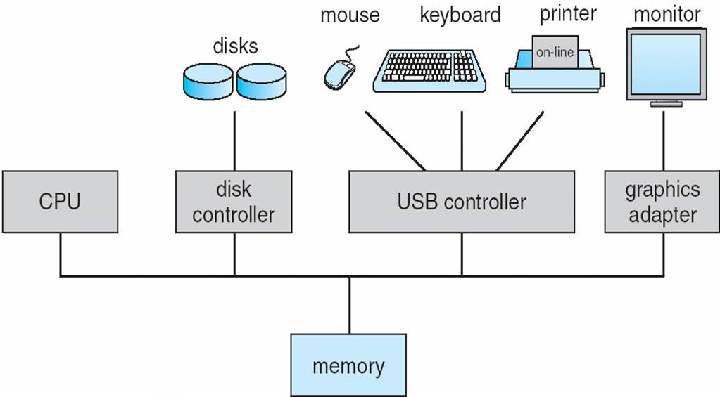
Bus-Oriented System

Slide 8
Features of Real-Time Kernels
Most real-time systems do not provide the features found in a standard desktop system
Reasons include
Real-time systems are typically single-purpose
Real-time systems often do not require interfacing with a user
Features found in a desktop PC require more substantial hardware that what is typically available in a real-time system

Slide 9
Virtual Memory in Real-Time Systems
Address translation may occur via:
1. Real-addressing mode where programs generate actual addresses
2. Relocation register mode
3. Implementing full virtual memory

Slide 10
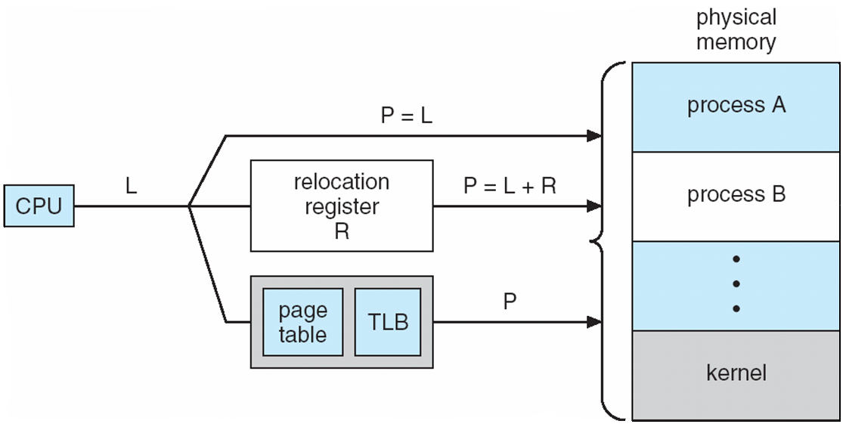
Address Translation

Slide 11
Implementing Real-Time Systems
In general, real-time operating systems must provide:
1. Preemptive, priority-based scheduling
2. Preemptive kernels
3. Latency must be minimized

Slide 12
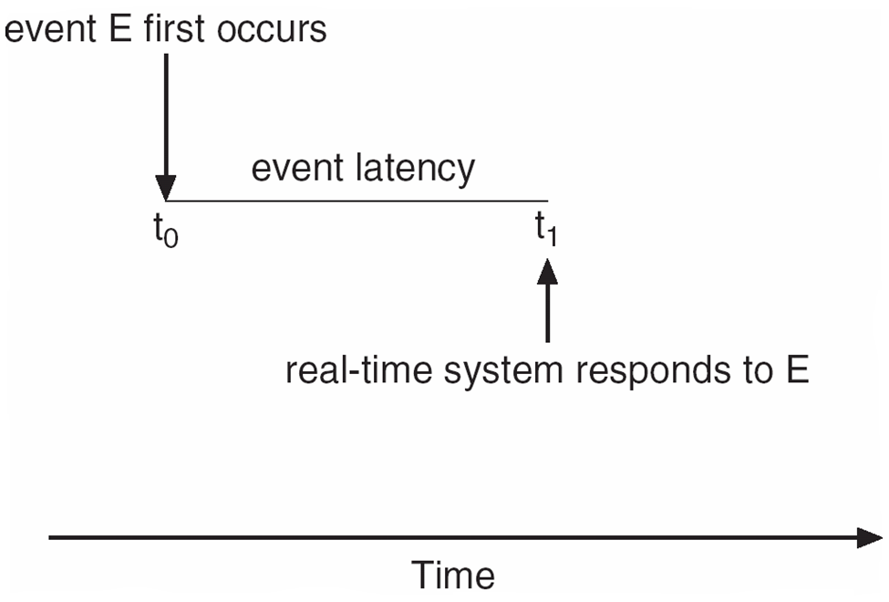
Minimizing Latency
Event latency is the amount of time from when an event occurs to when it is serviced.

Slide 13
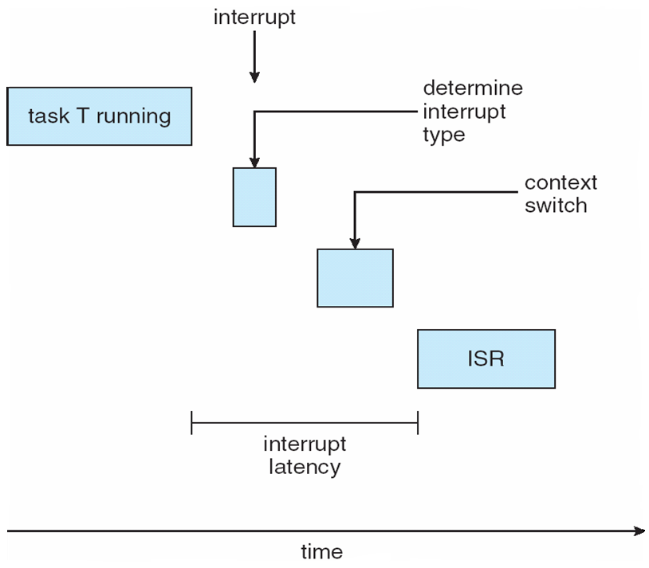
Interrupt Latency
Interrupt latency is the period of time from when an interrupt arrives at the CPU to when it is serviced

Slide 14
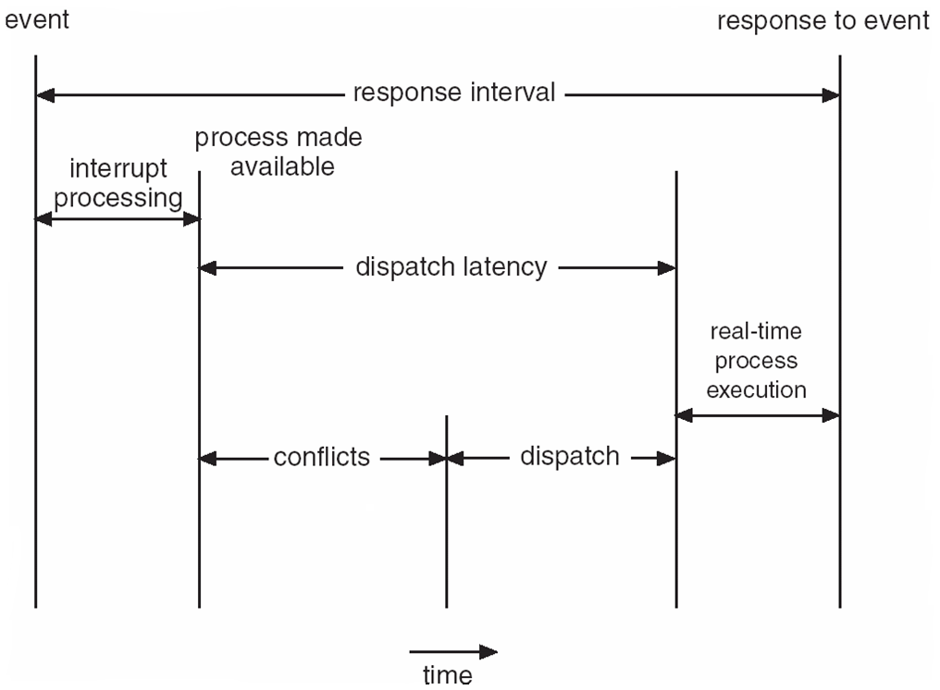
Dispatch Latency
Dispatch latency is the amount of time required for the scheduler to stop one process and start another

Slide 15
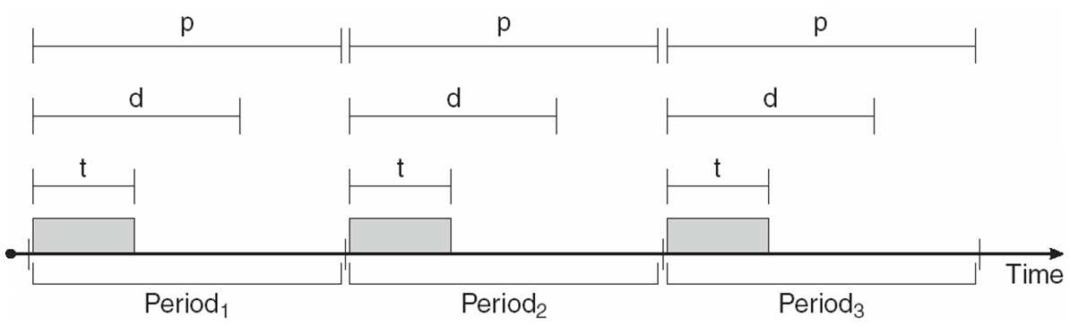
Real-Time CPU Scheduling
Periodic processes require the CPU at specified intervals (periods)
p is the duration of the period
d is the deadline by when the process must be serviced
t is the processing time

Slide 16
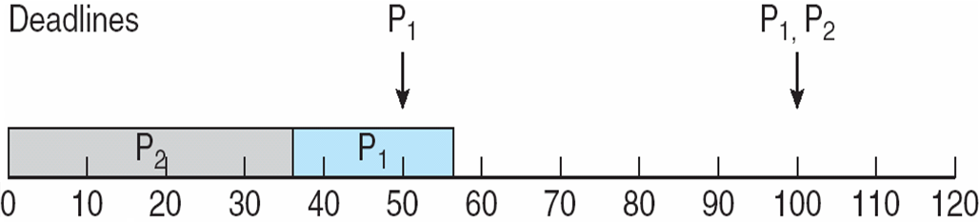
Scheduling of tasks when P₂ has a higher priority than P₁

Slide 17
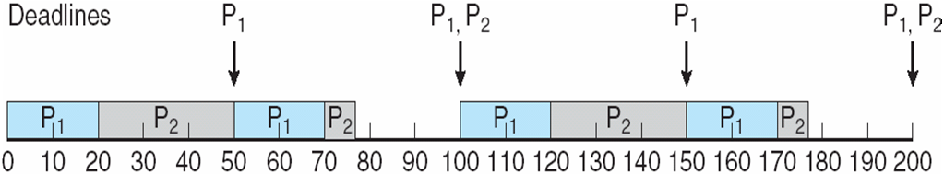
Rate Montonic Scheduling
A priority is assigned based on the inverse of its period
Shorter periods = higher priority;
Longer periods = lower priority
P₁ is assigned a higher priority than P₂.

Slide 18
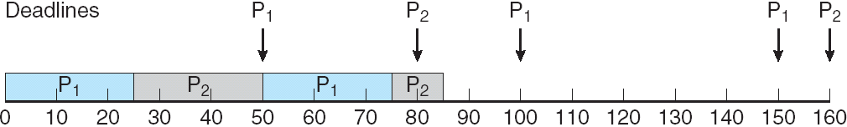
Missed Deadlines with Rate Monotonic Scheduling

Slide 19
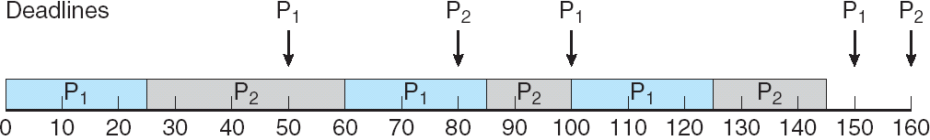
Earliest Deadline First Scheduling
Priorities are assigned according to deadlines: the earlier the deadline, the higher the priority;
the later the deadline, the lower the priority

Slide 20
Proportional Share Scheduling
T shares are allocated among all processes in the system
An application receives N shares where N < T
This ensures each application will receive N / T of the total processor time

Slide 21
Pthread Scheduling
The Pthread API provides functions for managing real-time threads
Pthreads defines two scheduling classes for real-time threads:
1. SCHED_FIFO - threads are scheduled using a FCFS strategy with a FIFO queue. There is no time-slicing for threads of equal priority
2. SCHED_RR - similar to SCHED_FIFO except time-slicing occurs for threads of equal priority

Slide 22
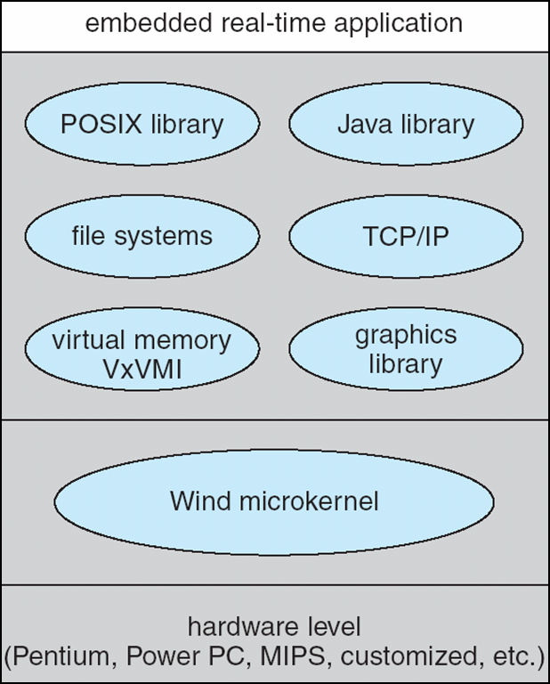
VxWorks 5.0

Slide 23
Wind Microkernel
The Wind microkernel provides support for the following:
1. Processes and threads
2. Preemptive and non-preemptive round-robin scheduling
3. Manages interrupts (with bounded interrupt and dispatch latency times)
4. Shared memory and message passing interprocess communication facilities

Slide 24
End of Chapter 19

