Slide 1
Chapter 20: Multimedia Systems

Slide 2
Chapter 20: Multimedia Systems
What is Multimedia?
Compression
Requirements of Multimedia Kernels
CPU Scheduling
Disk Scheduling
Network Management
An Example: Cineblitz

Slide 3
Objectives
To identify the characteristics of multimedia data
To examine several algorithms used to compress multimedia data
To explore the operating system requirements of multimedia data, including CPU and disk scheduling and network management

Slide 4
What is Multimedia?
Multimedia data includes
- audio and video clips (i.e., MP3 and MPEG files)
- live webcasts
Multimedia data may be delivered to - desktop PC’s
- handheld devices (PDAs, smart phones

Slide 5
Media Delivery
Multimedia data is stored in the file system like other ordinary data
However, multimedia data must be accessed with specific timing requirements
For example, video must be displayed at 24-30 frames per second. Multimedia video data must be delivered at a rate which guarantees 24-30 frames/second
Continuous-media data is data with specific rate requirements

Slide 6
Streaming
Streaming is delivering a multimedia file from a server to a client - typically the deliver occurs over a network connection.
There are two different types of streaming:
1. Progressive download - the client begins playback of the multimedia file as it is delivered. The file is ultimately stored on the client computer.
2. Real-time streaming - the multimedia file is delivered to - but not stored on - the client’s computer.

Slide 7
Real-time Streaming
There are two types of real-time streaming:
1. Live streaming - used to deliver a live event while it is occurring
2. On-demand streaming - used to deliver media streams such as movies, archived lectures, etc. The events are not delivered in real-time.

Slide 8
Multimedia Systems Characteristics
Multimedia files can be quite large
Continuous media data may require very high data rates
Multimedia applications may be sensitive to timing delays during playback of the media

Slide 9
Compression
Because of the size and rate requirements of multimedia systems, multimedia files are often compressed into a smaller form
MPEG Compression:
1. MPEG-1 - 352 X 240 @ 30 frames/second
2. MPEG-2 - Used for compressing DVD and high-definition television (HDTV)
3. MPEG-4 - Used to transmit audio, video, and graphics. Can be delivered over very slow connections (56 Kbps)

Slide 10
Operating Systems Issues
The operating system must guarantee the specific data rate and timing requirements of continuous media
Such requirements are known as Quality-of-Service (QoS) guarantees

Slide 11
QoS Guarantees
Guaranteeing QoS has the following effects in a computer system:
1. CPU processing
2. Scheduling
3. File systems
4. Network protocols

Slide 12
Requirement of Multimedia Operating Systems
There are three levels of QoS
1. Best-effort service - the system makes a best effort with no QoS guarantees
2. Soft QoS - allows different traffic streams to be prioritized, however no QoS guarantees are made
3. Hard QoS - the QoS rquirements are guaranteed

Slide 13
Parameters Defining QoS
Throughput - the total amount of work completed during a specific time interval
Delay - the elapsed time from when a request is first submitted to when the desired result is produced
Jitter - the delays that occur during playback of a stream
Reliability - how errors are handled during transmission and processing of continuous media

Slide 14
Further QoS Issues
QoS may be negotiated between the client and server
Operating systems often use an admission control algorithm that admits a request for a service only if the server has sufficient resources to satisfy the request.

Slide 15
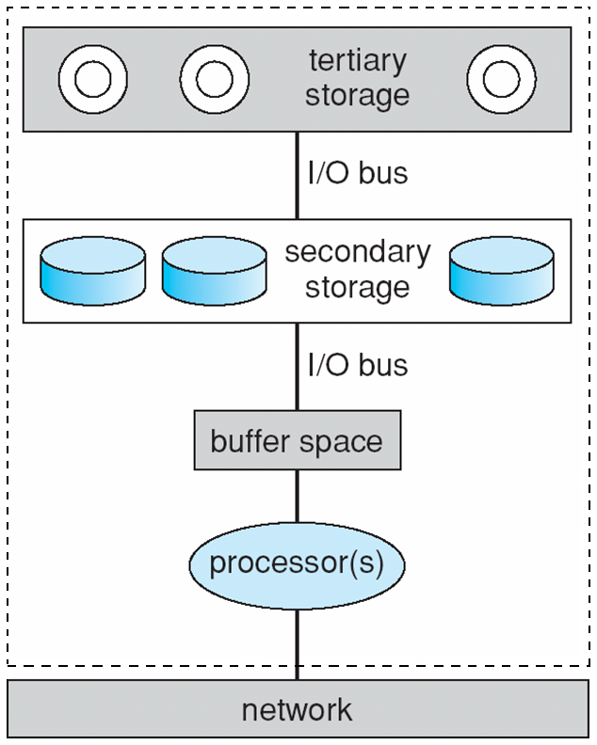
Resources on a file server

Slide 16
CPU Scheduling
Multimedia systems require hard realtime scheduling to ensure critical tasks will be serviced within timing deadlines
Most hard realtime CPU scheduling algorithms assign realtime processes static priorities that do not change over time

Slide 17
Disk Scheduling
Disk scheduling algorithms must be optimized to meet the timing deadlines and rate requirements of continuous media
Earliest-Deadline-First (EDF) Scheduling
SCAN-EDF Scheduling

Slide 18
Disk Scheduling (Cont.)
The EDF scheduler uses a queue to order requests according to the time it must be completed (its deadline)
SCAN-EDF scheduling is similar to EDF except that requests with the same deadline are ordered according to a SCAN policy

Slide 19
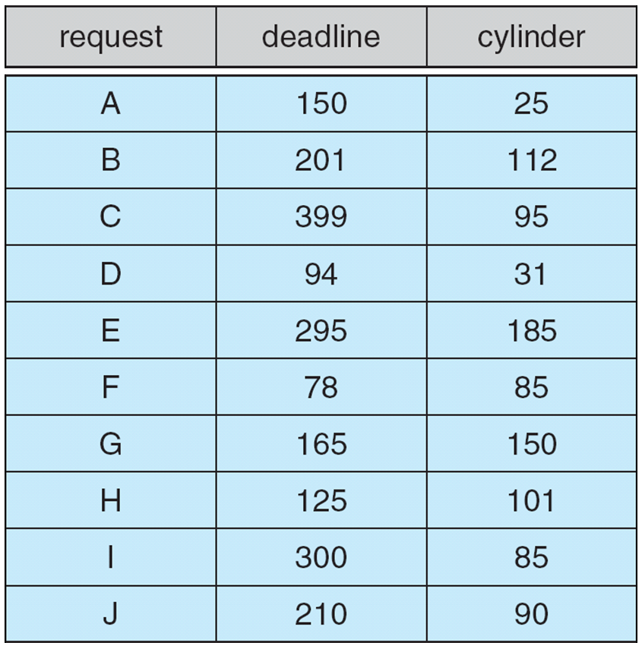
Deadline and cylinder requests for SCAN-EDF scheduling

Slide 20
Network Management
Three general methods for delivering content from a server to a client across a network:
1. Unicasting - the server delivers the content to a single client.
2. Broadcasting - the server delivers the content to all clients, regardless whether they want the content or not.
3. Multicasting - the server delivers the content to a group of receivers who indicate they wish to receive the content.

Slide 21
RealTime Streaming Protocol (RTSP)
Standard HTTP is stateless whereby the server does not maintain the status of its connection with the client.

Slide 22
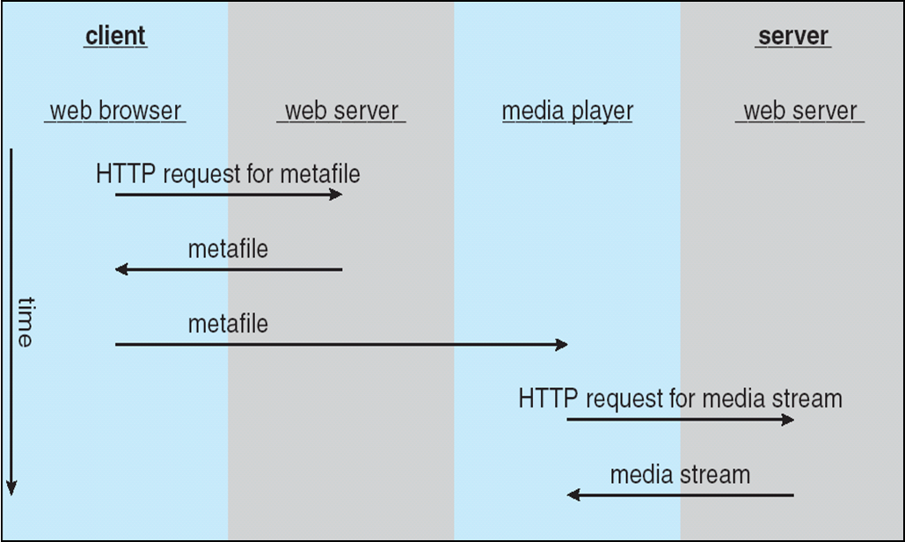
Streaming Media from a Conventional Web Server

Slide 23
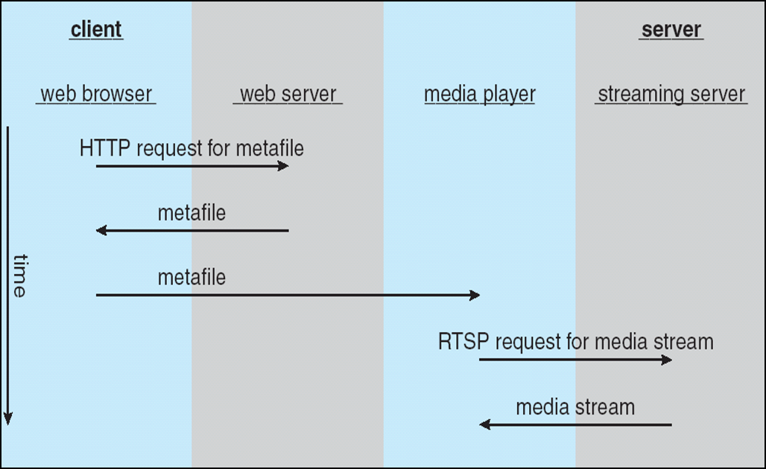
Realtime Streaming Protocol

Slide 24
RTSP States
SETUP - the server allocates resources for a client session
PLAY - the server delivers a stream to a client session
PAUSE - the server suspends delivery of a stream
TEARDOWN - the server breaks down the connection and releases the resources allocated for the session

Slide 25
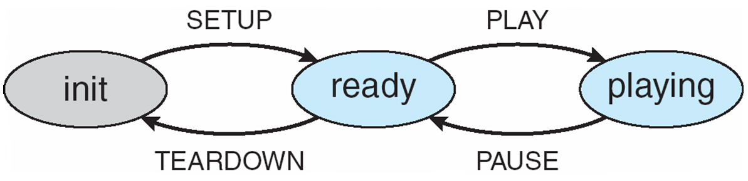
RTSP state machine

Slide 26
CineBlitz Multimedia Server
CineBlitz supports both realtime and non-realtime clients
CineBlitz provides hard QoS guarantees to realtime clients using an admission control algorithm
The disk scheduler orders requests using C-SCAN order

Slide 27
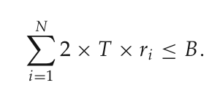
CineBlitz Admission Controller
Total buffer space required for N clients where client has rate requirement of r_{i}

Slide 28
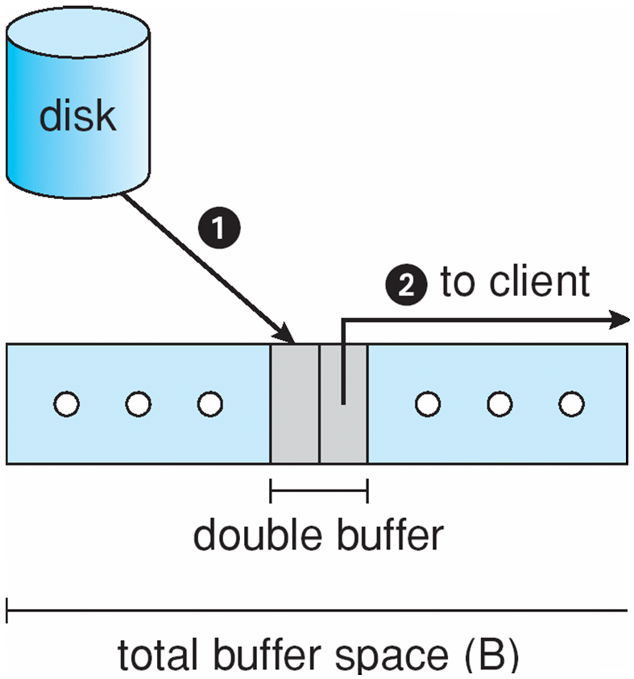
Double Buffering in CineBlitz

Slide 29
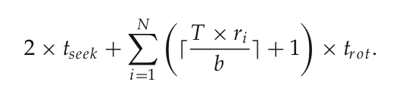
CineBlitz Admission Controller (Cont.)
If tseek and trot are the worst-case seek and rotational delay times, the maximum latency for servicing N requests is

Slide 30
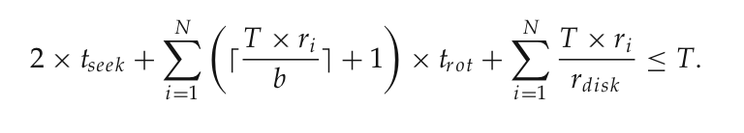
CineBlitz Admission Controller (Cont.)
The CineBlitz admission controller only admits a new client if there is at least 2 X T X r_{i} bits of free buffer space and the following equation is satisfied

Slide 31
End of Chapter 20

Slide 32
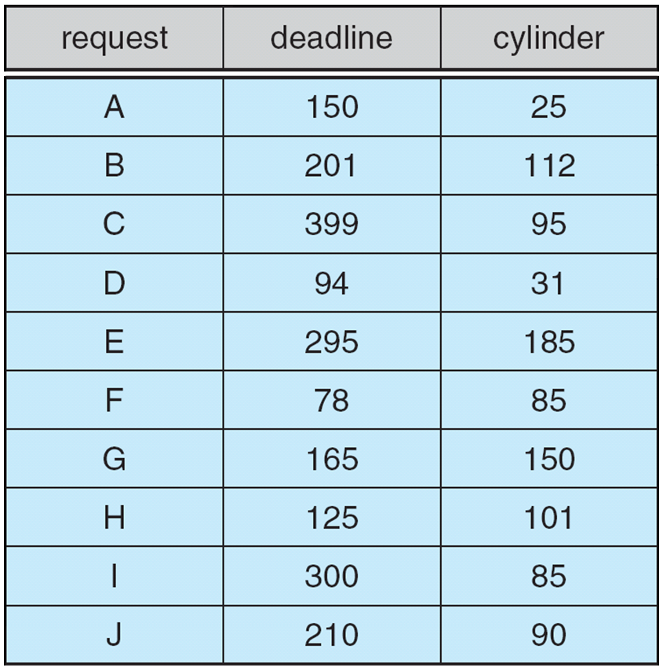

Slide 33
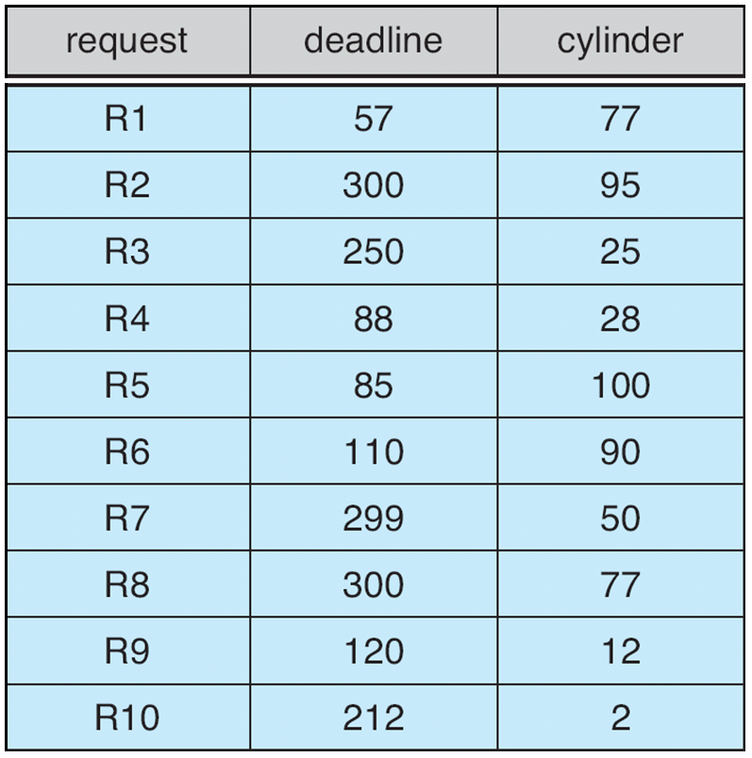
Exercise 20.10

