Slide 1
Link

Slide 2


SCU LawTech
陳偉傑 Wyne, TAN
東吳巨資延一

Slide 3





About Me
（Wyne Tan）
2020 AWS Educate Student Ambassador @AWS
Frontend Engineer & QA Engineer @中研院
法律
科技
雲端
運算
LinkedIn
WEI-JIE, (Wyne) TAN
Github
sefx5ever
金融
科技

Slide 4
Agenda
Getting start with Anaconda
Introduction of Jupyter Notebook
Dive in GitHub
The programming language – Python
Python Variables
Build-in Data Types a.k.a. Data Types
Build-in Function

Slide 5

Scan and Join LINE Group SCU_LawTech 咨詢小組

Slide 6
Anaconda
Install an Anaconda
Create a Python Environment

Slide 7

Install an Anaconda
Click and Download !

Slide 8
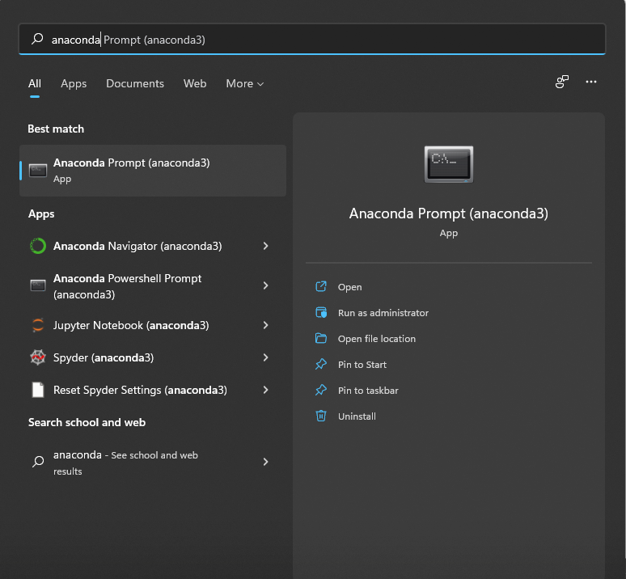
Create a Python Environment – STEP 1
Find “Anaconda Navigator”
and click it.

Slide 9
Create a Python Environment – STEP 2
Find “Anaconda Navigator”
and click it.

