Slide 1
https://bit.ly/30mn6d7

Slide 2


SCU LawTech
陳偉傑 Wyne, TAN
東吳巨資延一

Slide 3





About Me
（Wyne Tan）
2020 AWS Educate Student Ambassador @AWS
Frontend Engineer & QA Engineer @中研院
法律
科技
雲端
運算
LinkedIn
WEI-JIE, (Wyne) TAN
Github
sefx5ever
金融
科技

Slide 4
Agenda
Dive in GitHub
Getting start with Anaconda
Introduction of Jupyter Notebook
The programming language – Python
Python Variables
Build-in Data Types a.k.a. Data Types
Build-in Function

Slide 5

Scan and Join LINE Group SCU_LawTech 咨詢小組

Slide 6
GitHub
Download the course materials

Slide 7
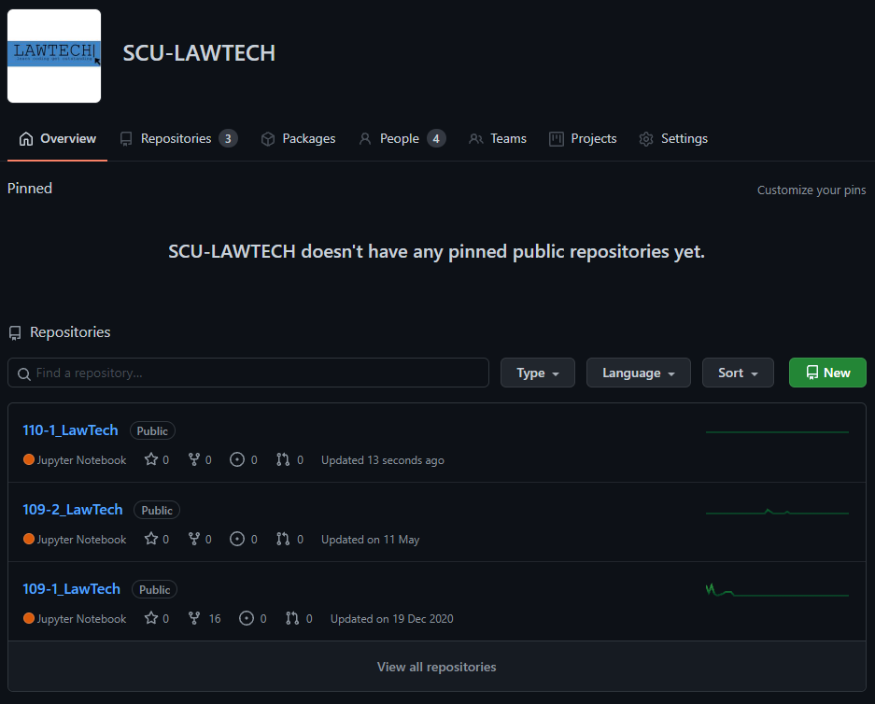
Download the course materials – STEP 1
Click on the LINK Then
Click on “110-1_LawTech”
TIPs
SCU-LawTech 的所有
課程教材

Slide 8
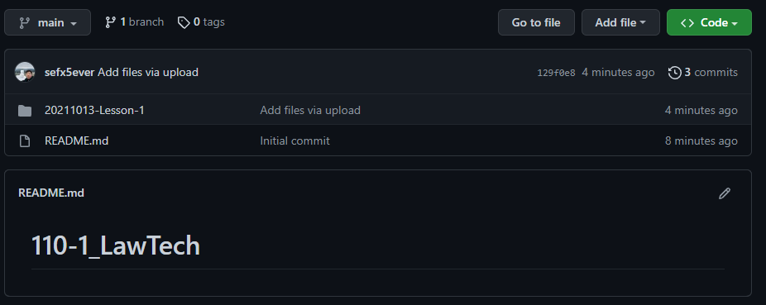
Download the course materials – STEP 2
Click on the folders “20211013-Lesson-1”

Slide 9
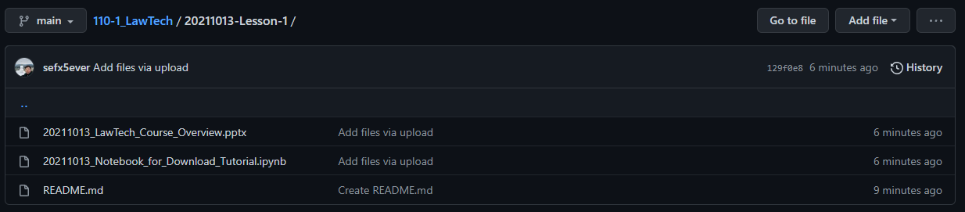

Download the course materials – STEP 3-1 .pptx
PPTX :
Click “20111013_LawTech_Course_Overview”, Then click on “ ” Button

Slide 10

Download the course materials – STEP 3-2 .ipynb
IPYNB :
Click “20111013_Notebook_for_Download_Tutorial”,
Click on “ ” Button

Slide 11
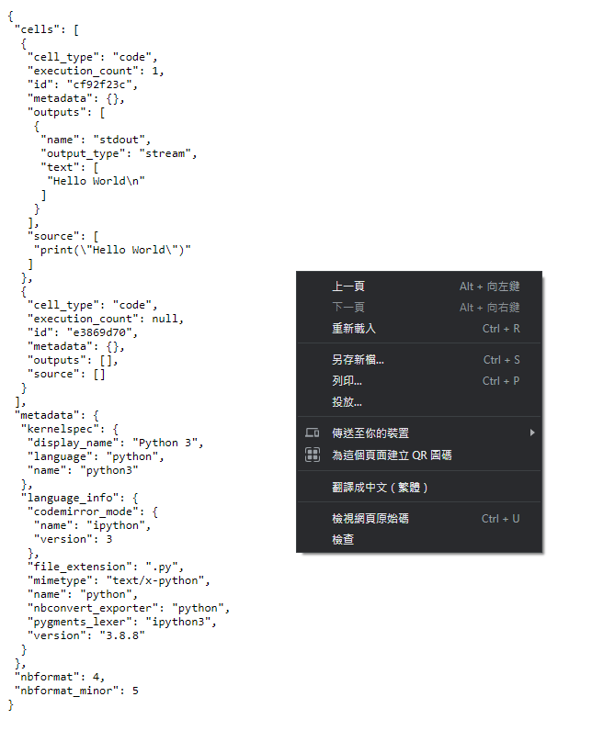
Download the course materials – STEP 3-2 .ipynb
IPYNB :
Click “另存新檔” Then
Click on “Save” Button
TIPs
儲存檔案時，請記得您把檔案儲存在
哪個文件夾下噢！

Slide 12
Anaconda
Install an Anaconda
Create a Python Environment

Slide 13

Install an Anaconda
Click and Download !

Slide 14
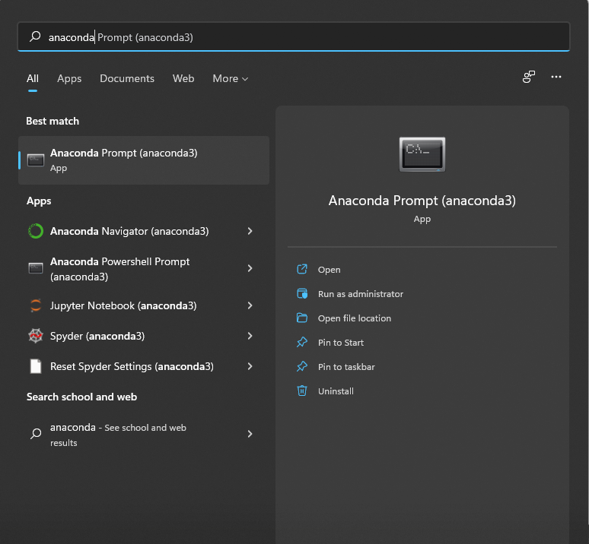
Create a Python Environment – STEP 1
Find “Anaconda Navigator”
and click it.

Slide 15
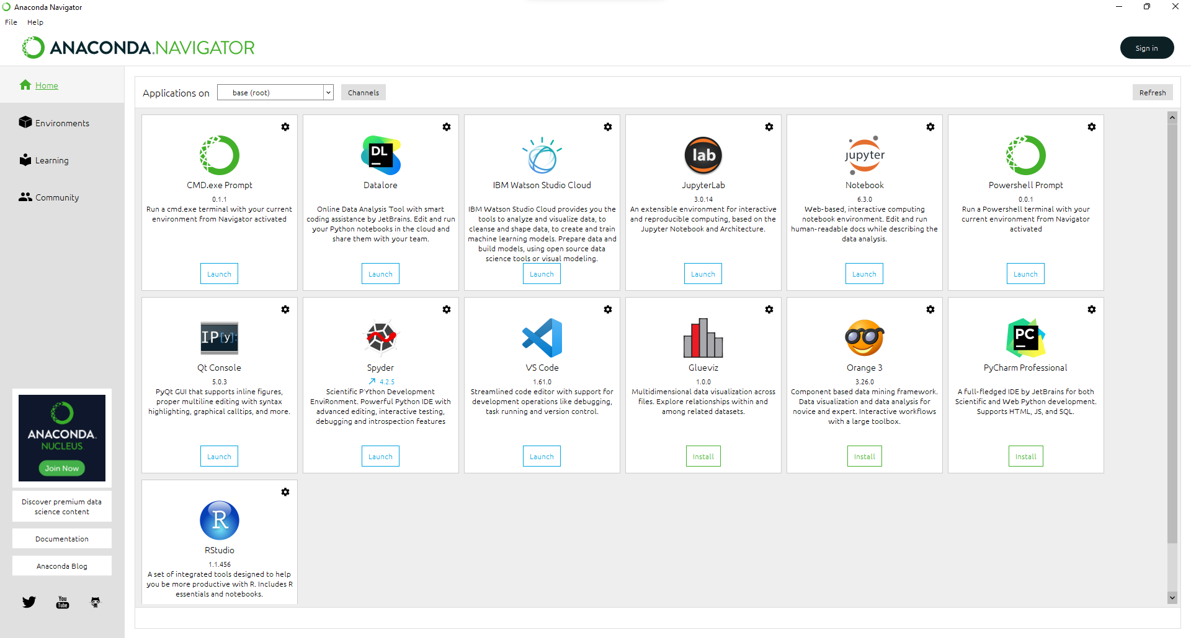
Create a Python Environment – STEP 2
Click “Launch” Jupyter Notebook

Slide 16
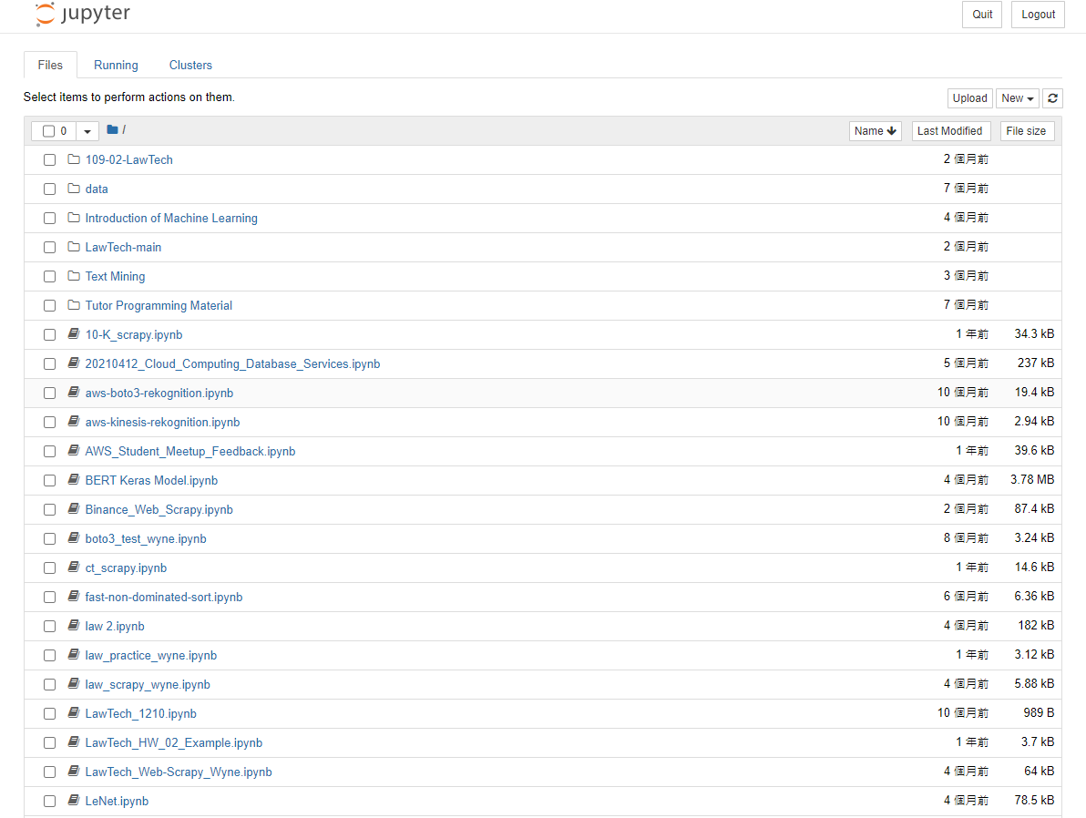
Create a Python Environment – STEP 3
Congratulation !
You had created a Python Environment.

Slide 17
Jupyter Notebook
Create a Python Project
Upload a Python Project
Python File Format
Jupyter Notebook Tutorial
Build your own Notebook

Slide 18
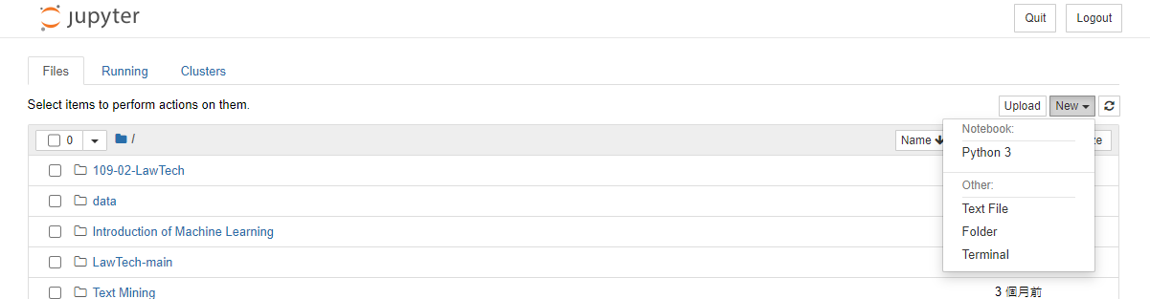
Create a Python Project – STEP 1
Click on “New” then
Choose the “Python 3”

Slide 19
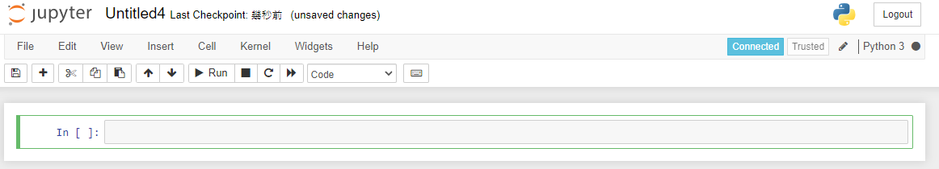
Create a Python Project – STEP 2
Congratulation !
You had created a Python Project!

Slide 20
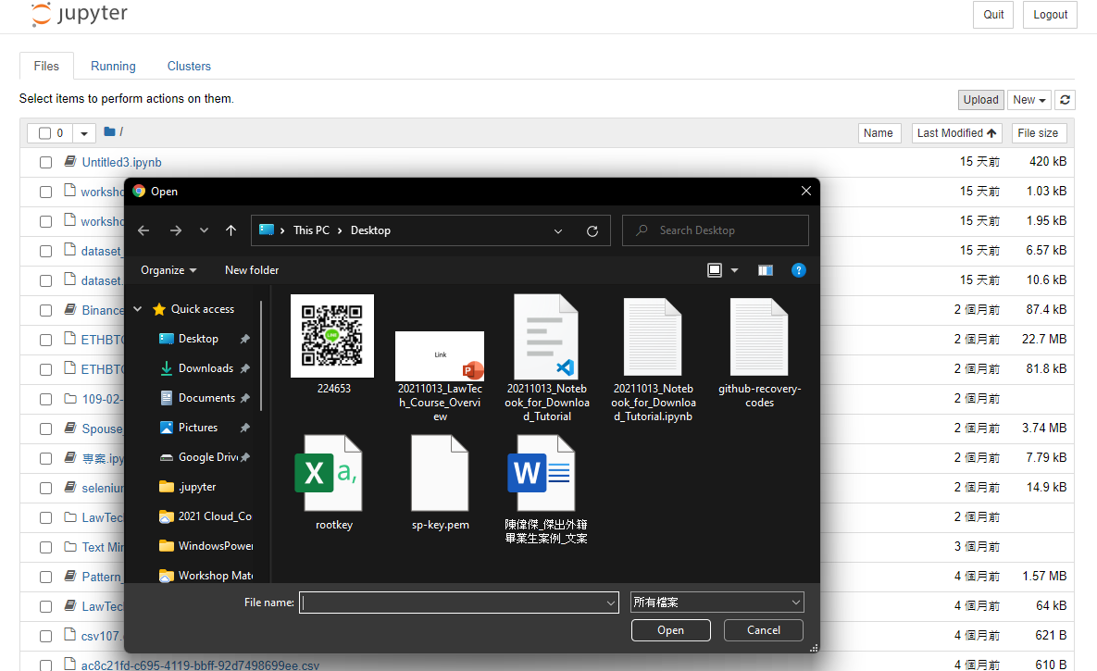
Upload a Python Project – STEP 1
STEP 1
IPYNB :
Back to “Home Page”
Click on “Upload”
Find the project you
Placed
Click “Open” Button
STEP 2
STEP 3

Slide 21
Upload a Python Project – STEP 2
STEP 1
IPYNB :
Click “Upload” Button
Find out and Tick the project
STEP 3
STEP 2

Slide 22
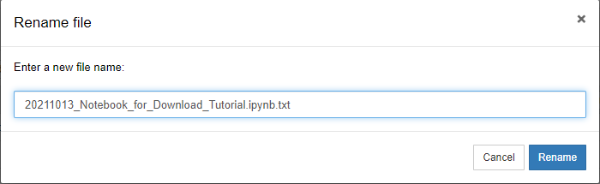
Upload a Python Project – STEP 3
STEP 1
STEP 2
IPYNB :
Delete “.txt” Then
Click “Rename” Button
Open the Project

Slide 23
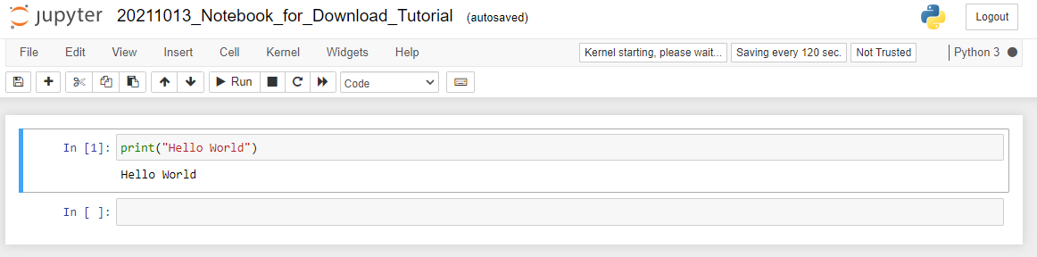
Upload a Python Project – STEP 4
Congratulation !
You had successfully uploaded and opened a project!

Slide 24
Python File Format
Back to “Home Page”
Find out the project that you created.

Slide 25
Python File Format
.ipynb
.py
一個 Python 筆記本
以特定格式包含筆記本代碼，執行結果和其他內部設置。
需在 Jupyter Notebook 環境上運行該檔案
常規的 Python 文件。
純文本，僅包含您的代碼

Slide 26
Jupyter Notebook Tutorial
Cell

Slide 27
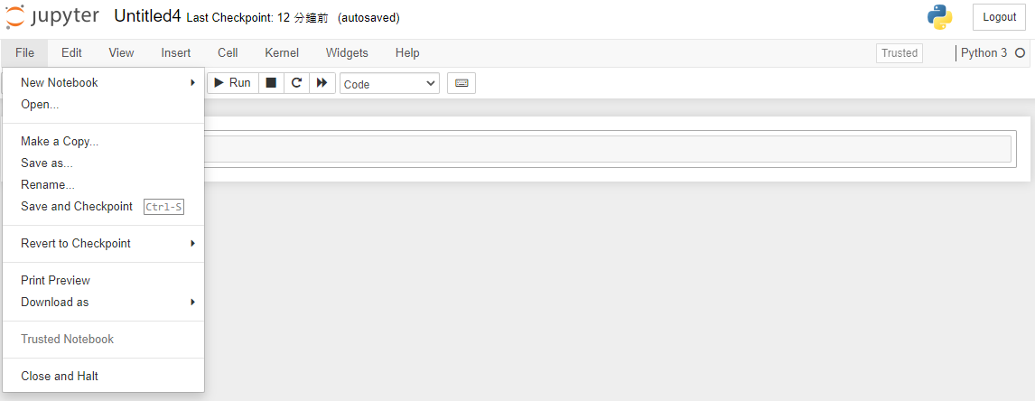
Jupyter Notebook Tutorial
Save

Slide 28
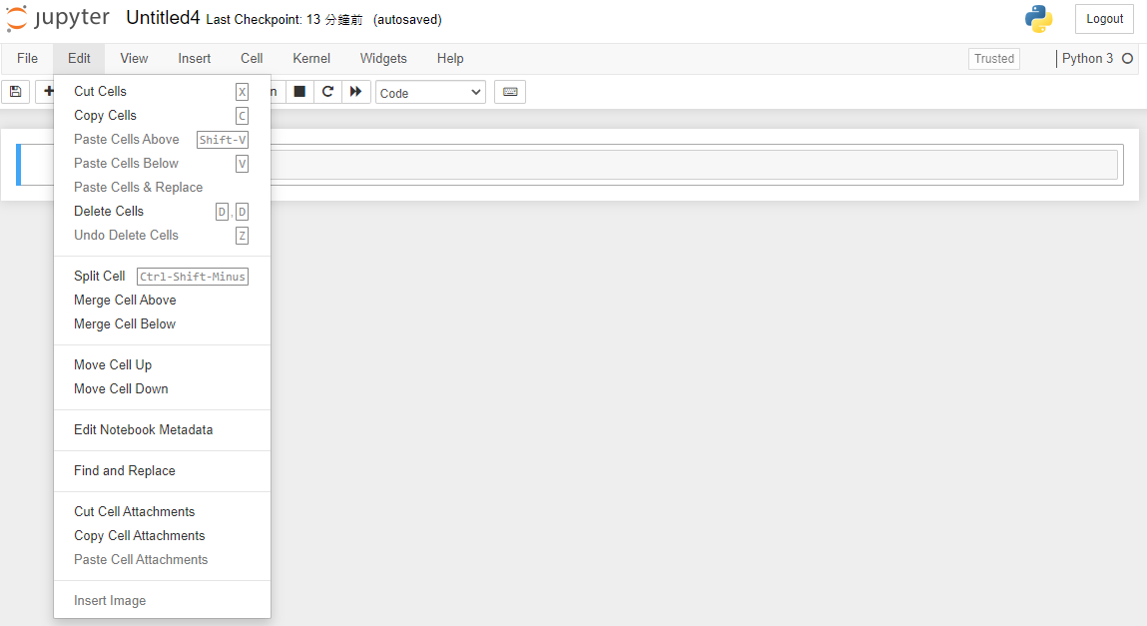
Jupyter Notebook Tutorial

Slide 29
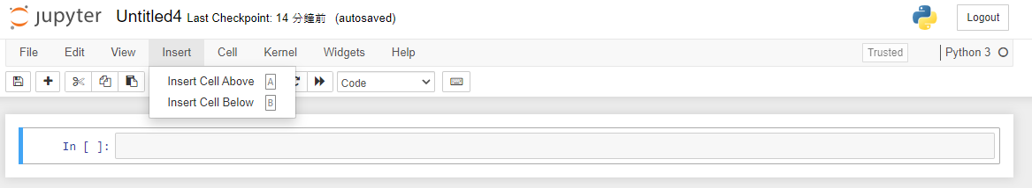
Jupyter Notebook Tutorial

Slide 30
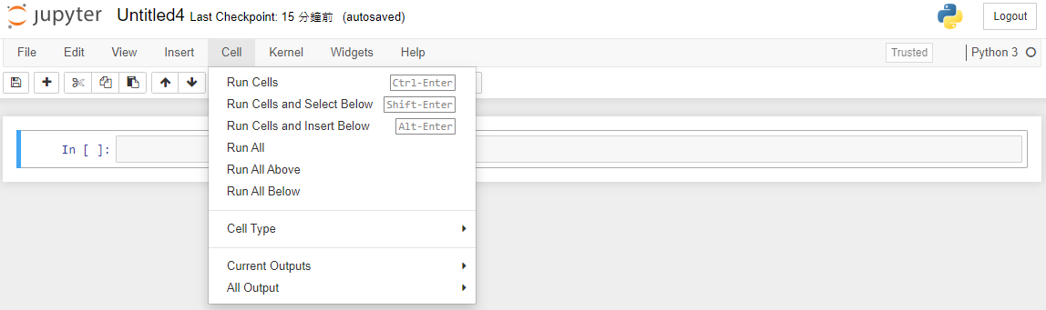
Jupyter Notebook Tutorial

Slide 31
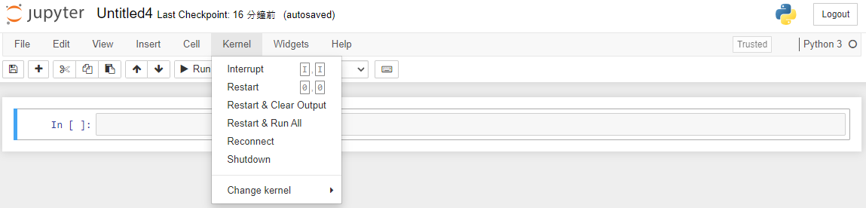
Jupyter Notebook Tutorial

Slide 32
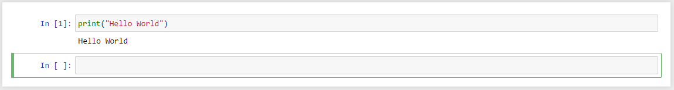
Jupyter Notebook Tutorial – Task : Print out the “Hello World”
STEP 1: Type【print(“Hellow World”)】in the cell
STEP 2: Press “Ctrl” + “Enter” Button

Slide 33
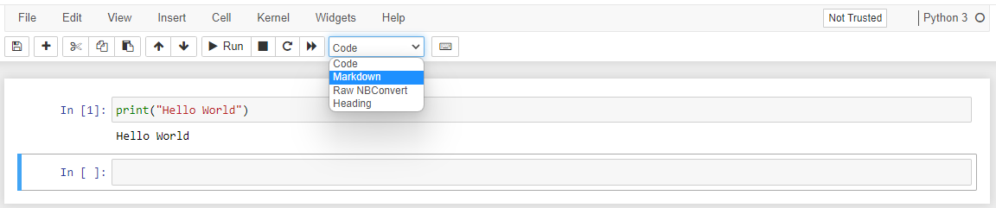
Build Your Own Notebook
Markdown（標記語言） Syntax（語法）
TIPs
若想使用 Markdown 語法，請將 Cell 的性質從 Code 切換程 Markdown 並執行該 Cell，
才能夠完全執行您輸入的語法噢！
參考文件：Markdown Basic Syntax

Slide 34
Python
What is Python
Variables
Data Types
Data Types Conversion
Build-in Function

Slide 35

What is Python ?
容易學習、功能強大
高效率的高階資料結構
簡單且有效的物件導向特性
優雅的語法及動態變數型態
適合快速開發應用程式
常見的應用：
Web 開發
桌面圖形界面
網頁爬蟲
人工智慧
軟體開發
資料分析

Slide 36
Variables 變數
X = ‘法律’
TIPs
“ = ” 在程式語言中是賦予、宣告的意思，
而並非數學代表 “等於” 的意思。

Slide 37
Variables 變數
Python 是物件導向的程式語言
物件包含三個要素
ID
Type
Value
唯一識別
物件形態
物件的值

Slide 38
Variables 變數 – Task : What number is X now?
X = 1
X = 4
X = 6
X = 8
TIPs
試想將進行不同順序的宣告時，X 變數會保留什麼值呢？
在 Python，符號 “#” 代表註解的意思噢！

Slide 39
Data Types 資料類型
Text – string
Numeric – integer, float
Boolean – bool
Type
使用 type 查看資料類型

Slide 40
Data Types Conversion 資料類型轉換
Text – string
Numeric – integer, float
Boolean – bool
Type
使用 type 查看資料類型

Slide 41
Built-in Function 內建函式 aka 保留字
id
type
input
int
str
float
len
isinstance
TIPs
若將保留字賦予其它值，其功能是否可以持續使用呢？
在 Python，到底有多少保留字呢？

Slide 42
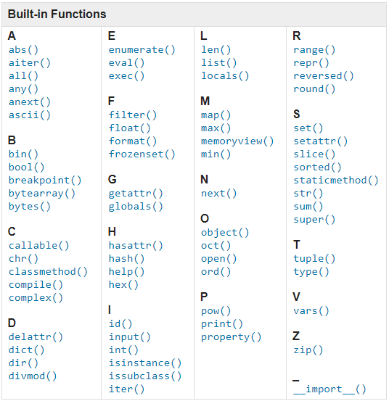
Built-in Function 內建函式 aka 保留字
id
type
input
int
str
float
len
isinstance
TIPs
若將保留字賦予其它值，其功能是否可以持續使用呢？
在 Python，到底有多少保留字呢？

Slide 43
Q & A
Ideas are worthless unless execution.

