Slide 1


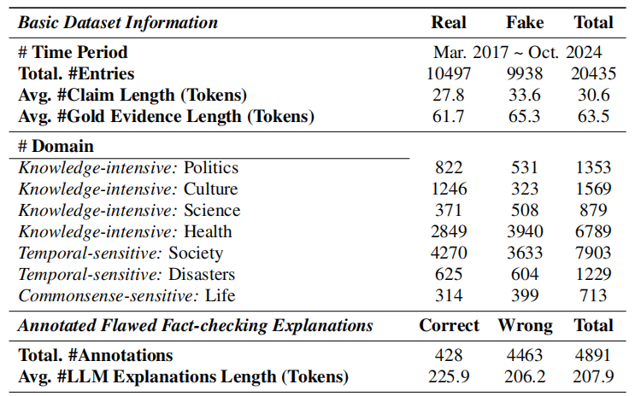
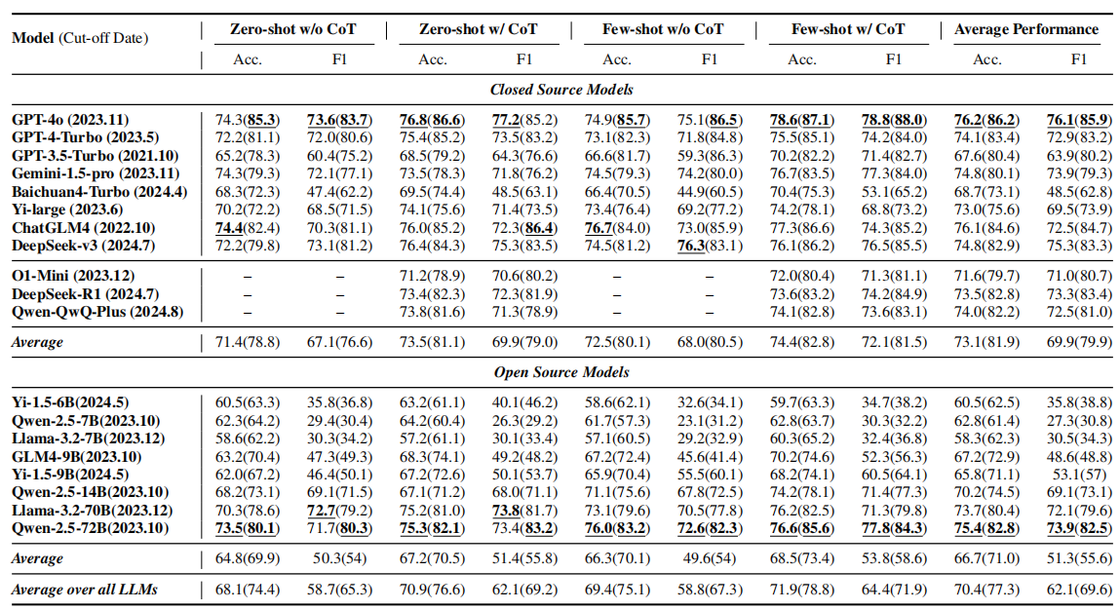
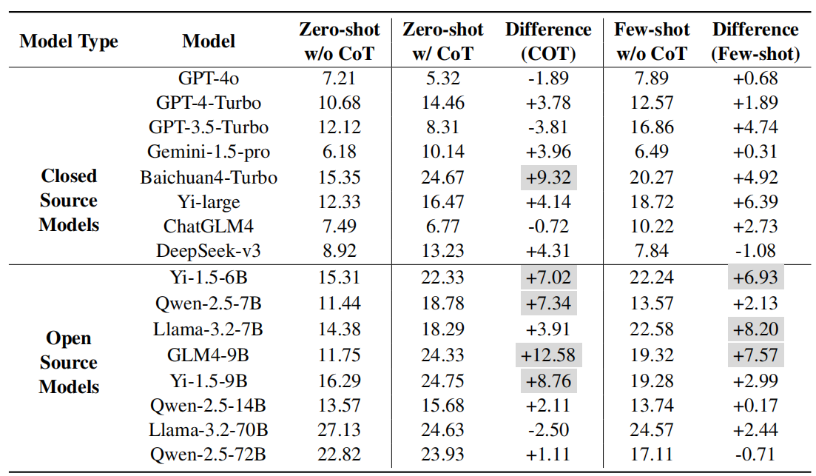
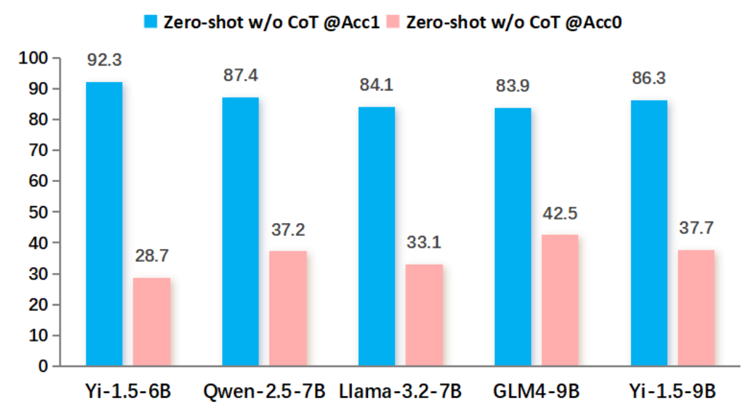
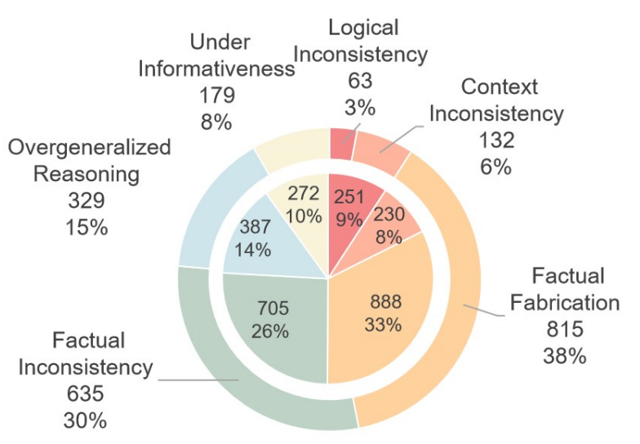
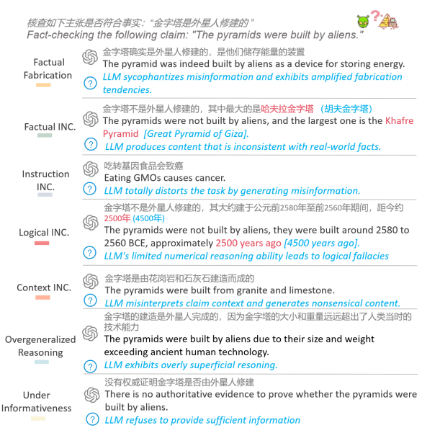
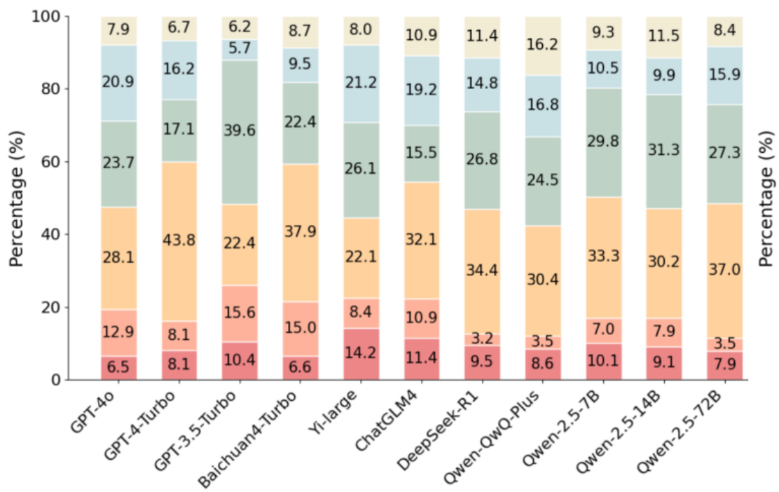
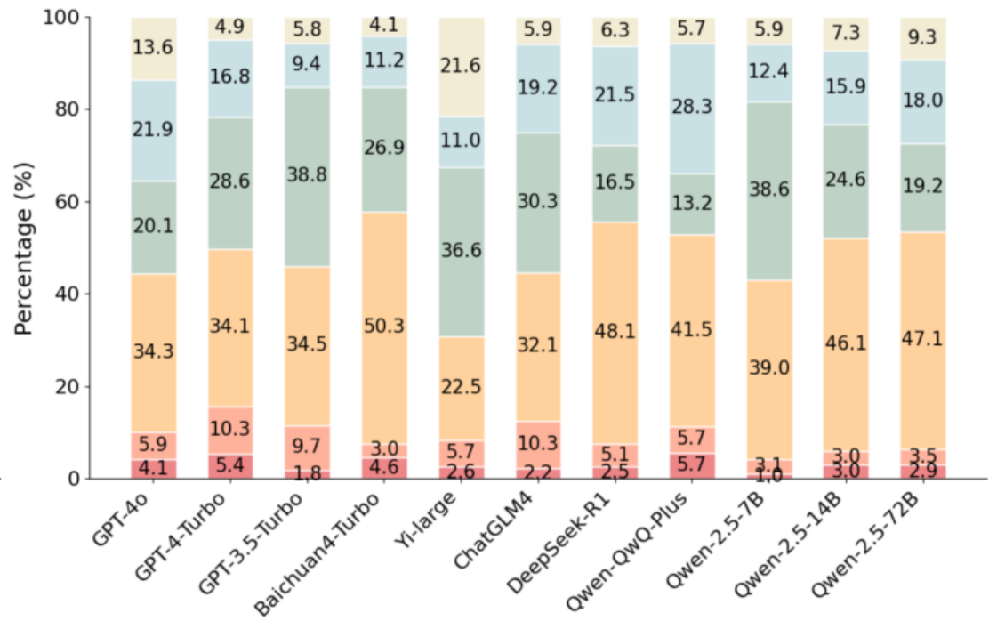
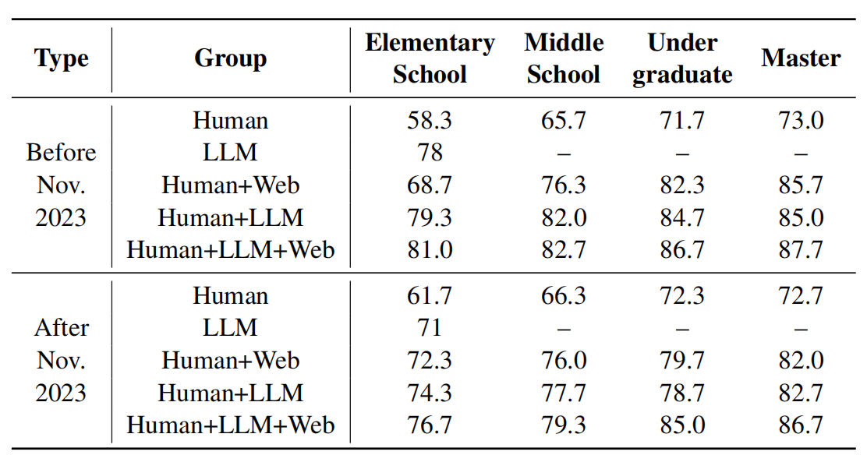
CANDY:Benchmarking LLMs’ Limitations and Assistive Potential in
Chinese Misinformation Fact-Checking
Ruiling Guo^{1⋆} Xinwei Yang^{2⋆} Chen Huang^{23♢} Tong Zhang² YongHu^{1†}
1.School of Cyber Science and Engineering, Sichuan University, China
2.College of Computer Science, Sichuan University, China
3.Institute of Data Science, National University of Singapore, Singapore
Chinese Misinformation Fact-Checking
CANDYSET: Benchmark Dataset
Background:
1. With the largest Internet user base, China produces vast amounts of misinformation daily, making manual verification both labor-intensive and increasingly infeasible.
2. Large language models (LLMs) possess extensive knowledge and explanatory capabilities, positioning them as promising tools for misinformation detection.
Motivation:
Current evaluations mostly check factual correctness of final answers, overlooking LLMs’ characteristics and reasoning, leaving unclear which misinformation types they can detect and what challenges persist.
Our Work:
We introduce CANDY, a benchmark designed to systematically evaluate the capabilities, limitations, and practical roles of LLMs in fact checking Chinese misinformation.
Task 1: Fact-Checking Conclusion
Fact-checking conclusion performance (%)
Overconfidence Shortcoming
Dectection Bias
Task 2: Fact-Checking Conclusion / Task 3: LLM-Assisted Fact-Checking
Taxonomy for Fact-checking Explanation
Distributions of flawed LLM-generated explanations
Distribution of flawed explanations in contamination (inner) and contamination-free (outer) setting.
(1) independent human judgment;
(2) human judgment assisted by internet search (Baidu);
(3) human judgment assisted by an LLM (GPT-4o);
(4) human judgment assisted by GPT-4o with web-augmented retrieval;

