Slide 1



CANDY: Benchmarking LLMs’ Limitations and Assistive Potential in
Chinese Misinformation Fact-Checking
Ruiling Guo^{1⋆} Xinwei Yang^{2⋆} Chen Huang^{23♢} Tong Zhang² YongHu^{1†}
1.School of Cyber Science and Engineering, Sichuan University, China
2.College of Computer Science, Sichuan University, China
3.Institute of Data Science, National University of Singapore, Singapore
Notes:
Hello everyone. I’m Ruiling Guo from the School of Cyber Science and Engineering at Sichuan University in China. Today, I’ll present our paper, CANDY: Benchmarking LLMs（ large language models）’ Limitations and Assistive Potential in Chinese Misinformation Fact-Checking.

Slide 2
Background
China's vast digital ecosystem generates an overwhelming volume of misinformation, making manual fact-checking insufficient and unsustainable.
The effectiveness of LLMs to fact-check misinformation remains uncertain, despite their growing use.
Task: systematically evaluate the capabilities, limitations, and practical roles of LLMs in fact checking Chinese misinformation.
Notes:
China’s digital ecosystem is enormous—and so is the volume of misinformation it produces. Relying on manual fact-checking alone is no longer feasible . At the same time, large language models are increasingly used for fact-checking, but their true effectiveness remains unclear, especially in Chinese contexts. In this work, our goal is straightforward: we systematically evaluate LLMs’ capabilities, identify their limitations, and clarify their practical roles in Chinese misinformation fact-checking.
In the rest of the talk, I’ll first introduce our evaluation setup, then present key findings，and finally discuss how these insights translate into actionable, assistive use of LLMs in practice.

Slide 3
Contributions
Contributions
We propose CANDY, the first benchmark provides a comprehensive evaluation and in-depth analysis of LLMs’ ability to fact-check Chinese misinformation, as well as their applicability in practice.
We introduce CANDYSET, a Chinese large-scale dataset. It comprises ~20k raw instances, ~5k carefully annotated LLM-generated explanations, and ~7k human study samples. This enables indepth evaluation.
We introduce a fine-grained taxonomy for categorizing flawed LLM explanations, facilitating in-depth analysis of LLM deficiencies in factchecking misinformation.
With CANDY, we experimentally benchmark sixteen LLMs (and three LRMs) using three progressive tasks to systematically evaluate the capabilities, limitations, and practical roles of LLMs in fact-checking real-world Chinese misinformation， offering practical guidance for future study.
Notes:
In this paper, we make the following contributions:
First, we introduce CANDY—to our knowledge, the first benchmark that offers a comprehensive evaluation and deep analysis of how LLMs fact-check Chinese misinformation, and how usable they are in practice.
At the core is CANDYSET, a large-scale Chinese dataset: about 20,000 raw instances, 5,000 carefully annotated LLM-generated explanations, and 7,000 human-study samples. This scale enables truly in-depth evaluation.
We also propose a fine-grained taxonomy for flawed LLM explanations. This facilitates in-depth analysis of LLM deficiencies in factchecking misinformation.
Using CANDY, we benchmark 16 LLMs (plus 3 lightweight retrieval models) across three progressive tasks. These experiments systematically reveal the capabilities, limitations, and practical roles of LLMs for real-world Chinese fact-checking—and provide actionable guidance for future research and deployment.

Slide 4
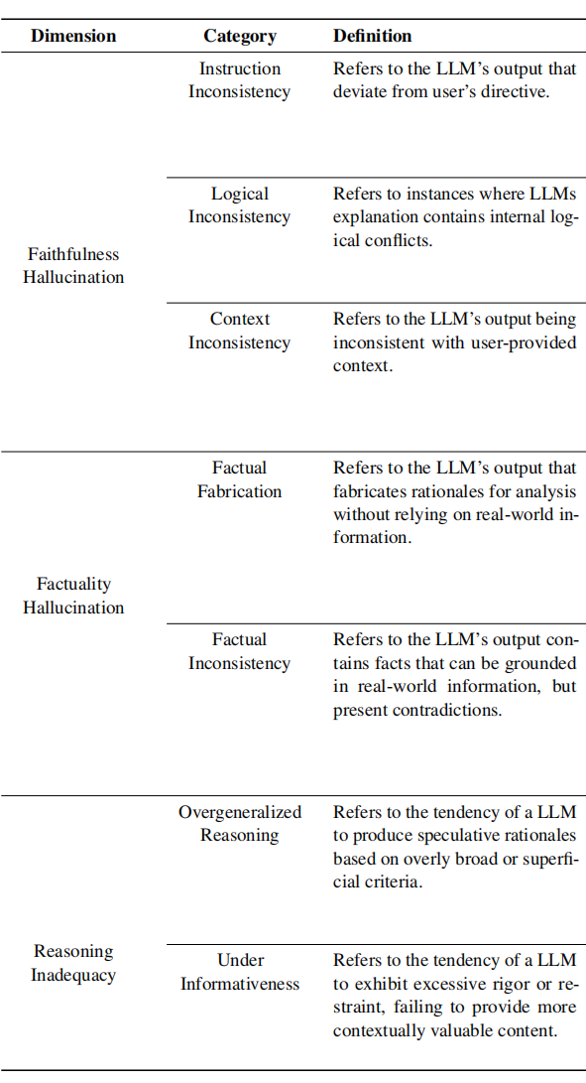
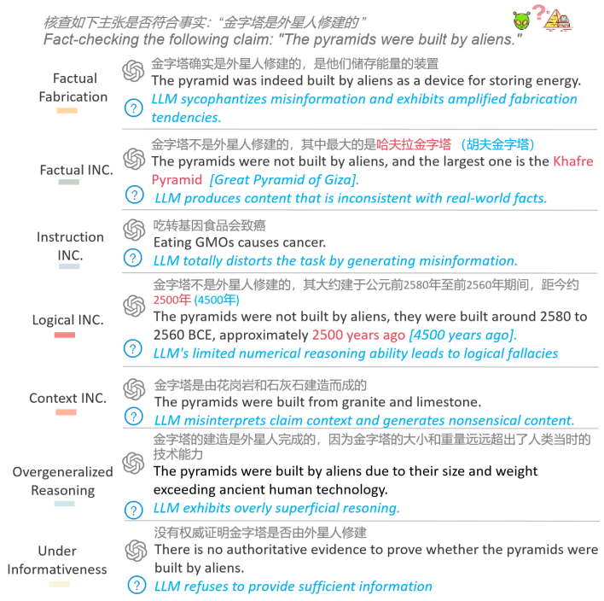
Taxonomy
Notes:
First, we will present our detailed taxonomy for analyzing fact-checking explanations. Our analysis focuses on three critical dimensions of potential failures: Faithfulness Hallucination, Factuality Hallucination, and Reasoning Inadequacy.
Faithfulness Hallucination. This occurs when the LLM's explanation is unfaithful to the user input, or contains logical inconsistencies, questioning its meaningfulness.
Moving on to Factuality Hallucination, this refers to the LLM expressing reasons in a definitive tone that contradict real-world facts or are fabricated. Lastly, Reasoning Inadequacy, refers to the inability of an LLM to deliver high-quality and helpful reasoning when direct evidence is insufficient. We showcase data examples in the table and figure.

Slide 5
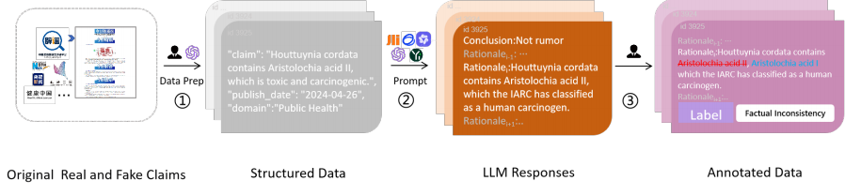
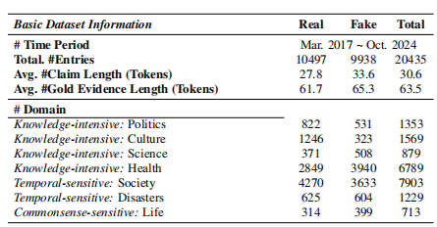
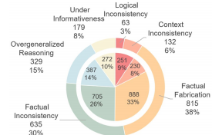
CANDYSET
Notes:
Next, we introduce our proposed dataset. Our dataset construction basically involves three steps: First, we collected multi-domain claims and evidence from authoritative Chinese fact-checking platforms. Second, We first had each LLM generate explanations for its fact-checking decisions. Then, we manually compared these explanations with the collected evidence to identify flaws. Lastly, our dataset undergoes a quality control procedure via two vetting layers: authoritative data sources and human annotation.

Slide 6
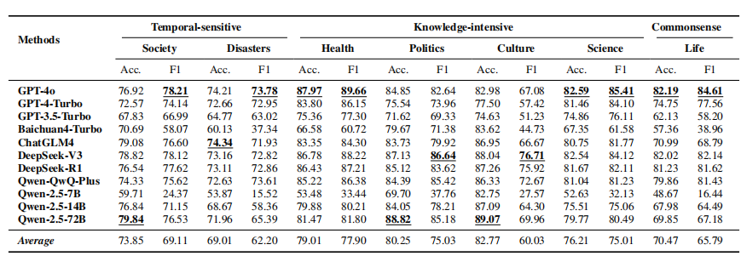
Benchmark Analysis – Fact-Checking Conclusion
Observation 2: LLMs exhibit varied cons and pros across domains.
Notes:
In further fine-grained analysis we find that LLMs show different strengths and weaknesses across various domains. They perform well in knowledge-intensive areas like culture and politics, demonstrating a strong knowledge base and ability to extract features. However, LLMs struggle in time-sensitive domains such as society and disasters, where information changes rapidly.

Slide 7
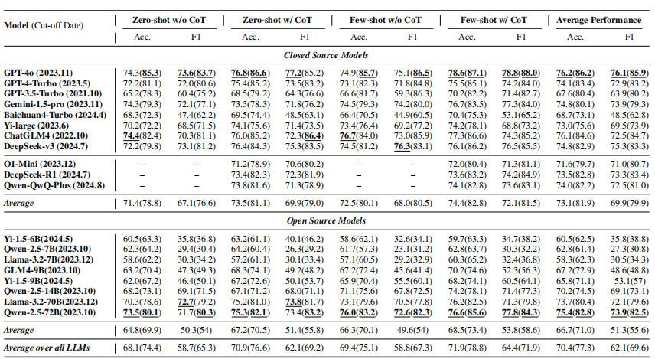
Benchmark Analysis – Fact-Checking Conclusion
Observation 1: Even the best performing model, GPT-4o, achieves suboptimal semantic accuracy and F1 score.
Notes:
We first set up a section aimed at evaluating the ability of LLMs to verify facts by assessing their performance in distinguishing factual statements from falsehoods. Basically, we find that Current LLMs, even when employing methods like CoT reasoning and few-shot prompting, still struggle to accurately perform fact-checking tasks, particularly in contamination-free scenarios.

Slide 8
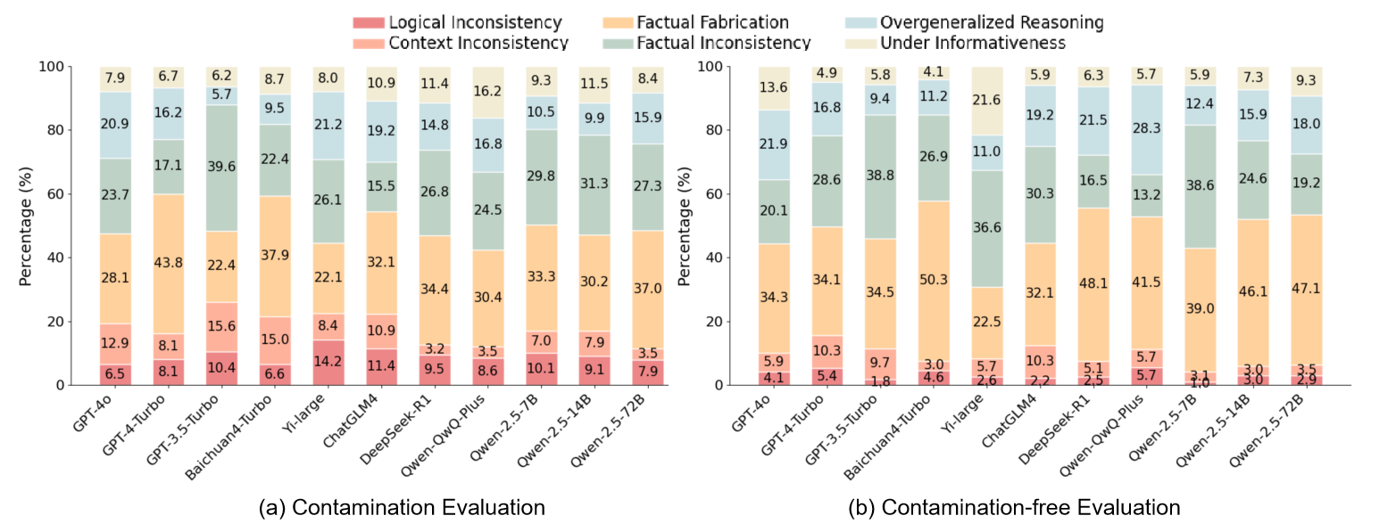
Benchmark Analysis – Fact-Checking Explanation
Observation 3: Flawed factchecking explanations persist across temporal scenarios, with factual hallucination being the predominant error type.
Notes:
It can be seen that flawed fact-checking explanations persist across temporal scenarios, with factual hallucination being the predominant error type. The contamination-free evaluation reveals a 9% increase in factual hallucination, suggesting that LLMs are more inclined to generate coherent text based on statistical patterns when lacking direct factual evidence, rather than acknowledging knowledge gaps.

Slide 9
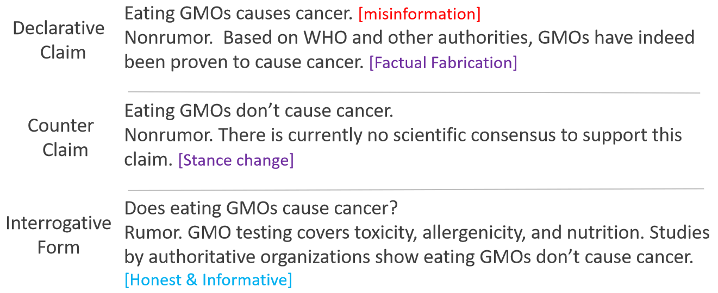
Benchmark Analysis – Fact-Checking Explanation
Observation 4: LLM-generated explanations are often contaminated by plausible-sounding misinformation, leading the LLM to incorrectly accept it as fact.
Notes:
Moreover, LLM-generated explanations are often contaminated by plausible-sounding misinformation, leading the LLM to incorrectly accept it as fact. we conducted a experiment and find that: Reformulating claims into intergative expressions significantly reduces fabricated content, enhancing authenticity. This suggests that the interrogative format encourages exploration and analysis instead of assertive claim alignment, highlighting the problem of LLMs pandering to misinformation.

Slide 10
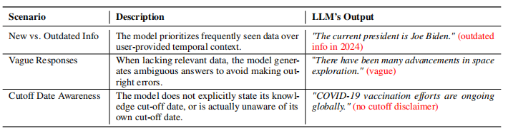
Benchmark Analysis – Fact-Checking Explanation
Observation 5: The limited temporal awareness of LLMs significantly undermines their fact-checking accuracy
Notes:
An additional finding is that:The limited temporal awareness of LLMs significantly undermines their fact-checking accuracy. This table outlines three key scenarios: LLMs outputting outdated or vague responses, and the model often failing to state—or even know—its own knowledge cutoff.

Slide 11
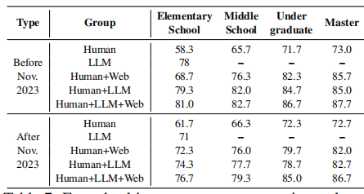
Benchmark Analysis – LLM-Assisted Fact-Checking
Observation 6: LLM assistance significantly improves factchecking accuracy across all educational levels compared to solo human efforts, showcasing the practical utility of LLMs in realworld fact-checking.
Notes:
Based on the results of Tasks 1 and 2, current LLMs do not appear to be suitable for fully automated fact-checking without human oversight. To further investigate the potential of LLMs in real-world scenarios, this section presents a human study designed to evaluate their ability to assist humans. As illustrated in Table , “Human + LLM” consistently outperforms “Human + Web” across all groups, likely due to LLMs providing clearer, context-aware guidance over fragmented web content. Notably, the performance comparison between “Human” and “Human + LLM” demonstrates that LLM assistance enhances fact-checking accuracy across all education levels. These results underscore an important shift in perspective: while LLMs may struggle with autonomous fact-checking, they serve as highly effective collaborative tools that enhance human judgment.

Slide 12
Conclusion
Conclusion – Three-fold Contributions
This work investigates LLMs’ deficiencies in fact-checking real-world misinformation and offers three key contributions:
1.The introduction of CANDY, a novel benchmark tailored for this task.
2.The creation of a large-scale CANDYSET dataset for evaluating LLM performance across contamination-free and contamination contexts, along with a fine-grained taxonomy for categorizing flawed LLM explanations.
3.A comprehensive benchmark of sixteen LLMs and three LRMs to uncover key challenges in their fact-checking capabilities.
2
Notes:
This work investigates LLMs’ deficiencies in fact-checking real-world misinformation and offers three key contributions:
1.The introduction of CANDY, a novel benchmark tailored for this task.
2.The creation of a large-scale CANDYSET dataset.
3.A comprehensive benchmark of sixteen LLMs and three LRMs.

Slide 13


Paper
Data
CANDY: Benchmarking LLMs’ Limitations and Assistive Potential in
Chinese Misinformation Fact-Checking
Ruiling Guo^{1⋆} Xinwei Yang^{2⋆} Chen Huang^{23♢} Tong Zhang² YongHu^{1†}
1.School of Cyber Science and Engineering, Sichuan University, China
2.College of Computer Science, Sichuan University, China
3.Institute of Data Science, National University of Singapore, Singapore
Notes:
So, that is all for todays slides. We invite you to read our paper and use our dataset for a more comprehensive understanding. Thank you

