Slide 1


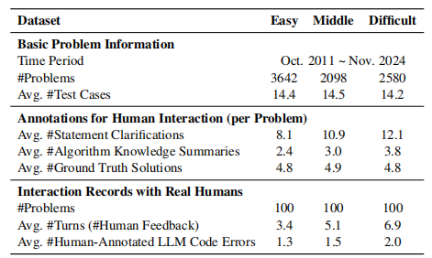
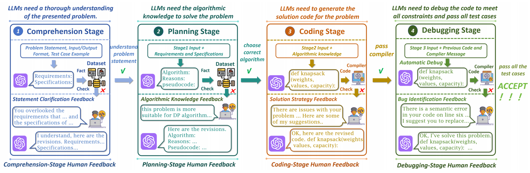
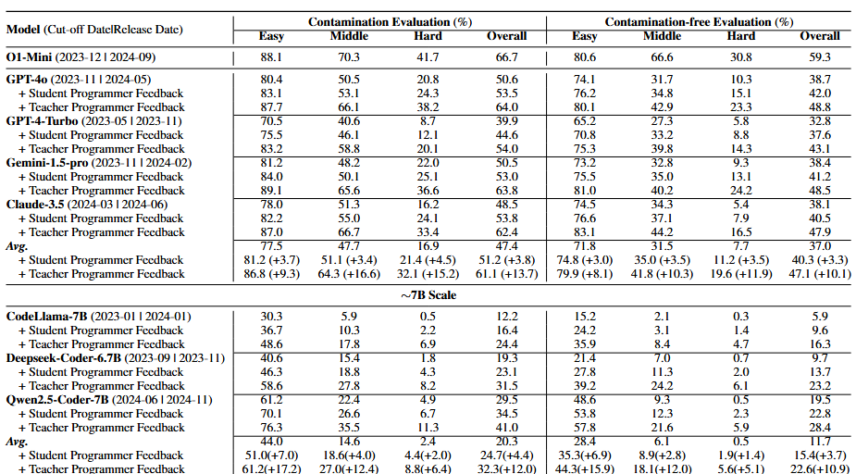
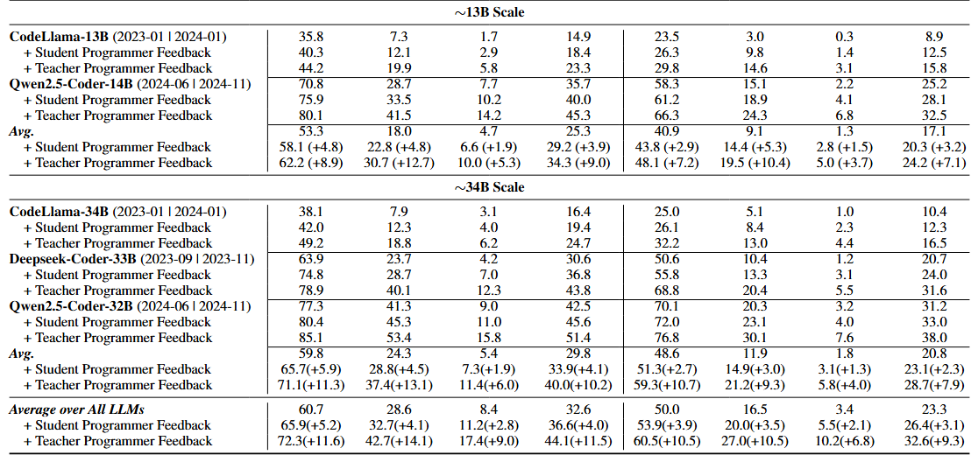
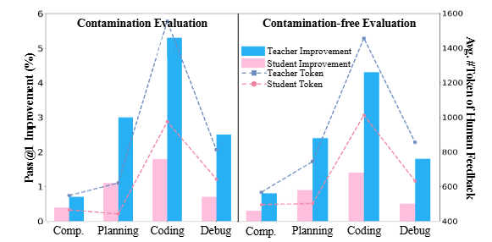
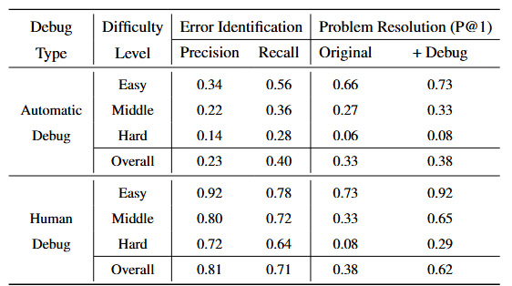
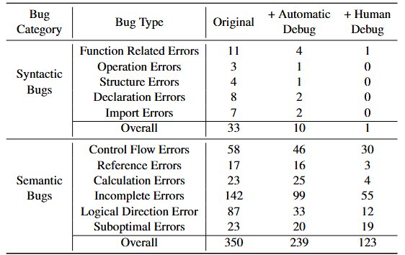
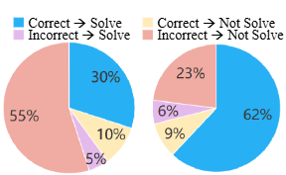
ELABORATION: A Comprehensive Benchmark on Human-LLM Competitive Programming
Xinwei Yang¹, Zhaofeng Liu2, Chen Huang1, Jiashuai Zhang1, Tong Zhang1, Yifan Zhang3, Wenqiang Lei1
¹Sichuan University ²Tianjin University of Science and Technology ³Vanderbilt University
Human-LLM Competitive Programming
ELABORATIONSET:Benchmark Dataset
Background:
While large language models have attracted attention in competitive programming, their practical utility remains limited due to underwhelming performance.
To address this, Human-LLM Competitive Programming employs a human-in-the-loop approach, using multi-turn feedback to improve LLM performance in competitive programming.
Motivation:
Existing research on Human-LLM collaboration in competitive programming is fragmented and lacks a unified benchmark to evaluate its effectiveness throughout the full problem-solving process.
Our Work:
We present ELABORATION, a novel benchmark for Human-LLM competitive programming with a comprehensive evaluation protocol that includes a taxonomy of human feedback and a new human-LLM programming dataset to assess the entire competitive programming process.
Evaluation Protocol & Human Feedback Taxonomy
Evaluation Protocol
Human Feedback Taxonomy
This diagram presents a four-stage evaluation framework for assessing LLMs in programming tasks — Comprehension, Planning, Coding, and Debugging.
At each stage, the model receives structured inputs and iterative human feedback to progressively refine its understanding, algorithm design, implementation, and final correctness, aiming to pass all test cases successfully.
Problem Construction
LLMs require a thorough understanding of the problem statement. To facilitate this, human feedback can provide crucial requirements and specifications.
Solution Planning
LLMs plan solutions by selecting suitable algorithms, guided by human feedback offering suggestions, justifications, or pseudocode.
Code Generation
LLMs must generate complete, compilable code. In this case, human feedback can suggest solution strategies to improve the generated code.
Code Debugging
LLMs must pass the complete set of test cases. In this case, humans assist in identifying errors until all unseen test cases are passed.
Benchmark Analysis
Experimental Setup
Task & Data: ELABORATIONSET
Baselines: O1-Mini, GPT-4o, GPT-4-Turbo, Gemini-1.5-pro , Claude-3.5, CodeLlama-Series, Deepseek-Coder-Series, Qwen2.5-Coder-Series.
Evaluation Metrics: we utilize the Pass@k (k=1,3,5)5 metric (Chen et al., 2021) to evaluate overall performance.
Overall Performance (RO1) :
They experimental results demonstrate limited capacity for solving competitive programming problems, particularly those of high difficulty or unseen ones.
Human-LLM collaboration significantly enhances LLM performance, demonstrating the crucial role of human feedback.
Finer-grained Analysis(RQ2):
1. During the coding stage, even on problems with no data contamination, the human feedback is most beneficial.
2. Expert feedback(Teacher Programmer) yields greater benefits, its higher cost necessitates efficient use of human resources.
Student Programmer: (Intermediate Skill Level) possess more than basic programming knowledge but lack the deep expertise.
Teacher Programmer: (Expert Level) possess a high level of programming skill and experience.
Collaborating with Real Humans(RQ3):
1. Humans play a vital role in identifying bugs and improving LLM performance.
2. Human and LLMs have complementary strengths, creating a powerful synergy.

