Slide 1
Introduction to lab1

Slide 2
The definition of words
word | code | word | code
const | 1 | > | 19
int | 2 | <= | 20
float | 3 | >= | 21
void | 4 | ! | 22
if | 5 | && | 23
else | 6 | || | 24
while | 7 | = | 25
break | 8 | { | 26
continue | 9 | } | 27
return | 10 | [ | 28
+ | 11 | ] | 29
- | 12 | ( | 30
* | 13 | ) | 31
/ | 14 | , | 32
% | 15 | ; | 33
== | 16 | literal | 34
!= | 17 | identifier | 35
< | 18
identifier → identifier-nondigit | identifier identifier-nondigit | identifier digit
identifier-nondigit →a|b|c|...z|A|B|C...Z|_
identifier digit→0|1|2|....9
literal→int|float
int→decimal-const | octal-const
| hexadecimal-const
decimal-const → nonzero-digit | decimal-const digit
octal-const → 0 | octal-const octal-digit
hexadecimal-const→ hexadecimal-prefix hexadecimal-digit
| hexadecimal-const hexadecimal-digit
hexadecimal-prefix → 0x | 0X
nonzero-digit →1|2|3....9
octal-digit→0|1|2......7
hexadecimal-digit→0|1|2......9|a|A|b|B|......f|F
digit→0|1|2....9
keyword=”const”|”int”|”float”|”void”|”if”|”else”|”while”|”break”|”continue”|”return”
operation='+' | '-' | '*' | '/' | '%' |"==" |"!=" |'<' | '>' | '<='| '>=' | '!' | '&&' | '||' | '='
delimiter='{' | '}' | '[' | ']' |'(' | ')' | ',' | ';'

Slide 3
The realization of program
1.Lists setting and classification:we set these lists: keyword_list, operation_list, delimiter_list, to store the element and signal_list to store “ ”and “\n”, and comment_list to store “//”,”/*”, ”*/”
2.Comment checking and deletion, word division.We read the source code as text and delete the comment.Meanwhile we check if the signal of comment is correct. Then we try to divide the words. Initially we set a list to store the word and a variable”new_word” to store the current word.
If we read the word in signal_list, we skip it, move “new_word” into the list and initialize the new_word to blank.
If we read the operation with length 2, we move the “new_word”into the list, and initialize it. Also move the recognized operation into the list.
If we read the operation or delimiter with length 1, we also do it the same as 4.
Else if we read char or number, we add it to the “new_word”and than read the next char.
3.Tuple generating.We write several functions to decide their type: keyword, operation, delimiter, identifier and literal. Then transfer each word into a 2-tuple according to the code table.

Slide 4
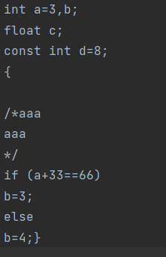
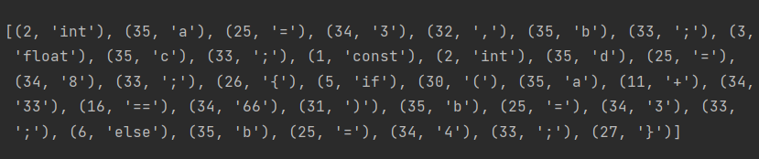
The result
input:
output:

Slide 5
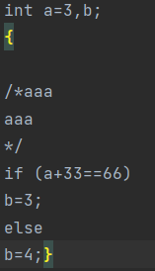
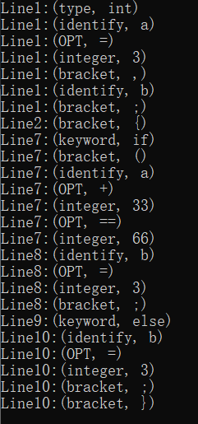
The flex-result

