Slide 1
GeoNexus-RSD
Current Status
DOTA2 S1 improves over RoI Transformer S0.
S2 shows repeatable early-checkpoint gain, but final checkpoints are unstable.
DIOR-R sanitized route is active with S1 replicas and S2 metrics pending.
Hierarchy- and Context-Aware Vision-Language Prompting for Oriented Remote Sensing Detection
Progress report | DOTA2 first, DIOR-R validation
Dinghao Li
Xi'an Jiaotong University
June 13, 2026

Slide 2
Contents
GeoNexus-RSD Progress
Advisor/group progress report structure
01
Intro
Problem and current GeoNexus-RSD route
02
Related Work
Oriented detectors and RS vision-language prompting
03
Method
Framework, prompt bank, regularization, adapters
04
Experiments
DOTA2 and DIOR-R progress with current risks

Slide 3
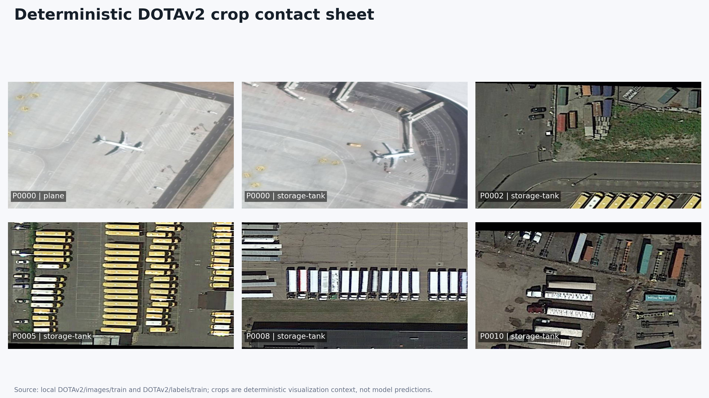
Intro: Oriented Detection Challenge
GeoNexus-RSD Progress
Remote sensing detection remains sensitive to scale, rotation, density, and class granularity.
Why this setting is hard
Objects appear at arbitrary orientations and large scale ranges.
Fine-grained categories share similar textures and layouts.
Dense scenes make proposal assignment and pseudo-label quality brittle.
DOTA2 is now the formal benchmark route; DOTA v1.5 remains archive/debug evidence.
Visual goal: improve prompt-aware oriented detection without over-claiming open-vocabulary behavior.

Slide 4
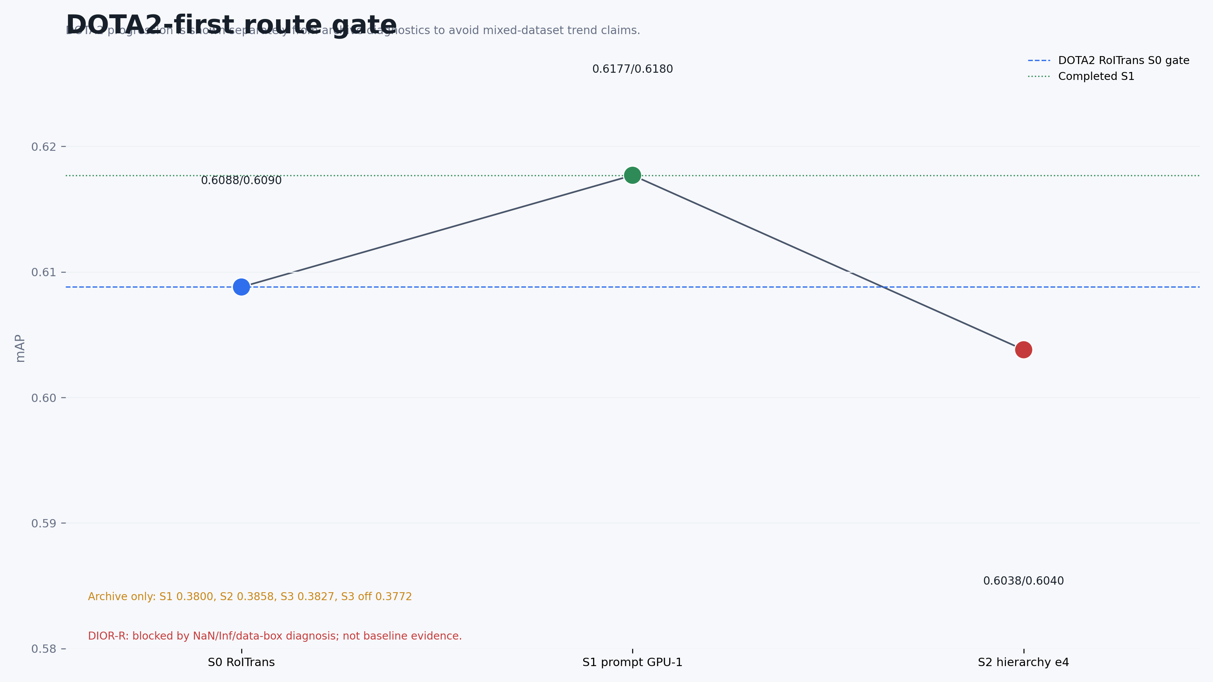
Intro: GeoNexus-RSD Route
GeoNexus-RSD Progress
The current route is staged: stabilize detector evidence first, then reopen pseudo-label/context extensions.
Current gate
DOTA2 S0 and S1 are completed and archived.
S2 loss-0 has repeatable early-checkpoint improvement but unstable final checkpoints.
DIOR-R sanitized S0 and S1 are available; S2 hierarchy replicas have clean startup and pending metrics.
S3/S4, pseudo-label purification, FAIR1M, and routing stay paused.

Slide 5
Related Work: Detector and VLM Context
GeoNexus-RSD Progress
We position GeoNexus against oriented detection baselines and recent RS prompt/OVD work.
Detector backbone
RoI Transformer is the main controlled oriented detector for DOTA2 and DIOR-R.
ORCNN and Rotated RetinaNet remain useful DIOR-R comparison baselines, but RoI Transformer currently leads.
Evaluation uses DOTA-style mAP/AP50; best and final checkpoints are reported separately.
Vision-language references
OpenRSD motivates open-prompt alignment for remote sensing detection.
RemoteCLIP is used as the project VLM embedding source.
RS-MPOD, DisDop, SOAR, and VK-Det inform future prompt, distillation, and pseudo-label ideas.

Slide 6
Related Work: Project Gap
GeoNexus-RSD Progress
Adjacent methods motivate the direction, but current claims must match implemented and measured modules.
Source
Main idea
Relation to GeoNexus-RSD
Use now
OpenRSD
Open prompts and alignment
Reference framing for RS prompt detection
Anchor
RS-MPOD
Multiple prompt cues
Prompt ambiguity in aerial categories
Defer
SOAR / VK-Det
Pseudo-label and prototype cues
Relevant to planned S4 purification
Paused
DisDop
Domain-prior distillation
Possible future teacher-prior branch
Future
Conservative gap statement: current evidence is hierarchy/prompt-aware detector progress, not a completed open-vocabulary or pseudo-label purification system.

Slide 7
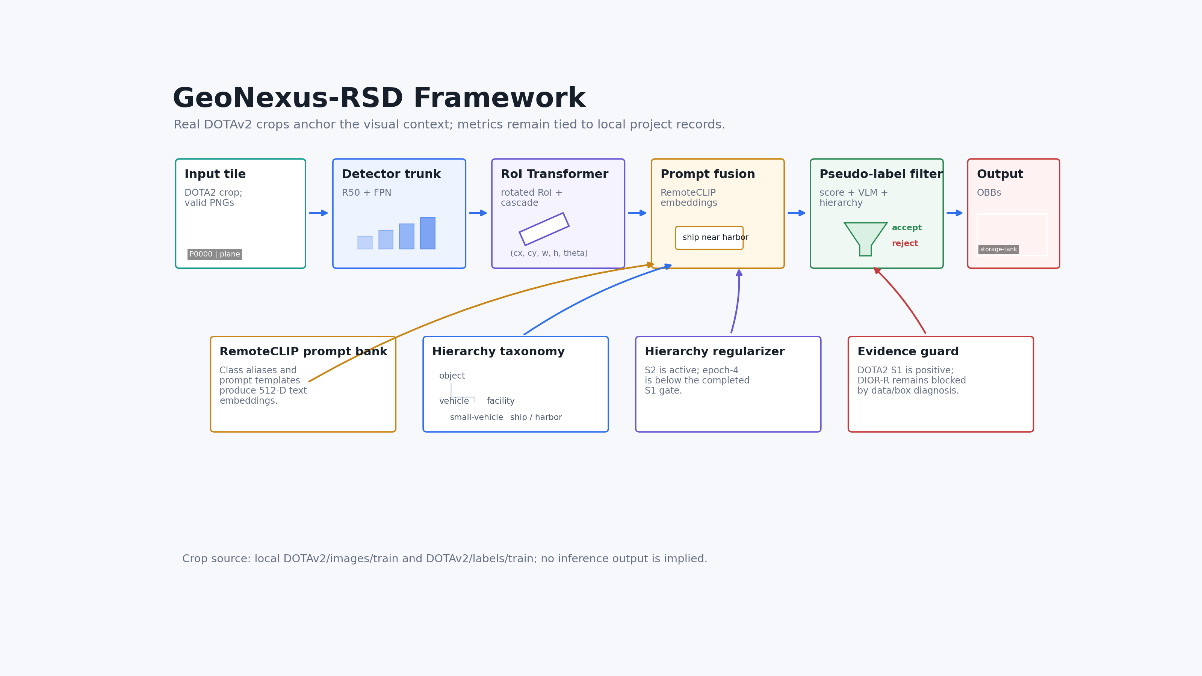
Method: Overall Framework
GeoNexus-RSD Progress
Existing framework asset, interpreted as the current staged pipeline rather than a final end-to-end claim.
Implemented / active
S0: RoI Transformer baseline
S1: RemoteCLIP prompt scoring
S2: hierarchy regularization variants
Planned / paused
Context adapter and pseudo-label purification are not yet paper-facing claims.

Slide 8
Method Key Point: Prompt Bank and Scoring
GeoNexus-RSD Progress
S1 uses a hierarchy-oriented prompt bank with RemoteCLIP-based prompt scoring.
Prompt bank
Class prompts are organized around fine-grained RS object semantics.
RemoteCLIP ViT-B/32 provides normalized prompt embeddings.
The DOTA2 S2 prompt artifact validates 18 classes, finite embeddings, and an 18 x 18 relation matrix.
Detector integration
RoI Transformer remains the detector backbone for controlled comparisons.
S1 tests whether prompt scoring improves the DOTA2 detector route.
Main DOTA2 S1 improves from 0.6088/0.6090 to 0.6177/0.6180.

Slide 9
Method Key Point: Regularization and Planned Modules
GeoNexus-RSD Progress
S2 is treated as an active stabilization question; later modules remain gated.
S2 hierarchy
Regularizes class relations through hierarchy-aware targets.
Loss-0 ablation gives repeatable early-checkpoint gains.
Final-checkpoint instability blocks stronger claims.
Context adapter
Planned scene/context prompt adapter.
Useful for dense ports, airports, and urban scenes.
Paused until S2 and DIOR-R stability are resolved.
Pseudo-label plan
Purify pseudo labels with VLM and hierarchy cues.
Inspired by SOAR/VK-Det/CastDet style evidence.
Not part of current paper-facing results yet.

Slide 10
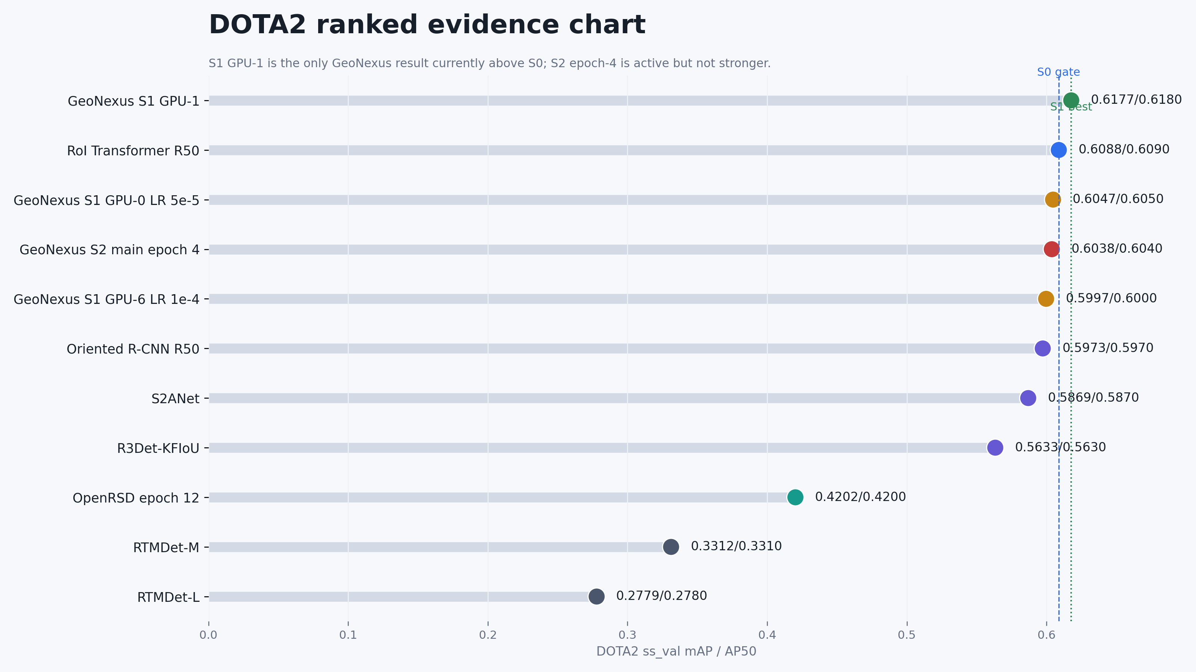
Experiments: DOTA2 Progress
GeoNexus-RSD Progress
DOTA2 is the primary benchmark route; S2 evidence is useful but not stable enough as a final claim.
Stage
mAP
AP50
Read
S0 RoI Trans.
0.6088
0.6090
base
S1 GeoNexus
0.6177
0.6180
up
S2 best mean
0.620606
-
early
S2 final mean
0.616655
-
unstable
Interpretation: S1 is the clean current gain. S2 best-checkpoint behavior is repeatable, but final checkpoints fall slightly below S1 on average.

Slide 11
Experiments: DIOR-R Sanitized Route
GeoNexus-RSD Progress
DIOR-R moved from non-finite detector failures to sanitized finite training and active GeoNexus replicas.
Run
mAP
AP50
Status
S0 RoI Transformer
0.6531
0.6530
best archived on sanitized labels
S1 replica A
0.6751
0.675
completed
S1 replica B
0.6690
0.669
completed
S2 hierarchy replicas
pending
pending
launched with clean startup
Readout
Sanitization removed invalid-size records and bounded train-step diagnostics stayed finite.
S1 improves over the sanitized RoI Transformer S0, but S2 hierarchy metrics are still active/pending.

Slide 12
Summary and Next Steps
Completed
DOTA2 S0/S1 archived.
DOTA2 S2 loss-0 stability analyzed.
DIOR-R sanitized S0/S1 evidence available.
Risks
S2 final checkpoints remain unstable.
DIOR-R S2 metrics are pending.
Pseudo-label and context modules are not yet measured.
Next
Archive DIOR-R S2 best/final metrics separately.
Decide whether S2 is best-checkpoint evidence or stays diagnostic.
Only then reopen context adapter and pseudo-label purification.

