Slide 1
AQUANET · 水眸 · TEDx TALK
你不看，水就消失了
What you don’t look at, disappears.
Joey Yip · 叶承祖
Founder · AquaNet 水眸
I. 开场 · OPENING
AQUANET-WATER.ORG

Slide 2
I. 开场 · OPENING
Why do we walk past things
that are sick?
QUESTION · PARK LANE HARBOUR · 小径湾 · 惠州 HUIZHOU
01

Slide 3
II. 问题重述 · THE PROBLEM REFRAMED
17 million people.
A small number of monitoring stations.
深圳 · SHENZHEN
Most of the water near you — the creek behind your apartment,
the pond next to your school — is invisible. Nobody is looking.
DATA · OFFICIAL MONITORING COVERAGE
02

Slide 4
II. 问题重述 · THE PROBLEM REFRAMED
We don’t have a science problem.
We have an attention problem.
REFRAME
03

Slide 5
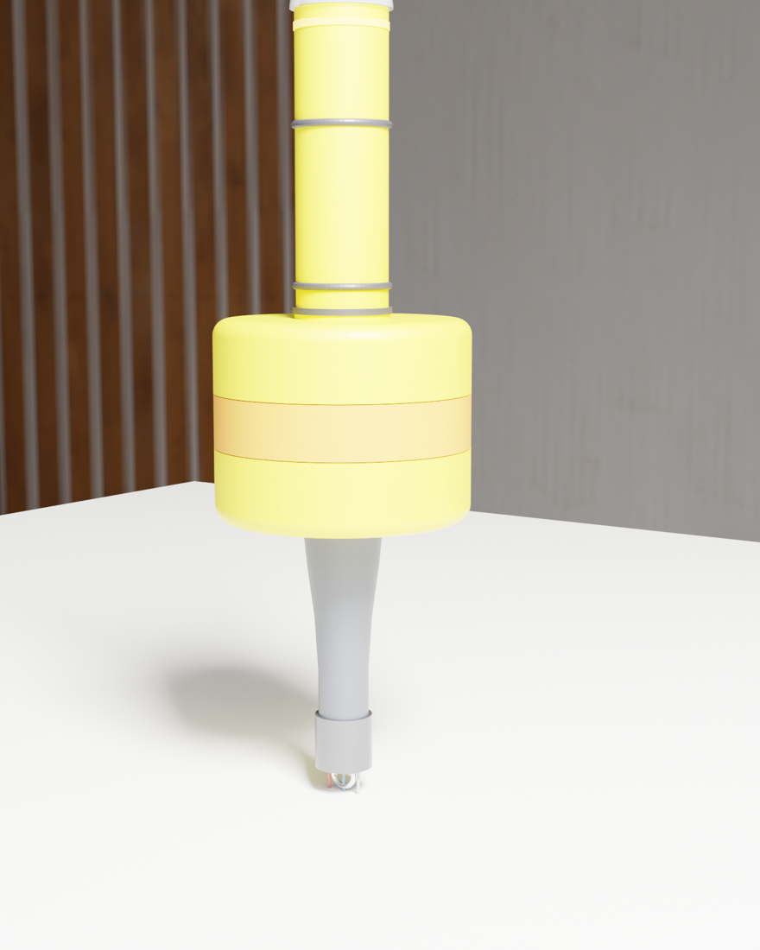
III. 我在建什么 · WHAT I’M BUILDING
水眸
AquaNet
The eye of the water.
DIAMETER
Φ 280 mm
COST
~$80 USD in parts
BRAIN
ESP32-S3
SENSORS
temperature · pH · turbidity
POWER
solar + 18650 + WiFi
LICENSE
open source
HARDWARE · BUOY v1
04

Slide 6

III. 我在建什么 · WHAT I’M BUILDING
aquanet-water.org
· LIVE
SOFTWARE · PUBLIC ARCHIVE
05

Slide 7
IV. 两段距离 · TWO DISTANCES
The water you don’t look at,
disappears.
你不看，水就消失了
THESIS
06

Slide 8
V. 收束 · CLOSING
It deserves
to be seen.
谢谢大家
AQUANET · 水眸
aquanet-water.org

