Slide 1
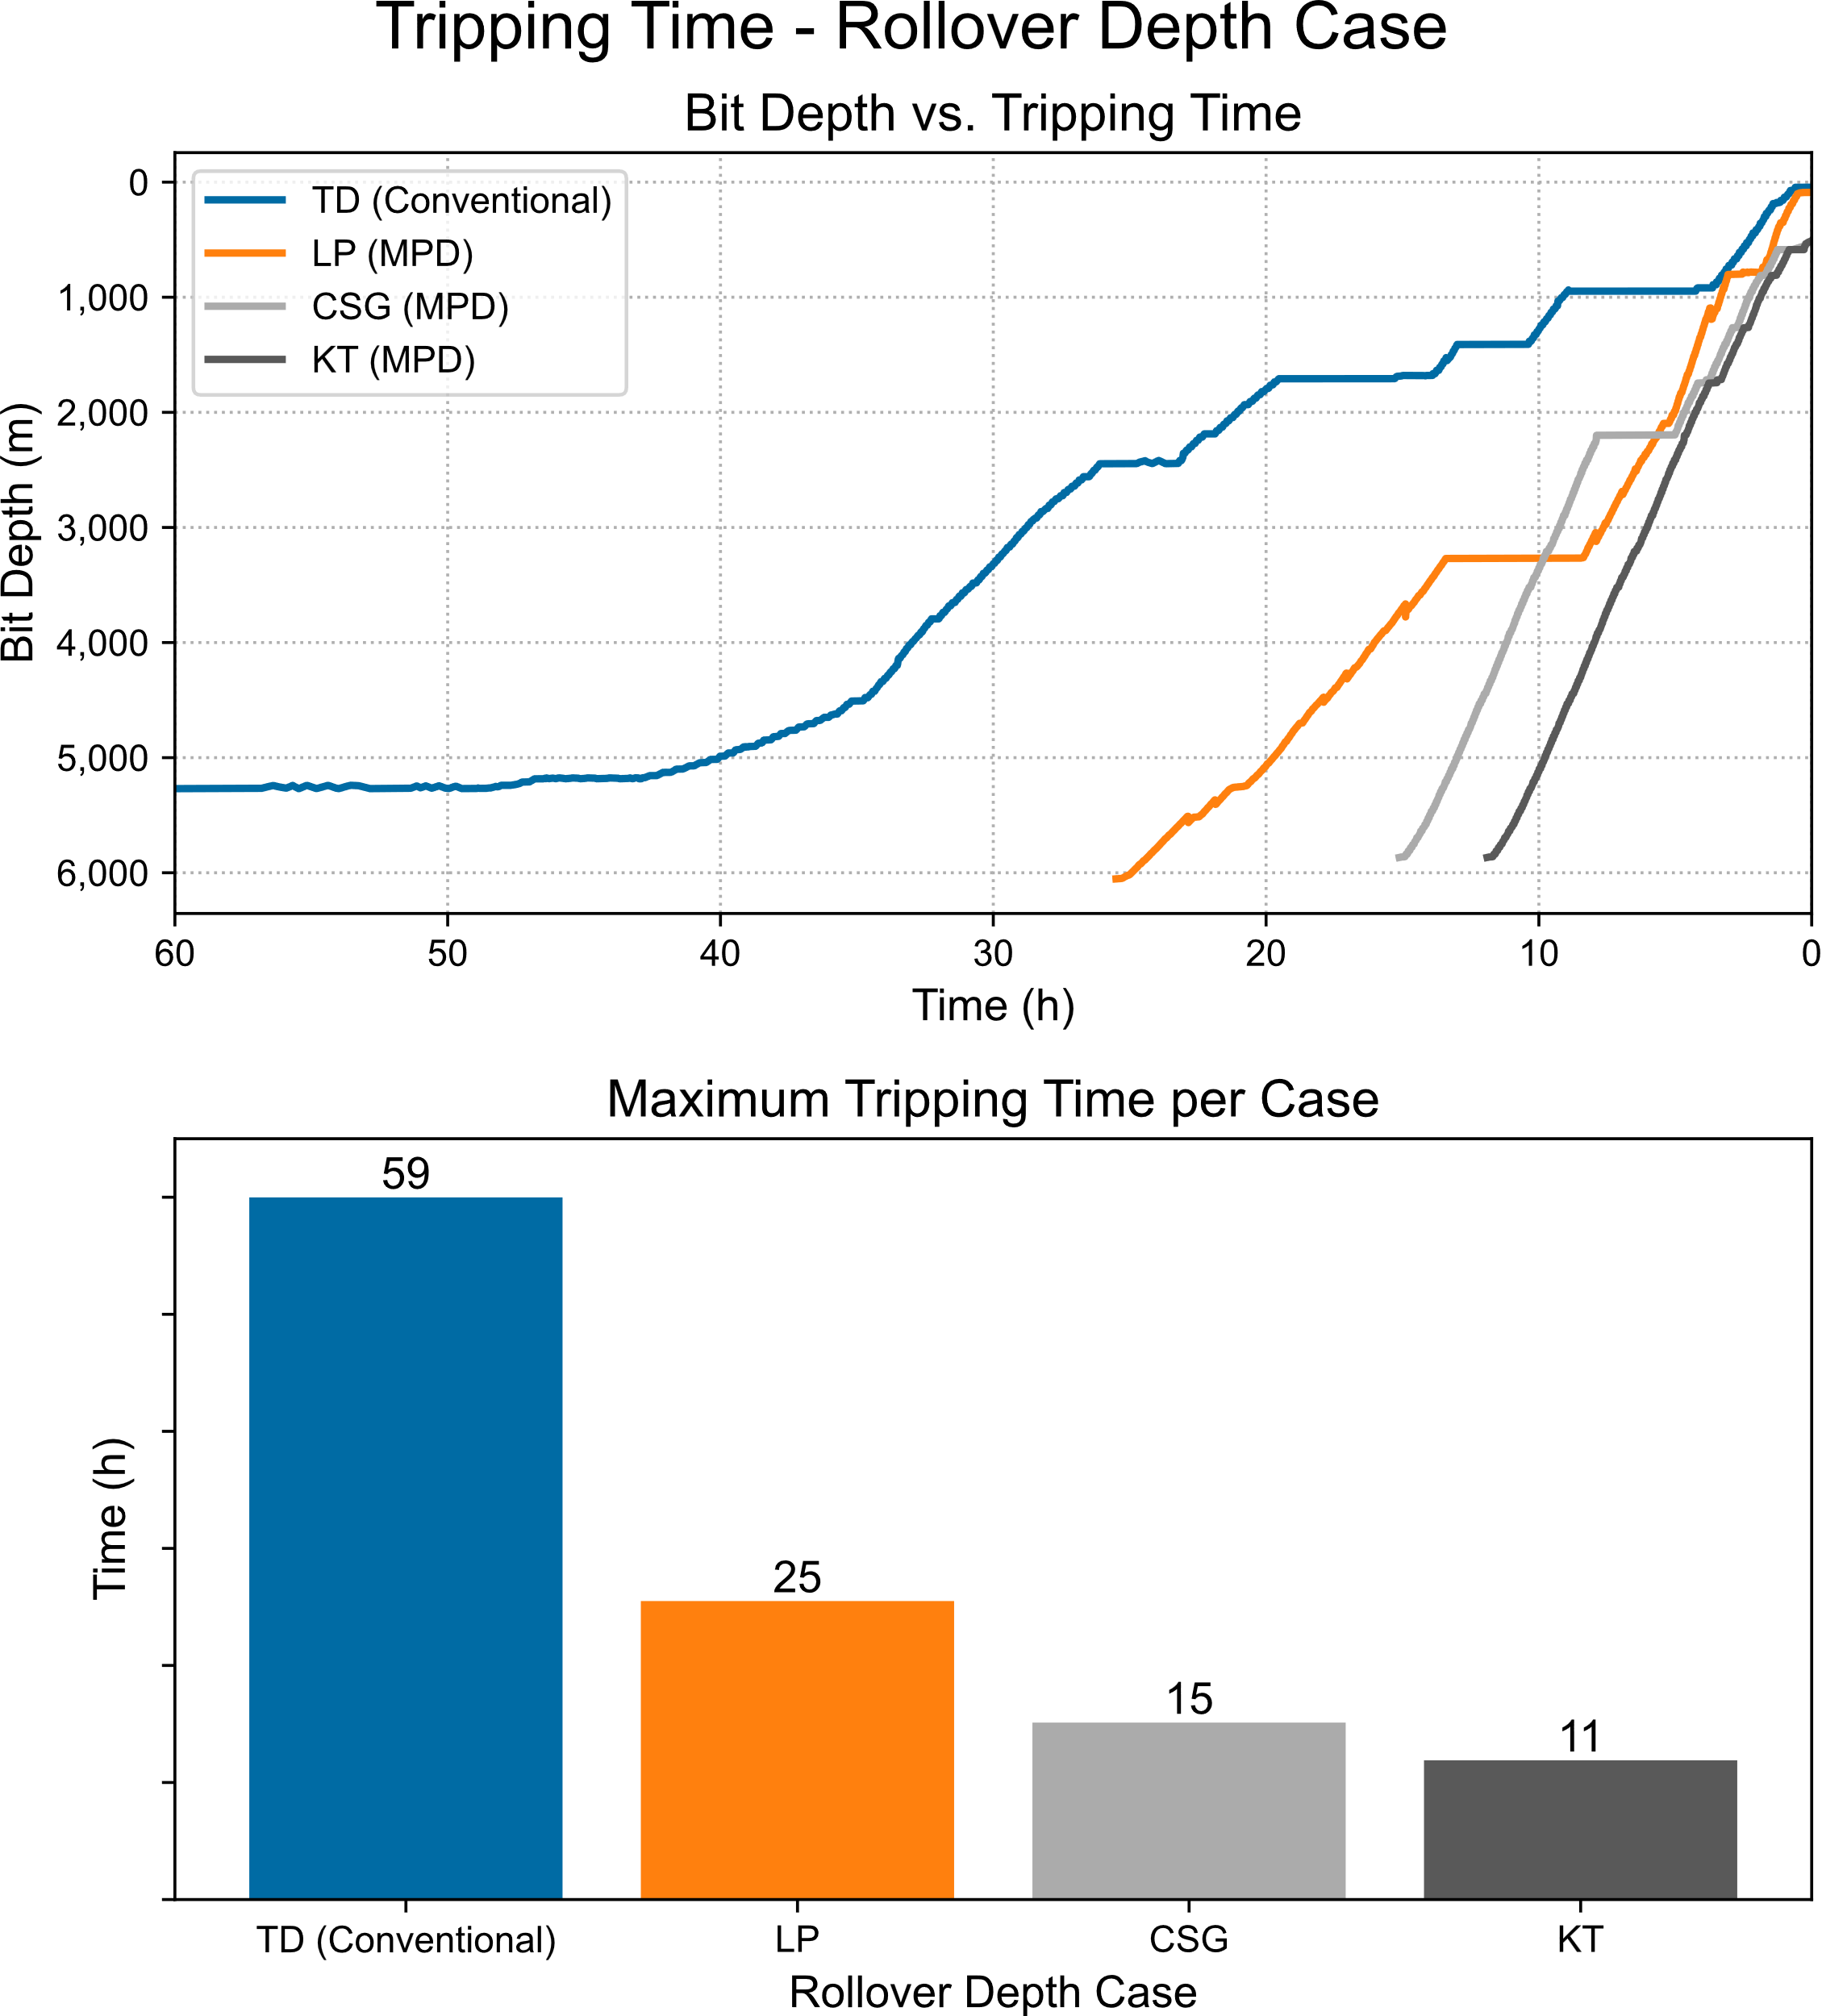
@TD
(Conventional)
@Landing Point
(MPD)
@Casing Shoe
(MPD)
@Top Kill (Slug & Backfill)
(MPD)
12-1/4”Hole
12-1/4”Hole
12-1/4”Hole
12-1/4”Hole
8-1/2” Hole
8-1/2” Hole
8-1/2” Hole
8-1/2” Hole
Kill Mud
6-1/8” Hole
6-1/8” Hole
6-1/8” Hole
6-1/8” Hole

Slide 2
@TD
(Conventional)
@Landing Point
(MPD)
@Casing Shoe
(MPD)
@Top Kill (Slug & Backfill)
(MPD)
12-1/4”Hole
12-1/4”Hole
12-1/4”Hole
12-1/4”Hole
8-1/2” Hole
8-1/2” Hole
8-1/2” Hole
8-1/2” Hole
Kill Mud
6-1/8” Hole
6-1/8” Hole
6-1/8” Hole
6-1/8” Hole

