Slide 1
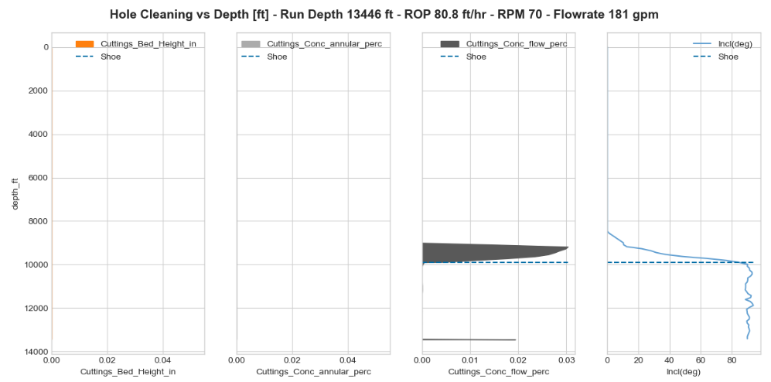
Cuttings Transport Results
No visible cutt. bed
Cuttings Flow accumulation on well toe

Slide 2
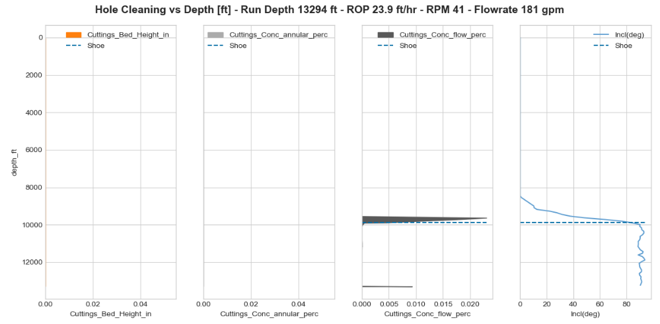
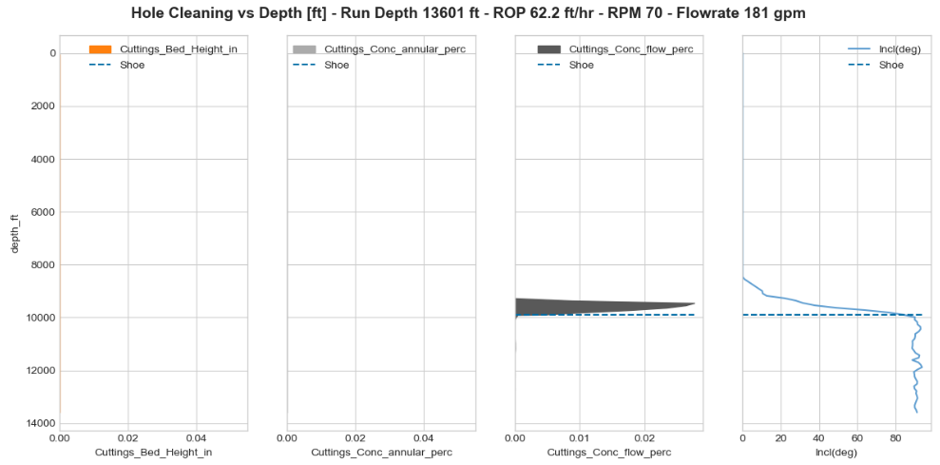
Cuttings Transport Results

Slide 3
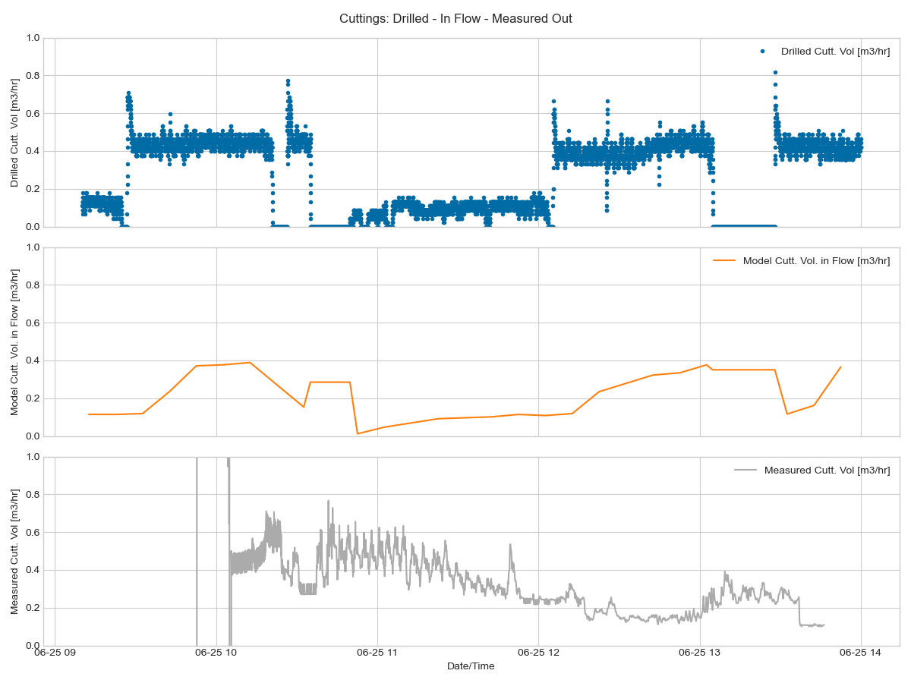
Cuttings Transport Results
Drilled Cuttings
Based on ROP and Bit Area
Modeled Cuttings in Flow
Modeled based on drilled cutt., critical velocity and cutt. percentage in flow
Cuttings Volume Rate Out
Measured by cuttings sensor

Slide 4
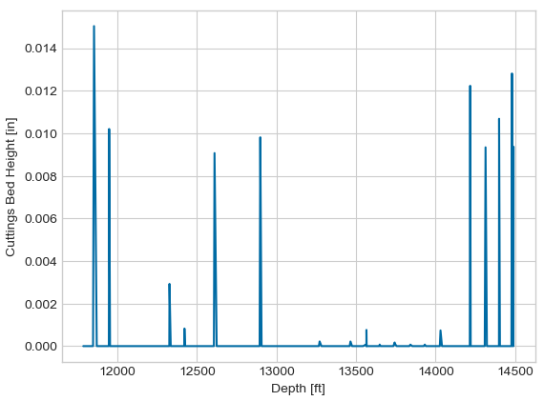
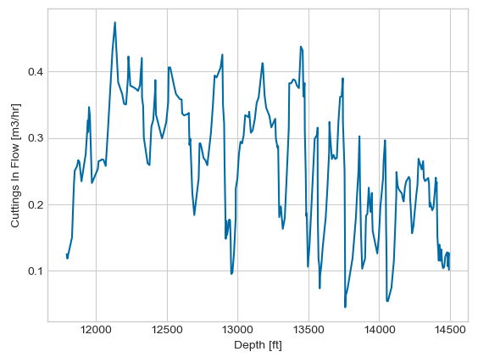

Slide 5
