Slide 1
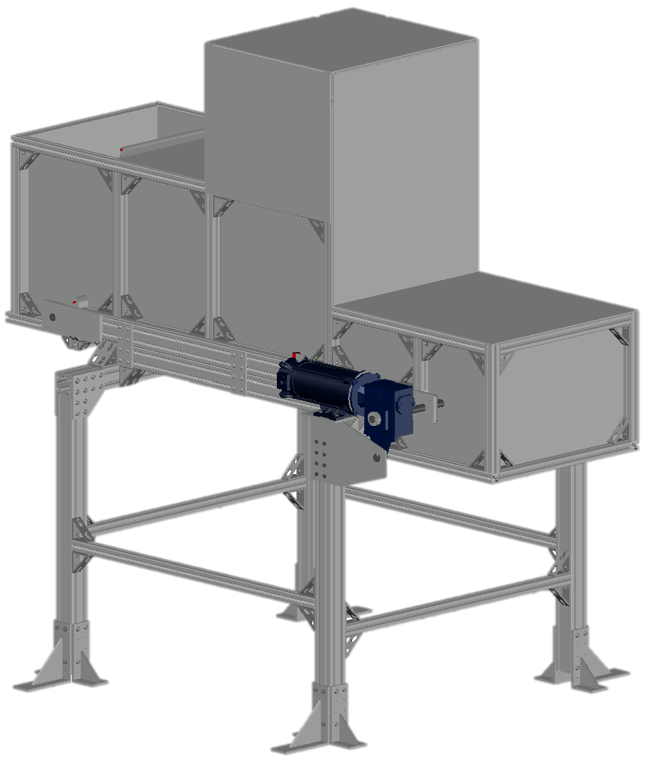
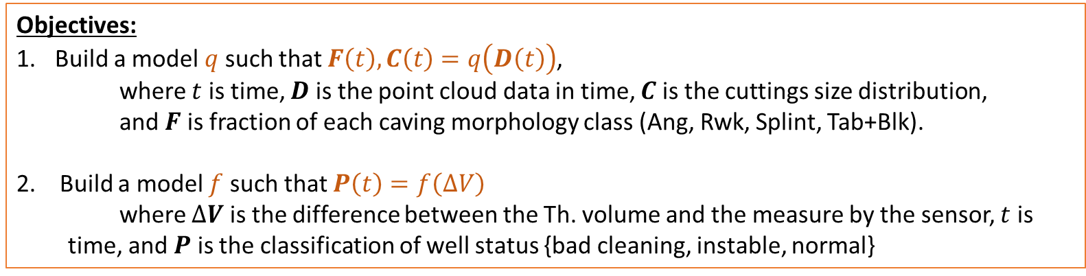




Redefined Workflow
Redefined Workflow:
Objectives:
Build a model $q$ such that $F\left(t\right), C\left(t\right)=q\left(D\left(t\right)\right)$,
where $t$ is time, $D$ is the point cloud data in time, $C$ is the cuttings size distribution,
and $F$ is fraction of each caving morphology class (Ang, Rwk, Splint, Tab+Blk).
2. Build a model $f$ such that $P\left(t\right)=f\left(∆V\right)$
where $∆V$ is the difference between the Th. volume and the measure by the sensor, $t$ is time, and $P$ is the classification of well status {bad cleaning, instable, normal}
❶
Obtain $B\left(t\right)$from Dr. Saini’s model, with feed data from field trial
$$V^{s}\left(t\right)$$
Dr. Saini’s
$$B\left(t\right)$$
❷
Fit a classifier $f$
$$V^{T}\left(t\right)=f\left(ROP, B\right)$$
$$∆V=cvg rate=V^{s}\left(t\right)−V^{T}\left(t\right)$$
❸
Run experiments at lab scale to build model $q$

Slide 2
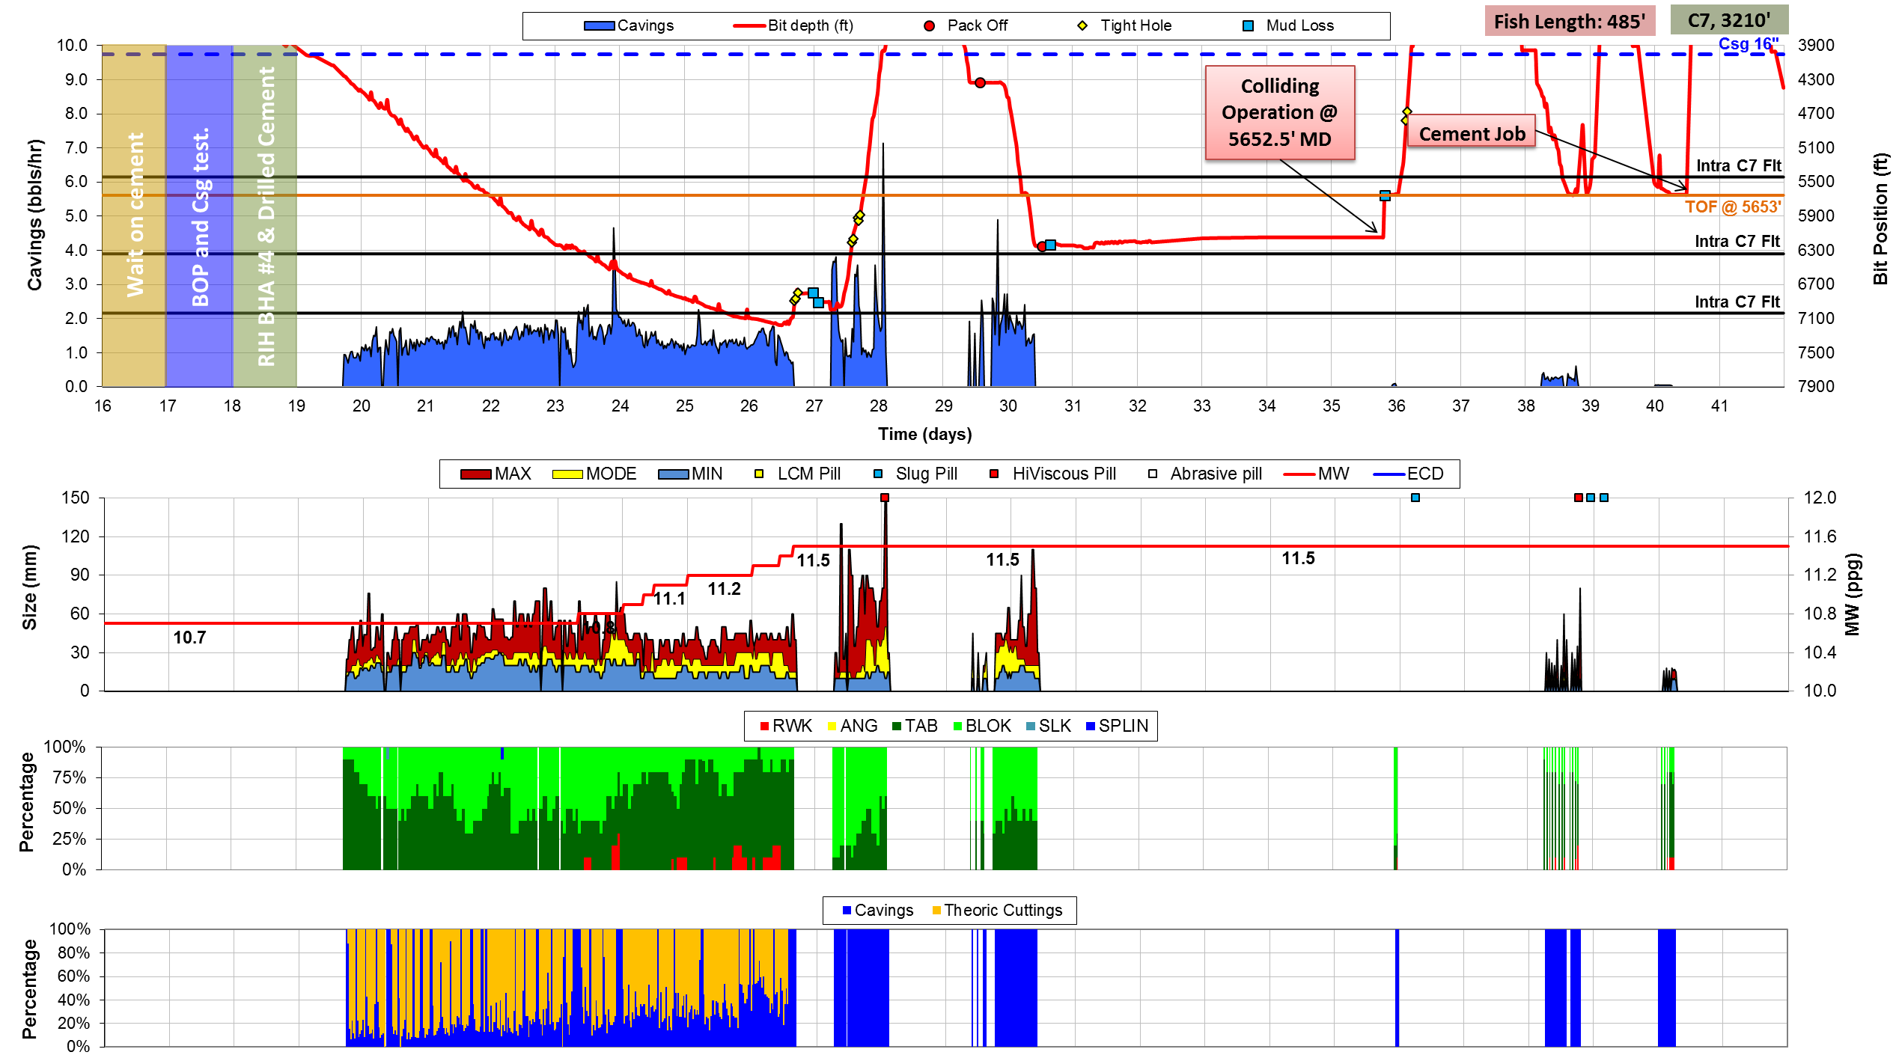
Automated cavings volume and morphology reading
Desired result:
Experiment Requirements:
Sensor operation fully understood
Sample gravel (Experiment Setup)
- Collecting (cuttings?)
- Labeling morphology (supervised)
- PSD of each sample
Experiment design: Controlling for confounding vars – Bias from morph./Cutting wet/type of cuttings.
Sample WBM construction and sample wetting.

Slide 3
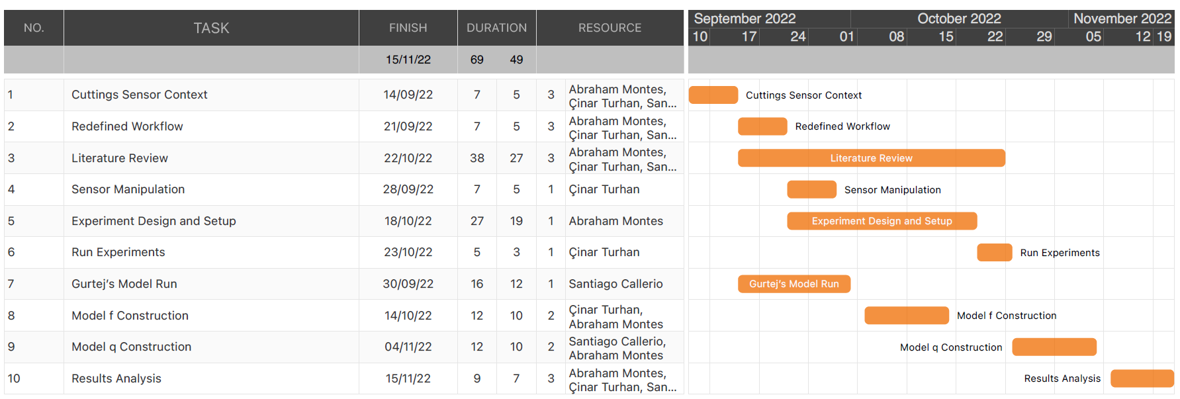
Workflow and Timeline
Today

Slide 4
Questions
Is there a time schedule already set up for paper publishing?
Dr. Saini’s contact
Sebastian’s report will be delivered in 2 weeks (update from Sep 21st)
Lab Schedule – Mud lab and rock mechanics’ lab
Improvement to cuttings drying before reaching the laser
Wet cuttings
Drier cuttings
Mud

