Slide 2
Cuttings Sensor Project
Proposed Schema
Insights from data
EDA & Feature Engineering
Parameters Correlation
Apache Field Trial Data
Un-supervised Learning Clusters
Find data clusters indicating condition (good, bad cleaning)
Classifier based on drilling data & cuttings load to predict hole cleaning
Model to detect cavings from 3d map (point cloud data) + camera images
Reflect Main Scripts Structure
Gurtej’s Cutting Transport Model
Insights from Code
Refactor & Modularize Code
Run model for Apache’s drilling data
Point cloud data storage & generation
Script for real time 3d map
Cuttings Sensor Prototype
Standard Operating Procedure
Database generation

Slide 3
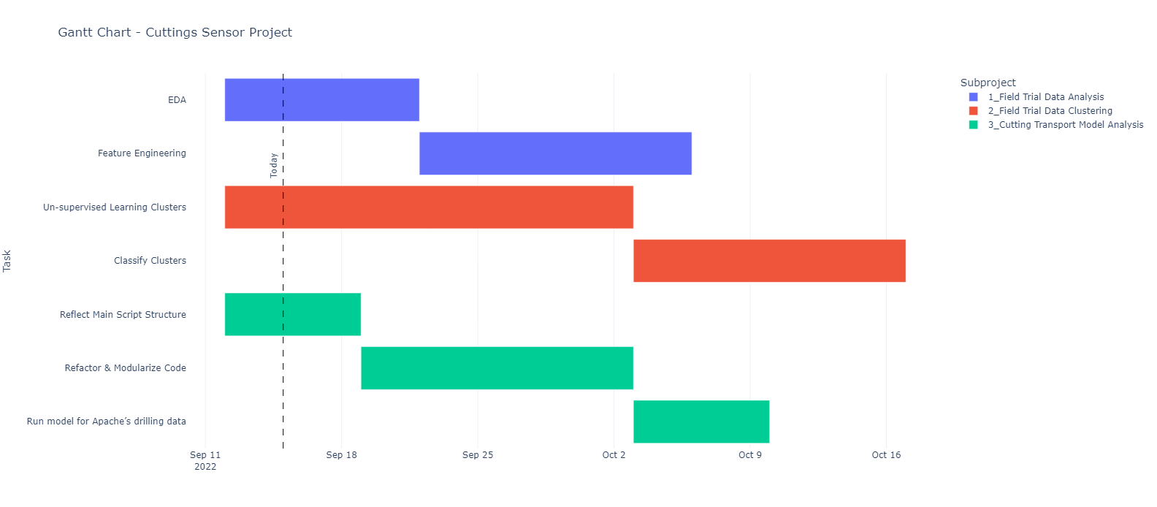
Cuttings Sensor Project - Timeline

