Slide 1
DOTS AND BOXES
Created by,
Anush Kumar 213
Roja S Rajan 251
Sunjay Calvvin 260
Vishnu G 263

Slide 2
Our Game
A n x n grid. (5 x 5)
Two players(sometimes more).
Players take turns to make lines between two unjoined adjacent dots.
Lines can be horizontal or vertical.
Aim
The game ends when no more lines can be placed. The winner is the player with the most points.

Slide 3
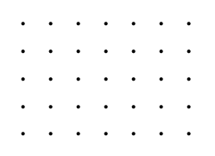
The Board

Slide 4
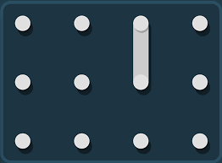
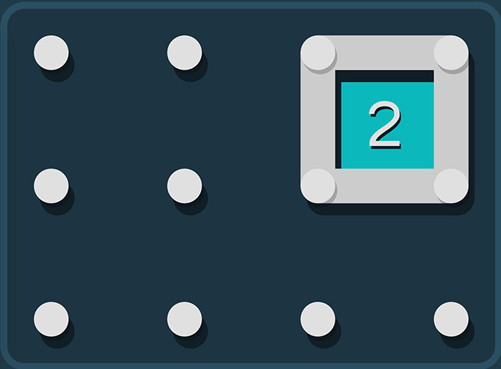
Expansion

Slide 5
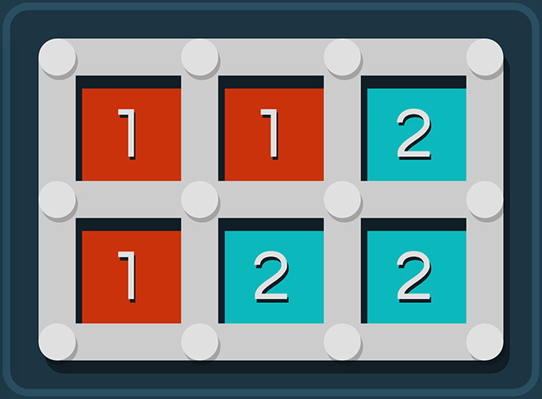
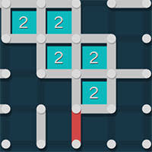
Take Over and Winning

Slide 6

Boundary Fill Algorithm
The algorithm takes three parameters: a start node, a target colour, and a replacement colour. The algorithm looks for all nodes in the array that are connected to the start node by a path of the target colour and changes them to the replacement colour.

Slide 7
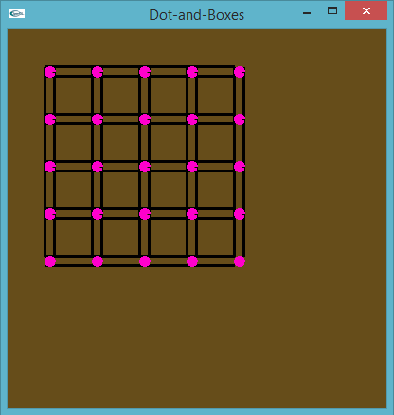
Our Implementation
Player 1 – Red.
Player 2 – Green.
Max Squares = 16 ((n-1)(n-1))

Slide 8
Line
struct line
{
struct POINTe p1; // point 1
struct POINTe p2; // point 2
struct POINTe p3;
struct POINTe p4;
int flag; // flag whether the line exists or not
int filled; // flag initially equal to zero
int horrizontal; // horizontal =1, vertical = 0
}L[100];
Struct POINTe
{ int x, y; }
p1
p3
p1
p2
p3
p4
p2
p4

Slide 9
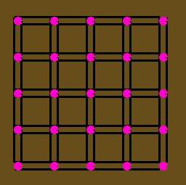
Numbering of Lines
0
2
4
6
1
3
5
7
8
9
11
13
15
10
12
14
16
17
18
20
22
24
19
21
23
25
26
27
29
31
33
28
30
32
34
35
36
38
40
42

Slide 10
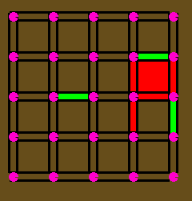

Horizontal checking. horizontal(line_num)
i-9
11
i-8
(i-8) +2
12
14
20
i
21
23
i+1
(i+1)+2
29
i+9

Slide 11
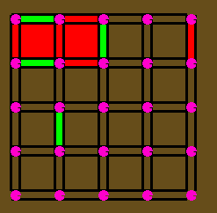

Vertical Checking vertical(line_num)
(i-1)-2
i-1
i-2
i
i+2
18
20
19
21
23
i+6
(i+6) + 2
27
29

Slide 12
Steps
Start.
Call display() . // displays the points and lines(circles and rectangles). Or displays the Grid (5x5).
Check for mouse activity and call mouse() .
End.

Slide 13
Variables.
total_squares = 16
cur_player = 0 // current player 0 = player1 and 1 = player2.
cur_user_flag = 0 // to know whether the current user has scored a point.
user_points[3]. // user_points[1] player 1 points similarly for player 2.
line_size //stores number of lines drawn.

Slide 14
Mouse Function
Get co ordinates of clicked points(x,y).
Call get_line_pos(x,y). // to check if points is inside a horiztonal l line or a vertical line.
Switch player
If current player has scored a point then
Don’t switch .
Else if current player hasn’t scored any point then
Switch player .
Check if total squares == 0
If yes print_winner() & game over.

Slide 15
get_line_pos(x,y)
Identify the line in which the point lies.
Call horizontal(line-num) if line is horiztonal
Else call vertical(line-num).
p1
p3
p1
p2
p3
p4
p2
p4

Slide 16
Future Improvements
From 5x5 dots board, improvement would be to make it n x n.
There is irregular notation of lines in our algorithm, we would like to make it more generalized.

Slide 17
THANK YOU

