Slide 1
Primitive to Traceless:
Computational Chemistry to
Spectroscopic Effective Potentials
Calc
For small molecules, coupled-cluster CCSD(T) level can be 1 kcal/mol accurate for energies of ground and excited states. and for dipole moments.
Higher moments like the quadrupole octupole and higher which make contributions to Rydberg spectra, birefringence and other properties. Ab-initio programs typically report “standard” forms (coordinate density integrals) not spectroscopic traceless moments. .
Spec
Spectroscopic analysis is a model driven process that requires a set of independent parameters adequate for the data. There should be no linear dependences among the parameters, and physical relevance. Spectroscopic analysis is a process of finding the simplest representation of data at current and future experimental resolution.
There is a long-standing disagreement on the role of standard (traced) and traceless electronic descriptions in experiments. Experimental and theoretical work supports the need for traceless expansions (Sonia Coriani and others)
STEPHEN L COY, ROBERT W FIELD, MIT Chemistry, Cambridge, MA, USA.

Slide 2
Primitive to Traceless:
Contents
Role of multipole moments and wave functions in electronic state analysis
  Dipole moments for Stark effect
  Quadrupole moments for birefringence
  Higher moments to distinguish and characterize electronic structure
Cartesian and spherical harmonic expansions of the molecular electrostatic potential
  Cartesian permutation complex, but useful for general geometry and for polarizability
  Spherical, correct degeneracy, but uniaxial character a problem for general geometry and for polarizability
Context: CFOUR MOLDEN files, checked by ORCA and MRCC. Auxiliary programs, primarily Multiwfn.
Example of the Cartesian expansion, for bent HNO
  By angular momentum, tables of term, term permutation weights, forms for primitive (== traced) and traceless expressions, HNO values
  Matching by Molden file in Multiwfn of CFOUR-calculated dipole through octupole traceless moments, using a repaired version of CFOUR.
Quick view of ScO odd-L quartet states resolved only by quadrupole and octupole
Conclusion and CFOUR fix availability

Slide 3
Primitive to Traceless:
Single-Reference Computational Chemistry
Theory
Theory with Experiment
Computation chemistry can be applied in generating interaction potentials, ionic and covalent properties, lifetimes and transition moments.
Extending computational results to obtain insight into dynamics and predicting application requires transfer of the calc data to other analysis programs and methods .
One of the sources of wave function and charge density data is the MOLDEN file, originally for the vintage MOLDEN application, but now widely used by other apps..
Experimental spectroscopy, molecular clustering and intermolecular energy transfer occur near vibrational and electronic equilibrium configurations.
Near equilibrium configurations can be represented by single-reference coupled-cluster or DFT calculations.
Calculated wave functions are made available in formats that include molden, and AIM (wfn , wfx) that allow further analysis of the wavefunctions.
We are going to give examples and then dive into the “standard” and “traceless” representations.

Slide 4
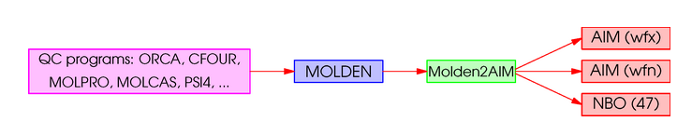
Primitive to Traceless: Molden files both ways
Molden data as generated by the many programs
Available in Cartesian form or Spherical Harmonic form
The definitions of these forms are not the same across the many programs that use them.
There is no adequately defined standard, causing no end of difficulty.
The standard interpretation is that of Tian Lu’s Multiwfn because of a checking facility.
Forms can be interconverted by the molden2AIM program of Wenli Zou.
  molden2AIM usage.
Molden file validity must be checked!
Apps that read molden files apply their own interpretations which may be non-standard or just erroneous.
Multiwfn can be used to analyze the molden file. Primary tests:
  Correctness of the total number of electrons, charge, multiplicity, …
  Do the multipole moments calculated by Multiwfn match those value calculated by the ab-initio program?
If there is a problem, results are qualitative at best, and the additional analysis may be incorrect.
  fix the ab-initio program source code (?).

Slide 5
Primitive to Traceless:
Two forms for Expansion: Cartesian and Spherical
Two origins: Taylor series and Coulomb sum rule
Cartesian: Good features
Cartesian is more flexible in mapping geometry to the symmetry of small to mid-sized molecules.
Cartesian coordinates can be transparently used in a general polarizability expansion including polarizabilities of any order.
Cart. Bad
The degeneracy of Cartesian terms by angular momentum L is 3^L with the number of permutation-unique terms (L+1)(L+2)/2.
For L>1, Poisson / Laplace relations are needed, but that cannot be done post-facto because of lack of uniqueness..
Spherical Harmonics: Good features
Each angular momentum L has exactly the expected minimum number of independent terms. (2L+1).
Real forms (cos,sin) of spherical hrmonics are used.
The spherical harmonic expansion can be generalized to polarizabiliities (Stone and Misquitta). .
SphH: Bad
Uniaxial (R, theta, phi) does not map to a general molecule very well.
Spherical harmonic forms of higher polarizabilities are confusing and opaque. (very not nice!)

Slide 6
Explicit forms
Traced from 3-D CartesianTaylor series
Traceless from Coulomb potential as a spherical harmonic sum
3-D Cartesian Taylor series (traced)
Coulomb potential in spherical harmonics (traceless)
Traced and Traceless Potential in Cartesian coordinates
Multipliers differ -- 1/n! and 1/(2n-1)!!
Inner boxed forms are functions of angles only.
The zeta moments (ς) are “primitive” or “traced” or “standard.” (Some octupole terms: x³,x²y, y²z etc.)
The xi moments (ξ) are traceless over any repeated subscripts. They satisfy the Laplace equation.

Slide 7
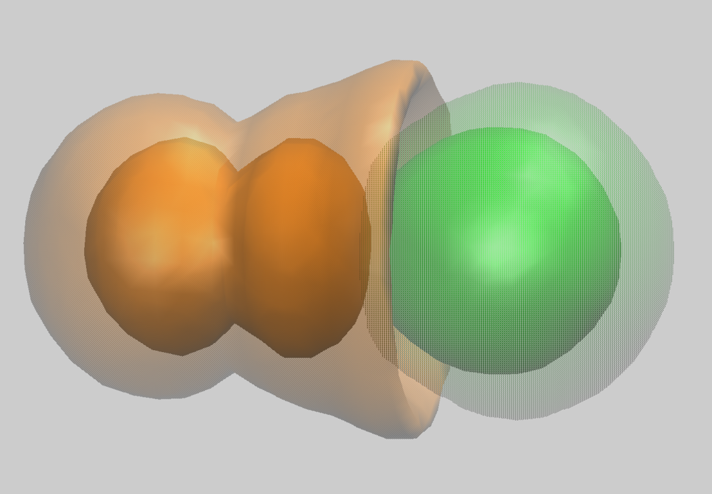
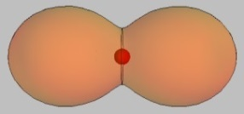
Example of the use of higher moments
The L=4 moment requires quadrupole Ca polarization in CaF+
Model matches out to the octupole with either dipole
or quadrupole on Ca. The Q4 requires Q2 on Ca.
The two lowest Ca+ states are s and d
s+d
Using a Ca+ quadrupole pby can match the hexadecapole!
This electron density difference was computed in Gaussian not CFOUR.

Slide 8
CFOUR problem in Molden files
Scandium monoxide quartet states
Natural orbitals R=3.38a0 CCSD(T) aug-cc-pwCVQZ
Uncorrected
Population of atoms:
Atom Alpha pop. Beta pop. Spin pop. Atomic charge
1(Sc) 10.96244 9.02963 1.93281 1.00793
2(O ) 4.90820 3.83403 1.07416 -0.74223
Total net charge: 0.26570256 Total spin electrons: 3.00697427
Charge and Multiplicity error
Corrected
Population of atoms:
Atom Alpha pop. Beta pop. Spin pop. Atomic charge
1(Sc) 11.08052 9.11162 1.96889 0.80786
2(O ) 4.91948 3.88838 1.03111 -0.80786
Total net charge: -0.00000000 Total spin electrons: 3.00000000
Match to correlated CFOUR calculated quadrupole
Quadrupole moments (Standard Cartesian form):
XX= -18.940367 XY= 0.000000 XZ= 0.000000
YX= 0.000000 YY= -17.053677 YZ= 0.000000
ZX= 0.000000 ZY= 0.000000 ZZ= -22.526950
Quadrupole moments (Traceless Cartesian form):
XX= 0.849947 XY= 0.000000 XZ= 0.000000
YX= 0.000000 YY= 3.679981 YZ= 0.000000
ZX= 0.000000 ZY= 0.000000 ZZ= -4.529928
Multiwfn quadrupole in standard and traceless forms.
The traceless forms from the corrected MOLDEN file match the CFOUR values

Slide 9
⁴ScO electronic states illustrate use of multipoles beyond the dipole
Context
CFOUR CCSD(T) energies
ScO+ triplet 9-10
ScO quartet 5-8
ScO doublet 1-4
³ScO⁺
Dipole moments of states 6 and 7 are nearly identical.
They are of odd L.
“Pi” label is from C2v. Odd-L is meant.
⁴ScO
²ScO

Slide 10
Resolution by Q2,Q3 and axial asymmetry.

Slide 11
L=4 moment from MOLDEN files
HNO L=4 terms
CFOUR CCSD(T) HNO bent geometry
Number of terms in the Cartesian potential expansion of order L
(L+1)(L+2)/2 terms counting permutations
  L=4, 15 terms
The number of Poisson relations is given by same expression using L-2, 2 for XX,YY,ZZ.
  L=4, 6 Poisson relations
The weight factor is the mumber of permuations of 4 items reduced by the X, Y, Z permutations
  L! / (nX! nY! nZ!), e.g.XYZZ = 12;
The factor needed to correct the CFOUR wave function MOLDEN increases particular terms in the traceless expansion (note 0!! and (-1)!! are 1.)
  Sqrt( (2nX-1)!! (2nY-1)!! (2nZ-1)!! ) )

Slide 12
Primitive to Traceless:
HNO L=4 Poisson relations
Poisson / Laplace relations are on individual terms.
The permutation weight does not play a role here, but is important in computing the potential.

Slide 13
Primitive to Traceless:
Conclusions
Understanding of bonding and aspects of spectroscopy in electronic states can benefit from post-processing of wave functions
Traceless moments are spectroscopically relevant while traced moments are not, although they are easier to compute
  Traceless quadrupoles were defined and measured by Buckingham and Longuet-Higgens
  Relevance of traceless quadrupoles rather than traced, shown for birefringence by Sonia Coriani
  Higher moments are useful to distinguish models of long range potentials including those for Rydberg spectra
Current CFOUR public version needs a fix for correct MOLDEN file output. A fix is available.

Slide 14
Effective Potentials
Field, R. W., J. H. Baraban, S. H. Lipoff and A. R. Beck (2011). Effective Hamiltonians for Electronic Fine Structure and Polyatomic Vibrations. In Handbook of High-resolution Spectroscopy, John Wiley & Sons, Ltd, DOI: 10.1002/9780470749593.hrs061.
Coy, S. L., D. D. Grimes, Y. Zhou, R. W. Field and B. M. Wong (2016). "Electric potential invariants and ions-in-molecules effective potentials for molecular Rydberg states." Journal of Chemical Physics 145(23): 20, DOI: 10.1063/1.4968228.
Solina, S. A. B., J. P. Obrien, R. W. Field and W. F. Polik (1996). "Dispersed fluorescence spectrum of acetylene from the (A)over-tilde (1)A(u) origin: Recognition of polyads and test of multiresonant effective Hamiltonian model for the (X)over-tilde state." Journal of Physical Chemistry 100(19): 7797-7809, DOI: 10.1021/jp953330s.
Traced or Traceless in spectroscopy
Christiansen, O., S. Coriani, J. Gauss, C. Hättig, P. JØrgensen, F. Pawłowski and A. Rizzo (2006). Accurate Nonlinear Optical Properties for Small Molecules. In Non-Linear Optical Properties of Matter: From Molecules to Condensed Phases. M. G. Papadopoulos, A. J. Sadlej and J. Leszczynski. Dordrecht, Springer Netherlands: 51-99, DOI: 10.1007/1-4020-4850-5_2.
Coriani, S., C. Puzzarini and A. Rizzo (2012). "First-order properties and Buckingham birefringence of N2O and OCS – A computational (re)investigation." Molecular Physics 110(19-20): 2543-2555, DOI: 10.1080/00268976.2012.709284.
“
... in the case of CO, with reference in particular to the existing disagreement between two semiclassical theories for the interpretation of the experimentally observed birefringence. The present results favor the older theory due to Buckingham and Longuet-Higgins.“ The use of the traceless expansion is more consistent with experiment for the effect of quadrupole moment on birefringenc.

Slide 15
Multipole expansions
Zangwill A (2012) Modern Electrodynamics. Cambridge U. Press, New York. doi:10.1017/CBO9781139034777
Stone AJ (2013) The Theory of Intermolecular Forces, Second Edition. Oxford UP, Oxford. doi:10.1093/acprof:oso/9780199672394.001.0001
Brink DM, Satchler GR (1993) or (1968) Angular Momentum. Oxford, New York
Dipole moments of diatomics
Steimle TC (2000) Permanent electric dipole moments of metal containing molecules. Int Rev Phys Chem 19 (3):455-477. doi:10.1080/01442350050034199

