Slide 1

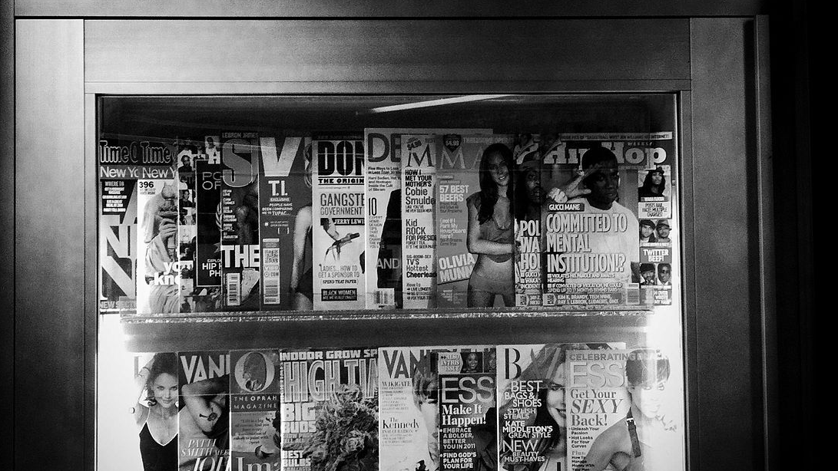
What is News?
Let’s practice what you have learned about news values.
Click to begin
This Photo by Unknown Author is licensed under CC BY-SA

Slide 2
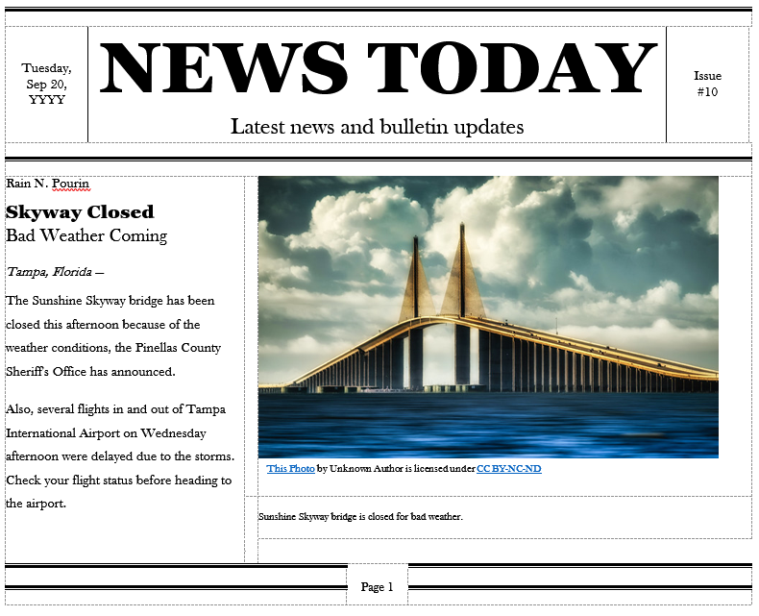
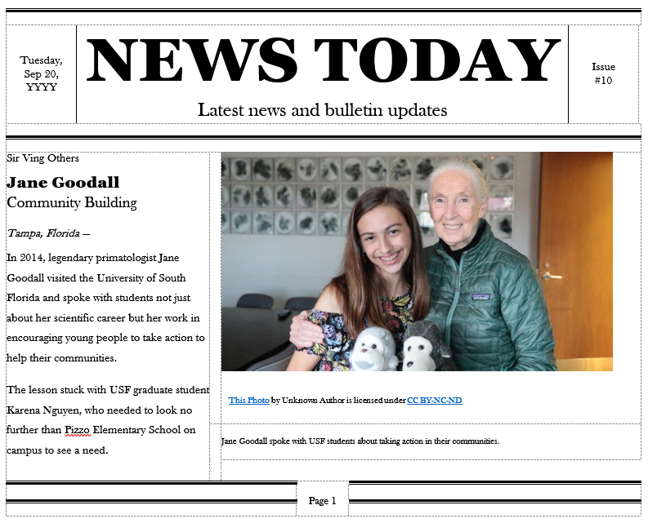

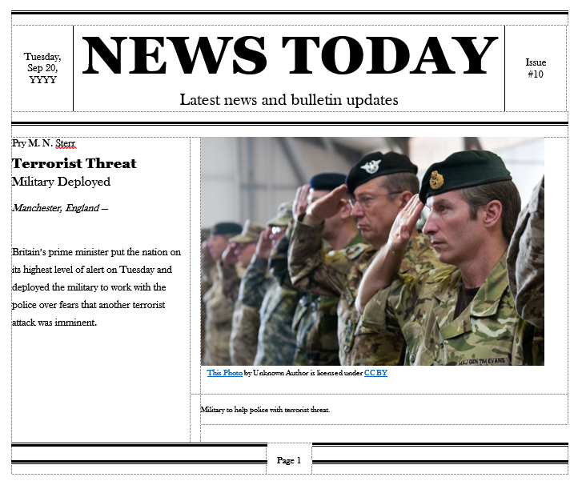
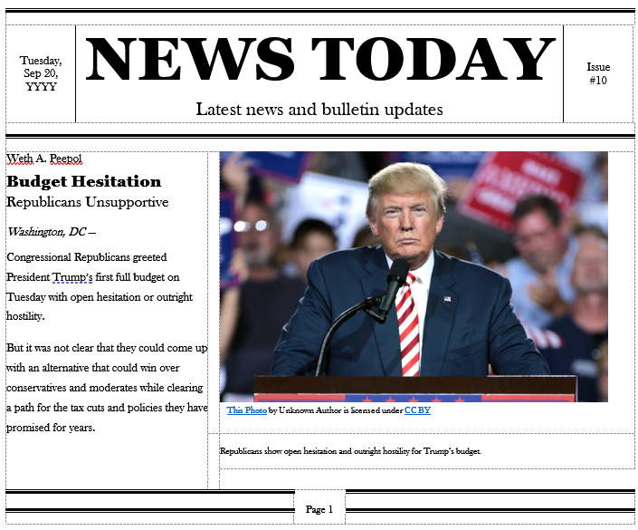

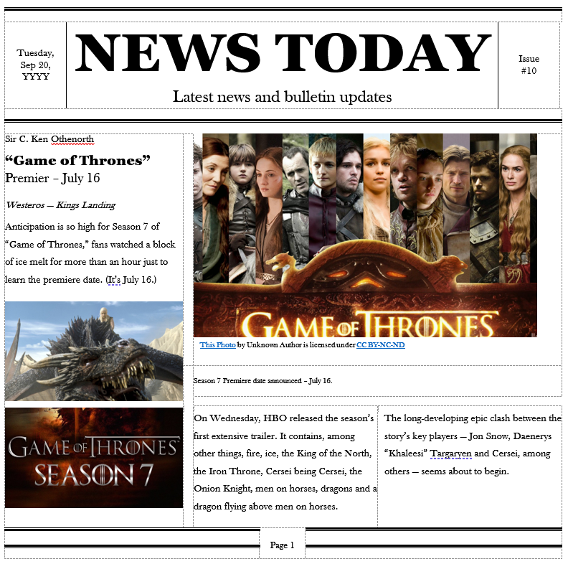
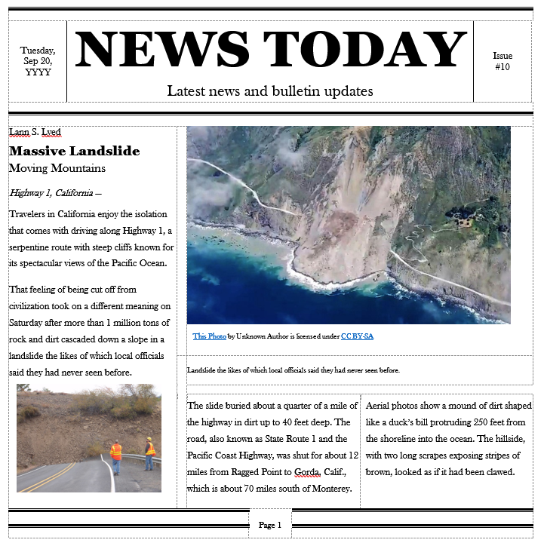
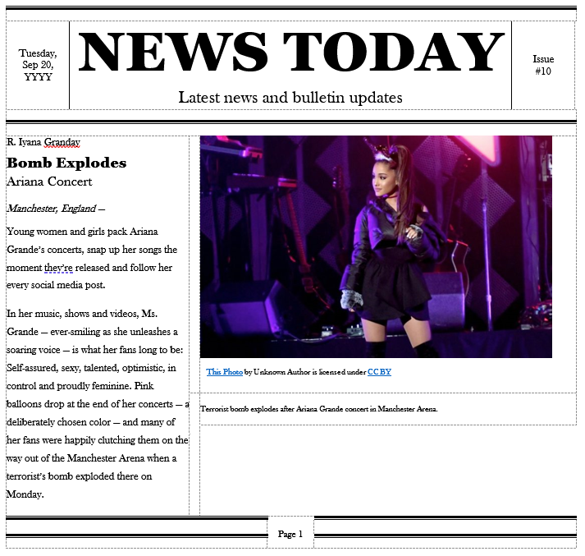



Instructions
Read
Match
Complete
Click each newspaper to read the stories.
Drag the appropriate news value to the matching story
Repeat until all values and stories are matched appropriately.
Value
Value
Next

Slide 3

?
This Photo by Unknown Author is licensed under CC BY-SA

Slide 4
Read the news articles.
Then drag the corresponding news values to the appropriate article.
* While a story might touch on several values, please choose the DOMINANT value.
?
This Photo by Unknown Author is licensed under CC BY-SA

Slide 5
Proximity
Timeliness
Community Interest
Conflict
Prominence
Novelty
Impact
?
This Photo by Unknown Author is licensed under CC BY-SA

Slide 6
Proximity
Timeliness
Community Interest
Conflict
Prominence
Novelty
Impact
?
This Photo by Unknown Author is licensed under CC BY-SA

Slide 7
Proximity
Community Interest
Conflict
Timeliness
Prominence
Novelty
Impact
?
This Photo by Unknown Author is licensed under CC BY-SA

Slide 8
?
This Photo by Unknown Author is licensed under CC BY-SA

