Slide 1

राष्ट्रीय प्रौद्योगिकी संस्थान पुदुच्चेरी
NATIONAL INSTITUTE OF TECHNOLOGY PUDUCHERRY
(An Institute of National Importance under MoE, Govt. of India)
KARAIKAL – 609 609
Final Year project Phase II - Second Review Meeting
AI Based Design for Frequency Selective Surface (FSS)
Project Guide
Dr. Boopathi Rani R
Assistant Professor,
Depatment of ECE,
NIT Puducherry, Karaikal,
India
Presented by
KAPA ADHEESHWAR REDDY
Reg No: EC21B1023
SADHU POORNA SAI
Reg No:EC21B1043
SANAPALA CHANDRA SEKHAR
Reg No:EC21B1044
B.TECH Department of ECE,
NIT Puducherry, Karaikal,
India

Slide 2
Introduction:
What are Frequency Selective Surfaces (FSS)? Frequency Selective Surfaces (FSS) are advanced structures used in modern wireless communication systems. They play a vital role in filtering, controlling, and altering electromagnetic waves.
Applications of FSS:
FSS is utilized to improve antenna performance by filtering specific frequencies.
FSS aids in shielding electronic devices from unwanted electromagnetic interference.
FSS structures are essential in managing signal propagation and enhancing overall system efficiency.
FSS finds applications in satellite communication systems, where it helps in controlling signal interference and improving data transmission.
Challenges in FSS Design:
Traditional Design Methods: FSS design often involves iterative processes, which are computationally intensive and time-consuming.
Complexity: Achieving the desired electromagnetic properties through conventional methods requires substantial expertise and resources.
Scalability: Scaling FSS designs for large systems while maintaining performance and cost-efficiency presents significant challenges.

Slide 3
Problem Statement:
Designing Frequency Selective Surfaces (FSS) with specific electromagnetic properties traditionally demands considerable computational resources, expertise, and time. Moreover, managing large datasets for AI-driven designs presents additional challenges. The need for more efficient, data-driven models arises—ones that preserve high accuracy while reducing computational load. This project seeks to develop AI-based models to overcome these challenges, enhancing the design efficiency of FSS for applications in wireless communication, antenna design, and electromagnetic shielding.
Objectives:
Develop an AI-Based FSS Design Framework: Implement an efficient design approach for Frequency Selective Surfaces (FSS) using a deep neural network model to predict transmission coefficients.
Enhance Optimization Efficiency: Integrate optimization algorithms with the deep neural network to iteratively refine FSS structural parameters, enabling faster convergence with high accuracy.
Improve Design Accuracy: Achieve precise FSS design results by minimizing errors in transmission coefficients at critical frequency points.
Reduce Computational Time: Improve design efficiency relative to traditional methods, accelerating FSS design and making it more adaptable to practical applications.

Slide 4
Methodology:
Data Preprocessing The dataset is cleaned, and input parameters (l, t, freq) are normalized using MinMaxScaler. This prevents bias due to varying magnitudes. The S21 values are also normalized to improve model performance. The data is split into training and validation sets for better generalization.
Neural Network Architecture & Training The model consists of hidden layers with ReLU activation and dropout layers for regularization. The Adam optimizer is used for training stability. A custom loss function ensures accurate predictions, especially in the stop-band. Early stopping prevents overfitting and improves efficiency.
S21 Prediction & Stop-Band Identification The trained network predicts S21 across frequencies for different FSS parameters. The stop-band is identified where S21 drops below -10 dB. The resonant frequency is determined based on the lowest S21 value, helping evaluate FSS performance.

Slide 5
Genetic Algorithm-Based Optimization GA optimizes FSS parameters using selection, crossover, and mutation to improve stop-band width and attenuation. A fitness function is designed to maximize attenuation while maintaining a wide stop-band.
Refinement Using Simulated Annealing SA fine-tunes parameters by escaping local optima through a probabilistic search. The temperature decay helps refine the global solution. This step enhances the FSS design further by ensuring better stop-band characteristics.
Visualization & Results Analysis The optimized S21 curve is analyzed against initial predictions to verify improvements. The final optimized parameters confirm the effectiveness of combining neural networks with GA and SA.

Slide 6
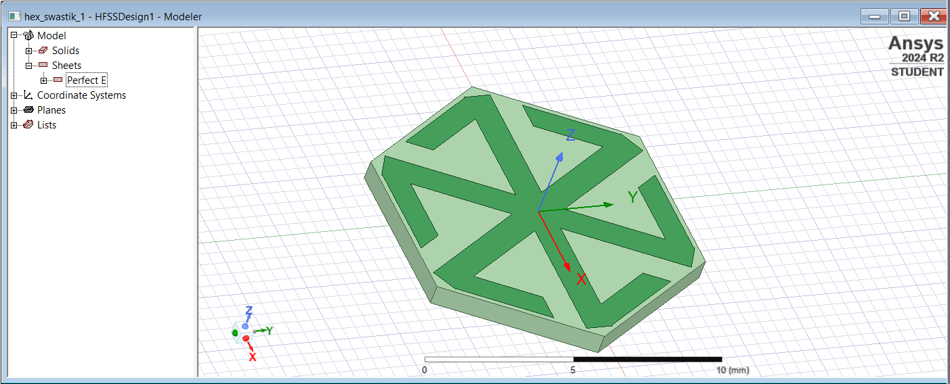

Frequency Selective Surfaces (FSS) Design :
Fig(1).Simulation Image of FSS in HFSS Software
Copper
Substrate

Slide 7
Performance: The deep learning model trained with a custom weighted loss function effectively minimized errors in S21 predictions. The inclusion of an additional hidden layer improved feature extraction, leading to better convergence and stability. The final training and validation losses indicate a well-generalized model with no overfitting.
Key Outcomes:
The predicted S21 values closely match expected trends, confirming high prediction accuracy. The hybrid optimization using Genetic Algorithm (GA) and Simulated Annealing (SA) successfully identified optimal FSS parameters, ensuring a wide stop band with deeper suppression at the target frequencies.
Output:
S21 Prediction Results
Enter value for l [mm]: 5.8
Enter value for t [mm]: 0.6
First 5 scaled inputs before prediction:
[[1. 0.5 0. ]
[1. 0.5 0.01010101]
[1. 0.5 0.02020202]
[1. 0.5 0.03030303]
[1. 0.5 0.04040404]]
4/4 ━━━━━━━━━━━━━━━━━━━━ 0s 16ms/step

Slide 8
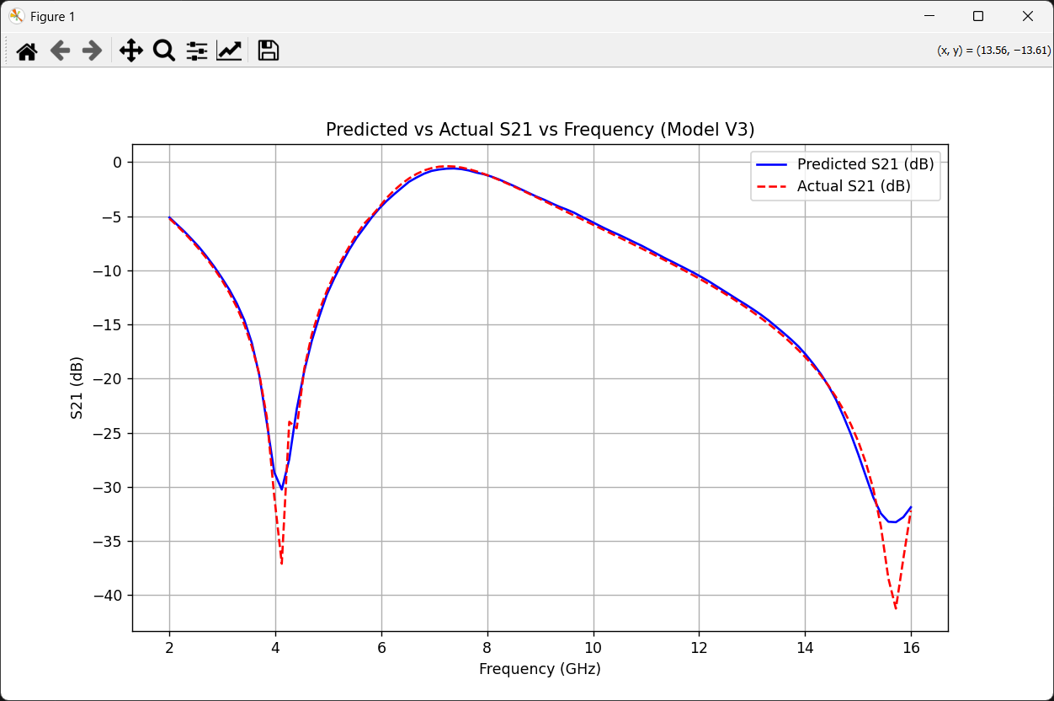
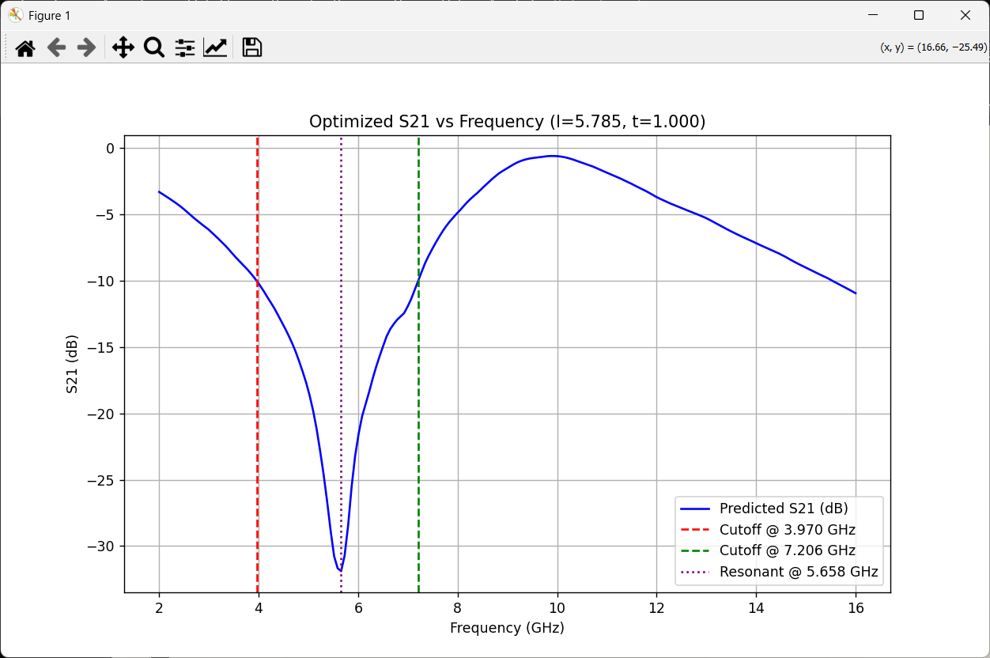
Optimal FSS parameters
7/7 ━━━━━━━━━━━━━━━━━━━━ 0s 4ms/step
🔹 Final Parameters: l = 5.785 mm, t = 1.000 mm
Stop Band: 3.970 GHz - 7.206 GHz, Avg S21: -17.708 dB
🎯 Resonant Frequency: 5.658 GHz (Lowest S21 Point)
Fig(2).Predicted vs Actual S21 Frequency
Fig(3).Optimized S21 vs Frequency

Slide 9
Conclusion :
Effectiveness of AI: AI demonstrated strong potential in automating and enhancing the design process for Frequency Selective Surfaces (FSS), showing high accuracy in predicting frequency responses.
Streamlined Process: This AI-driven approach significantly simplifies the FSS design workflow, enabling efficient alignment with precise performance targets.
Feasibility and Accuracy: The close alignment between actual and predicted values validates the effectiveness of machine learning for automating and refining FSS design, ensuring both feasibility and accuracy in real-world applications.

Slide 10
References :
R. Cong, C. Zhang, N. Liu, K. Yang, X. Gao, and X. Sheng, "A Novel Method for Frequency Selective Surface Design Using Deep Learning with Improved Particle Swarm Algorithm," 2022 IEEE the 9th International Symposium on Microwave, Antenna, Propagation and EMC Technologies for Wireless Communications (MAPE), 2022, pp. 374-379, doi: 10.1109/MAPE53743.2022.9935221.
Thank You

