Slide 1

राष्ट्रीय प्रौद्योगिकी संस्थान पुदुच्चेरी
NATIONAL INSTITUTE OF TECHNOLOGY PUDUCHERRY
(An Institute of National Importance under MoE, Govt. of India)
KARAIKAL – 609 609
Final Year project Phase II - Final Review Meeting
AI Based Design for Frequency Selective Surface (FSS)
Project Guide
Dr. Boopathi Rani R
Assistant Professor,
Department of ECE,
NIT Puducherry, Karaikal,
India
Presented by
KAPA ADHEESHWAR REDDY
Reg No: EC21B1023
SADHU POORNA SAI
Reg No:EC21B1043
SANAPALA CHANDRA SEKHAR
Reg No:EC21B1044
B.TECH Department of ECE,
NIT Puducherry, Karaikal,
India

Slide 2
Introduction:
What are Frequency Selective Surfaces (FSS)? Frequency Selective Surfaces (FSS) are advanced structures used in modern wireless communication systems. They play a vital role in filtering, controlling, and altering electromagnetic waves.
Applications of FSS:
FSS is utilized to improve antenna performance by filtering specific frequencies.
FSS aids in shielding electronic devices from unwanted electromagnetic interference.
FSS structures are essential in managing signal propagation and enhancing overall system efficiency.
FSS finds applications in satellite communication systems, where it helps in controlling signal interference and improving data transmission.
Challenges in FSS Design:
Traditional Design Methods: FSS design often involves iterative processes, which are computationally intensive and time-consuming.
Complexity: Achieving the desired electromagnetic properties through conventional methods requires substantial expertise and resources.
Scalability: Scaling FSS designs for large systems while maintaining performance and cost-efficiency presents significant challenges.

Slide 3
Problem Statement:
Designing Frequency Selective Surfaces (FSS) with specific electromagnetic properties traditionally demands considerable computational resources, expertise, and time. Moreover, managing large datasets for AI-driven designs presents additional challenges. The need for more efficient, data-driven models arises—ones that preserve high accuracy while reducing computational load. This project seeks to develop AI-based models to overcome these challenges, enhancing the design efficiency of FSS for applications in wireless communication, antenna design, and electromagnetic shielding.
Objectives:
Develop an AI-Based FSS Design Framework: Implement an efficient design approach for Frequency Selective Surfaces (FSS) using a deep neural network model to predict transmission coefficients.
Enhance Optimization Efficiency: Integrate optimization algorithms with the deep neural network to iteratively refine FSS structural parameters, enabling faster convergence with high accuracy.
Improve Design Accuracy: Achieve precise FSS design results by minimizing errors in transmission coefficients at critical frequency points.
Reduce Computational Time: Improve design efficiency relative to traditional methods, accelerating FSS design and making it more adaptable to practical applications.

Slide 4
Methodology:
Data Preprocessing The dataset is cleaned, and input parameters (l, t, freq) are normalized using MinMaxScaler. This prevents bias due to varying magnitudes. The S21 values are also normalized to improve model performance. The data is split into training and validation sets for better generalization.
Neural Network Architecture & Training The model consists of hidden layers with ReLU activation and dropout layers for regularization. The Adam optimizer is used for training stability. A custom loss function ensures accurate predictions, especially in the stop-band. Early stopping prevents overfitting and improves efficiency.
S21 Prediction & Stop-Band Identification The trained network predicts S21 across frequencies for different FSS parameters. The stop-band is identified where S21 drops below -10 dB. The resonant frequency is determined based on the lowest S21 value, helping evaluate FSS performance.

Slide 5
GA-SA Based Hybrid Optimization The Genetic Algorithm (GA) identifies optimal FSS parameters by evolving solutions through selection, crossover, and mutation. To enhance precision, Simulated Annealing (SA) is applied post-GA, refining results by escaping local optima via a controlled probabilistic search. This GA-SA hybrid balances global and local optimization effectively for better stop-band performance.
NSGA-II - SA Based Hybrid Optimization NSGA-II handles multiple objectives, such as maximizing bandwidth while minimizing transmission. When combined with SA, it fine-tunes the best Pareto-optimal solutions, improving local convergence and ensuring a well-balanced FSS response.
PSO-SA Based Hybrid Optimization PSO efficiently locates near-optimal solutions by simulating particle behavior in search space. SA then refines these solutions, improving parameter precision. This combination offers fast convergence and strong performance in FSS tuning.
Visualization & Results Analysis The optimized S21 curve is analyzed against initial predictions to verify improvements. The final optimized parameters confirm the effectiveness of combining neural networks with different optimization approaches.

Slide 6
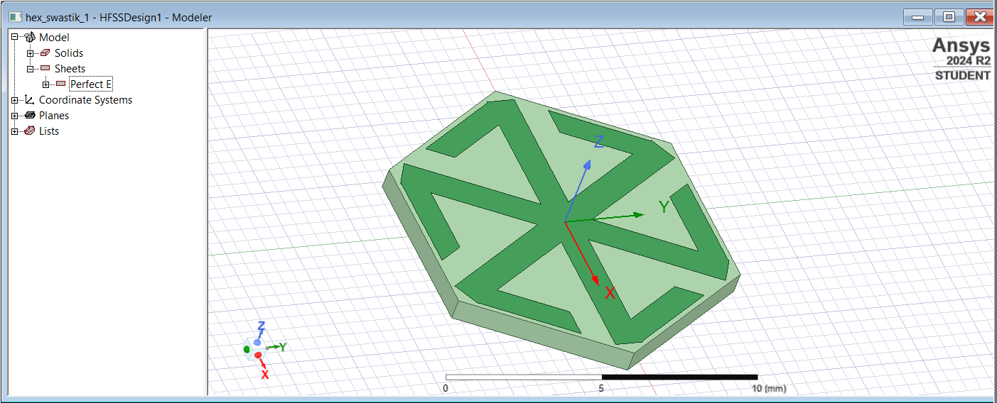

Frequency Selective Surfaces (FSS) Design :
Fig(1).Simulation Image of FSS in HFSS Software
Copper
Substrate

Slide 7
Genetic Algorithm + Simulated Annealing (GA + SA): This hybrid approach begins with Genetic Algorithm to explore the parameter space using selection, crossover, and mutation. It aims to maximize stop-band width and minimize S21 values. Simulated Annealing then refines these results by escaping local optima using a probabilistic temperature-based search. This combination ensures both global exploration and local exploitation, leading to optimal filter characteristics.
NSGA-II + Simulated Annealing (NSGA-II + SA): NSGA-II, a multi-objective evolutionary algorithm, generates a Pareto-optimal front by optimizing conflicting objectives like bandwidth and attenuation. It ensures diversity in solutions. Simulated Annealing enhances this by fine-tuning selected Pareto solutions, improving the design's precision. Together, they deliver balanced FSS designs with superior performance and flexibility.
Particle Swarm Optimization + Simulated Annealing (PSO + SA): PSO simulates the social behavior of particles to rapidly converge on promising regions in the design space. It offers faster optimization with fewer iterations. When paired with Simulated Annealing, the solution is fine-tuned to escape local minima and achieve global optimality. This method combines speed and accuracy, making it efficient for complex FSS optimization tasks.

Slide 8
Performance: The deep learning model trained with a custom weighted loss function effectively minimized errors in S21 predictions. The inclusion of an additional hidden layer improved feature extraction, leading to better convergence and stability. The final training and validation losses indicate a well-generalized model with no overfitting.
Key Outcomes:
The predicted S21 values closely match expected trends, confirming high prediction accuracy. The hybrid optimization using Genetic Algorithm (GA) and Simulated Annealing (SA) successfully identified optimal FSS parameters, ensuring a wide stop band with deeper suppression at the target frequencies.
Output:
S21 Prediction Results
Enter value for l [mm]: 5.8
Enter value for t [mm]: 0.6
First 5 scaled inputs before prediction:
[[1. 0.5 0. ]
[1. 0.5 0.01010101]
[1. 0.5 0.02020202]
[1. 0.5 0.03030303]
[1. 0.5 0.04040404]]
4/4 ━━━━━━━━━━━━━━━━━━━━ 0s 16ms/step

Slide 9
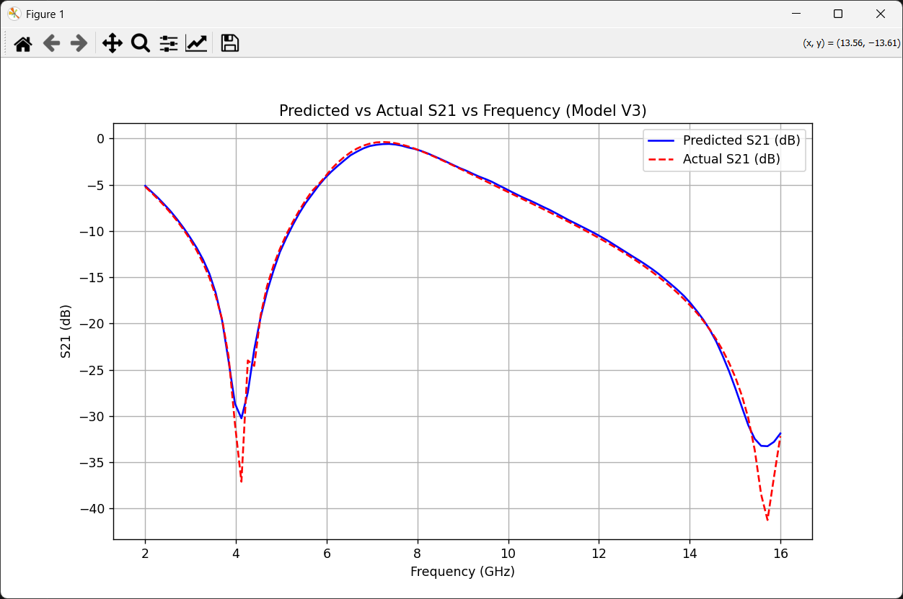
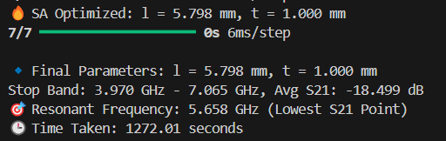
Optimal FSS parameters – GA+SA Optimization
7/7 ━━━━━━━━━━━━━━━━━━━━ 0s 4ms/step
🔹 Final Parameters: l = 5.785 mm, t = 1.000 mm
Stop Band: 3.970 GHz - 7.206 GHz, Avg S21: -17.708 dB
🎯 Resonant Frequency: 5.658 GHz (Lowest S21 Point)
Fig(2).Predicted vs Actual S21 Frequency
Fig (3) Results of the GA + SA Optimization

Slide 10
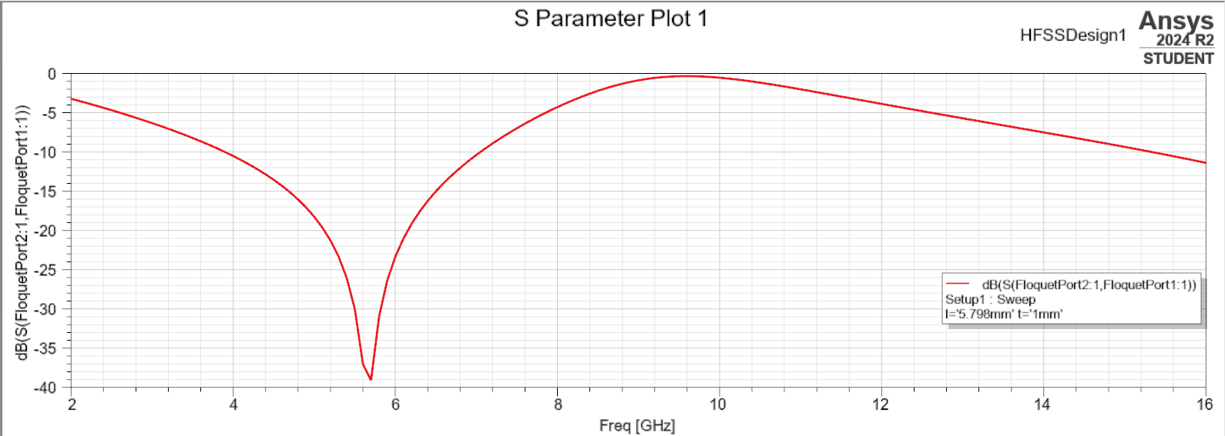
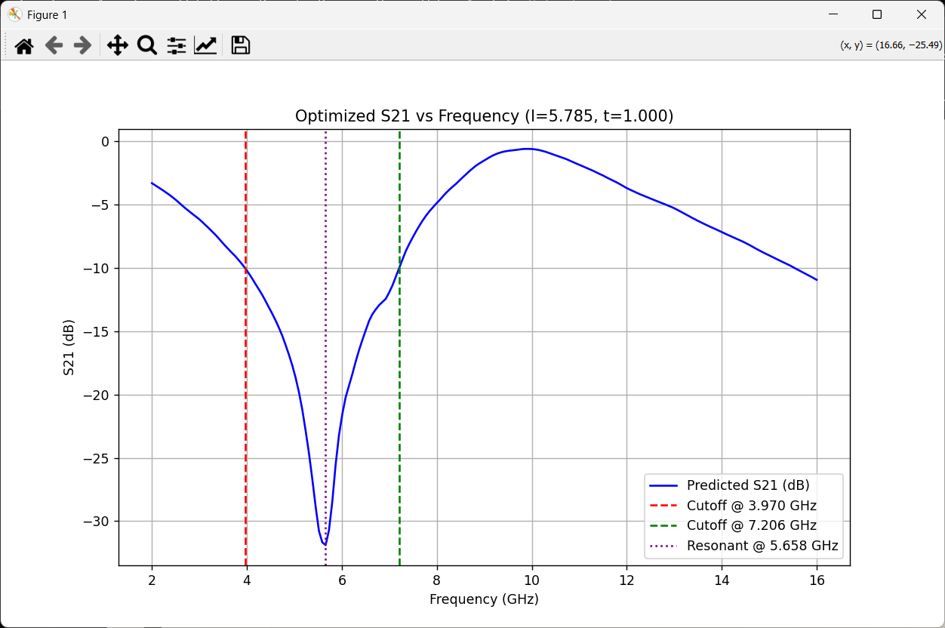
S-PARAMETER PLOT OF SIMULATED AND PREDICTED VALUES FOR OPTIMIZED PARAMETERS
Fig (4) Simulated S21 Plot of Optimized Parameters
Fig(5).Optimized S21 vs Frequency

Slide 11

Results and Visualization of NSGA-II + SA Approach:
NSGA-II + SA - Key Outcome: The NSGA-II and Simulated Annealing combination efficiently balanced multiple objectives, leading to optimal parameter sets that maintained a wide stop band and low transmission loss. The approach proved effective in generating a diverse range of solutions, enhancing design flexibility while preserving strong attenuation performance.
Optimal FSS parameters – NSGA-II+SA Optimization
🔥 Final Optimized: l = 5.797, t = 1.000
Stop Band: 3.970 - 7.065 GHz | Avg S21: -18.497 dB
Resonant: 5.658 GHz
🕒 Time Taken: 900.15 seconds
Output:
Fig (6) Results of the NSGA + SA Optimization

Slide 12
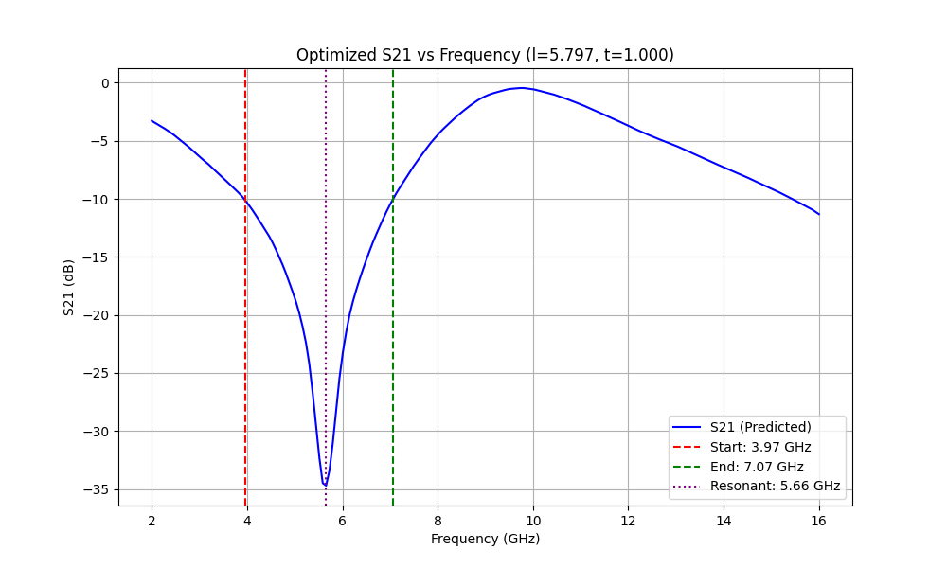
S-PARAMETER PLOT OF SIMULATED AND PREDICTED VALUES FOR OPTIMIZED PARAMETERS
Fig (7) Simulated S21 Plot of Optimized Parameters
Fig (8) Visualization of S21 values Optimized Parameters by NSGA+SA

Slide 13
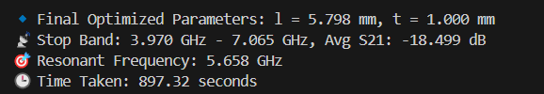
Results and Visualization of PSO+ SA Approach:
PSO + SA - Key Outcome: The Particle Swarm Optimization enhanced by Simulated Annealing rapidly converged to optimal FSS parameters, offering near-identical stop band performance with reduced computation time. The hybrid approach achieved a smooth and deep S21 response, demonstrating its suitability for time-efficient yet accurate optimization.
Optimal FSS parameters – PSO+SA Optimization
🔹 Final Optimized Parameters: l = 5.798 mm, t = 1.000 mm
📡 Stop Band: 3.970 GHz - 7.065 GHz, Avg S21: -18.499 d
🎯 Resonant Frequency: 5.658 GHz
🕒 Time Taken: 897.32 seconds
Output:
Fig (9) Results of the PSO + SA Optimization
13

Slide 14
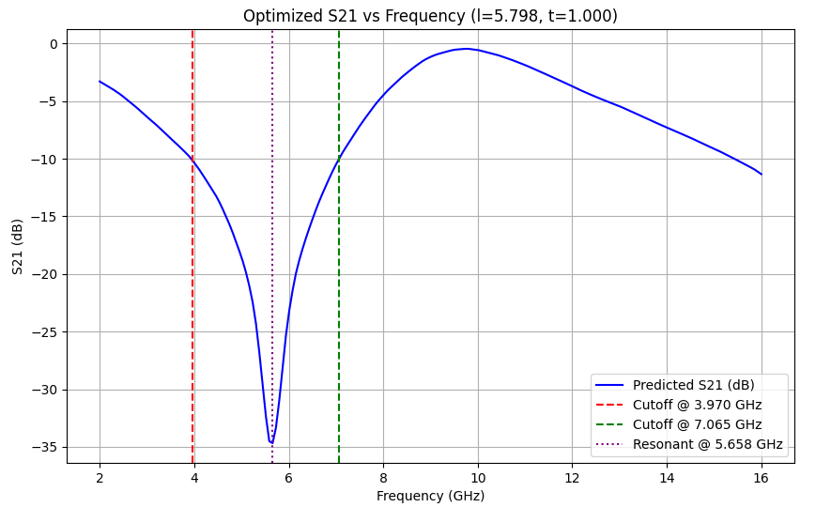
S-PARAMETER PLOT OF SIMULATED AND PREDICTED VALUES FOR OPTIMIZED PARAMETERS
Fig (10) Simulated S21 Plot of Optimized Parameters
Fig (11) Visualization of S21 values Optimized Parameters by PSO+SA

Slide 15
COMPARISON TABLE FOR RESULTS OF ALL 3 APPROACHES :
Optimization Approach | Optimized Parameters (l, t) | Stop Band (GHz) | Average S21 (dB) | Resonant Frequency (GHz) | Time (seconds)
GA + SA | l = 5.798 mm t = 1.000 mm | 3.970 – 7.065 | -18.499 | 5.658 | 1272.01
NSGA-II + SA | l = 5.797 mm t = 1.000 mm | 3.970 – 7.065 | -18.497 | 5.658 | 900.15
PSO + SA | l = 5.798 mm t = 1.000 mm | 3.970 – 7.065 | -18.499 | 5.658 | 897.32
Table 1: Comparative Analysis of Hybrid Optimization Approaches for FSS Parameter Tuning
The comparative analysis in Table 1 demonstrates that all hybrid optimization techniques achieved nearly identical performance in terms of stopband, average S21, and resonant frequency. However, the combination of Particle Swarm Optimization with Simulated Annealing exhibited the fastest convergence time, making it the most time-efficient approach among the evaluated methods.

Slide 16
Conclusion :
Effectiveness of AI: AI demonstrated strong potential in automating and enhancing the design process for Frequency Selective Surfaces (FSS), showing high accuracy in predicting frequency responses.
Streamlined Process: This AI-driven approach significantly simplifies the FSS design workflow, enabling efficient alignment with precise performance targets.
Feasibility and Accuracy: The close alignment between actual and predicted values validates the effectiveness of machine learning for automating and refining FSS design, ensuring both feasibility and accuracy in real-world applications.

Slide 17
References :
Z. Gu, D. Li, Y. Fan, L. Zhang, Y. Liu and E. Li, "Intelligent Design of Arbitrary Bandstop FSS Through Deep Learning and Genetic Algorithm," 2022 Asia-Pacific International Symposium on Electromagnetic Compatibility (APEMC), Beijing, China, 2022, pp. 649-651, doi: 10.1109/APEMC53576.2022.9888547.
Thank You

