Slide 1

राष्ट्रीय प्रौद्योगिकी संस्थान पुदुच्चेरी
NATIONAL INSTITUTE OF TECHNOLOGY PUDUCHERRY
(An Institute of National Importance under MoE, Govt. of India)
KARAIKAL – 609 609
Final Year project Phase II - First Review Meeting
AI Based Design for Frequency Selective Surface (FSS)
Project Guide
Dr. Boopathi Rani R
Assistant Professor,
Depatment of ECE,
NIT Puducherry, Karaikal,
India
Presented by
KAPA ADHEESHWAR REDDY
Reg No: EC21B1023
SADHU POORNA SAI
Reg No:EC21B1043
SANAPALA CHANDRA SEKHAR
Reg No:EC21B1044
B.TECH Department of ECE,
NIT Puducherry, Karaikal,
India

Slide 2
Introduction:
What are Frequency Selective Surfaces (FSS)? Frequency Selective Surfaces (FSS) are advanced structures used in modern wireless communication systems. They play a vital role in filtering, controlling, and altering electromagnetic waves.
Applications of FSS:
FSS is utilized to improve antenna performance by filtering specific frequencies.
FSS aids in shielding electronic devices from unwanted electromagnetic interference.
FSS structures are essential in managing signal propagation and enhancing overall system efficiency.
FSS finds applications in satellite communication systems, where it helps in controlling signal interference and improving data transmission.
Challenges in FSS Design:
Traditional Design Methods: FSS design often involves iterative processes, which are computationally intensive and time-consuming.
Complexity: Achieving the desired electromagnetic properties through conventional methods requires substantial expertise and resources.
Scalability: Scaling FSS designs for large systems while maintaining performance and cost-efficiency presents significant challenges.

Slide 3
Problem Statement:
Designing Frequency Selective Surfaces (FSS) with specific electromagnetic properties traditionally demands considerable computational resources, expertise, and time. Moreover, managing large datasets for AI-driven designs presents additional challenges. The need for more efficient, data-driven models arises—ones that preserve high accuracy while reducing computational load. This project seeks to develop AI-based models to overcome these challenges, enhancing the design efficiency of FSS for applications in wireless communication, antenna design, and electromagnetic shielding.
Objectives:
Develop an AI-Based FSS Design Framework: Implement an efficient design approach for Frequency Selective Surfaces (FSS) using a deep neural network model to predict transmission coefficients.
Enhance Optimization Efficiency: Integrate optimization algorithms with the deep neural network to iteratively refine FSS structural parameters, enabling faster convergence with high accuracy.
Improve Design Accuracy: Achieve precise FSS design results by minimizing errors in transmission coefficients at critical frequency points.
Reduce Computational Time: Improve design efficiency relative to traditional methods, accelerating FSS design and making it more adaptable to practical applications.

Slide 4
Structure of the Design
The design follows a periodic pattern, meaning the same unit cell is repeated in an array format to create the full FSS structure.
Hexagonal Shape:
The basic unit cell has a hexagonal boundary that acts as the fundamental repeating element.
A Swastik pattern is inscribed inside the hexagon to control the transmission characteristics of the surface.
Swastik Pattern:
The Swastik-shaped geometry inside the hexagon acts as a resonant element, which helps in filtering specific frequencies.
The open-ended arms of the Swastik influence the capacitive and inductive effects, which determine the filtering behavior.
Material Selection:
The substrate material is likely Rogers RO4003C (εr ≈ 3.38).
The conducting layer (FSS pattern) is usually copper (σ = 5.8 × 10⁷ S/m).
Design Parameters
FSS design is controlled by two primary parameters:
(a) L (Length of the Swastik Arm) : Range: 1 mm to 5.8 mm
(b) T (Thickness of the Arm) : Range: 0.2 mm to 1 mm

Slide 5
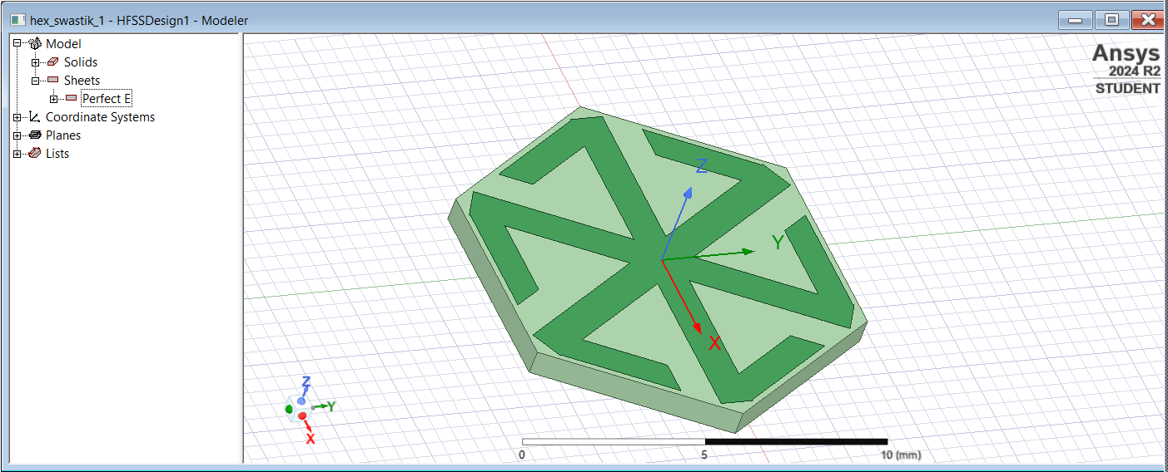

Frequency Selective Surfaces (FSS) Design :
Fig(1).Simulation Image of FSS in HFSS Software
Copper
Substrate

Slide 6
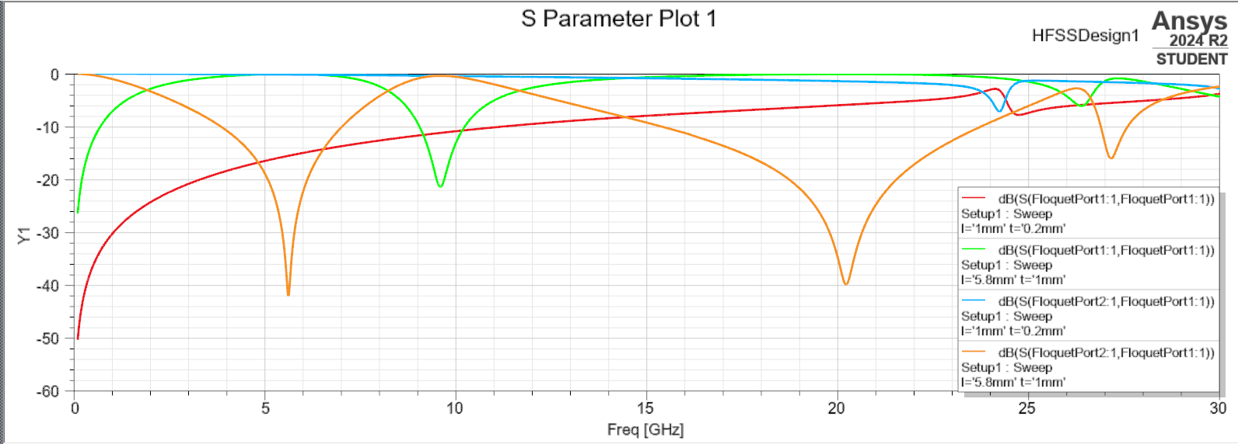
Results
After running the HFSS simulation, the following outputs are expected:
S-Parameters Analysis:
S21 (Transmission Coefficient): Determines how much signal passes through the FSS.
S11 (Reflection Coefficient): Measures how much signal is reflected.
Resonance Frequency Identification:
The simulation helps in identifying the frequencies where the structure exhibits strong filtering properties.
The optimal values of L and T are determined based on the desired frequency response.
Fig(2). S Parameter Plot (S21 and S11)

Slide 7
Future Work: Advanced Optimization Techniques
(a) Implement Machine Learning (ML) / AI-Based Optimization
Machine Learning models can be trained using simulation data from HFSS to predict the best values of L and T for achieving a specific resonance frequency.
Process:
Generate Training Data:
Run multiple HFSS simulations with different values of L and T.
Record the S21 and S11 values for each case.
Train an ML Model:
Use ML algorithms like Neural Networks, Random Forest, or Support Vector Machines (SVM) to learn the relationship between L, T, and the frequency response.
Predict Optimal Parameters:
Once trained, the model can predict the best L and T values without running full HFSS simulations, significantly reducing computation time.

Slide 8
Conclusion :
Effectiveness of AI: AI demonstrated strong potential in automating and enhancing the design process for Frequency Selective Surfaces (FSS), showing high accuracy in predicting frequency responses.
Streamlined Process: This AI-driven approach significantly simplifies the FSS design workflow, enabling efficient alignment with precise performance targets.
Feasibility and Accuracy: The close alignment between actual and predicted values validates the effectiveness of machine learning for automating and refining FSS design, ensuring both feasibility and accuracy in real-world applications.

Slide 9
References :
R. Cong, C. Zhang, N. Liu, K. Yang, X. Gao, and X. Sheng, "A Novel Method for Frequency Selective Surface Design Using Deep Learning with Improved Particle Swarm Algorithm," 2022 IEEE the 9th International Symposium on Microwave, Antenna, Propagation and EMC Technologies for Wireless Communications (MAPE), 2022, pp. 374-379, doi: 10.1109/MAPE53743.2022.9935221.
Thank You

