Slide 1

HAND GESTURE MOUSE
Presentation by Gudla Monish (ENG22AM0096) and Chethan S (ENG22AM0084)
AI-Mini project | 3rd semester
Dayananda Sagar University

Slide 2


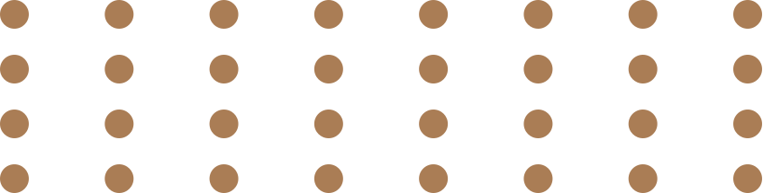
INTRODUCTION
OBJECTIVE
Our project, the "Hand Gesture Mouse," introduces a novel way to interact with computers. By using simple hand gestures, users can effortlessly control the computer cursor and perform actions without physical contact with the mouse. This innovative approach aims to enhance user experience and accessibility in human-computer interaction.
APPLICATIONS
LIMITATIONS
WORKING AND RESULT
AI-mini project

Slide 3


Python libraries used in project
OpenCV
PyAutoGUI
The libraries identify hand landmarks, allowing users to control the cursor and simulate mouse clicks through hand gestures. The program maps the hand movements to the screen, enabling users to move the cursor by moving their hands and trigger a click by aligning their thumb with the index finger.
Problem statement: Hand gestured mouse using python that can perform functions of a move like clicking
and moving the cursor around.

Slide 4
INTRODUCTION
1. Real-time Hand Recognition: Implement a recognition system capable of accurately
recognizing hand.
2. Real-time Gesture Recognition: Implement a real-time gesture recognition system capable
of accurately interpreting hand movements.
2. Cursor Control: Enable users to control the computer cursor with hand movement, resulting
in hands-free interaction.
3. Gesture Commands: Implement a set of predefined hand gestures for common commands such
as clicking.
4. User-Defined Gestures: Empower users to customize and define their own gestures by changing
code –works with support of libraries.
5. Implementation of necessary Python Libraries: python libraries required for import
python / AI-ML concepts are used.
OBJECTIVE
APPLICATIONS
LIMITATIONS
WORKING AND RESULT
AI-mini project

Slide 5
INTRODUCTION
OBJECTIVE
·Accessibility: - The system serves as an assistive technology, offering individuals with motor impairments an accessible means to interact with computers effortlessly.
·
Presentations:- Ideal for presentations and interactive sessions, presenters can seamlessly control slides using intuitive hand gestures, fostering engaging and dynamic communication.
·Gaming: - Elevate the gaming experience by translating hand movements into in-game actions
·Healthcare: - In healthcare settings, the Gesture-Controlled Mouse minimizes physical contact with computers, significantly reducing the risk of contamination in sterile environments.
·General integration: - In devices like TV’s , washing machines , and any device that can take in Input from a cam and perform a certain activity.
APPLICATIONS
APPLICATIONS
LIMITATIONS
WORKING AND RESULT
AI-mini project

Slide 6
INTRODUCTION
··Learning Curve: Users may need time to adapt to the new control, especially those accustomed to traditional input devices.
·
Environmental Factors and surroundings: The effectiveness may be influenced by environmental factors such as lighting conditions and background clutter.
·Frame rate and camera quality: System might have hard time understanding gestures and recognizing hands if quality and frame rate are bad.
·Fatigue: Constant heavy gesturing might be tiring for user
·Gesture Ambiguity: Some gestures may be inherently ambiguous or prone to misinterpretation, potentially resulting in unintended actions.
·System specifications: Requires high computing power and a overall well equipped System to Run it properly
·Integration: Integrating it into high level businesses products and in daily life is expensive
OBJECTIVE
APPLICATIONS
LIMITATIONS
LIMITATIONS
WORKING AND RESULT
AI-mini project

Slide 7
INTRODUCTION
OBJECTIVE
The methodology for the "Hand Gesture Mouse" project centers on computer vision and gesture recognition principles, integrating established libraries
for a responsive hands-free interface.
Methods of Data Collection:
Primary data is real-time video input processed by OpenCV, detecting and tracking hand landmarks. The collected data includes coordinates crucial for subsequent analysis.
Selection of Case Study Materials:
The case study involves hand gestures, particularly the detected landmarks (fingertips and joints) using MediaPipe, essential for mapping hand movements and gesture recognition.
Type of Materials Analyzed:
Materials analyzed are real-time coordinates of hand landmarks from MediaPipe, serving as input data for gesture recognition.
Data Preparation:
Before analysis, Python scripts check data integrity, addressing missing values or outliers to ensure reliable gesture recognition.
APPLICATIONS
LIMITATIONS
WORKING AND RESULT
WORKING AND RESULT
AI-mini project

Slide 8
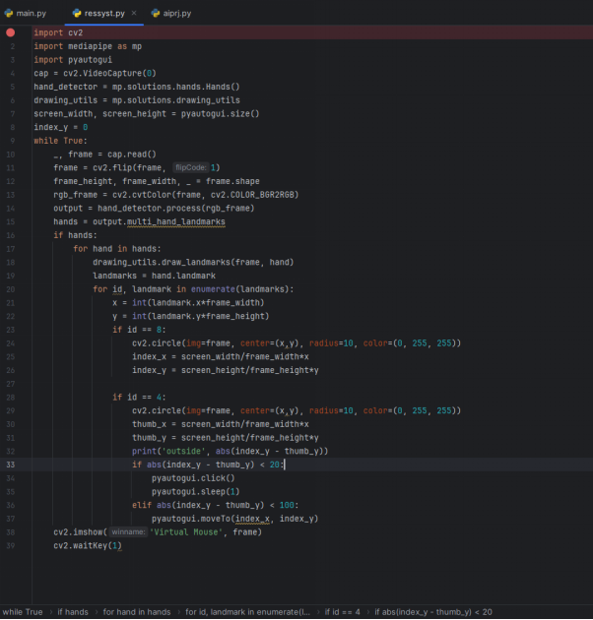
Implemented Code:
Github -
https://github.com/mon11sh/hand-gesture-mouse

Slide 9
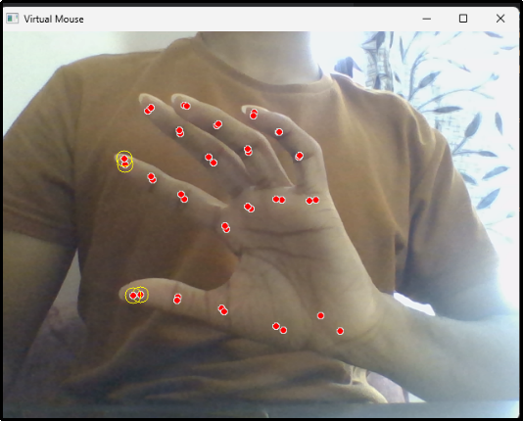
I.GENERAL TEST CASE 1:
AFTER THE IMAGE IS PROCESSED, THE SYSTEM CAN PROVIDE FEEDBACK OR INFORMATION ABOUT THE IDENTIFIED FINGER POINTS. THIS INFORMATION MAY INCLUDE THE COORDINATES OR POSITIONS OF THE FINGERTIPS, THE ANGLES BETWEEN JOINTS, OR ANY OTHER RELEVANT DATA THAT CHARACTERIZES THE HAND GESTURE.
FOR EXAMPLE, THE SYSTEM MIGHT OUTPUT A LIST OF COORDINATES REPRESENTING THE FINGERTIPS, ALLOWING THE USER OR DEVELOPER TO UNDERSTAND HOW THE HAND GESTURE HAS BEEN INTERPRETED BY THE ALGORITHM. ADDITIONALLY, THE SYSTEM COULD INDICATE THE RECOGNIZED GESTURE OR PROVIDE INSIGHTS INTO THE POSITIONING OF THE FINGERS, WHICH CAN BE VALUABLE FOR ASSESSING THE ACCURACY AND RELIABILITY OF THE FINGER POINT IDENTIFICATION PROCESS.

Slide 10
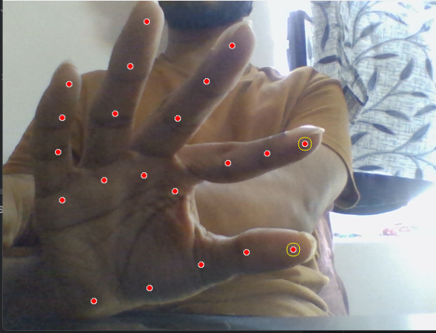
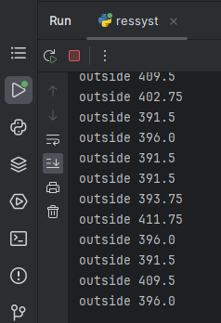
II. TEST CASE 2 - DEMONSTRATES WHEN TWO FINGERS
ARE AT A DISTANCE FROM EACH OTHER
OUTPUT:

Slide 11
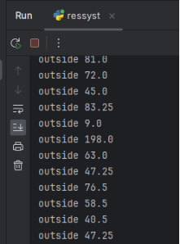
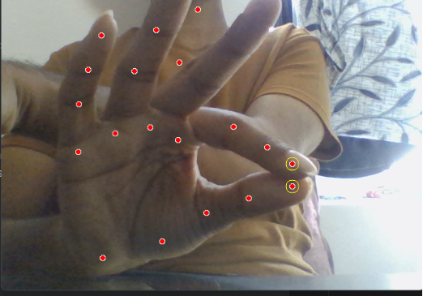
III. TEST CASE 3- DEMONSTRATES TWO FINGERS ARE AT A MINIMUM DISTANCE
I.E. ATTACHED TO EACH OTHER.
1.IN THIS CERTAIN CASE, THE MOUSE CURSOR STARTS WORKING AND MOVES
IN THE DIRECTION IN WHICH THE FINGER COORDINATES MOVE
2.FURTHER DECREASING THE DISTANCE BETWEEN ALL COORDINATES RESULTS
IN A CLICKING ACTION.
OUTPUT:

Slide 12
THANK YOU

