Slide 1
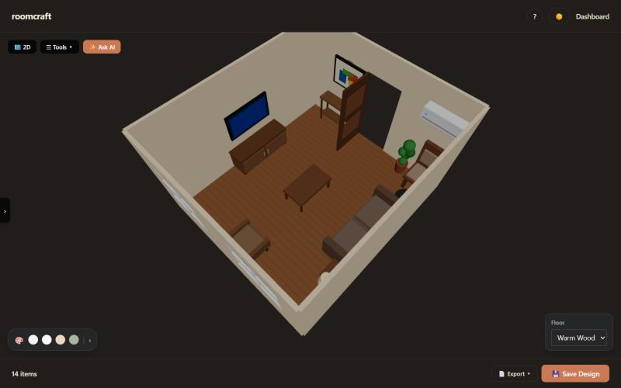
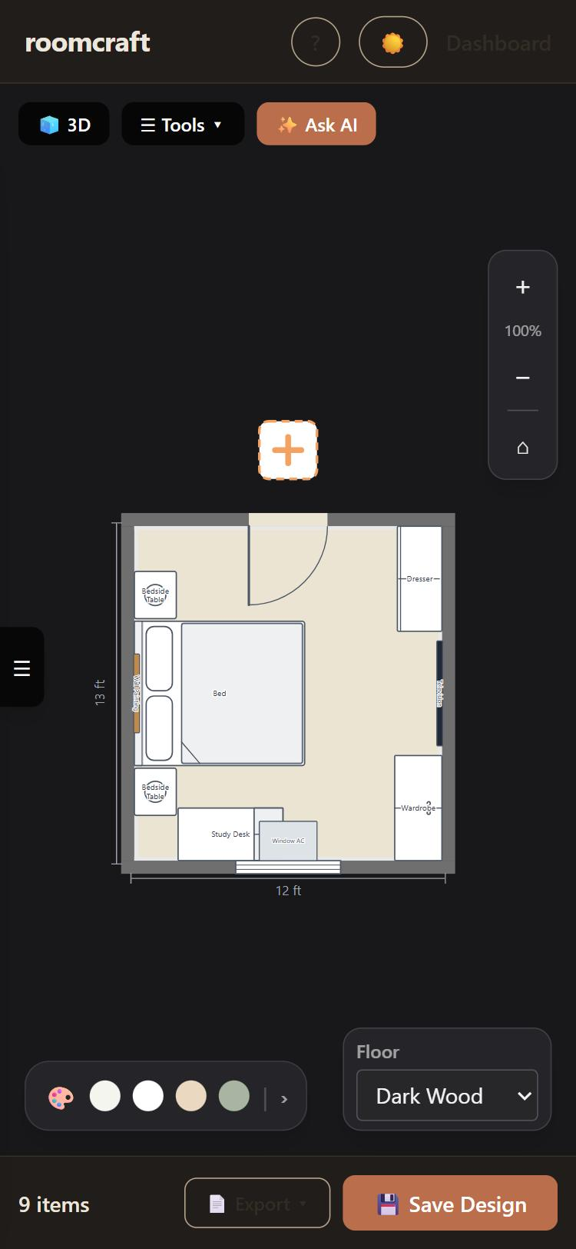
roomcraft
An AI interior designer: scan a real room with your phone, design it in 2D and 3D, and furnish it with AI
[Team member 1] · [Team member 2]
[Team member 3] · [Team member 4]
Guide: [Guide name] · [College] · November 2026
Notes:
Introduce the team and the project. roomcraft is a web app: you measure your real room with your phone's camera, then design and furnish it in 2D and 3D, with an AI assistant that suggests and applies changes.

Slide 2
Planning a room is mostly guesswork
1
2
3
Measuring is slow
Will it fit?
Design is hard
Tape, graph paper, and redrawing the room by hand before any design can start.
Is there space for the bed and the wardrobe, and does the door still open?
Which colours, which furniture, and where? Most people do not know where to begin.
roomcraft starts from the real room instead of an empty box.
Notes:
Three pain points. Professional tools need exact measurements and training; simple planners start from an empty box you must measure and draw yourself, and leave the design choices to you.

Slide 3
From a real room to a finished design
1
2
3
4
Scan
Design
Ask AI
Save & export
Tap the room's corners, doors and furniture with an Android phone
Edit the room as a 2D plan and a 3D model, with real rules
"Furnish this as a cozy study": tap Apply, or Undo
Designs saved to your account; labelled PDF floor plans
Works on phones and laptops, in light and dark themes.
Notes:
The whole journey in four steps. Scan on the phone, design on the laptop or phone, ask the AI for changes, save and export. Each of the next sections covers one part.

Slide 4
Architecture
Laptop browser
Frontend (Vite, HTTPS)
Backend (Express)
dashboard, 2D / 3D editor
React app
AR scanner page
/api/detect: camera guess
proxies /api and /uploads
sign-up with email code, JWT login
profile and photo upload
designs: save, open, delete
AI assistant
rate limits
Android phone
Chrome + ARCore (WebXR)
Google Gemini
PostgreSQL
plans, chat, camera guess
users, codes, designs
Notes:
Two pages from one frontend: the React app and the AR scanner. Both only talk to the frontend's own HTTPS address; API calls are passed on to the Express backend, which stores everything in PostgreSQL. Gemini is called from the server side, so the API key never reaches the browser.

Slide 5
Technology stack
Frontend
3D
Backend
Database
React 19, Vite 8, Tailwind CSS v4
three.js, React Three Fiber, drei
Node.js, Express, multer
PostgreSQL 16
Accounts
AR scanning
Vision
Generative AI
JWT, bcrypt, email codes
WebXR: hit test, anchors
MediaPipe EfficientDet-Lite0 on the phone
Google Gemini, JSON schemas
Notes:
The stack. Everything is JavaScript end to end. The 2D plan is SVG drawn by React, which we also reuse for the PDF export. Tests run with Vitest; lint with oxlint.

Slide 6
The room editor: 2D plan and 3D view
Generate a room: type, size, style; furniture placed automatically
Drag pieces in 2D or 3D; rotate to any angle, snaps straight near 90°
Resize to any decimal; doors swing, flip and open in or out
Wall colours, 7 floors, 4 styles; 14 room types, 86 furniture types
Notes:
Demo point: the same room in 2D and 3D, changes in one appear in the other. A generated 14 by 16 ft living room. Rotation is free but snaps straight near the right angles, and any angle that would cause a collision is refused.

Slide 7
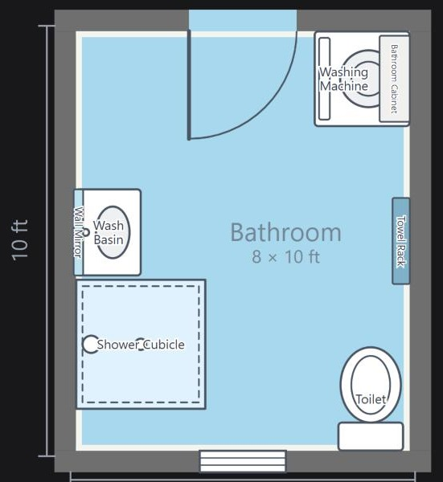
Furniture follows real rules
0.05 ft
0.13 ft
minimum gap between two pieces
from a wall's centre line: flush with the wall
Door swing
Openings
kept clear of floor furniture
never covered by a TV, shelf or painting
Notes:
One set of rules in utils/layout.js is used everywhere: the editor, the room generator, the AI placer and the scanner's tidy-up. A dragged piece stops at the last free spot instead of overlapping. On the right, a bathroom plan: every piece labelled inside its box.

Slide 8
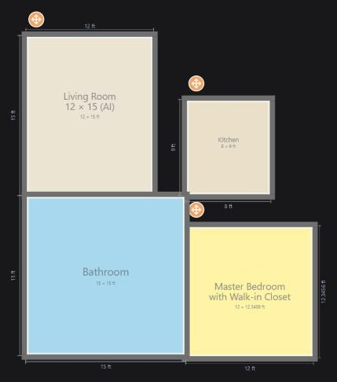
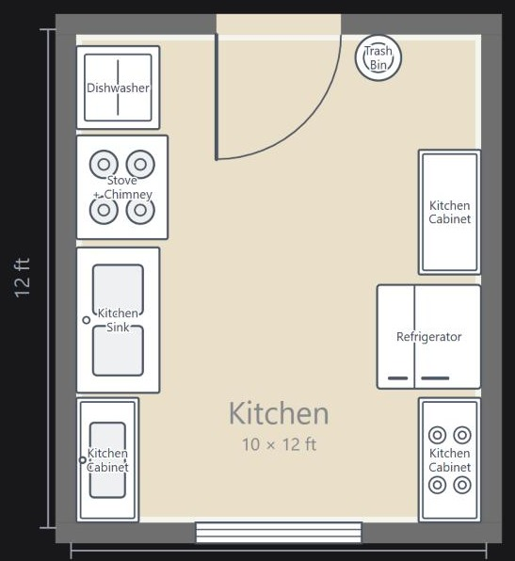
Connected rooms and PDF floor plans
+ outside a door adds a room; rooms dock wall to wall and turn 90°
Every room shows its width and length; every piece is labelled
Labels never touch: they slide or shrink to stay clear
Export: A4 PDF drawn from the same plan you see
Notes:
Multi-room layouts: each room keeps its own furniture, colours and floor. The PDF export renders the same React component as the screen, so the printout always matches the editor.

Slide 9
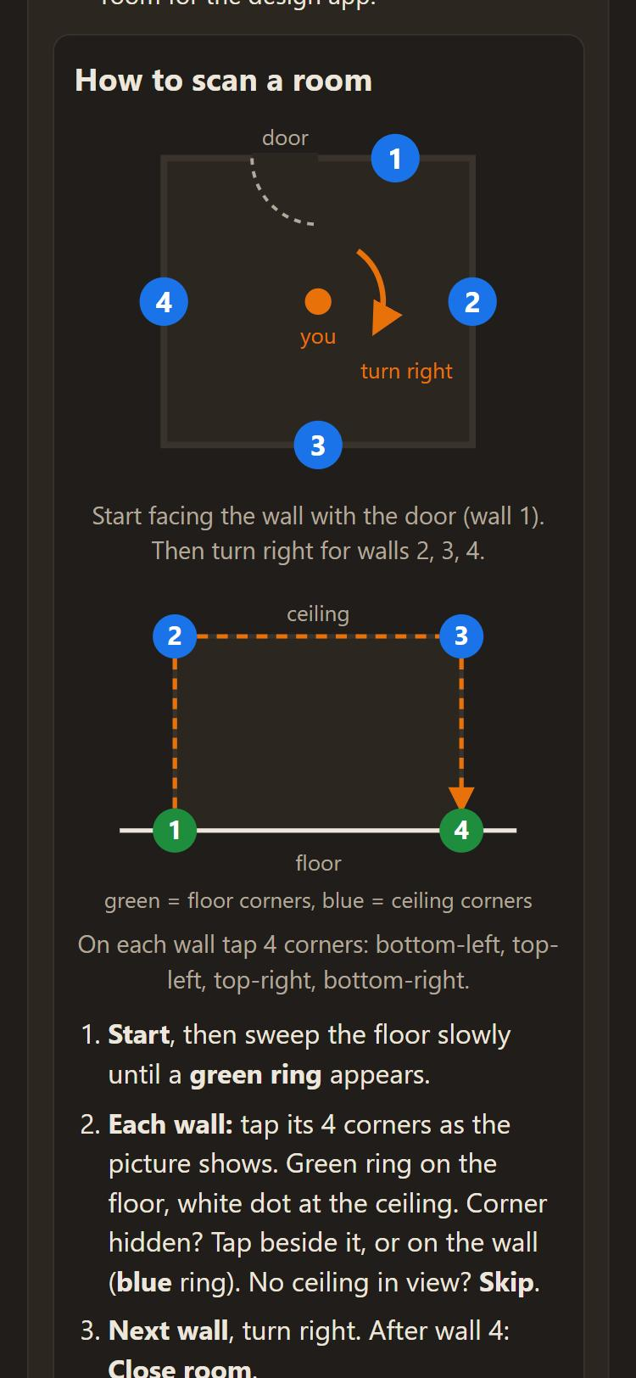
Scan a real room with a phone
1
Walls
Tap 4 corners in a U on each wall, turning right
2
Close room
When the last corner meets the first
3
Doors, windows, furniture
2 corners for openings; type + one tap for furniture
4
Save
Straight into My Designs, ready to edit
Notes:
No app to install: WebXR augmented reality in Chrome on Android with ARCore. The phone tracks its position; a hit test gives the 3D point under the centre of the screen. An on-screen diagram shows the current wall and the next corner.

Slide 10
How the scanner measures
Each wall is a line through its floor taps; the room is the rectangle that best fits all four lines
Hidden corners don't matter: taps on furniture are dropped and the wall uses its top corners
Ceiling height from where the top-corner aiming lines meet each wall
Raw taps are saved, so old scans improve when the code improves
2.72 m
ceiling measured
(tape: 2.74 m)
1–2 cm
typical error on
floor lines
306
automated tests
all passing
Notes:
The key idea: never rely on exact corner points. A wall is a line on the floor; the room is the best-fitting rectangle. On a real room the ceiling came out at 2.72 m against 2.74 m by tape. The geometry is covered by 306 tests that use rotated, off-origin rooms like a real AR session.

Slide 11
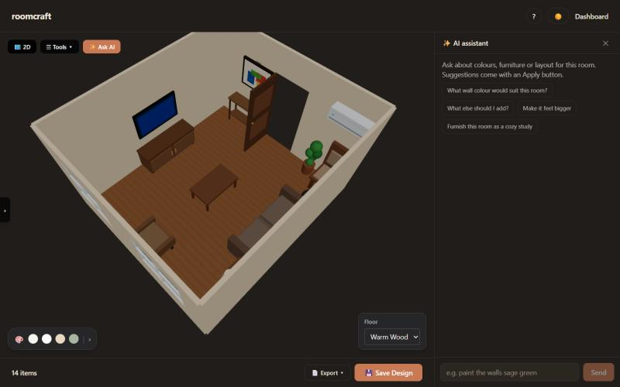
✨ Ask AI: suggestions you apply with a tap
1
You ask
"Paint the walls sage", "furnish as a study"
2
Gemini chooses
only from the app's own catalogue
3
The app places
with the same no-overlap rules
4
You decide
Apply each change, or Undo it
Notes:
The assistant never gives coordinates. It answers with typed actions checked against the catalogue on the server; the app places each piece itself, so AI-made rooms never overlap or block doors. Nothing changes until the user taps Apply, and everything can be undone. Time limits and a fallback model keep it responsive.

Slide 12
Naming furniture from the camera
1
2
3
Quick guess on the phone
Gemini looks closer
You confirm
MediaPipe EfficientDet-Lite0 runs on the device: beds, chairs, sofas, tables, TVs
One camera frame goes through the server; the answer must be a type from the catalogue
The best match is highlighted in the picker; tap it, or pick another type
The Gemini key stays on the server; a wrong guess never lands in the room unnoticed.
Notes:
During a scan, Guess from camera saves picking the furniture type by hand. A fast on-device detector gives a first guess; Gemini gives a better one from a single frame; the user always confirms.

Slide 13
Accounts and security
Accounts
Protection
Sign-up confirmed by an emailed 5-digit code
Login with a signed token (JWT)
Profile: name, profession, photo, password
My Designs: open, export, delete, scan
Passwords stored only as bcrypt hashes
Rate limits on login, codes, uploads and AI
Secrets in server-side .env files only
Every design query filtered by the user's id
4
database tables
19
API routes
7
rate limits
Notes:
Four database tables: users, one-time codes, onboarding answers, designs. 19 API routes. Rate limits: for example 10 logins per 15 minutes and 12 AI requests per minute. Designs are stored as one row each with JSON lists of furniture and openings.

Slide 14
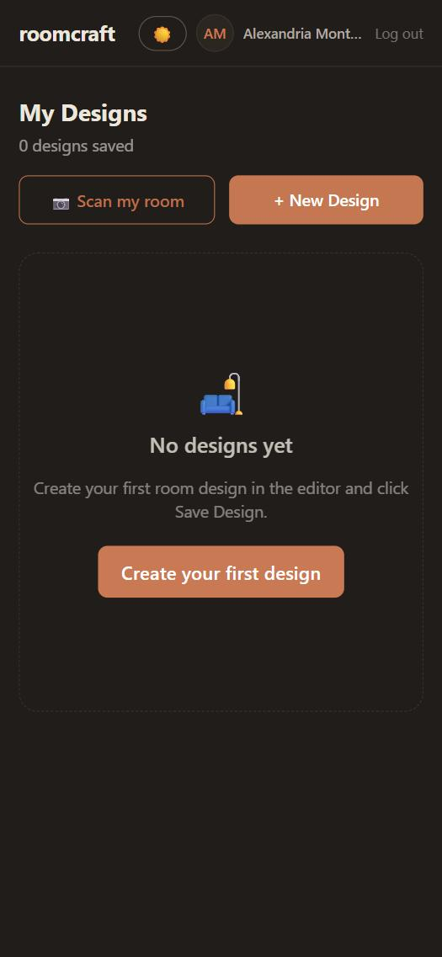
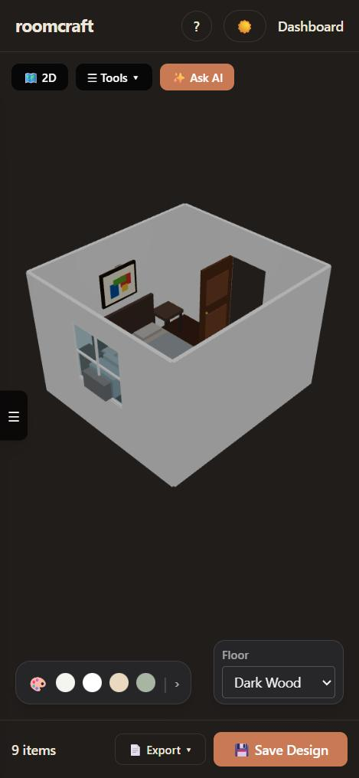
Built for phones as well as laptops
Top and bottom bars pinned; tools in one ☰ menu
Selected piece: size, rotate, delete right beside it
No control overlaps another at phone width
8-step guided tour; light and dark themes
My Designs
2D plan
3D view
Notes:
Everything was checked at 375 px phone width and 1280 px laptop width. On a laptop the AI chat opens as a column beside the room so nothing is covered; on a phone it is a bottom sheet.

Slide 15
Results
306
2 cm
14
scanner tests passing
typical line error
room types
86
19
~19k
furniture types
API routes
lines of code
Notes:
End to end, a room scanned on a phone opens in the laptop editor with its real size, ceiling height, doors and furniture. All 14 room types were generated and drawn through the PDF export path with no overlapping labels.

Slide 16
Limitations and next steps
Today
Next
Rectangular rooms (others: connect several rooms)
Scanning needs Android; iPhone Safari has no WebXR AR
Phone tracking can drift on plain walls or fast turns
One-tap furniture uses standard sizes
Go live: Vercel + Neon (PostgreSQL) + Gmail codes
Drift correction and measured furniture sizes
Rooms with more than four walls
Shopping links, cost estimates, shared designs
Notes:
Be upfront about limits. The scanner flags inconsistent walls and suggests a rescan. Deployment to the public web is the immediate next step.

Slide 17
Thank you
Questions and live demo
[Team member 1] · [Team member 2]
[Team member 3] · [Team member 4]
Notes:
Offer a live demo: scan or open a scan file, open it in the editor, ask the AI to furnish it, export the PDF.

