Slide 1


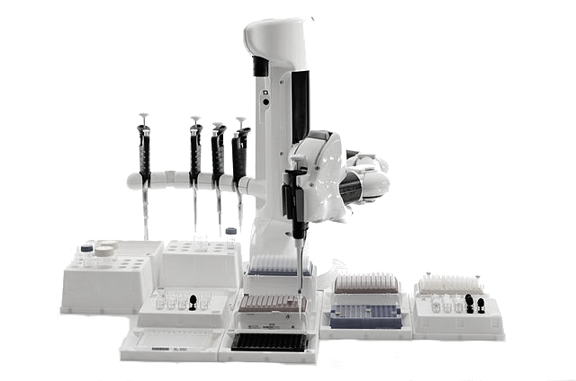

Protocol Interface
What requests are OK?
Assistive
design
Automatic
checking
Requester
Execution Request
Provider
Specific samples, parameters

Slide 2
Parameters
name/value pairs
cardinality, legal range
Protocol
Samples
Measurements
combinatorial SBOL
cardinality, constraints
instrument @ time
available instruments
legal times

