Slide 1


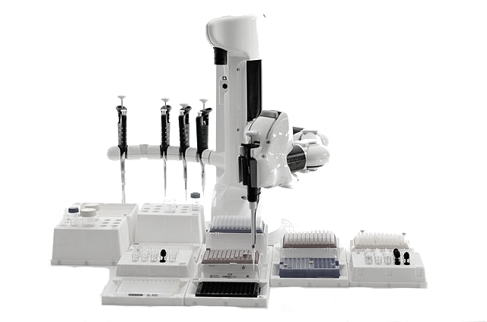

Protocol Interface
What requests are OK?
Assistive
design
Automatic
checking
Requester
Execution Request
Provider
Specific samples, parameters

