Slide 1
AI-Powered Resume Screening Tool
Presented by: Sudipta Das
ID: 0562210005101040

Slide 2
Contents
Introduction
Problem & Solution
Tech Stack
Dataset Summary
NLP Methodology
System Architechture
User Input Interface
Output Section
Summary & Futurescope
Conclusion

Slide 3
Introduction
• What is it?
-An AI-based tool for automatically screening resumes based on job descriptions.
• Why this project?
-Manual screening is time-consuming, inconsistent, and prone to human bias.

Slide 4
Problem & Solution
• Problem:
-Recruiters spend a lot of time manually reviewing resumes for each job role.
-Many qualified candidates are rejected due to missing keywords or poor resume formatting.
-Job seekers are often unaware of how well their resume matches the job description.
• Solution:
-A web-based Resume Screening Tool that analyzes resumes using Natural Language Processing (NLP).
-Automatically compares the resume with a job description and provides a match percentage.
-Highlights missing skills and gives smart recommendations to improve the resume.

Slide 5
Tech Stack
• Frontend:
- HTML, CSS, JavaScript
• Backend:
- Python (Flask, Pandas, Scikit-learn, NLP)
• Development Tools:
- Visual Studio Code (VS Code)

Slide 6
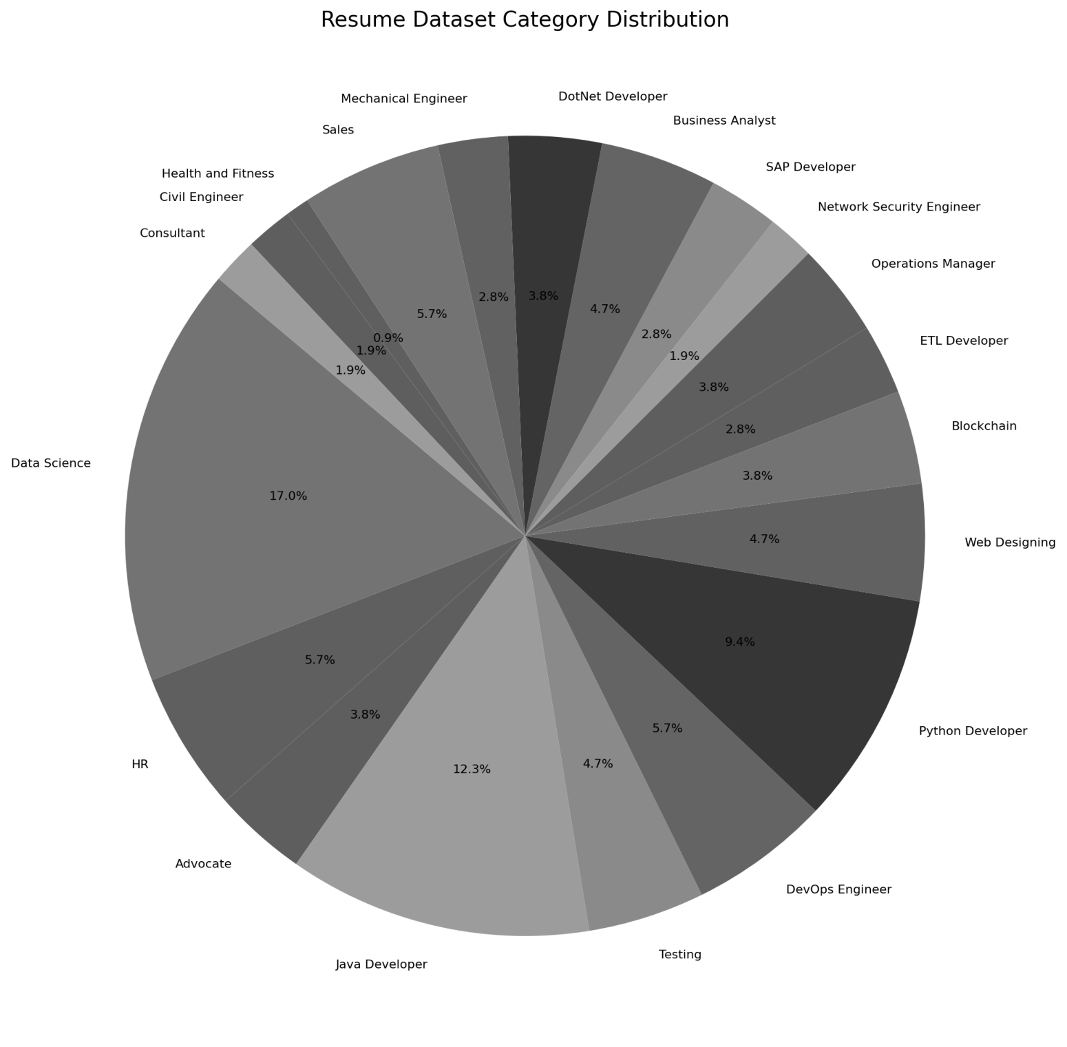
Dataset Summary
• Dataset Used:
- UpdatedResumeDataSet
• Fields:
- Resume text
- Category (Job Role)
- Skills
• Job Role Distribution

Slide 7
NLP Methodology
Explain NLP pipeline used:
Text cleaning (punctuation, stopwords removal)
Tokenization
Lemmatization or stemming
TF-IDF vectorization
Classification using traditional ML (e.g., Logistic Regression or Naive Bayes)

Slide 8
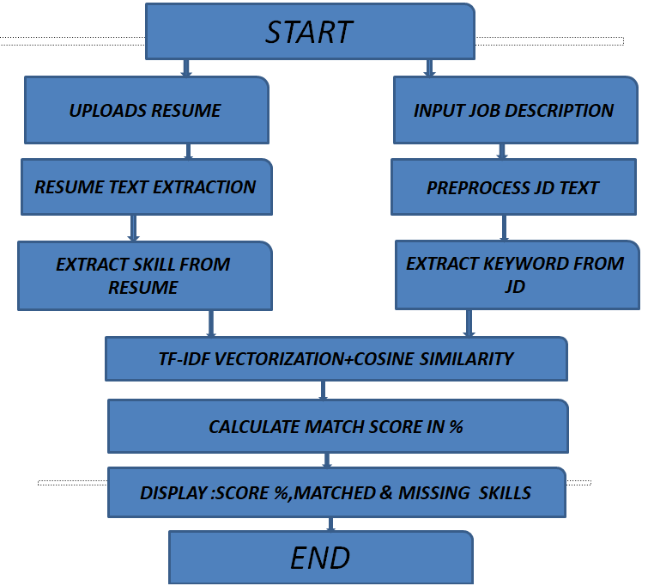
System Architecture
Visual pipeline from resume input → NLP preprocessing → Classification → Skill Extraction → Output

Slide 9
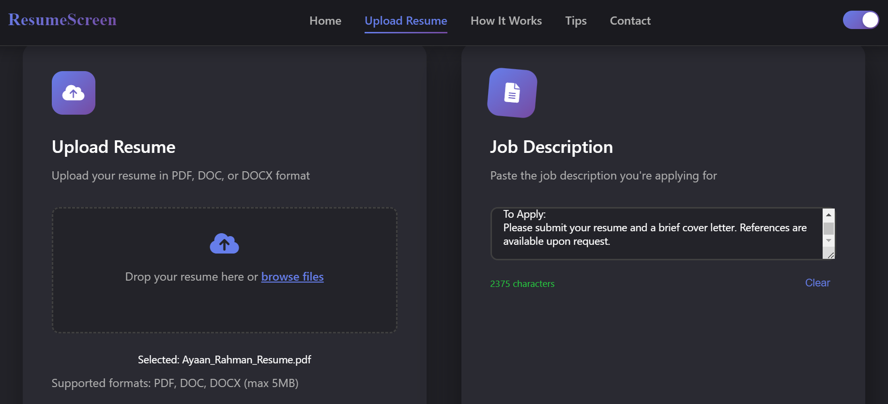
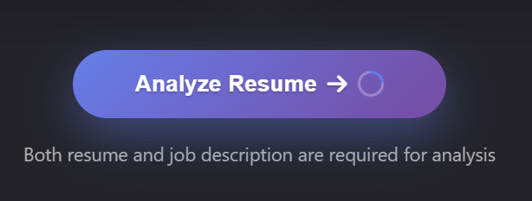
User Input Interface
Users upload their resume and enter a job description into the interface. Both inputs are analyzed using NLP to extract, match, and evaluate relevant skills.
Click "Analyze Resume" to get resume checked and see the results.

Slide 10
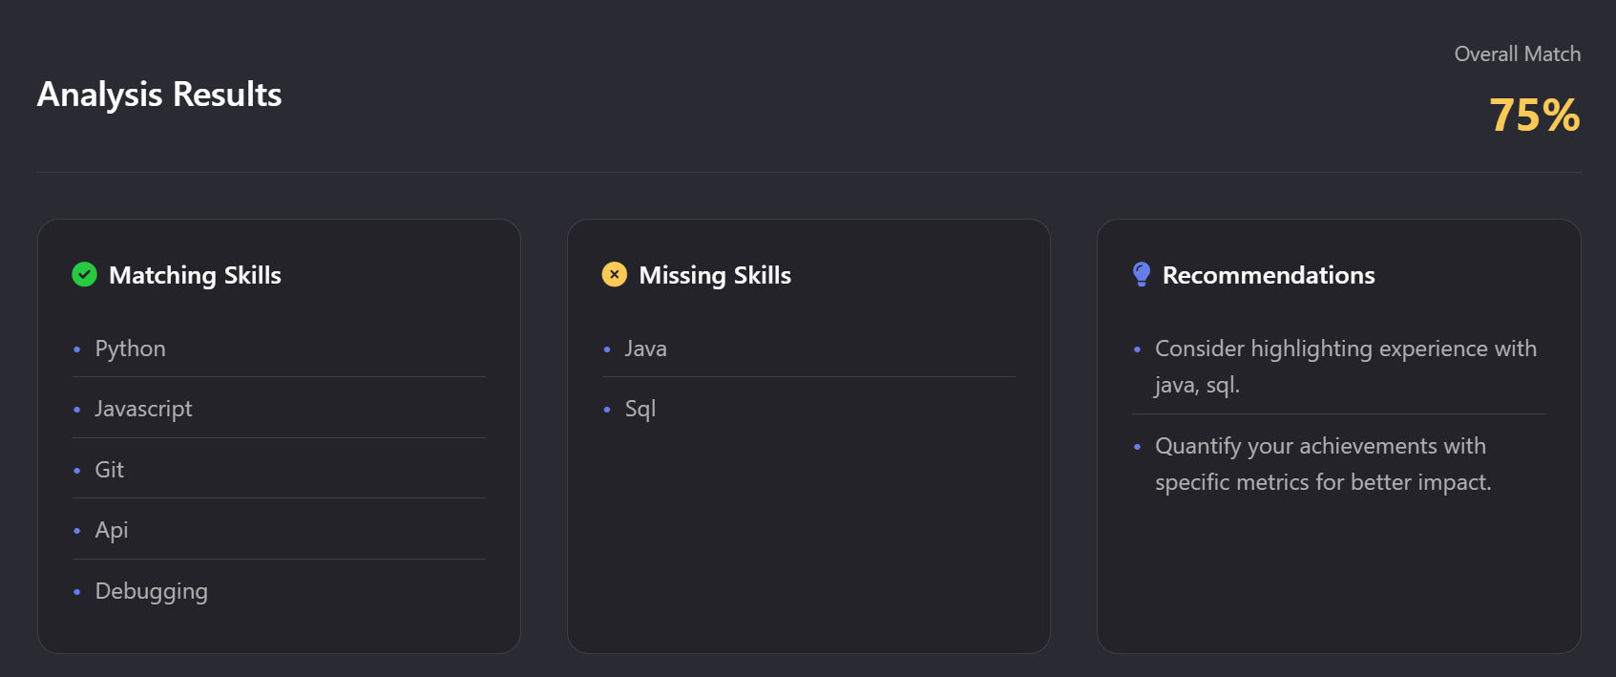
Output Section
Shows how much your resume matches the job (e.g., Match Score: 75%).
Lists matching and missing skills from the job description.
Provides tips to improve your resume (e.g., "Add Python", "Highlight SQL experience").
Helps you understand what skills to focus on for better job fit.

Slide 11
Summary & Future Scope
• Summary:
- Reduced screening time
- Improved accuracy
- Eliminated human bias
• Future Improvements:
- Resume PDF parsing
- Deep learning classifier
- HR dashboard with analytics

Slide 12
Conclusion
-In conclusion, this project effectively automates the resume screening process using NLP techniques. It helps recruiters save time by identifying the most relevant candidates and guides job seekers to improve their resumes with skill-based recommendations. This tool demonstrates a practical and impactful use of AI in modern recruitment.

Slide 13
Thank you
Any Question?

