Slide 1
The Mayflower Compact

Slide 2
The Mayflower Compact (1620)
The settlers who came to the New World brought with them a great deal of background in the form of ideas and beliefs they had held dear in England. Indeed, many of them, such as the Puritans, came to America so they could live in stricter accord with those beliefs. The Pilgrims, a branch of the Puritans, arrived off the coast of Massachusetts in November 1620, determined to live sacred lives according to biblical commands, and in so doing to build a "city upon a hill" that would be a beacon to the rest of the world.

Slide 3
But aside from their religious enthusiasm, the Pilgrims also knew that the English settlement founded a few years earlier at Jamestown in Virginia had practically foundered because of the lack of a strong government and leadership. They would not make that mistake, and agreed that once a government had been established, they would obey the commands of its leaders.

Slide 4
In making this compact, the Pilgrims drew upon two strong traditions. One was the notion of a social contract, which dated back to biblical times and which would receive fuller expression in the works of Thomas Hobbes and John Locke later in the century. The other was the belief in covenants. Puritans believed that covenants existed not only between God and man, but also between man and man.

Slide 5
The Pilgrims had used covenants (sacred agreements) in establishing their congregations in the Old World. The Mayflower Compact is such a covenant in that the settlers agreed to form a government and be bound by its rules.

Slide 6
The Compact is often described as America's first constitution, but it is not a constitution in the sense of being a fundamental framework of government. Its importance lies in the belief that government is a form of covenant, and that for government to be legitimate, it must derive from the consent of the governed. The settlers recognized that individually they might not agree with all of the actions of the government they were creating; but they, and succeeding generations, understood that government could be legitimate only if it originated with the consent of those it claimed to govern.

Slide 7

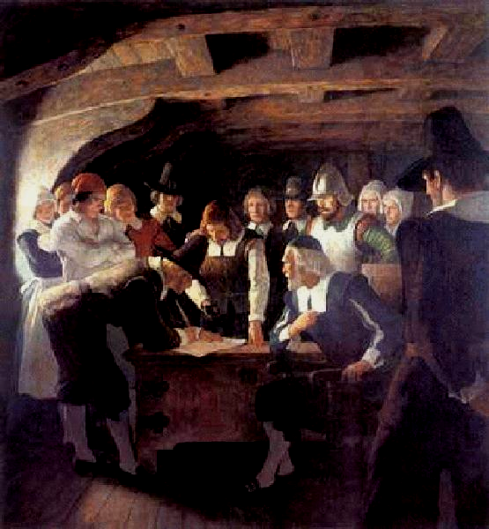
MAYFLOWER COMPACT
41 Male passengers on the Mayflower formed into a “civil body politic”, signed a compact promising to write and obey "just and equal laws ... for the general good of the colony."
The compact brought an element of democracy to America and was an example of the practice of self-government in the colonies.
All the colonies practiced some form of self-government…………

Slide 8
MAYFLOWER COMPACT
In the name of God, amen…We whose names are underwritten, the loyal subjects of our dread sovereign lord, King James, by the grace of God, of Great Britain, France, and Ireland King, Defender of the Faith, etc, having undertaken, for the glory of God, and advancement of the Christian faith, and honor of our King and country, a voyage to plant the first colony in the northern parts of Virginia, do by these presents solemnly and mutually, in the presence of God and one another, covenant and combine ourselves together into a “civil body politic”, for our better ordering and

Slide 9
MAYFLOWER COMPACT
preservation and furtherance of the ends aforesaid; and by virtue hereof to enact, constitute, and “frame such just and equal laws”, ordinances, acts, constitutions, and offices, from time to time, as shall be thought most meet and convenient for the general good of the colony, unto which “we promise all due submission and obedience”. In witness whererof we have hereunto subscribed our names a Cape Cod the eleventh of November, in the reign of our sovereign lord, King James, of England, France, and Ireland, the eighteenth, and of Scotland, the fifty-fourth…..AD 1620.

Slide 10
Building the Bay Colony
Franchise (right to vote) extended to “freemen” – adult Puritan men of Congregational church (about 40% of men in the colony ~ higher percentage than in England)
However, in town government, all property-owning males could vote in town meetings
  Direct democracy----self government
Since idea of government was to enforce God’s laws, religious leaders (e.g. John Cotton) were very influential

Slide 11
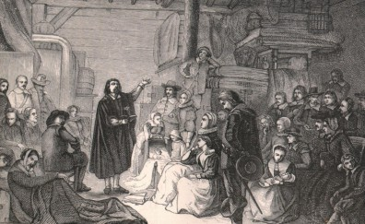
Building the Bay Colony
Clergy were barred from formal political office – early “church/state separation”
Puritan ideas: “calling” to God’s work, Protestant work ethic, limited worldly pleasures, fear of hell

Slide 12
Questions for response
Why did the Puritans first come to the colonies?
What kind of ideals did they bring with them?

Slide 13
Questions for response
What is meant by the idea of “social contract?”
What is meant by the term “covenant?”

Slide 14
Questions for response
From what must a government derive in order to be legitimate?
Do ALL people have to agree with ALL of the rules (laws) the government makes in order for them to be legitimate? Explain your answer.

