Slide 1
Data Science Database
Sarah Brownell

Slide 2
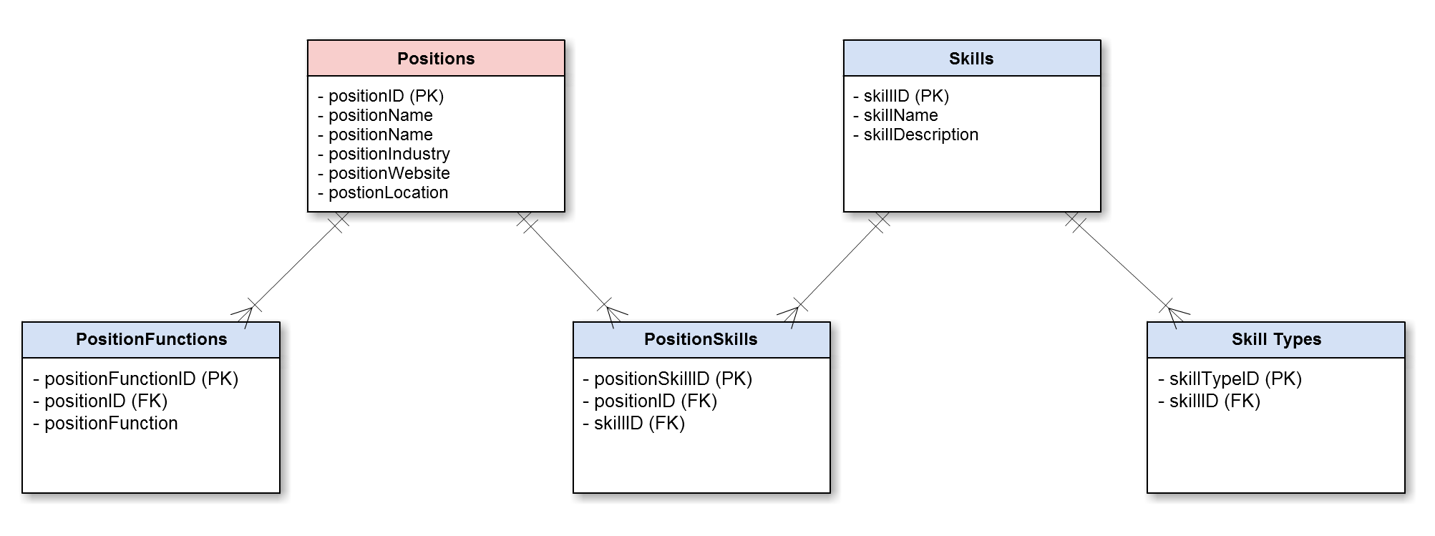
Data Science Database Overview
Overview
Local Queries
Web based Queries
Mission Statement
“I will utilize the website linkedIn to discover more information about current Data Science Internship positions in the United States.”

Slide 3
Local Queries
Queries
select positionSkillID from positionSkillsF inner join positionsF on positionSkillsF.positionSkillID=positionsF.positionID where positionIndustry='Consumer Goods';
select positionFunction from positionFunctionsF inner join positionSkillsF on positionFunctionsF.positionFunctionID=positionSkillsF.positionSkillID where positionSkillID=2;
Results
Merged three tables:
positions-> positionSkills -> positionFunctions
First query result: positionSkillID=2
Second query result: positionFunction=‘Analyst’

Slide 4
Local Queries Continued
Queries
select positionCompany from positionsF where positionLocation='New York City, NY';
select skillName from skillsF inner join positionsF on skillsF.skillID=positionsF.positionID where positionCompany='MediaMath';
select skillTypeID from skillTypesF inner join skillsF on skillTypesF.skillTypeID=skillsF.skillID where skillName='Matlab';
Results
Merged three tables:
positions-> skills -> skillTypes
First query result: positionCompany=‘MediaMath’
Second query result: skillName=‘Matlab’
Third query result: skillTypeID=5

Slide 5
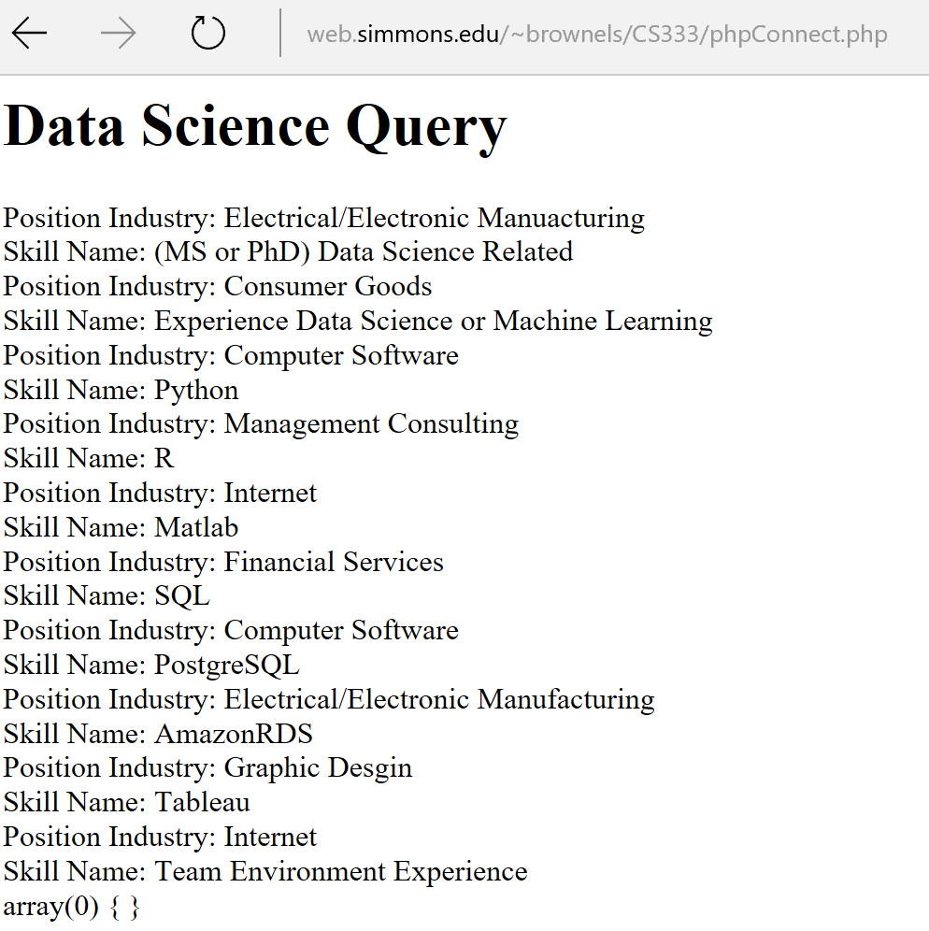
Web Based Queries (Display)
"select positionIndustry, skillName from positionsF inner join skillsF on positionsF.positionID=skillsF.skillID group by positionID"
Web based query linking position industry and skill name in order to identify what job skills are required for data science positions in different types of industries.

Slide 6
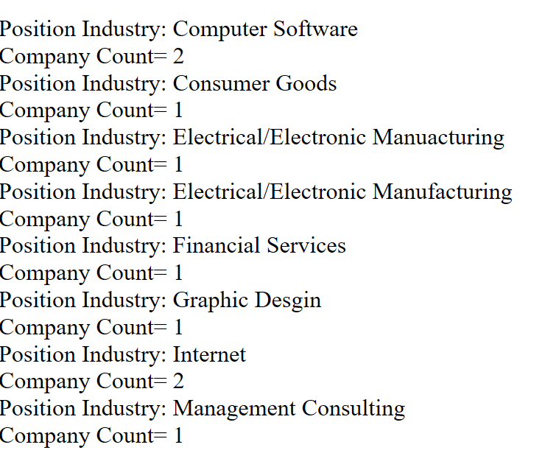

Web Based Queries (Display)
select positionIndustry, count(*) positionCompany from positionsF group by positionIndustry;
This web based query displays the amount of companies for each type of industry in the database.

Slide 7
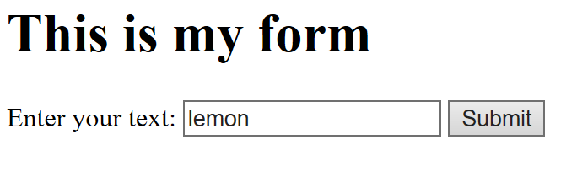
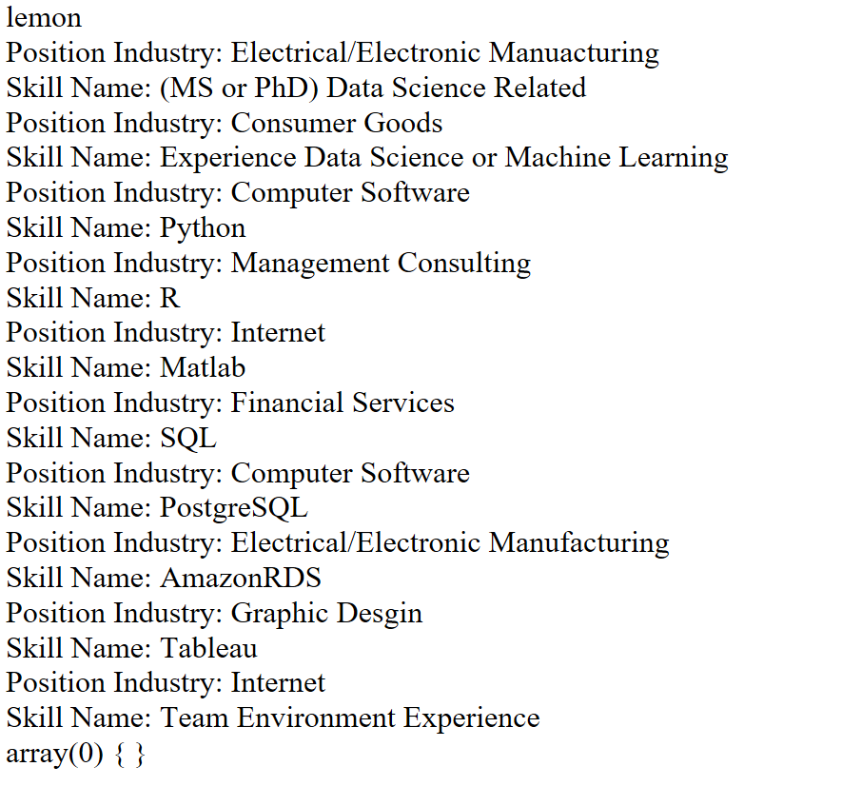
Web Based Queries(Add)
Web based query adding the data value lemon to my past data from my previous query.

