Slide 1
Regression project
By Ruben, Vlad, and Richard

Slide 2
Introduction: The project focused on building a regression model based on data provided
Data provided
Approach
A large dataframe containing multiple datapoints of over 21,000 past transactions was provided to the group
The dataframe was provided as in an “xls” and “csv”
Analysis was done in Jupyter notebook, MySQL workbench, and Tableau
This presentation will focus on the outputs from Jupyter Notebook
Detailed exploration of dataframe
Removal of columns that have no causation with price
Review of multicollinearity and corresponding adjustment of dataframe
Check for outliers in columns with continuous data
Transformation of numeric data into dummies where necessary
Selection of ideal model to build regression
Analysis of model output and limitations
1
2
3
4
5
6
7
Build a model that will predict the price of a house based on features provided in the dataset

Slide 3
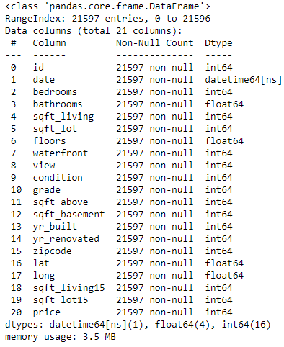
Exploration: The dataframe included twenty different datapoints for each historical transaction
1
Data set
Comments
The “id” column holds an unique identifier for each historical transaction
For each unique identifier, twenty different datapoints were provided which are listed on the left-hand side
Data was provided in three different formats: integers, floats, and in datetime
Not all datapoints could be used in the form provided (e.g. “zipcodes” as an integer)
Overall, it appears that no null values were included in the dataset

Slide 4
Causation analysis: Columns that appear to have no causation to the calculation of price were removed
2
Data set
Comments
“id” was removed as it only serves as an unique identifier
“date” was removed as it was deemed to have no causation with the price
“lat” was removed due to conveying similar information as the zip code das
“long” was removed due to conveying similar information as the zip code das

Slide 5
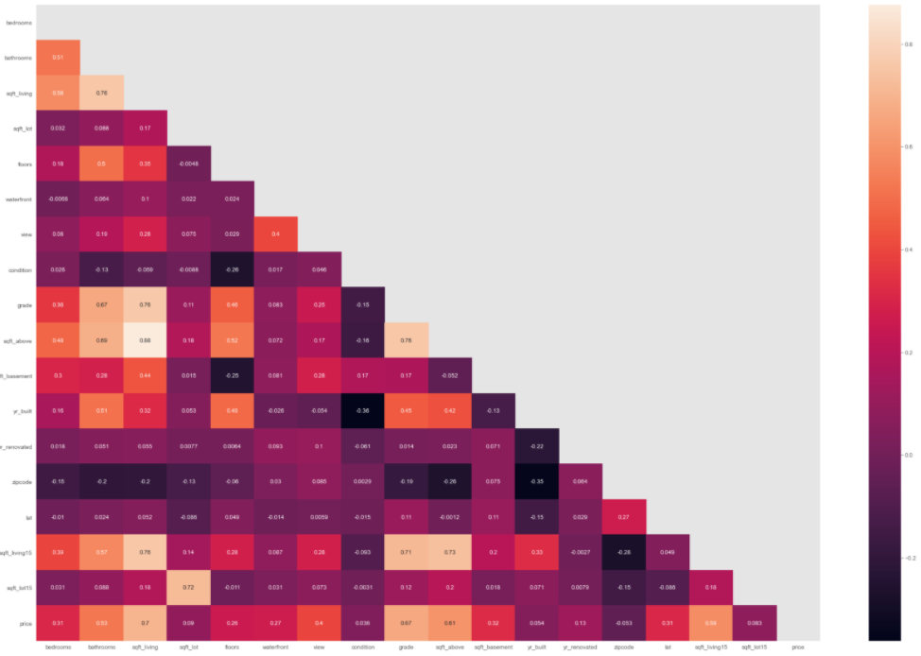
Multicollinearity analysis (1/2): Any correlation between determining variables were identified
3
Large correlation matrix
Comments
A correlation matrix was plotted to find any correlation between the given variables
It was decided to further look into all correlation >0.75 and disregard the rest

Slide 6
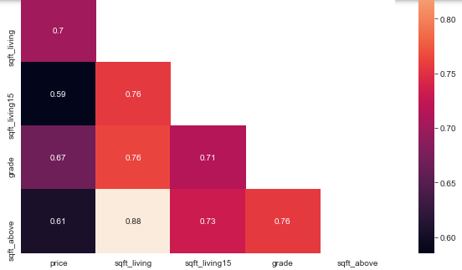
Multicollinearity analysis (2/2): Variables with strong correlation were analysed further to potentially exclude some
3
Small correlation matrix
Comments
Overall, four variables showed strong correlation with each other
After trial-and-error, it was decided so exclude the “sqft_above” datapoints
“sqft_above” showed a comparatively low correlation with price, however high correlation with all other variables

Slide 7
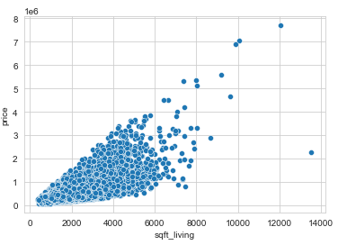
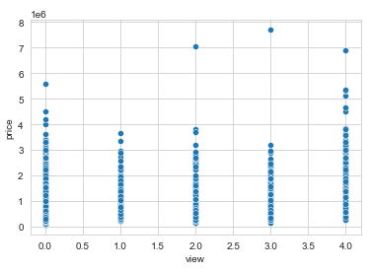
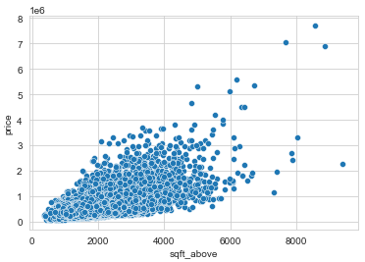
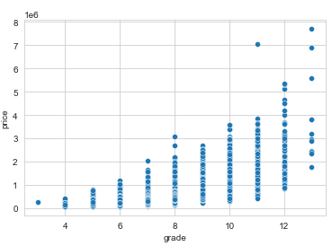
Outlier analysis: Selected variables were plotted against price to identify potential outliers
4
Data plots of selected variables
Comments
All variables were plotted (amongst others the graphs displayed on the left-hand side)
Outliers were identified, especially for variables that display a variation of living area (in square feet)
It was decided to not exclude any outliers, as it did not significantly improve the model

Slide 8
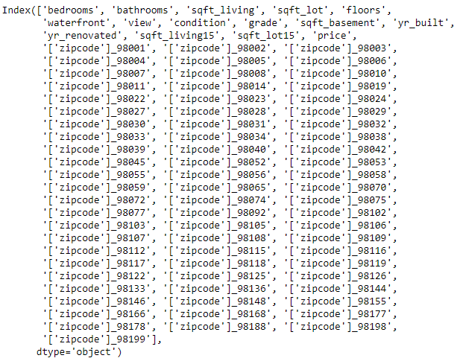
Zip code transformation (1/2): The information provided for zip codes was dummified to use for regression analysis
5
New data set
Comments
Information on zipcodes was given in form of an integer
As such, the information could not be used as it would have been misinterpreted by the regression analysis
Therefore, the zip code information was dummified for further usage

Slide 9
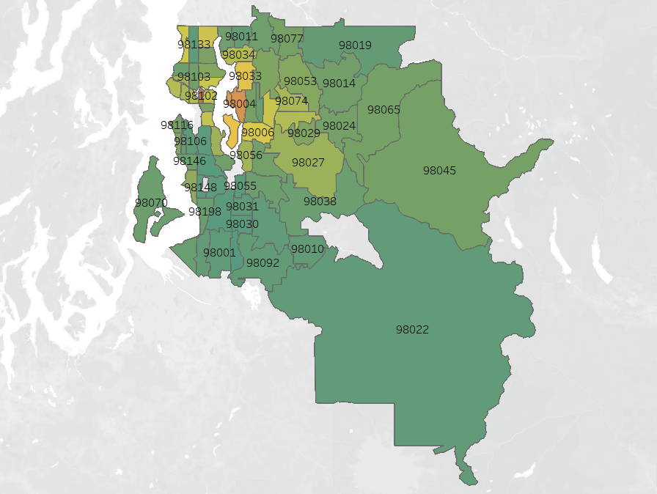
Zip code transformation (2/2): Zip code information was analysed further in Tableau
5
Zip code data
Comments
A better approach would have been to further quantify the zip code information (e.g. as distance from city centre)

Slide 10

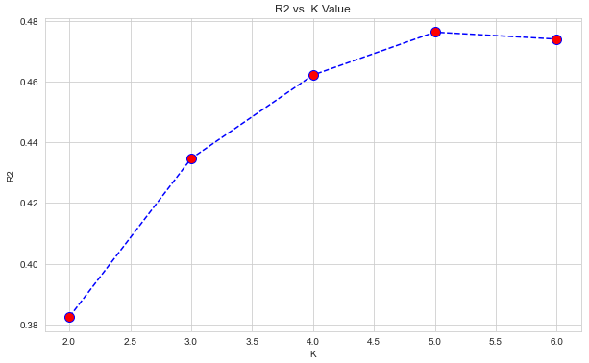
Modell selection: Multiple models were applied to the data set in order to find the best fit
6
Model outputs
Comments
Linear
regression
Multiple different approaches to find the best fit were applied via trial-and-error
Nevertheless, of the four versions presented, none were accurate enough
Other models were tested as well, however outputs were not satisfactory
Therefore, the team decided to use the polynomial approach as detailed on the next slide
Random
forest
KNN
regressor

Slide 11

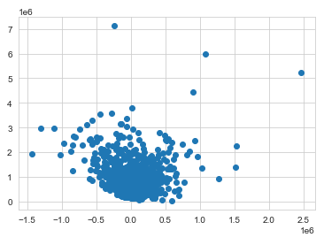
Modell output und limitation: A polynomial regression showed the most promising results in regards to predicting house prices
7
Polynomial regression output
Comments
The polynomial regression delivered the best result with an R2 and Adj. R2 score von 0.89
As seen by the residual scatter plot, the model loses it’s accuracy as house size increases – this is currently the biggest limitation
One alternative to solve this problem would be to build to regression models – one for normal sized houses, and one exclusively for large houses

Slide 12
Thank you very much!

