Slide 1
Recommend a location in Hong Kong to open a new cinema

Slide 2
Introduction
Watching movie is a part of whole afternoon or night activities. Cinema should has many restaurants and shopping places nearby. Transportation is also an important factor. Customer can walk to cinema within 5 minutes from public transport facilities is perfect.
Selection of cinema location according to its nearby environment. Cinema facility and rental price is not my concern. I finds out top 10 favorite cinemas in Hong Kong with rating.
I select 5 possible locations to build the cinema. Which location should be the best one?

Slide 3
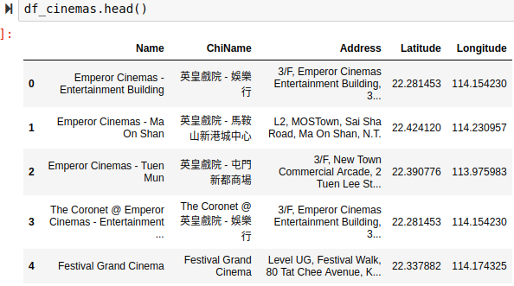
Data
1. Geographic coordinate of Hong Kong cinemas
https://hkmovie6.com/cinema .

Slide 4
Data
2. Geographic coordinates of 5 possible cinema addresses
possible_locations = [
{ 'Location': 'L1', 'Address': 'Sau Mau Ping Shopping Centre, Sau Mau Ping'},
{ 'Location': 'L2', 'Address': '148 Wu Chui Rd, Tuen Mun, Hong Kong'},
{ 'Location': 'L3', 'Address': 'Un Chau Shopping Centre, Cheung Sha Wan'},
{ 'Location': 'L4', 'Address': 'Prosperity Millennia Plaza, North Point'},
{ 'Location': 'L5', 'Address': '138-168 Sai Lau Kok Rd, Tsuen Wan, Hong Kong'},
]

Slide 5
Data
3. Favorite cinema list of stakeholder
My target template cinema list
boss_favorite = [
{'Name': 'Broadway Circuit - MONGKOK', 'Rating': 4.5},
{'Name': 'Broadway Circuit - The ONE', 'Rating': 4.5},
{'Name': 'Grand Ocean', 'Rating': 4.3},
{'Name': 'The Grand Cinema', 'Rating': 3.4},
{'Name': 'AMC Pacific Place', 'Rating': 2.3},
{'Name': 'UA IMAX @ Airport', 'Rating': 1.5},
]

Slide 6
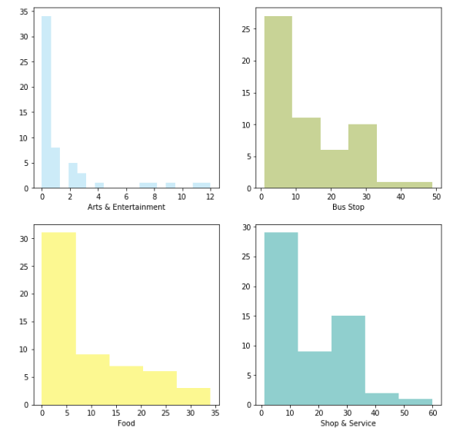
Data
4. Eating, Shopping and Public transportation facility around cinema(Food, Shop & Service, Bus Stop, Metro Station, Nightlife Spot, Arts & Entertainment)
Distribution of data

Slide 7
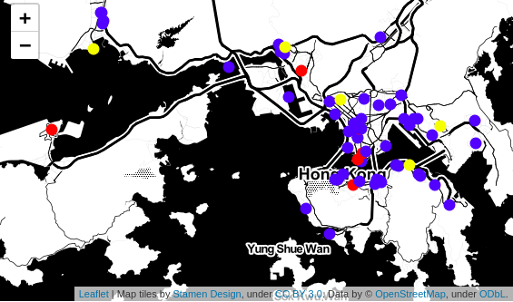
Analyze
Distribution of cinema
Red dot is template
Yellow dot is target
Blue dot is all cinema

Slide 8
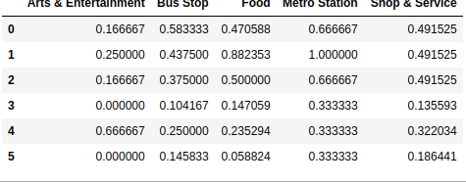
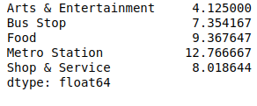
Machine Learning
Get my weight of rating on each category according to template target and its rating.

Slide 9
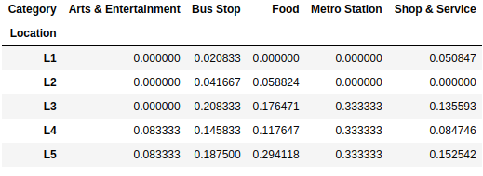
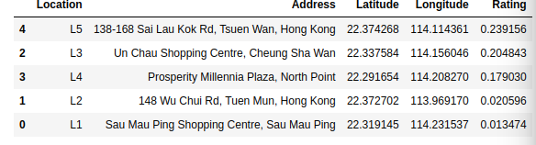
Result
Depend on the Weight Matrix get target cinema result.

Slide 10
Conclusion
Based on the table ahead location "L5" should be recommended

