Slide 1
SKGcode
От Стойчо Димитров, Георги Калчев и Кристиан Лалев

Slide 2
Our team!
Stoicho Dimitrov - 9A <sddimitrov18@codingburgas.bg> | Manager, Lead Developer
Georgi Kalchev – 9B <gskalchev18@codingburgas.bg> | Developer, Researcher
Kristian Lalev – 9G <kalalev18@codingburgas.bg> | Lead Researcher

Slide 3
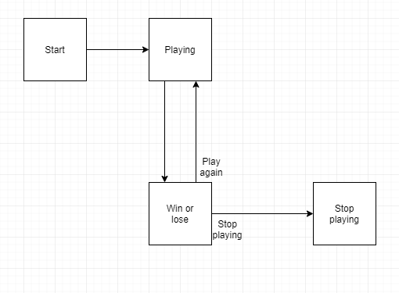
How it all works

Slide 4


Used technologies
For technical purposes | For communicational purposes

Slide 5
Future ideas
1. To add more functionality for our game.
2. To make the game more and more client sided.
3.To add different game modes.

Slide 6
Thank you for the attention!

