Slide 1

Javamon
Andrew Nickerl
Andrew Szymanek
Sohail Farooq

Slide 2
Presentation Features
Objectives
Planning
Game description
Demo
If we had more time
Impact of this project
Code review
Refactor
Biggest challenges
Lessons learned
Summary
???

Slide 3
Objectives
Inherit existing text game
Enhance features at request of customer
Follow Agile principles
Use Scrum techniques
Deliver minimum value product (MVP) in 3-days sprints
Tracking work using Kanban

Slide 4
Planning
Sprint 1
Plan out the sprints
Explore best approaches to deliver value to customer using Agile principles
Sprint 2
Refactor
Packages – moving some code
Removed hard coded features – added XML
Sprint 3
Catch a wild Pokemon
Presentation

Slide 5
Code review
What we received
Pokemon game GUI
One package
Our contribution
Refactoring into packages
Added static classes where appropriate
Removal of unused code
Images/Instructions
Catching a wild pokemon
Text parser
Hit ‘enter’ key on keyboard

Slide 6
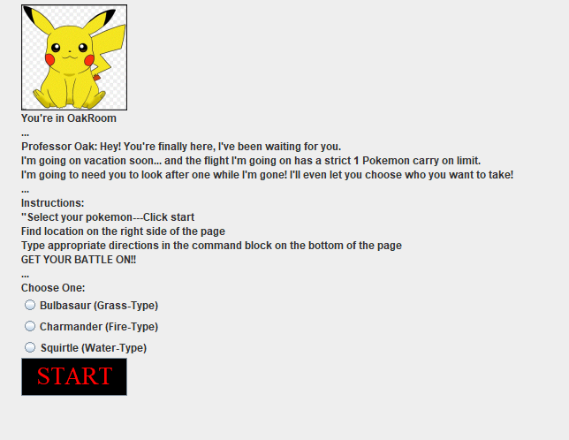
Game Description
Javamon GUI
Select your Pokemon
Battle with Pokemon
Catch a wild Pokemon
Win!!

Slide 7

Demo

Slide 8
Biggest Challenges
Little time to really understand code base
Will refactoring deliver value to the customer?

Slide 9
Lessons Learned
Commenting code is extremely important
Using descriptive naming techniques is very important
Pair programming very helpful to us
Everyone on same page
Singleton design pattern
JAR file

Slide 10
…IF WE HAD MORE TIME
Complete a refactor of GUI class by implementing full separation of concerns
Switch from Swing to a more effective framework
Add graphics and show Pokemon battle

Slide 11
Impact of this project
Us
Amazon
TLG
Relationship with customer
Meeting
Delivering value
Understanding needs
Design patterns understanding increased
User stories/tasks in the Kanbon
Leadership principles
Customer Obsession
Dive Deep
Deliver Results
Enhance learning experiences for future cohorts through feedback

Slide 12
Presentation Features
Objectives
Planning
Code review
Demo
If we had more time
Impact of this project
Game description
Refactor
Biggest challenges
Lessons learned

Slide 13

Questions
???????
!!!! GO VOTE !!!!

