Slide 1

SDE Cohort 20.10 Practical Application Capstone Project

Slide 2
Applying concepts in Agile & working on turned over code.
Team 1A
Team 1B (us)
Bradley Pratt
Debora Bitencourt da Rocha
Aliona Demerau
Dustin Morris
Chris Ruaboro
Cody Cronberger
Paul Lewis

Slide 3
Challenges
Wrapping our minds around other peoples' code and why did they do what they did
Fixing bugs: Both Inherited and our own prior to final production
Refactoring code to make it more scalable
Java Swing
Creating a runnable jar that reads resources and can work outside of IDE
Thinking up features the Client might want. Since this team has no regular players of RPGs

Slide 4
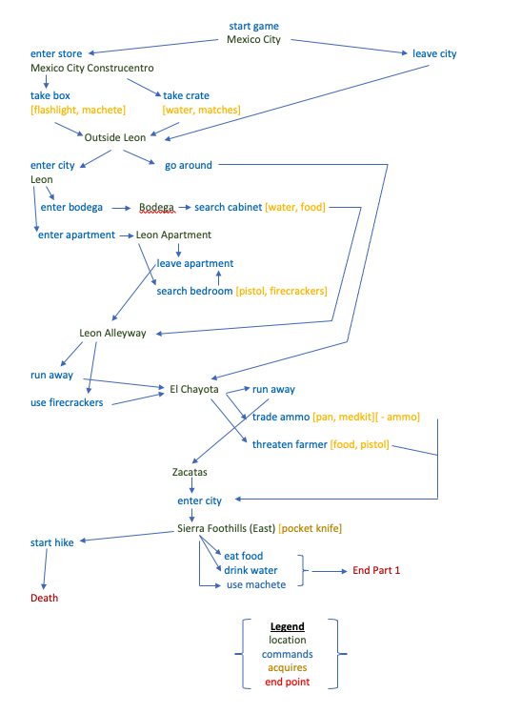
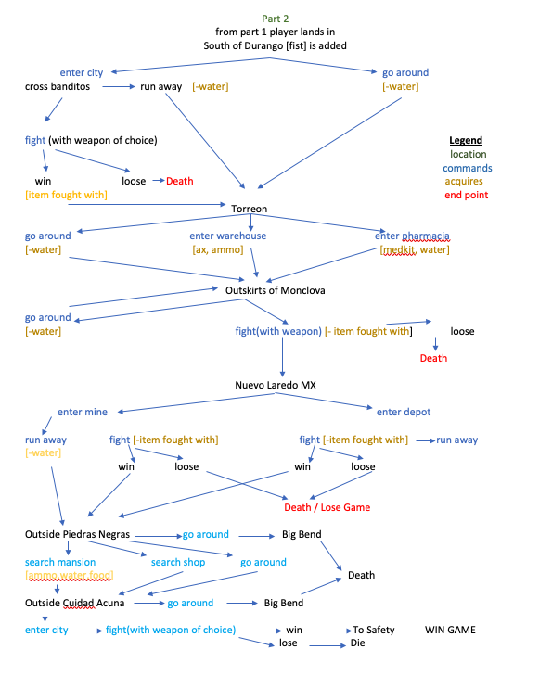
Chapter 1 Game Map Chapter 2

Slide 5
Team Highlights
Getting Java Swing (an old technology) to work as Cody wanted it to
Expanding the story to accommodate the client with combat, and not breaking existing code
A Barter System working; that Chris envisioned
Learning to game the system we created. (Gamers appear to like to do this.)
And above all: Good team work

Slide 6
Game Time (Rennie, try not to killed)

Slide 7
Follow-up : What would be next?
With a fresh, more diverse crew, that include creative types and Gamers; this game could continue onto V3.0.
If the Client was willing to allocate time, the code could be refactored to allow stories to be more efficiently brought in.
Longer sprints could allow creative ideas to be spawned and grown.

