Slide 1
BioNexus: Clinical Sequencing Quality Gates
CAP / CLIA Compliant Secondary Analysis & ACMG Tiering

Slide 2
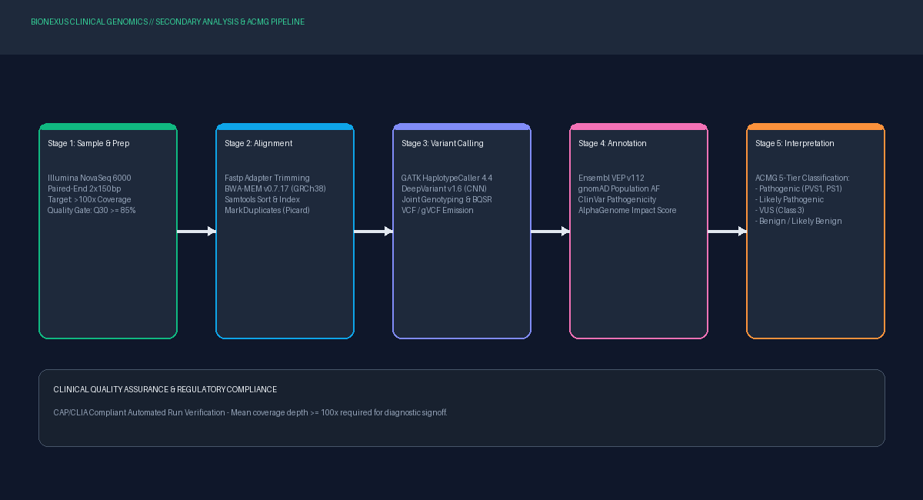
Automated Secondary Pipeline Workflow

