Slide 1
Project Apollo: Mission Avionics Overview
High-Reliability Multi-Rotor Autonomous Guidance System

Slide 2
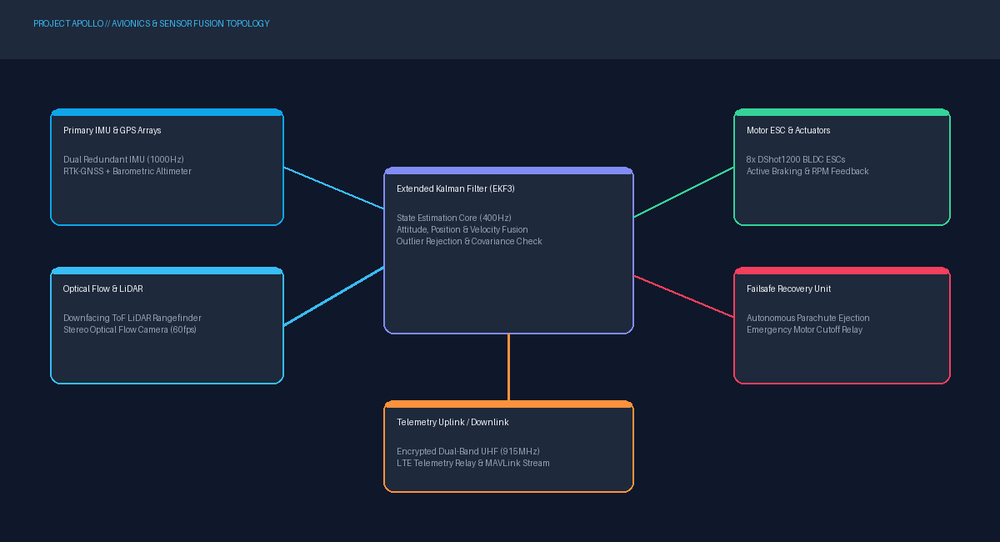
Avionics Interconnect & Actuator Data Bus

