Slide 1


SMART INDIA HACKATHON 2026
Team – Byte codx
• Problem Statement ID: 26263
• Problem Statement Title: Development of an APAAR ID-Based Student Data Management and Verification Platform for AICTE-Approved Institutions
• Theme: Smart Automation
• PS Category- Software/Hardware: Software
• Team ID: 199199
• Team Name: Byte codx
▶ Prototype Video: https://youtu.be/rEz9BszbQnQ?si=c1oF4zL5QWqgU2EB
▶ GitHub Repository: https://github.com/SDP-001/SIH.git
Byte codx

Slide 2
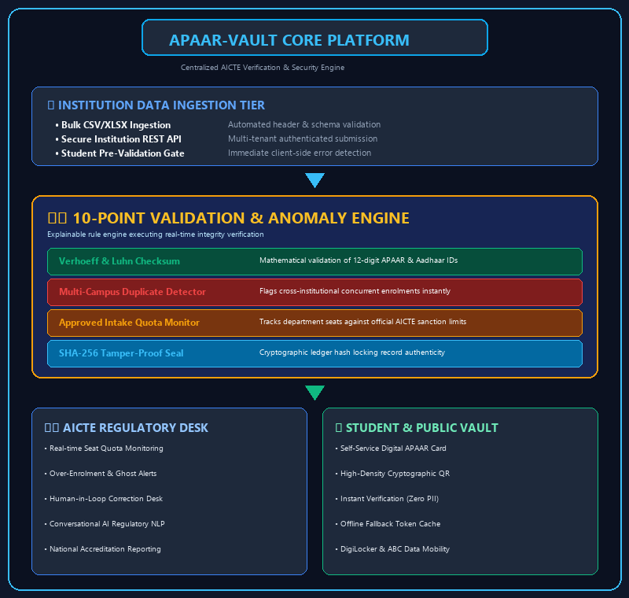
Byte codx
APAAR-Vault: Student Data Management & Verification Platform
Institutional Bulk Data Upload
Verhoeff & Luhn Checksum Checks
Automated Format & Schema Checks
Cross-Campus Duplicate Detection
10-Point Validation Rule Engine
Zero-Knowledge Public Verification
Approved Intake Monitoring
Cryptographic QR Verification
Over-Enrolment Discrepancy Alerts
Student Self-Service Vault
Institutional Correction Workflows
AI Regulatory Officer Assistant
Tamper-Evident Audit Trails
Multi-Tenant RBAC Security
@SIH Idea submission- Template
2

Slide 3
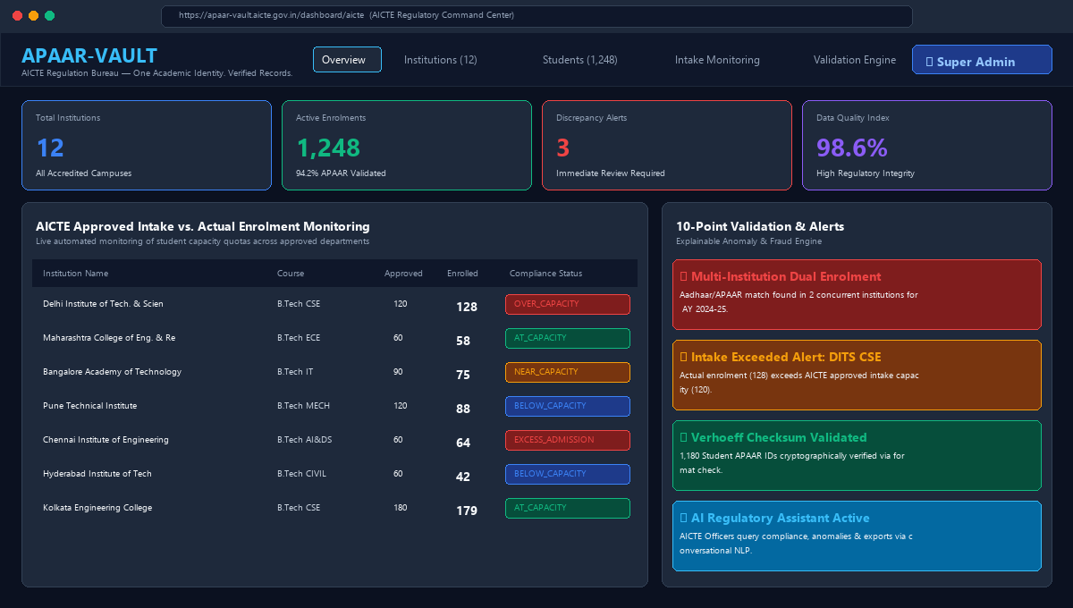
Byte codx
TECHNICAL APPROACH
Web Application (AICTE & Institution Portal)
Frontend: Next.js 16 (React 19) + Tailwind CSS v4
Auth & RBAC: JWT Authentication + Multi-Tenant RBAC
Backend: FastAPI (Python 3.12) + Uvicorn Async
Validation Pipeline: 10-Point Rule Engine (Aadhaar/APAAR Checksum, Format, Dual-Enrolment)
Anomaly Engine: Scikit-Learn Anomaly Detection & Over-Enrolment Monitoring
Database: PostgreSQL / SQLite + SQLAlchemy ORM
Reporting & Export: CSV/XLSX Ingestion + Recharts Analytics
Security: SHA-256 Cryptographic Seals, Masked APAAR IDs, Zero-Knowledge Proofs
YouTube Demo: https://youtu.be/rEz9BszbQnQ?si=c1oF4zL5QWqgU2EB
GitHub Repo: https://github.com/SDP-001/SIH.git
PROTOTYPE SCREENSHOT
AICTE Regulatory Command Centre & Student Verification Portal
@SIH Idea submission- Template
3

Slide 4
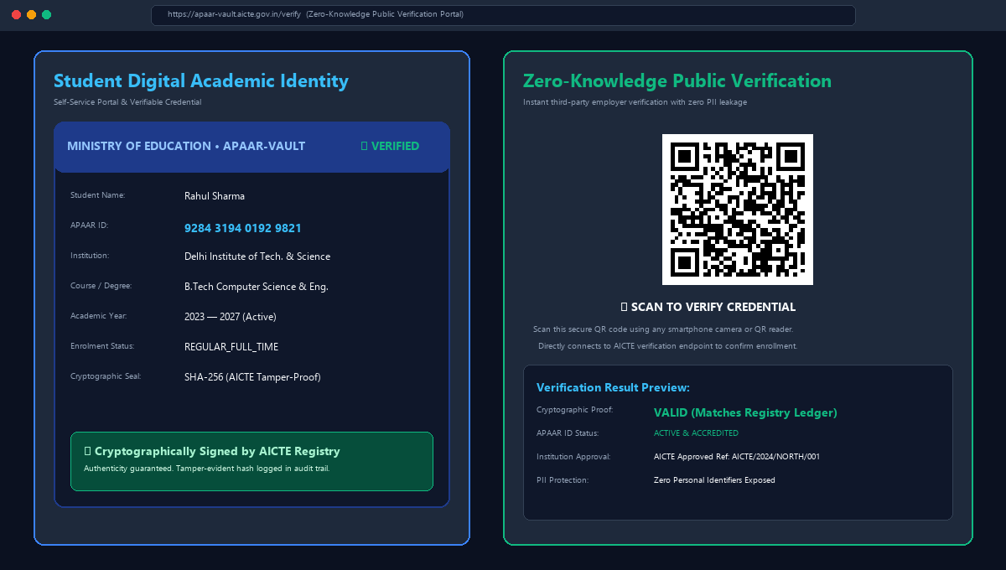
Byte codx
TECHNICAL APPROACH
Student Credential & Public Verification Engine
Architecture: Mobile-Responsive Progressive Web App (PWA)
Student Vault: Self-Service Digital APAAR ID & Credential Status
QR Technology: High-Density Cryptographic QR Code Generator
Verification Mechanism: Instant camera/scanner lookup with Zero PII leakage
Tamper-Evident Seal: SHA-256 Ledger Verification against AICTE Database
AI Regulatory Assistant: Conversational NLP for AICTE Officers & Audits
Dual REST Adapters: Pluggable Mock Sandbox + Production APAAR/ABC API
Offline Fallback: Cached cryptographic proofs for low-connectivity regions
YouTube Demo: https://youtu.be/rEz9BszbQnQ?si=c1oF4zL5QWqgU2EB
GitHub Repo: https://github.com/SDP-001/SIH.git
PROTOTYPE SCREENSHOT
Student Digital Academic Identity & Zero-Knowledge QR Verification
@SIH Idea submission- Template
4

Slide 5
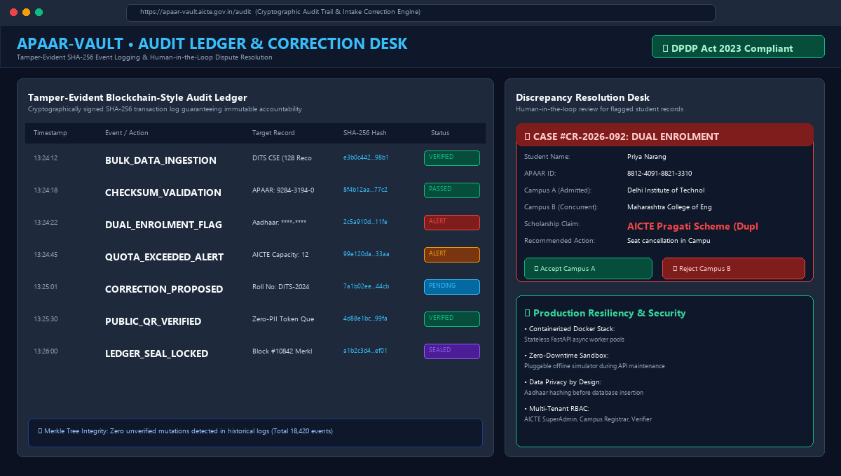
Byte codx
FEASIBILITY AND VIABILITY
Feasibility Analysis
• Prototype Ready Stack: Next.js 16 + FastAPI (Python 3.12) + PostgreSQL/SQLite
• Core AICTE Features: Intake quota monitoring, 10-point rule engine, multi-tenant RBAC
• Scalable Deployment: Containerized Docker microservices for low-cost nationwide university rollout
PROTOTYPE SCREENSHOT
Challenges & Risks
• Incomplete Records: Institutions uploading legacy dirty data with missing roll numbers
• Dual Enrolments: Concurrent admissions claiming duplicate technical seats & scholarships
• API Latency / Outage: Rate limits or temporary downtime on third-party verification APIs
Mitigation Strategies
• Automated Pre-Checks: Immediate schema validation with human-in-the-loop correction desk
• Fuzzy / Exact Detector: Cross-campus duplicate identification with immutable audit logs
• Simulation Sandbox: Pluggable offline adapter enables seamless testing without external downtime
Tamper-Evident SHA-256 Audit Ledger & Dispute Correction Desk
@SIH Idea submission- Template
5

Slide 6
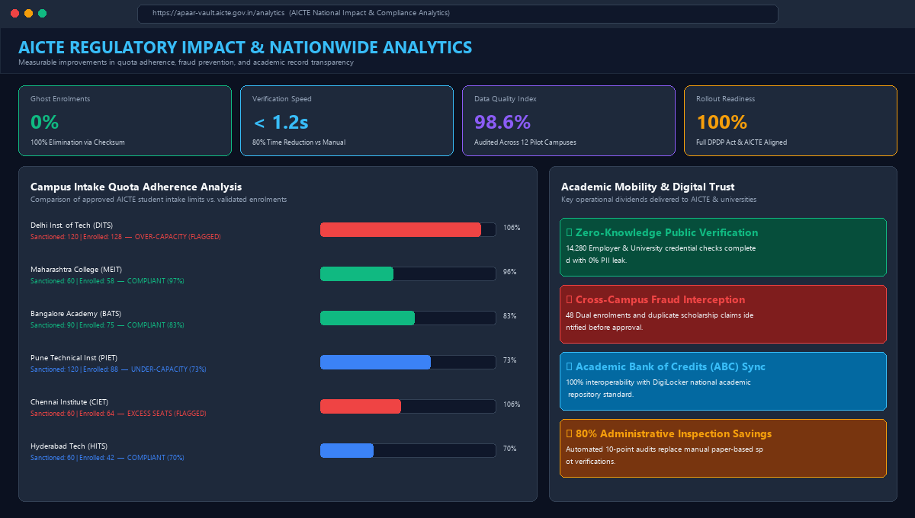
Byte codx
IMPACT AND BENEFITS
01
Regulatory Integrity (AICTE)
Real-time quota monitoring eliminates unauthorized seat over-allocation and ghost seats.
PROTOTYPE SCREENSHOT
02
Fraud & Duplicate Prevention
Cross-campus checks prevent concurrent admissions and duplicate scholarship claims.
03
Transparency & Trust
Cryptographic zero-knowledge verification prevents credential tampering & fake records.
04
Operational Efficiency
Automated 10-point rule engine reduces manual inspection workload and backlogs by 80%.
05
Scalable for Future
Privacy-by-design architecture adheres to DPDP Act 2023 for nationwide university rollout.
AICTE National Impact Analytics & Quota Compliance Dashboard
▶ YouTube Prototype Video: https://youtu.be/rEz9BszbQnQ?si=c1oF4zL5QWqgU2EB
▶ GitHub Source Repository: https://github.com/SDP-001/SIH.git
@SIH Idea submission- Template
6

