Slide 1
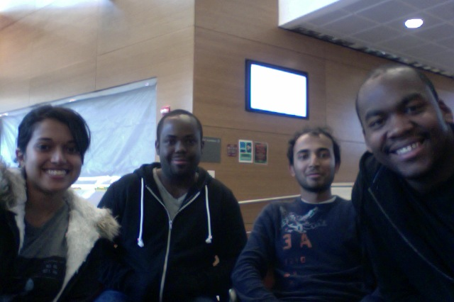
ClockAide
Anita Ganesan (EE), Eric Moore (EE), Sachin Honnudike (CSE/EE + Webmaster), Joel Jean-Claude (CSE + Team Manager)
Advisor: Professor Soules, Professor Leonard (Spring ’13)
Notes:
1.) Joel starts speaking and introduces himself
2.) Everyone else introduces themselves

Slide 2
Presentation Outline
Goals
Changes from Fall ‘12
Deliverables
Design
Prototype
Updated Cost and Budget

Slide 3
Goals of ClockAide
Create an educational learning tool for special
needs students at West Springfield Middle School
Relieve burden of repetition on the teacher
Solve two problems stated by Megan Ferrari
      Independently learn how to tell time
      Entering ID numbers for lunch

Slide 4
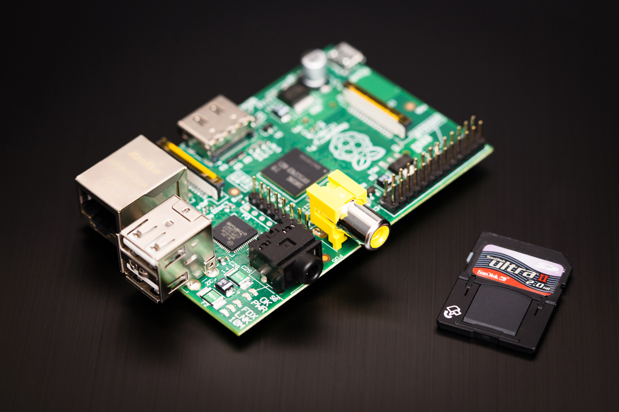
Changes from Fall ‘12
Transition from Arduino to Raspberry Pi Prototype
    Full fledged computer running Linux
    High performance

Slide 5
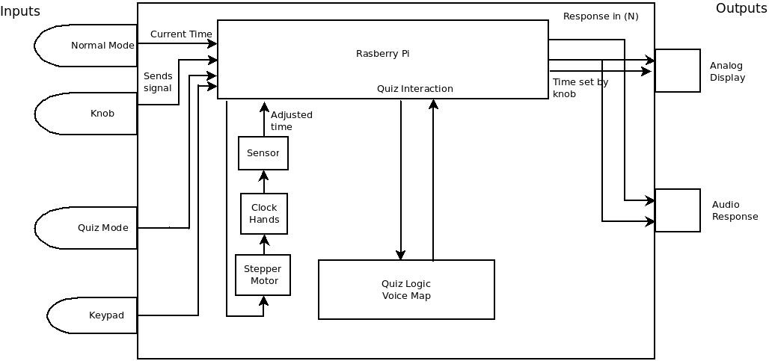
Block Diagram – Raspberry Pi

Slide 6

CDR Deliverables at MDR
What we promised | What we delivered
Components working together | Type a time on the keypad, see it on the display, stepper motors will move to the position
Quiz Modes 1 and 2 | “Read Mode”
Normal mode will speak the current time | Voice Mapping integrated with Raspberry Pi

Slide 7
Demo
Keypad switching modes
Stepper motors communicating with Pi

Slide 8
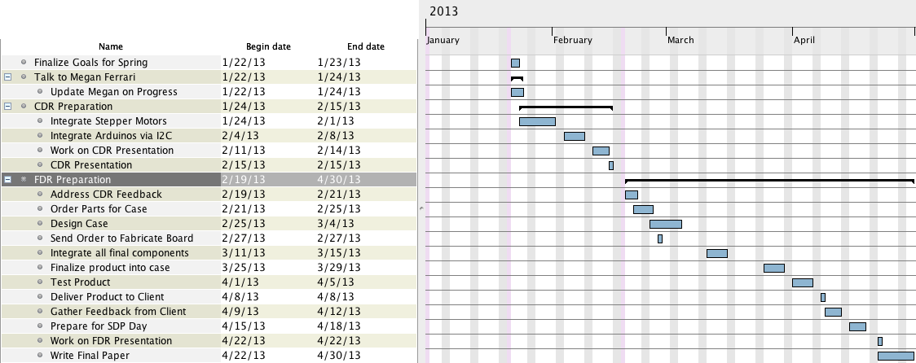
CDR - FDR Timeline

Slide 9
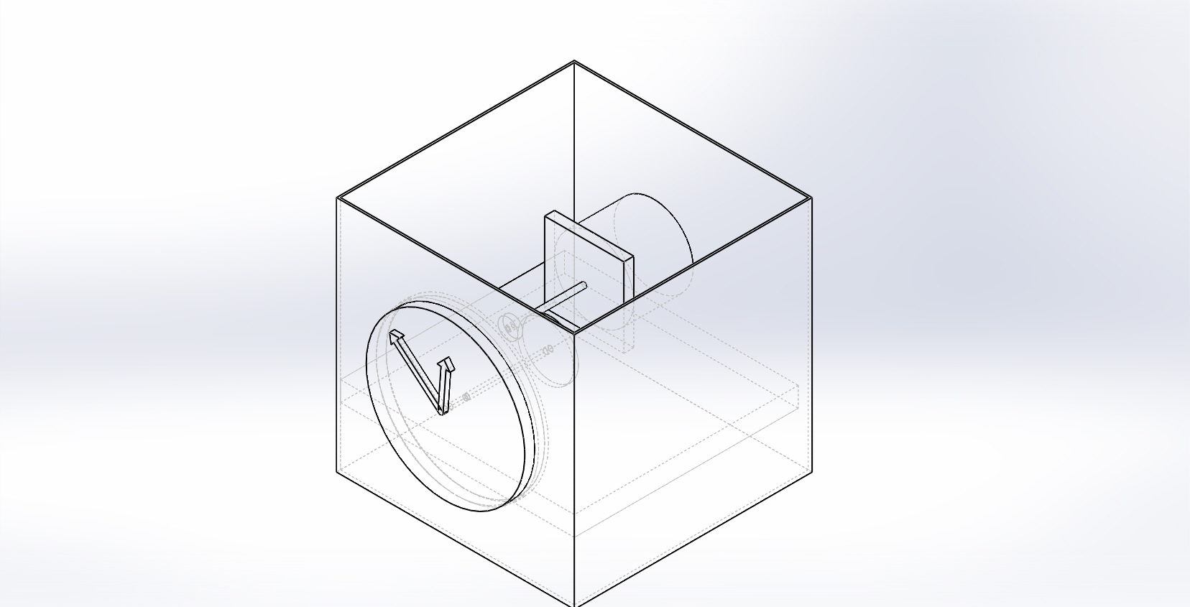
Deliverables for FDR
Casing ordered and built
All software and hardware components complete
All Three Modes working
Entire device integrated within casing
Instruction Manual

Slide 10
Updated Cost & Budget
Current
Projected
8GB SD cards (2) | $12.38
Arduino MP3 Shield | $39.95
Raspberry Pi | $69.85
RTC | $21.73
LCD Screens (2) | $27.90
Gears +Piping | $20.00
Subtotal | $191.81
Shipping | $38.90
Total | $230.71
Percentage | 53.85%
Item | Description | Price
Stepper Motors | Smaller motors (5V) | $100
Casing | Enclosure | $150
PCB | Custom Circuit Board | $60
Gears | Hardware to control hands | $25
 | Total | $335
 | Aggregate Total | $546
 | Overage | ($46)
Notes:
40%

Slide 11
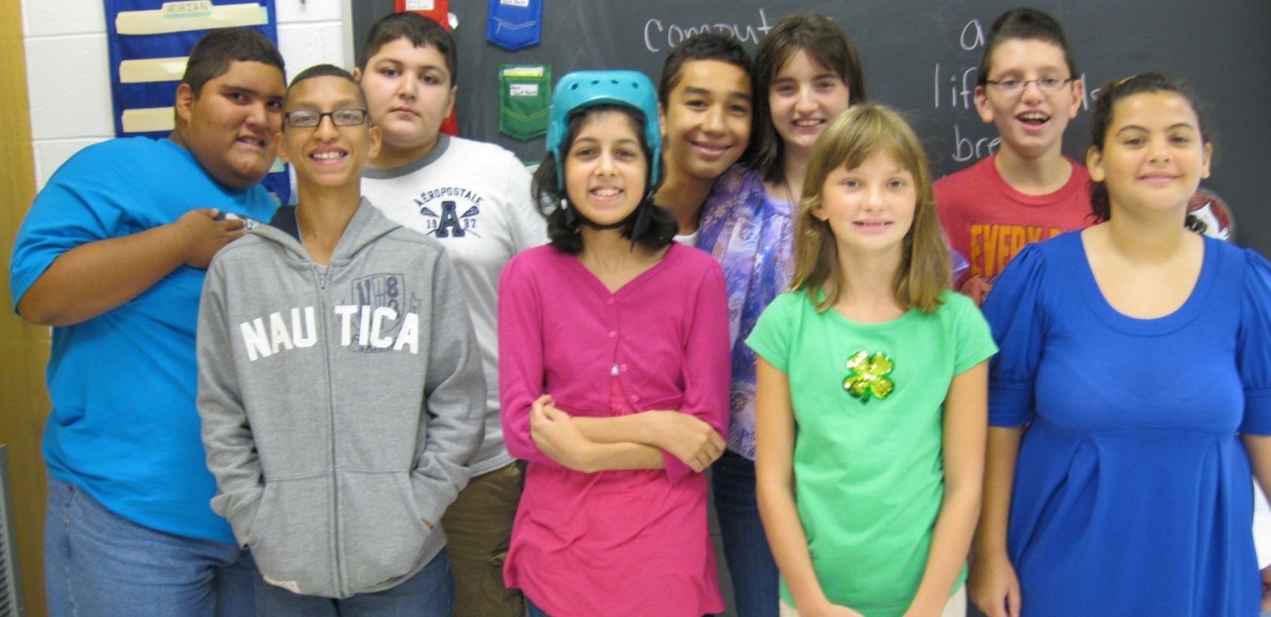
Questions?

