Slide 1
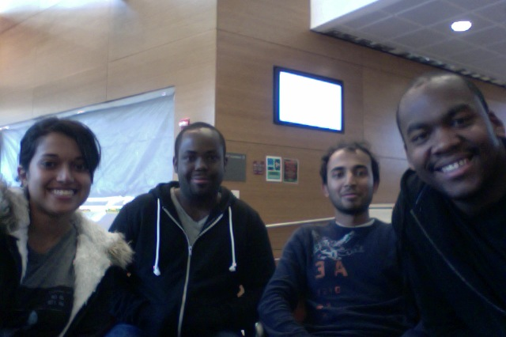
ClockAide
Anita Ganesan, Eric Moore, Sachin Honnudike, Joel Jean-Claude
Notes:
Joel
Welcome Everyone to the final project review for ClockAide

Slide 2
Outline
Project Overview
Requirements Overview
Demonstration – Main System
Components Overview
Challenges
Budget
Demonstration – Additional functionality
Notes:
Joel

Slide 3
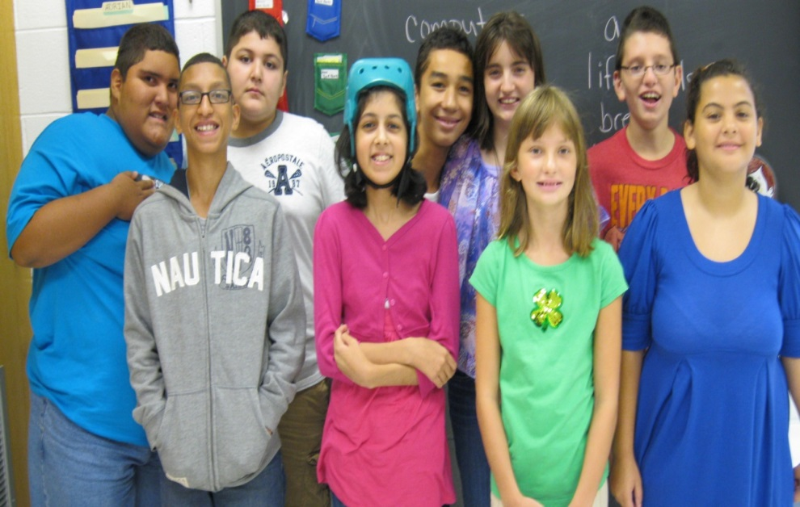
Project Overview
ClockAide is an educational tool for special needs students in West Springfield
Students of varying skill level will use our device to learn how to Set and Read an analog clock
Notes:
Joel

Slide 4
Requirements
Device will speak and display the current time to user when prompted
Device will allow user to practice reading time
Device will allow user to practice setting time
Device will allow users lacking fine motor skills to turn knobs for easy setting of the hands
Device size will not obstruct the normal use of the classroom and be approximately the size of a students' desk
Notes:
Eric

Slide 5
Demonstration
Normal Mode
User Identification
Set Mode
Read Mode
Notes:
Eric

Slide 6
Components Overview
Power Source
  ATX Power Source
  Breakout Board
Raspberry Pi
Stepper Motors
  Arduino Microcontroller
  Coaxial shaft for hour and minute hand representation
Keypad
  Arduino Microcontroller
  Reverse engineered keypad matrix
  Serial controlled 16x2 LCD screen
Casing
  Dual coloured acrylic sheets
Notes:
Eric

Slide 7
Components – Raspberry Pi
Implemented a finite state machine for control of ClockAide
Real Time Clock for system time
Coding done in Python
Implemented Serial Communication interface for communication with motor and keypad microcontrollers
Determined logic to correctly select and play the appropriate sound sample for user prompt
Notes:
Sachin

Slide 8
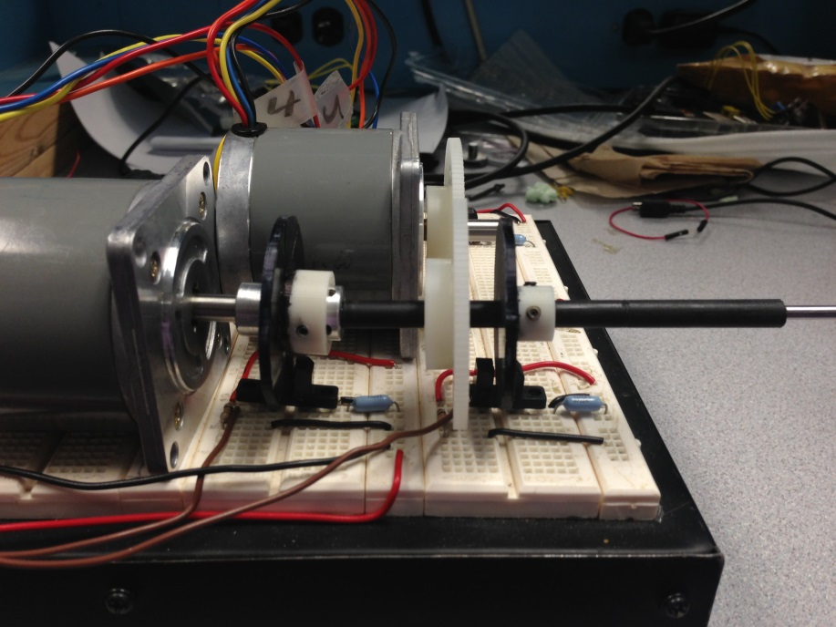
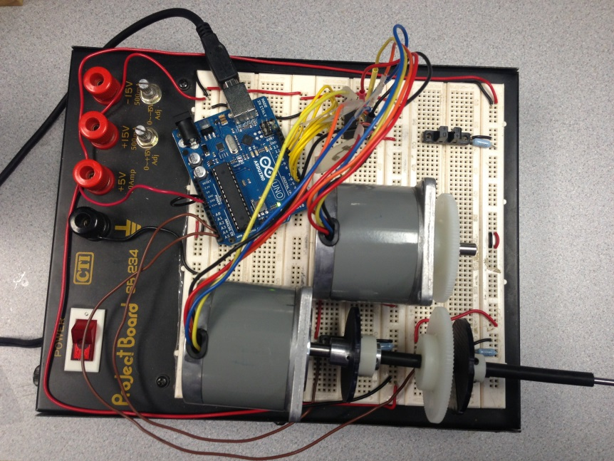
Components – Mechanical Drive System
Stepper Motors
Arduino Microcontroller
Coaxial gear driven shaft
Hand and Minute Representation
Notes:
Sachin
2 Stepper Motors vs one → Speed
Angular displacement

Slide 9
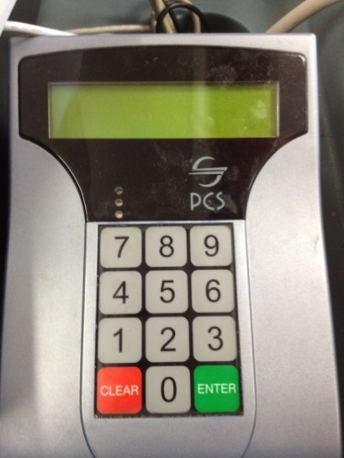
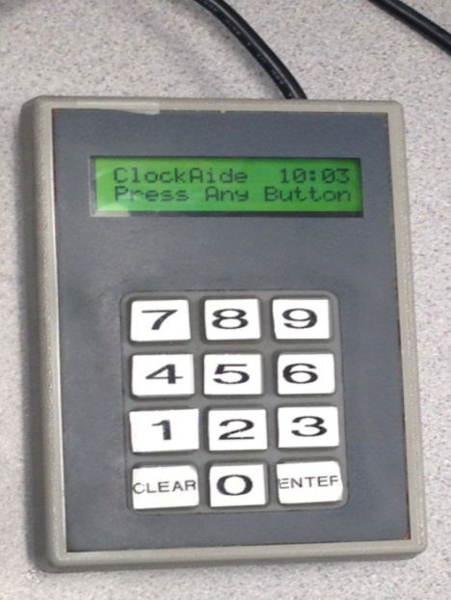
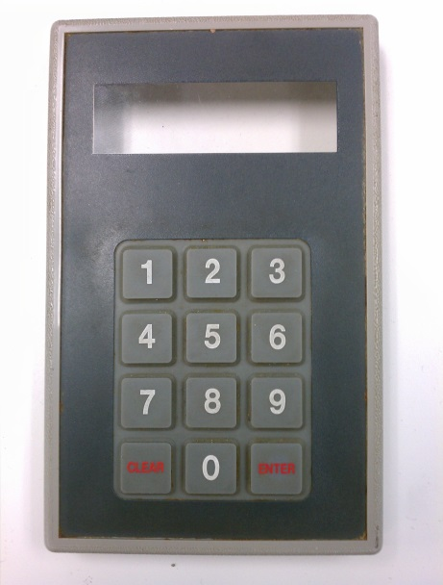
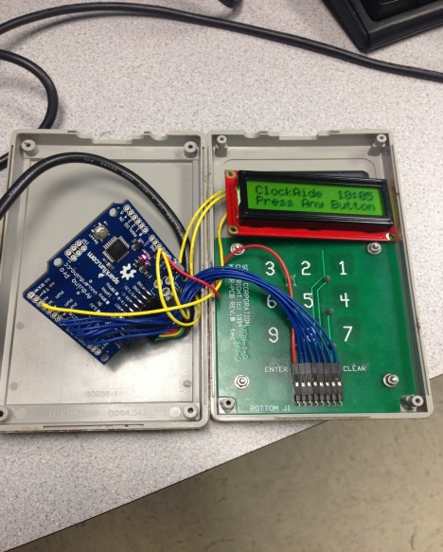
Components - Keypad
Arduino Pro
Reverse engineered the keymap matrix
Serial LCD Screen
Notes:
Sachin

Slide 10
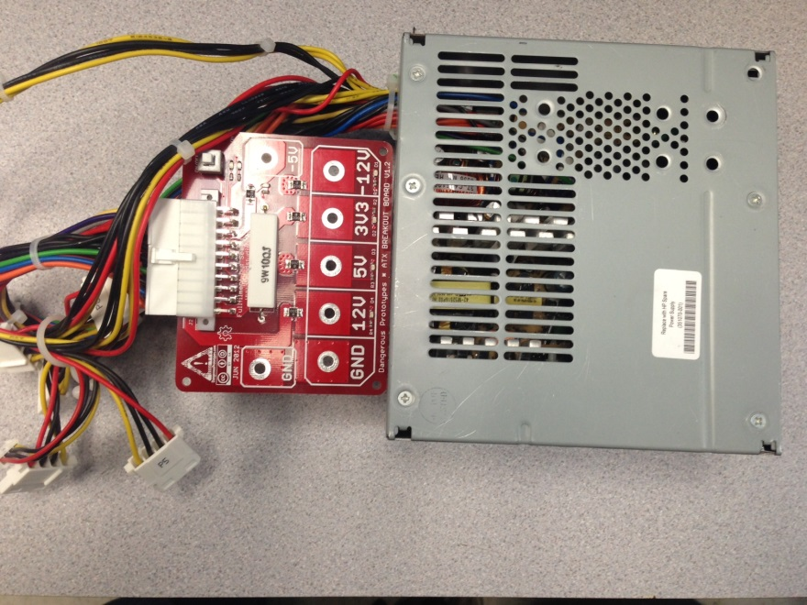
Components – Power Source
ATX Power source
INPUT: 100-127V /6A
      200-240VAC/3A 50/60 Hz
Output: +5VDC / 20A MAX
      +3.3VDC / 17A MAX
      +12VDC / 15A MAX
ATX Breakout board
Output: +5VDC
      +3.3VDC
      +12VDC
Notes:
Sachin

Slide 11
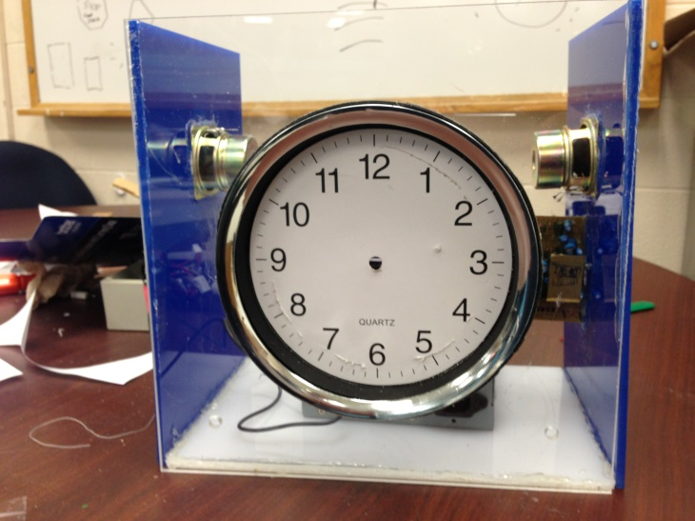
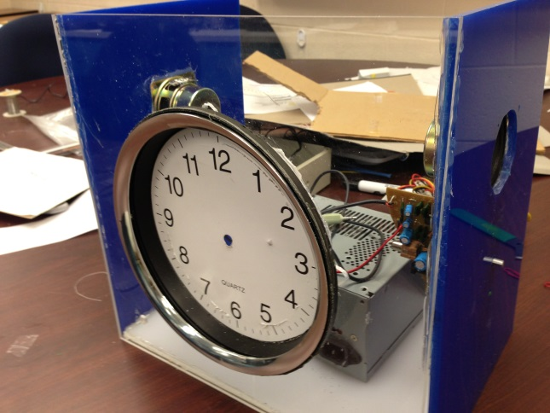
Components – Casing
Dual colored acrylic sheets representing W. Springfield Middle School colors
Extensive machine shop work to cut sheets into desired shapes
Integrated Speakers
Built shelf for part placement
Size of a students’ desk
Notes:
Anita

Slide 12
Challenges
Integration
Robust communication between Raspberry Pi and peripherals
Keypad
Stepper motors
Raspberry Pi was continuously resetting – challenge at CDR (fixed)
Arduino processing time
Encoders Broken – Set mode
Feedback will be integrated in time for delivery – end of May
Notes:
Anita

Slide 13
Updated Cost
8GB SD cards (2) | $12.38
Arduino MP3 Shield | $39.95
Raspberry Pi | $69.85
RTC | $21.73
LCD Screens (2) | $27.90
Gears +Piping | $20.00
Casing | $60.00
PCB | $70.00
Encoders | $18.00
Subtotal | $321.81
Shipping | $38.90
Total | $378.71
Percentage | 75.74%
Notes:
Anita
Significantly under budget

Slide 14
Deliverables
Feedback system
  Implemented not integrated
CSV file to excel for accessing data
Set Time feature
PCB
Notes:
Joel

Slide 15
Demonstration
Feedback System
CSV
Notes:
Joel

Slide 16
Thank You!

