Slide 1
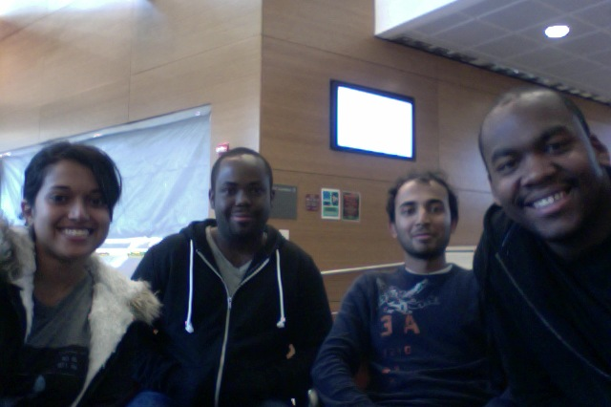
Clockade
Anita Ganesan (EE), Eric Moore (EE), Sachin Honnudike (CSE/EE + Webmaster), Joel Jean-Claude (CSE + Team Manager)
Adviser: Prof. T. B. Soules
Notes:
-Joel starts speaking:
-Introduce yourself and team members

Slide 2
Introduction
Students with special needs require toys that can assist with learning
About 1/3 of students in the West Springfield school district have special needs including:
  Auditory
  Motor Skills
  Autism

Slide 3
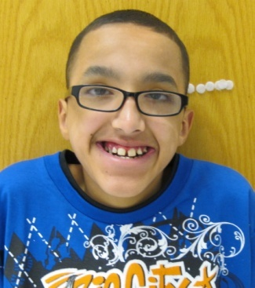
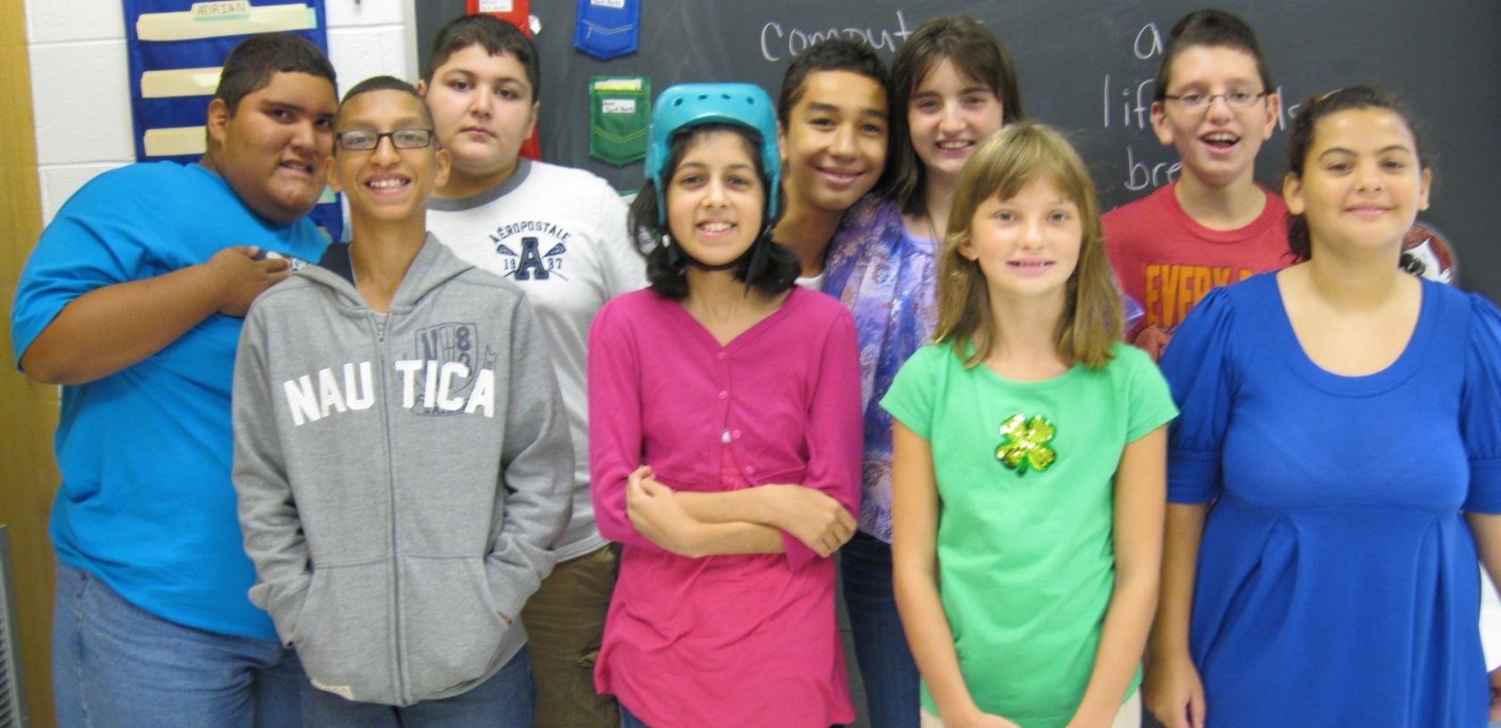
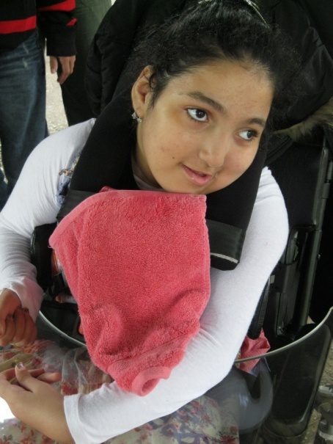
The Client
Megan Ferrari
Special education teacher, West Springfield Middle School

Slide 4
The Client
Student Profile
6th to 8th grade students
Functioning level – 2nd grade
Needs
Require a lot of repetition to internalize lesson
Extra adult support
Auditory feedback

Slide 5
Problem Statement
Telling Time
  Ms. Ferrari students cannot look up at a wall clock to read the time
  Constantly ask the teacher to read the time for them
  Lunch Numbers
  Students get nervous to dial Student Identification Numbers for lunch
  Overwhelmed by crowds
  Need a way to practice without stress

Slide 6
Proposed Solution
Trainer Clock with Keypad
Normal Mode
  Displays current time
  Will speak current time when button is pressed
Quiz Mode
  Will interact with child by asking him/her to set the clock to a specified time
  Provide feedback depending on how the child responds
  Keypad
  Students enter ID numbers
  Numbers are used to differentiate students in data log
Notes:
Clock would have audio input – digital clock to test the voice part for manipulation

Slide 7
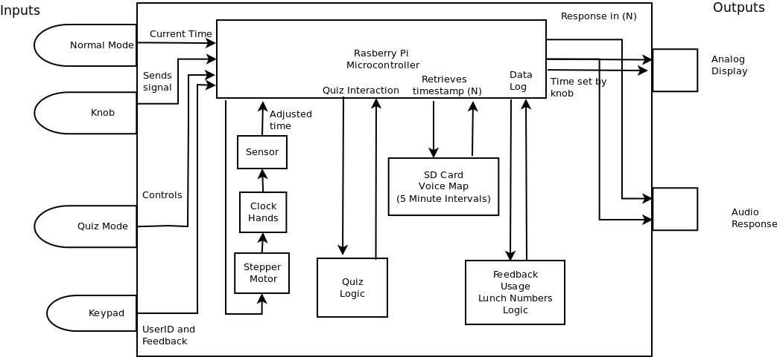
Block Diagram

Slide 8
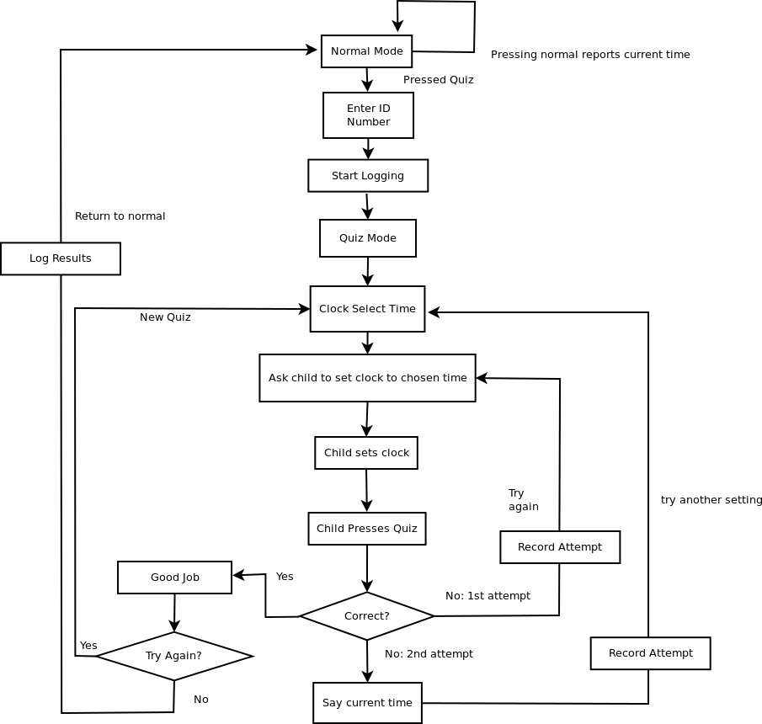
Workflow

Slide 9
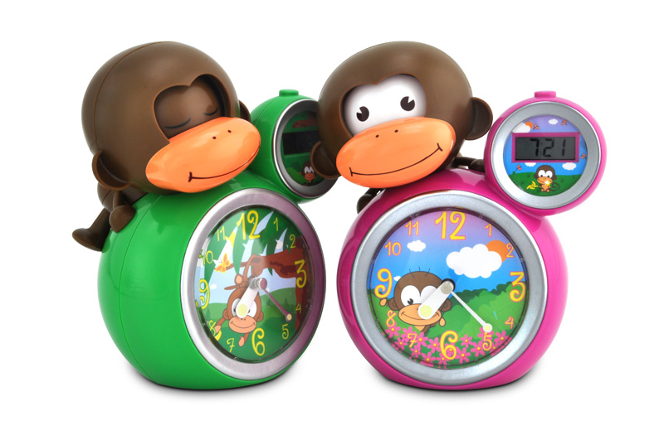
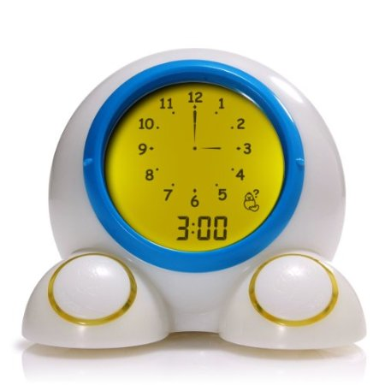
Competition
Below: Onearoo Clock
Above: The Momo Clock
Priced between $25 to $50
Notes:
Most trainer clocks deal with kids getting up in the middle of the night. The selling point is to teach children when is the right time to wake up.
Onearoo Clock: Teaches children how to tell time by providing an analog and digital display
The Momo Clock: The momo clock teaches kids when the correct time to wakeup is.

Slide 10
Innovation
Feedback
  Keeps track of progress
  Can be viewed by teachers
  Can be sent to parents
  Increases the value of the toy
Open Source
  All code (including our website) and design files available on GitHub: https://github.com/SDP13-Team10
Notes:
Anita

Slide 11
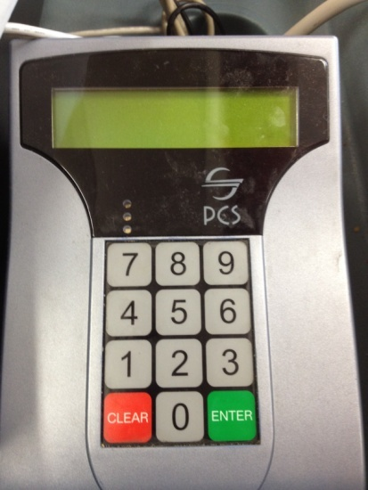
Requirement Specifications
Dimensions (LWH)
Trainer Clock
18 in. x 12 in. x 12 in.
(Detachable) Keypad
Minimize number of buttons for simple operation
Robust and sturdy
Easy to maintain
Notes:
Anita

Slide 12
MDR Deliverables
Trainer Clock with Keypad
  Characterization of Stepper Motor
  Record voices for time playback (in M5 Recording Studio)
  Familiarization with microcontroller and keypad
Notes:
Anita

Slide 13
Rough Budget
Trainer Clock with Keypad
Raspberry Pi - $35
Buttons, Knob, Casing, Peripherals - $100
SD Card (2G) - $15
Stepper Motor - $75
MISC - $25
Keypad - $50
Total = $300

Slide 14
Questions?
Thank you!
References:
Massachusetts Department of Elementary and Secondary Schools
Megan Ferrari Slideshow Presentation (Sept 20th)

