Slide 1
U Mass Amherst
Partnership
Providing electronic systems to help students with special needs

Slide 2
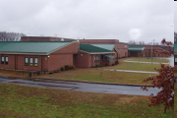
West Springfield Middle
West Springfield, MA
6th to 8th grade
980 students
Diverse community - ELL students, special education, AAP and FAP

Slide 3
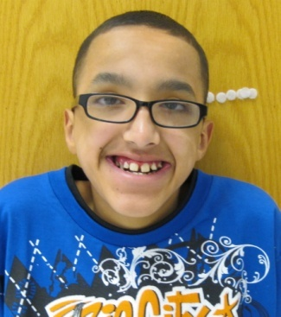
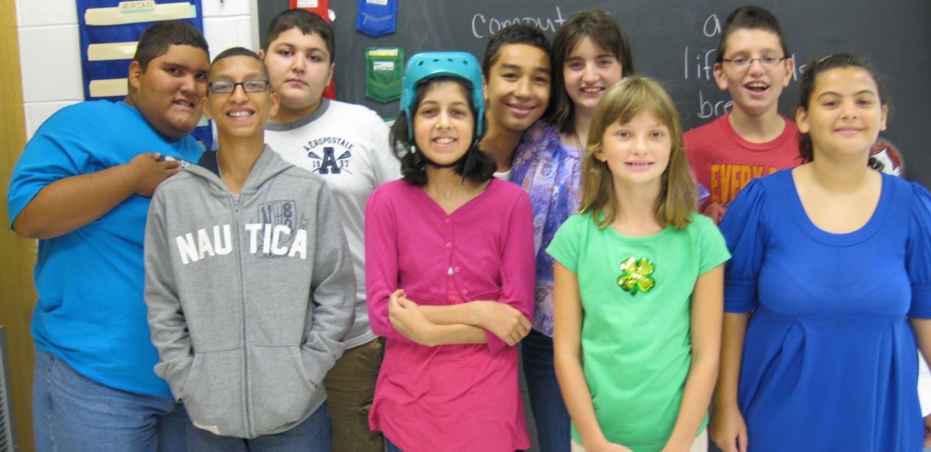
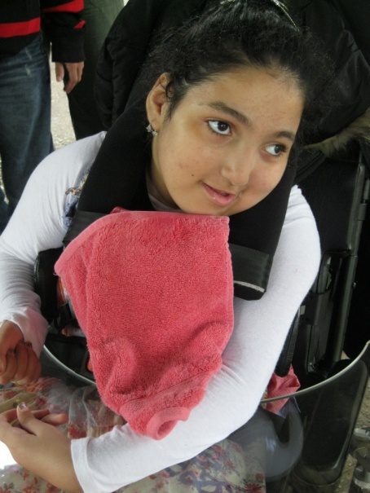
The Students

Slide 4

Our needs
Varying levels (pk – 4th)
Words, pictures, and symbols
Extra adult supports
Lots of time to process and produce work
Communication aides
Fine motor

Slide 5
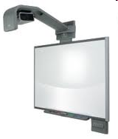
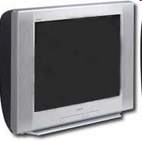
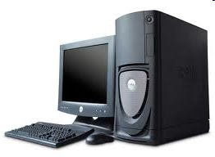
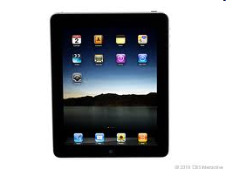
Technology

Slide 6
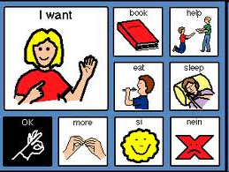
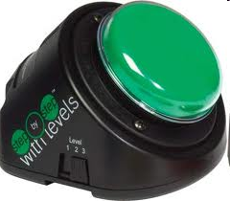
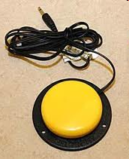

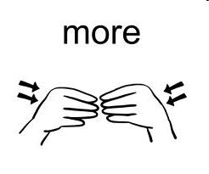
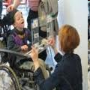
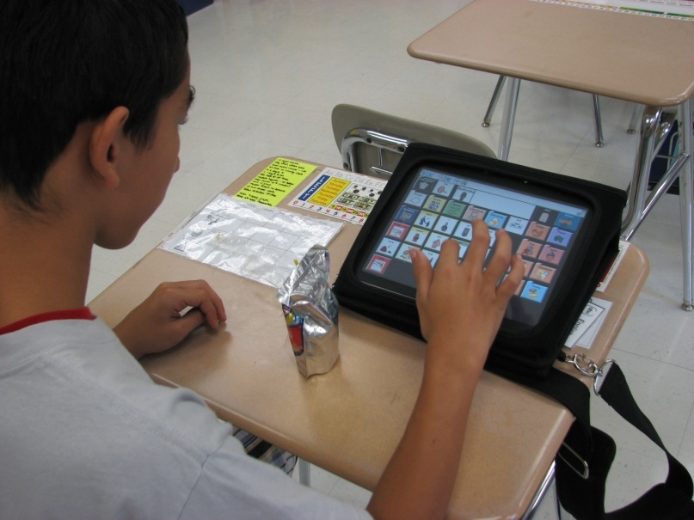
Communication

Slide 7

What we teach
English, Math, Science and Social Studies
Life skills – hygiene, getting along with others, rules of the world, safety, etc.
Therapies
INDEPENDENCE!

Slide 8
Teaching Methods
Students require lots of repetition on the same skill.
Use various inputs – auditory, visual, kinesthetic
Find ways to increase independence in all tasks
How to generalize knowledge learned in class into “outside” world.

Slide 9
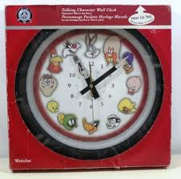
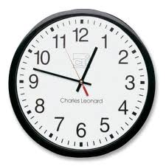
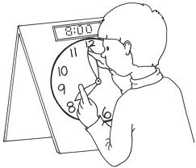
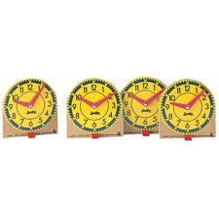

Problem 1
Telling Time
Talking classroom clock
Only on the hours
What time is it?
Increase independence
With auditory feedback
Individual Practice
Clock manipulatives
No feedback

Slide 10




Problem 2
Listening to Music
Need help with spelling
Not radio stations,
Preprogrammed music
Fine motor needed

Slide 11
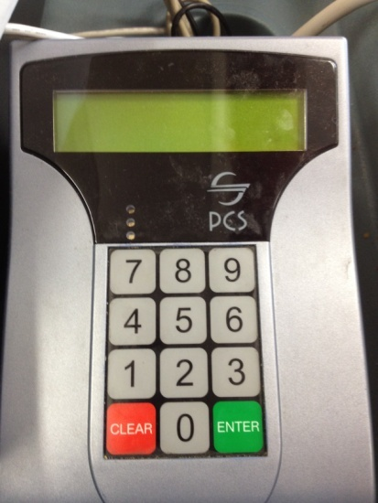
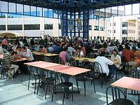

Lunch Numbers
Enter code to pay for lunch
Over stimulating, distracting
Time to practice?
Loud environment

Slide 12
Possible Projects
Talking clock with two components
1. Students can manipulate as learning tool.
2. Use as classroom clock, students can press a button to find out the time instead of asking teachers.
Radio that finds stations via voice (human and voice output)
Lunch code machine that will allow students time to practice entering their lunch codes – give auditory response when correct/incorrect – programmable with different numbers as students change

Slide 13
Contact Info
Megan Ferrari - ferrari@wsps.org
Brenda St. Peter – stpeter@wsps.org
Visits to school…
Need to have CORI done to have interactions
with students during school hours. Takes 3-4
weeks to process.
West Springfield Town Hall
26 Central St., West Springfield, MA

Slide 14
Questions?

